Slide 1
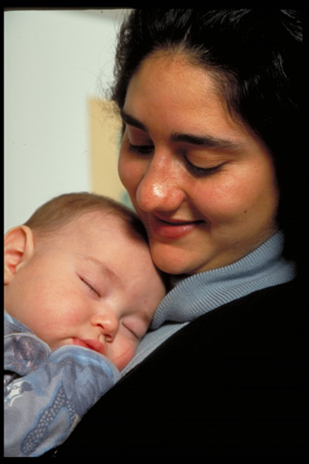
This section provides information on the number of Canadian girls and boys aged 0-5, where they live and who their parents are. Life expectancy at birth, fertility rates and projected population growth are also presented.

Slide 2
Notes:
By answering 4 easy questions, this tool will provide you with a customized summary of data, information, resources, and links as well as ideas on how to create partnerships that will increase your impact on the overall health and well-being of young children and their families.

Slide 3
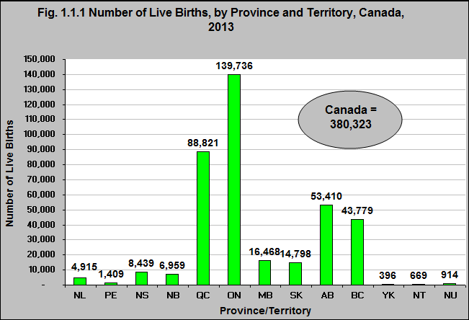
Notes:
Summary
In 2013 there were 380,323 babies born in Canada. The largest number of live births were in Ontario (139,736) making up 36.7% of all live births in Canada.
The overall number of live births increased by 1% between 2010 and 2013.¹
¹Statistics Canada, Canadian Vital Statistics, Birth Database, Table 102-4503. Live births, by age of mother, Canada, provinces and territories, annual. http://www5.statcan.gc.ca/cansim/a26?lang=eng&retrLang=eng&id=1024503&&pattern=&stByVal=1&p1=1&p2=-1&tabMode=dataTable&csid= -accessed March 15th, 2017.
Source: CICH graphic created using data adapted from Statistics Canada, Canadian Vital Statistics, Birth Database, Table 102-4503 Live births, by age of mother, Canada, provinces and territories, annual. http://www5.statcan.gc.ca/cansim/a26?lang=eng&retrLang=eng&id=1024503&&pattern=&stByVal=1&p1=1&p2=38&tabMode=dataTable&csid= -accessed March 15, 2017.

Slide 4
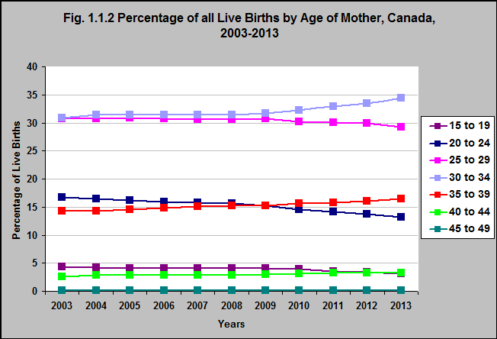
Notes:
Summary
Between 2003 and 2013 the percentage of live births to mothers aged 30 to 34 and 35 to 39 increased.
While the percentage of live births to mothers aged 20 to 24 and 25 to 29 decreased, so did the percentage of live births to mothers aged 15 to 19 years.
Implications
The trend in increasing maternal age has far reaching repercussions for families and communities. This shift increases the likelihood that many adults will be caring for their children and their own parents during the same years. In addition, there are concerns regarding delayed childbearing and infertility. The rate of infertility in Canada, depending on the definition, varies from about 12% to 16%.¹
¹Bushnik, T., Cook, J.L., Yuzpe, A.A., Tough, S., & Collins, J., (2012).Estimating the prevalence of infertility in Canada, Human Reproduction, 27, 738-746. https://www.ncbi.nlm.nih.gov/pubmed/22258658 -accessed July 15, 2017.
Source: CICH graphic created using data adapted from Statistics Canada, Canadian Vital Statistics, Birth Database, Table 102-4503 Live births, by age of mother, Canada, provinces and territories, annual. http://www5.statcan.gc.ca/cansim/a26?lang=eng&retrLang=eng&id=1024503&&pattern=&stByVal=1&p1=1&p2=38&tabMode=dataTable&csid= -accessed March 15, 2017.

Slide 5
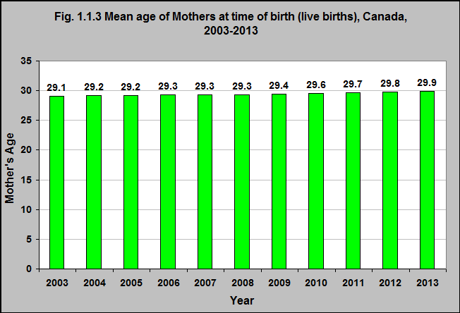
Notes:
Summary
The mean age* of mothers when they give birth is increasing.
In 2013, the mean age of mothers giving birth in Canada was almost 30 years of age (29.9). This increased from 29.1 in 2003 and 27.7 in 1991.¹
*Mean age of a mother for Canada, a province or a territory is calculated by summing the mothers’ ages at their last birthday preceding delivery and then dividing the sum by the total number of live births in that jurisdiction.
To estimate mid-year mean age, a statistic often used in analyses, add 0.5 to the mean age.
¹Statistics Canada, Table 102-4504, Mean age of mother at time of delivery (live births), Canada, provinces and territories, annual (years). http://www5.statcan.gc.ca/cansim/a26?lang=eng&retrLang=eng&id=1024504&&pattern=&stByVal=1&p1=1&p2=38&tabMode=dataTable&csid= -accessed March 15, 2017.
Implications
For most Canadians, the most intensive period of child rearing – raising young children – takes place when they are in their thirties. The result is that many more children are likely to live in families where one or both parents have more secure employment and relatively higher incomes than children of younger parents.
Source: CICH graphic created using data adapted from Statistics Canada, Table 102-4504, Mean age of mother at time of delivery (live births), Canada, provinces and territories, annual (years). http://www5.statcan.gc.ca/cansim/a26?lang=eng&retrLang=eng&id=1024504&&pattern=&stByVal=1&p1=1&p2=38&tabMode=dataTable&csid= -accessed March 15, 2017.

Slide 6
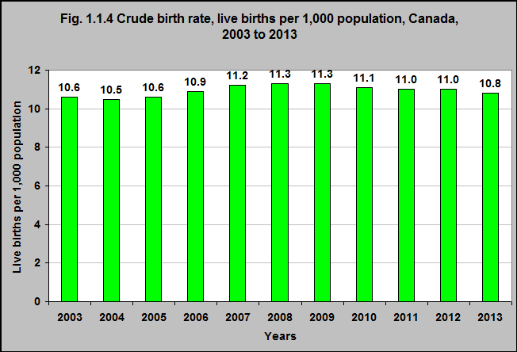
Notes:
Summary
In 2013 the crude birth rate, or the number of live births per 1,000 population, was 10.8.
The crude birth rate rose between 2006 and 2009, but then began to fall again with the 2013 crude birth rate being similar to 2006.
Source: CICH graphic created using data from Statistics Canada, Table 102-4505 - Crude birth rate, age-specific and total fertility rates (live births), Canada, provinces and territories, annual (rate). http://www5.statcan.gc.ca/cansim/a26?lang=eng&retrLang=eng&id=1024505&&pattern=&stByVal=1&p1=1&p2=38&tabMode=dataTable&csid= -accessed March 15, 2017.

Slide 7
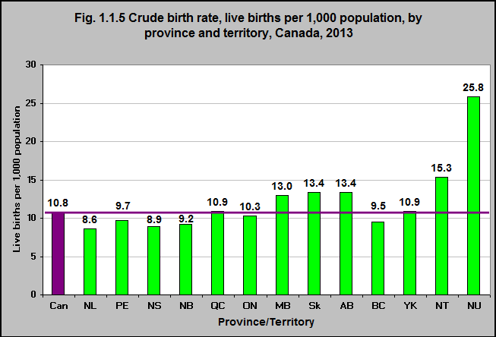
Notes:
Summary
In 2013, the crude birth rates varied considerably between the provinces and territories.
The crude birth rates in Newfoundland & Labrador and Nova Scotia are about 20% lower than the national rate at 8.6 and 8.9, while the rate in Nunavut is more than double at 25.8.
Source: CICH graphic created using data from Statistics Canada, Table 102-4505 - Crude birth rate, age-specific and total fertility rates (live births), Canada, provinces and territories, annual (rate). http://www5.statcan.gc.ca/cansim/a26?lang=eng&retrLang=eng&id=1024505&&pattern=&stByVal=1&p1=1&p2=38&tabMode=dataTable&csid= -accessed March 17, 2017.

Slide 8
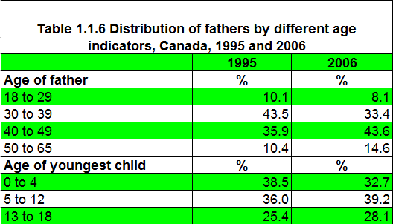
Notes:
Summary
The percentage of fathers* in Canada who have children 0 to 4 years of age declined between 1995 and 2006.
In 1995 39% of fathers had a child under 5 – declining to 33% in 2006.
*Fathers were defined as between age 18 to 65 at the time of the survey who were living with or reported having fathered, adopted or reared a child who was 18 years of age or under at the time of the survey.
Source: CICH table created using data adapted from Beaupré P, Dryburgh H and Wendt M. Making Fathers Count. Canadian Social Trends 11-008-X No. 90. 2010002. Statistics Canada. General Social Survey. 1995 and 2006. http://www.statcan.gc.ca/pub/11-008-x/2010002/article/11165-eng.htm -accessed March 19, 2017.

Slide 9
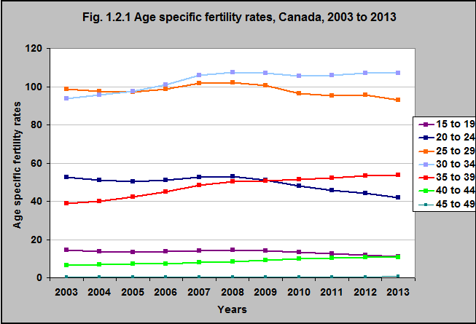
Notes:
Summary
The age specific fertility rate* among women 15 to 19 and 20 to 24 years of age decreased by 23% and 21% respectively between 2003 and 2013.
On the other hand between 2003 and 2013, the age specific fertility rate increased among women 30 to 34 years of age by 14%, among women 35 to 39 years of age by 39% and among those 40 to 44 years of age by 65%.
*Age-specific fertility rate (ASFR) is the number of live births per 1,000 females in a specific age group. Five-year age groups were used in these tabulations (ranging from 15 to 19 years to 45 to 49 years).
Implications
While the age specific fertility rate among teenagers aged 15 to 19 is decreasing, and births to teenage women account for a very small percentage of all births, health and social programs need to continue to be made available to address the special needs of teenage mothers. The trend in increasing maternal age also has far reaching repercussions for families and communities. This shift increases the likelihood that many adults will be caring for their children and their own parents during the same years. In addition, there are concerns regarding delayed childbearing and infertility.
Source: CICH graphic created using data adapted from Statistics Canada, Table 102-4505 - Crude birth rate, age-specific and total fertility rates (live births), Canada, provinces and territories, annual (rate). http://www5.statcan.gc.ca/cansim/a26?lang=eng&retrLang=eng&id=1024505&&pattern=&stByVal=1&p1=1&p2=38&tabMode=dataTable&csid= - accessed March 15, 2017.

Slide 10
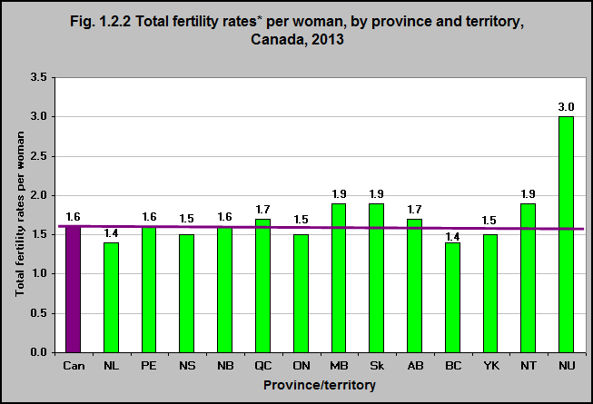
Notes:
Summary
In 2013 the total fertility rate per 1,000 women was 1,587 or about 1.6 babies per woman.
This varied from a low of just over 1,400 (1.4 babies per woman) in Newfoundland & Labrador and British Columbia to a high of over 3,000 (3 babies per woman) in Nunavut.
This total fertility rate has been relatively stable since the mid-1970s but is less than half of what it was in 1960. The fertility rate among Indigenous women is also decreasing. However, in 2010/11 their fertility rate (2.2) was higher than the Canadian average.²
*The total fertility rate refers to the number of children that a woman would have over the course of her reproductive life if she experienced the age-specific fertility rates observed in a particular calendar year. It is based on a compilation of the fertility experiences of many different cohorts of women in a given year.¹
¹Fertility: Overview, 2009 to 2011. Component of Statistics Canada Catalogue no. 91-209-X Report on the Demographic Situation in Canada, 2013. http://www.statcan.gc.ca/pub/91-209-x/2013001/article/11784-eng.pdf ² ²See CICH Profile Module 7: Indigenous Children and Youth, Section 5, Figure 5.1.3
Source: CICH graphic created using data adapted from Statistics Canada, Table 102-4505 - Crude birth rate, age-specific and total fertility rates (live births), Canada, provinces and territories, annual (rate). http://www5.statcan.gc.ca/cansim/a26?lang=eng&retrLang=eng&id=1024505&&pattern=&stByVal=1&p1=1&p2=38&tabMode=dataTable&csid= -accessed March 15, 2017.

Slide 11
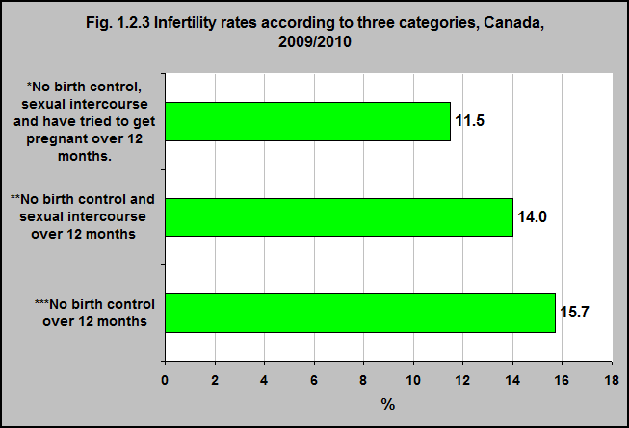
Notes:
Summary
According to three categories of infertility, among Canadian couples the rate varies from 11.5% to 15.7%.
Definitions of infertility *Couples who reported no pregnancy, did not use any form of birth control, reported having sexual intercourse during the previous 12 months and had tried at some point to become pregnant with their current partner. **Couples who reported no pregnancy, did not use any form of birth control, and reported having sexual intercourse during the previous 12 months. ***Couples who reported no pregnancy and did not use any form of birth control during the previous 12 months.
In 2009/10, the infertility rate among Canadian couples who reported that they have not used birth control, have had sexual intercourse and were trying to get pregnant in the last year was 11.5%.
Among couples that reported only they had used no birth control and had sexual intercourse, the rate was 14.0%.
Among couples who reported only that they had not used birth control the rate was 15.7%.
Implications
The impact of infertility on women and their partner can be significant. They may experience many emotional impacts related to loss – grief, depression, anger, frustration and a loss of self-esteem and sense of control. This can impact mental health and their relationship. In addition, if women and families seek infertility treatments – these can be very expensive, resulting in potential financial pressures, and the drugs can have difficult side effects.¹
¹Harvard Mental Health Letter. The psychological impact of infertility and its treatment. May, 2009. http://www.health.harvard.edu/newsletter_article/The-psychological-impact-of-infertility-and-its-treatment - accessed July 16, 2017.
Source: CICH graphic adapted from Statistics Canada, Canadian Community Health Survey, 2009-2010. Bushnik, T., Cook, J.L., Yuzpe, A.A., Tough, S., & Collins, J., (2012).Estimating the prevalence of infertility in Canada, Human Reproduction, 27, 738-746. https://www.ncbi.nlm.nih.gov/pubmed/22258658 -accessed July 15, 2017.

Slide 12
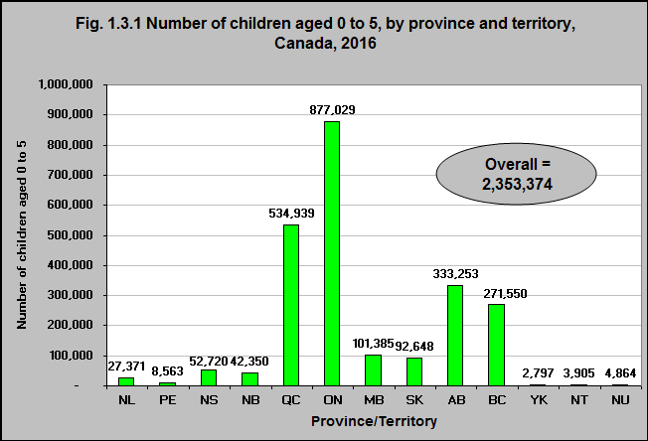
Notes:
Summary
In 2016, there were over 2.3 million (2,353,374) children aged 0 to 5 living in Canada.
Over one-third lived in Ontario and almost one-quarter lived in Quebec.
Source: CICH graphic created using data adapted from Statistics Canada, Table 051-0001 - Estimates of population, by age group and sex for July 1, 2016, Canada, provinces and territories. http://www5.statcan.gc.ca/cansim/a26?lang=eng&retrLang=eng&id=0510001&&pattern=&stByVal=1&p1=1&p2=37&tabMode=dataTable&csid= -accessed March 19, 2017.

Slide 13
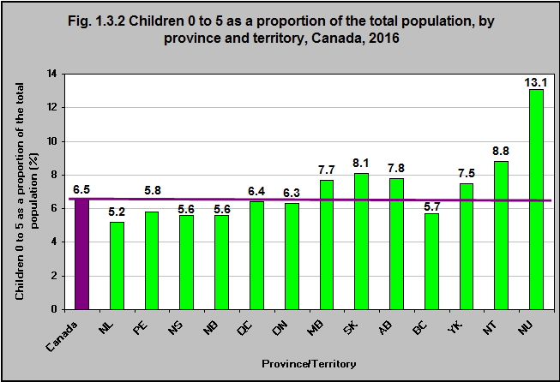
Notes:
Summary
In 2016, children under 6 accounted for 6.5% of the Canadian population.
This proportion varied by province and territory. Nunavut children under age 6 accounted for 13.1% of the population, and that figure was 8.1% in Saskatchewan, 7.8% in Alberta and 7.7% in Manitoba. In contrast, children under age 6 accounted for only 5.2% of the total population in Newfoundland & Labrador.
Source: CICH graphic created using data adapted from Statistics Canada, Table 051-0001 - Estimates of population, by age group and sex for July 1, 2016, Canada, provinces and territories, annual (persons unless otherwise noted). http://www5.statcan.gc.ca/cansim/a26?lang=eng&retrLang=eng&id=0510001&&pattern=&stByVal=1&p1=1&p2=37&tabMode=dataTable&csid= -accessed March 15, 2017.

Slide 14
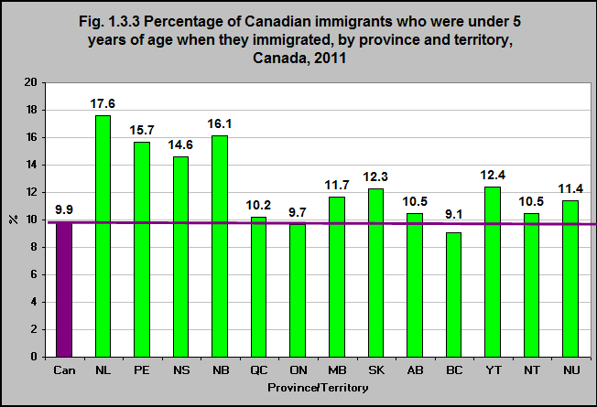
Notes:
Summary
In 2011, almost 10% of all Canadian immigrants indicated they had immigrated when they were under 5 years of age.
In some provinces that proportion was much higher - especially in Atlantic Canada.
In Newfoundland and Labrador 18% of all immigrants were children under 5. In PEI and New Brunswick 16% of all immigrants were children under 5 and that proportion was 15% in Nova Scotia.
Note: Global Non-Response Rate 26.1%. For more information go to: http://www12.statcan.gc.ca/nhs-enm/2011/dp-pd/dt-td/Rp-eng.cfm?LANG=E&APATH=3&DETAIL=0&DIM=0&FL=A&FREE=0&GC=0&GID=0&GK=0&GRP=0&PID=107647&PRID=0&PTYPE=105277&S=0&SHOWALL=0&SUB=0&Temporal=2013&THEME=95&VID=0&VNAMEE=undefined&VNAMEF=undefined -accessed March 19, 2017.
Source: CICH graphic created using data adapted from Statistics Canada, 2011 National Household Survey, Statistics Canada Catalogue no. 99-010-X2011036. http://www12.statcan.gc.ca/nhs-enm/2011/dp-pd/dt-td/Rp-eng.cfm?LANG=E&APATH=3&DETAIL=0&DIM=0&FL=A&FREE=0&GC=0&GID=0&GK=0&GRP=0&PID=107647&PRID=0&PTYPE=105277&S=0&SHOWALL=0&SUB=0&Temporal=2013&THEME=95&VID=0&VNAMEE=undefined&VNAMEF=undefined -accessed March 19, 2017.

Slide 15
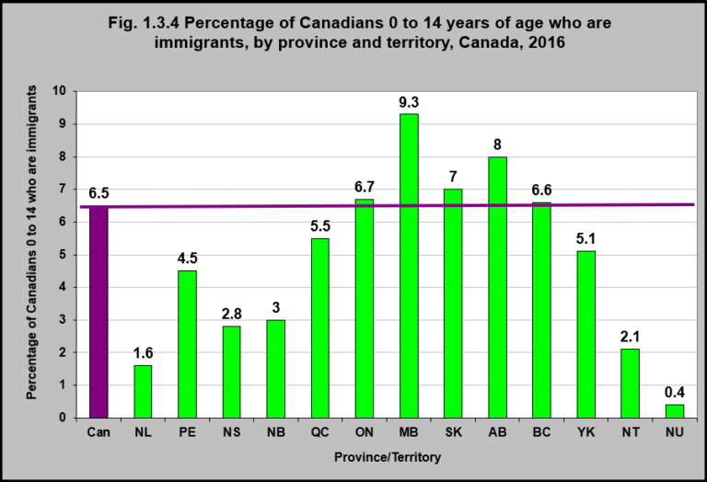
Notes:
Summary
In 2016, 6.5% of all Canadian children under fifteen years of age were born in another country.
In Manitoba, 9% of all children under age 15 were immigrants. That was the case for 8% in Alberta and 7% in British Columbia and Saskatchewan.
Implications
A large proportion of young Canadian children are immigrants – from diverse ethnic origins. This diversity adds richness to our Canadian society. However, these children and families may also face challenges in the form of discrimination which can have a significant impact on education, recreation and leisure as well as other domains of daily life.
Source: CICH graphic created using data adapted from Statistics Canada, 2016 Census, Statistics Canada Catalogue no. 98-402-X2016007. http://www12.statcan.gc.ca/census-recensement/2016/dp-pd/hlt-fst/imm/index-eng.cfm – accessed June 21, 2018.

Slide 16
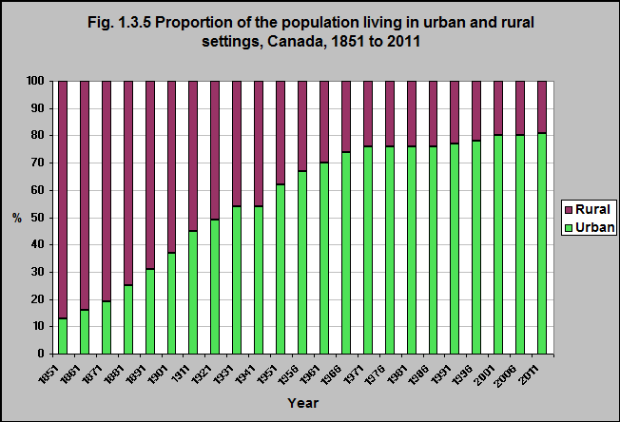
Notes:
Summary
The majority of Canadians – 81% - live in urban settings (2011), reflecting a dramatic increase over the past 150 years.
This has remained consistent over the last two decades.
Notes: The term ‘population centre’ replaces the term ‘urban area’. The rural population for 1981 to 2011 refers to persons living outside centres with a population of 1,000 AND outside areas with 400 persons per square kilometre. Previous to 1981, the definitions differed slightly but consistently referred to populations outside centres of 1,000 population.
Source: CICH graphic created using data adapted from Statistics Canada, 2011 Census of Population. http://www.statcan.gc.ca/tables-tableaux/sum-som/l01/cst01/demo62a-eng.htm - accessed July 18, 2017.

Slide 17
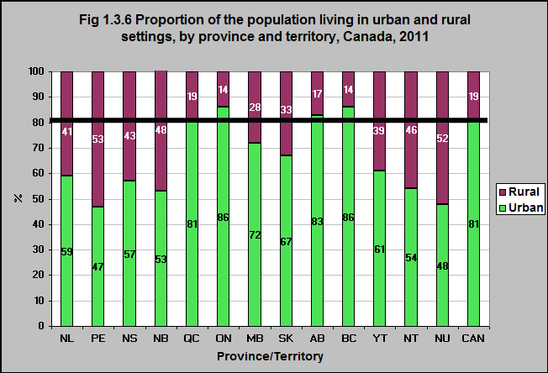
Notes:
Summary
In 2011, the proportion of Canadians who lived in urban versus rural settings differed among the provinces and territories.
In Ontario only 14% of the population lived in rural communities.
In Prince Edward Island 53% of people lived in rural communities as did 52% in Nunavut and 48% in New Brunswick.
Implications
Living in urban versus rural settings creates different experiences and benefits to young children.
For example, in rural areas, children may have more access to green space – which we know is advantageous for their health and development.
On the other hand, children may have more access to early child care programs and health services in urban settings.
Source: CICH graphic created using data adapted from Statistics Canada, 2011 Census of Population. http://www.statcan.gc.ca/tables-tableaux/sum-som/l01/cst01/demo62a-eng.htm - accessed July 18, 2017.

Slide 18
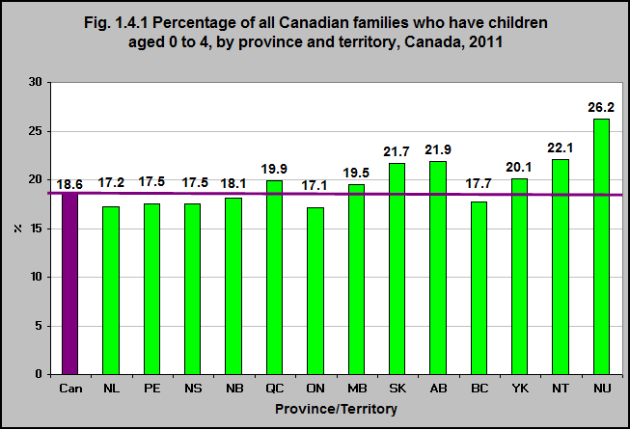
Notes:
Summary
In 2011 there were 1,856,475 families in Canada who had children aged 0 to 4 years, representing 18.5% of all Canadian families.
That proportion varies by province and territory with over 26% of families in Nunavut having children under five and 22% of families in Saskatchewan, Alberta and the Northwest Territories having children under 5 years of age.
Source: CICH graphic created using data adapted from Statistics Canada, 2011 National Household Survey, Statistics Canada Catalogue no. 98-312-X2011024. http://census.gc.ca/census-recensement/2011/dp-pd/tbt-tt/Rp-eng.cfm?LANG=E&APATH=5&DETAIL=0&DIM=0&FL=A&FREE=0&GC=2478015&GID=0&GK=3&GRP=0&PID=102075&PRID=0&PTYPE=101955&S=0&SHOWALL=0&SUB=0&Temporal=2011&THEME=89&VID=0&VNAMEE=&VNAMEF= -accessed March 19, 2017.

Slide 19
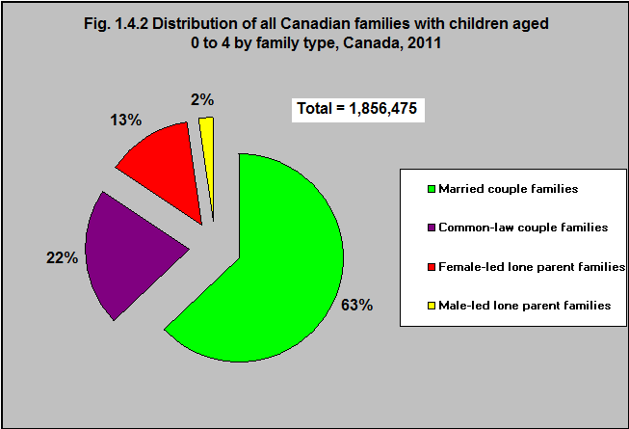
Notes:
Summary
According to the 2011 National Household Survey, over 60% of Canadian families with children under age 5 were married couple families. A further 22% were common-law couple families. 15% were lone parent families - the majority being female-led.
These proportions varied between the provinces and territories. In Quebec, almost half (48%) of all families with young children were couple families living common-law. That percentage was about 12% in Ontario.¹
The proportion of families with young children who were lone parents ranged from 12.5% in Quebec to about 24% in Newfoundland & Labrador and Nova Scotia and 25% in Nunavut.¹
¹Statistics Canada, 2011 National Household Survey, Statistics Canada Catalogue no. 98-312-X2011024, accessed March 19, 2017.
Implications
While the majority of Canadian children under age 5 live with both parents – 15% of them – more than 275,000 – live in lone-parent families. Lone-parents face the same challenges as other parents, but often have fewer human and financial resources to meet those challenges. For example, they may have increased problems harmonizing work and childcare schedules. They may be more likely to experience isolation and less likely to find time for themselves. Policies and programs that provide affordable, accessible child care; workplace policies that support parenting; and policies that support secure employment with adequate income can all change these realities for lone-parent families.
Source: CICH graphic created using data adapted from Statistics Canada, 2011 National Household Survey, Statistics Canada Catalogue no. 98-312-X2011024. http://census.gc.ca/census-recensement/2011/dp-pd/tbt-tt/Rp-eng.cfm?LANG=E&APATH=5&DETAIL=0&DIM=0&FL=A&FREE=0&GC=2478015&GID=0&GK=3&GRP=0&PID=102075&PRID=0&PTYPE=101955&S=0&SHOWALL=0&SUB=0&Temporal=2011&THEME=89&VID=0&VNAMEE=&VNAMEF= -accessed March 19, 2017.

Slide 20
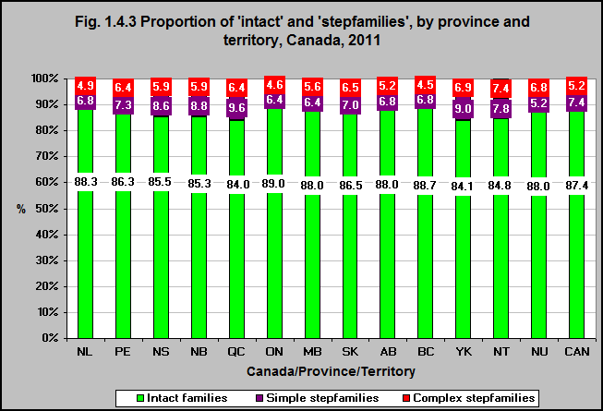
Notes:
Summary
In 2011, there were 464,335 stepfamilies in Canada. They accounted for 12.6% of all couple families with children aged 24 and under.
In Québec, 16.1% of all couple families were stepfamilies, as was the case for 15.8% in the Yukon and 15.3% in the Northwest Territories. In Ontario stepfamilies account for only 11% of all couple families.
Stepfamilies - or blended families - take many forms in Canada today. There were 271,925 “simple” stepfamilies in Canada in 2011 - accounting for 59% of all stepfamilies.
In 2011, there were 192,410 “complex” stepfamilies in Canada - accounting for 41% of all stepfamilies.
Notes: Intact family - all children are the biological and/or adopted children of both married spouse or of both common-law partners’. Simple stepfamily - a couple family in which all children are biological or adopted children of one, and only one, married spouse or common-law partner whose birth or adoption preceded the current relationship. Complex stepfamily - any of the following: a family in which there is at least one child of both parents and at least one child of only one parent; a family in which there is at least one child of each parent; and/or a family in which there is at least one child of both parents and at least one child of each parent.
Source: CICH graphic created using data adapted from Statistics Canada, 2012. Families and Households Highlight Tables. 2011 Census. Statistics Canada Catalogue no. 98-312-XWE2011002. http://www12.statcan.gc.ca/census-recensement/2011/dp-pd/hlt-fst/fam/index-eng.cfm?Lang=E -accessed March 19, 2017.

Slide 21
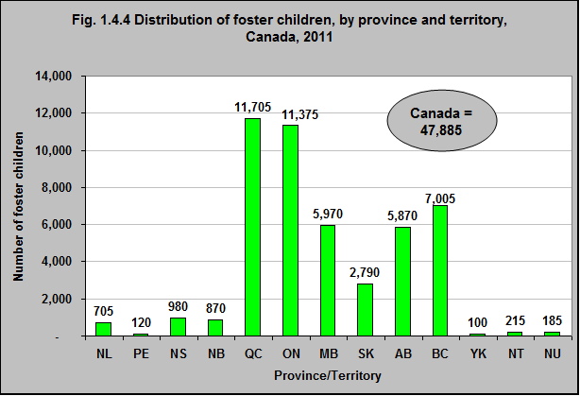
Notes:
Summary
In 2011 there were 47,885 children living with foster families in Canada.
Almost half were in Ontario and Quebec - with 24% in each of the two provinces.
Another 15% were in BC and 12% in Alberta.
Source: CICH graphic created using data adapted from Statistics Canada, 2012, Families and Households Highlight Tables. 2011 Census. Statistics Canada Catalogue no. 98-312-XWE2011002. http://www12.statcan.gc.ca/census-recensement/2011/dp-pd/hlt-fst/fam/index-eng.cfm?Lang=E -accessed March 19, 2017.

Slide 22
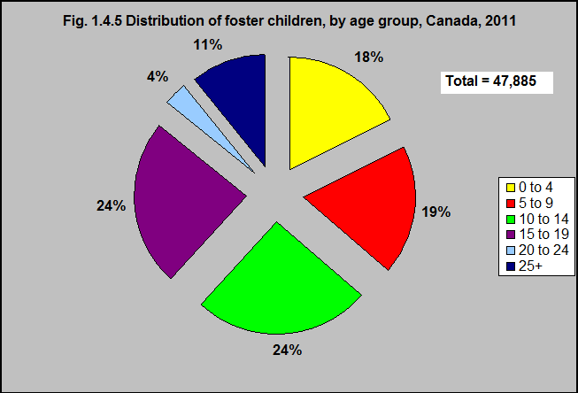
Notes:
Summary
Of the 47,885 children living with foster families in 2011, almost 18% were under 5 years of age.
Source: CICH graphic created using data adapted from Statistics Canada, 2012, Families and Households Highlight Tables. 2011 Census. Statistics Canada Catalogue no. 98-312-XWE2011002. http://www12.statcan.gc.ca/census-recensement/2011/dp-pd/hlt-fst/fam/index-eng.cfm?Lang=E -accessed March 19, 2017.

Slide 23
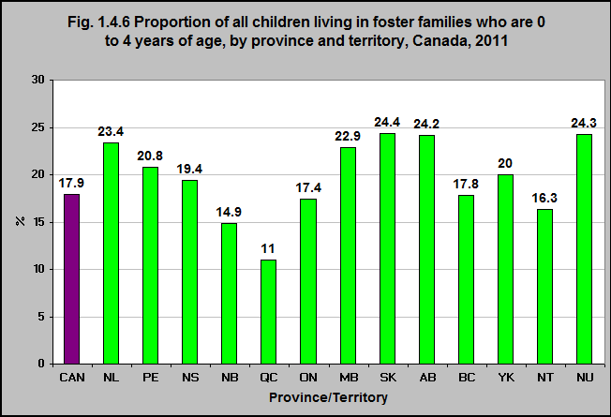
Notes:
Summary
Almost a quarter of all children living in foster families in Saskatchewan, Alberta and Nunavut are under 5 years of age.
Only 11% of children living in foster families are under 5 in the province of Québec.
Source: CICH graphic created using data adapted from Statistics Canada, 2012, Families and Households Highlight Tables. 2011 Census. Statistics Canada Catalogue no. 98-312-XWE2011002. http://www12.statcan.gc.ca/census-recensement/2011/dp-pd/hlt-fst/fam/index-eng.cfm?Lang=E -accessed March 19, 2017.

Slide 24
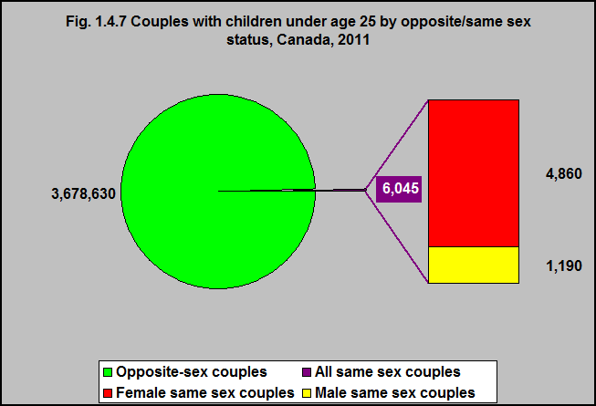
Notes:
Summary
In 2011 there were 3,684,675 couples with children under 25 in Canada.
There were 6,045 same sex couples with children under 25 - 4,860 were female couples and 1,190 were male couples.
Source: CICH graphic using data adapted from Statistics Canada - 2011 Census. Catalogue Number 98-312-XCB2011046. http://www12.statcan.gc.ca/census-recensement/2011/dp-pd/tbt-tt/Rp-eng.cfm?LANG=E&APATH=3&DETAIL=0&DIM=0&FL=A&FREE=0&GC=0&GID=0&GK=0&GRP=1&PID=102659&PRID=0&PTYPE=101955&S=0&SHOWALL=0&SUB=0&Temporal=2011&THEME=89&VID=0&VNAMEE=&VNAMEF -accessed March 19, 2017.

Slide 25
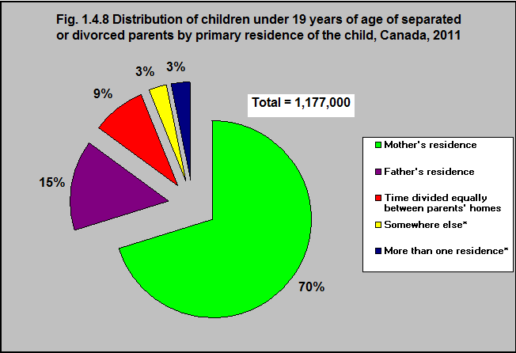
Notes:
*Somewhere else and More than one residence - use with caution. Notes: This category includes parents with two or more children who do not live at the same primary residence. Includes parents with one or more children (aged 18 years and under at the time of the survey), who do not all live at the same primary residence and who separated or divorced within the last 20 years. Totals include the “don’t know” and “refused” categories, which are not shown in the table. Percentages may not add to 100%.
Summary
In 2011 there were almost 1.2 million (1,177,000) children under 19 whose parents were divorced, separated, and who did not all live at the same primary residence.
The majority, 70%, of these children and youth, lived primarily with their mother.
15% lived primarily with their father and 9% divided their time equally between their parents’ homes.
Source: CICH graphic created using data adapted from Statistics Canada, General Social Survey, 2011. http://www.statcan.gc.ca/pub/89-652-x/2014001/tbl/tbl01-eng.htm - accessed July 18, 2017.

Slide 26
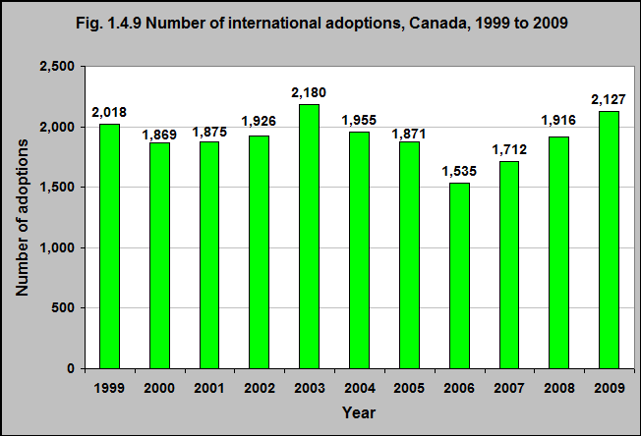
Notes:
Summary
Between 1999 and 2009, there were a total of 20,984 international adoptions in Canada.
The number of international adoptions peaked in 2003 at 2,180, then declined to 1,535 in 2006 and then rose again.
Source: CICH using data adapted from Statistics Canada, Catalogue no. 91-209-X. http://www.statcan.gc.ca/pub/11-402-x/2012000/chap/c-e/c-g/desc/desc03-eng.htm -accessed March 19, 2017.

Slide 27
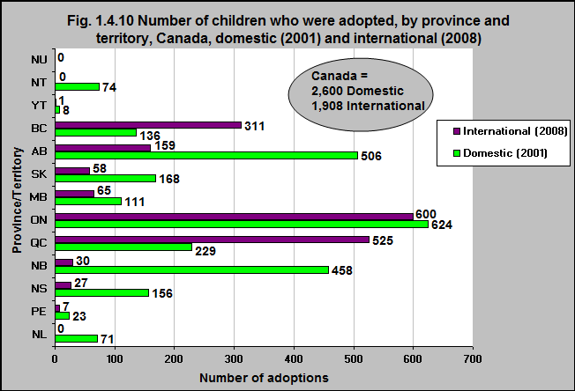
Notes:
Summary
In 2001 there were 2,600 domestic adoptions in Canada. In 2008 there were 1,908 international adoptions.
International adoptions were more numerous in Quebec, Ontario and British Columbia.
59% of all of the international adoptions were in Ontario and Quebec (combined). A further 16% were in British Columbia.
Source: CICH graphic created using data adapted from Adoption Council of Canada (personal communication with the Adoption Council of Canada), Human Resources Development Canada, Child and Family Services Statistical Report 1998-1999 to 2000-2001 http://www.pa-pa.ca/pdf/Child%20and%20Family%20Services%20Statistical%20Report%201998-1999%20to%202000.pdf (accessed March 18, 2017) and Citizenship and Immigration Canada as per Adoption Council of Canada website http://www.adoption.ca/ - accessed March 18, 2017.

Slide 28
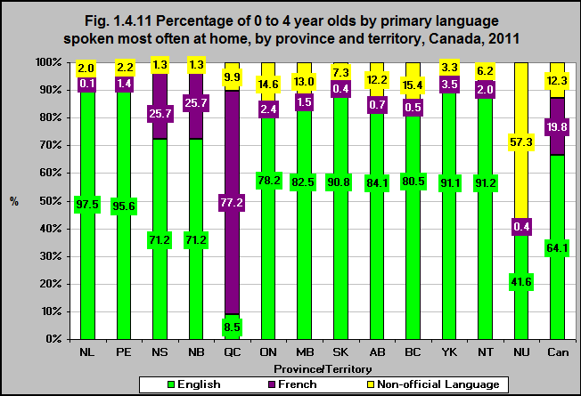
Notes:
Note: Numbers do not add to 100% due to rounding.
Summary
Sixty-four percent of young children under five live in households where the primary language spoken is English.
Almost 20% live in homes where French is the primary language, while over 12% live in homes where the language most often spoken is neither English nor French.
In Quebec just under 9% of young children live in homes where English is the primary language. French is the primary language in 77% of homes and another language is the primary language in almost 10% of homes.
In Ontario and British Columbia 15% of young children live in homes where a language other than English or French is the primary language - that is the case for 57% of children in Nunavut.
Implications
The relatively large proportion of Canadian children who speak another language other than English or French at home is a reflection of immigration patterns overall and highlights the growing diversity of the population living in Canada. Meeting the needs of children from diverse linguistic backgrounds is an important challenge for all support systems – particularly for the provision of quality early childcare and education programs. These programs can have a significant impact on the healthy development of young children.
Source: CICH graphic created using data adapted from Statistics Canada - 2011 Census. Catalogue Number 98-314-XCB2011042. https://www12.statcan.gc.ca/census-recensement/2011/dp-pd/tbt-tt/Rp-eng.cfm?LANG=E&APATH=3&DETAIL=0&DIM=0&FL=A&FREE=0&GC=0&GID=0&GK=0&GRP=1&PID=103089&PRID=10&PTYPE=101955&S=0&SHOWALL=0&SUB=0&Temporal=2011&THEME=90&VID=0&VNAMEE=&VNAMEF= -accessed March 19, 2017.

Slide 29
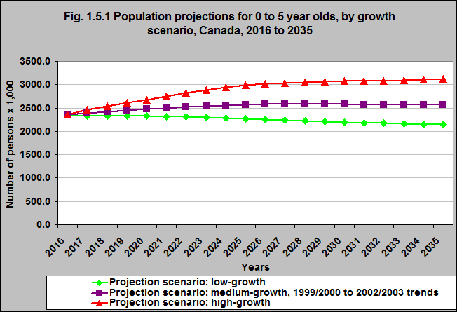
Notes:
Summary
Based on a medium growth projection, it is projected that there will be approximately 2.6 million children under 6 living in Canada in 2035 - up from 2.4 million in 2017.
Based on high growth projections the number of young children will rise from 2.4 million to 3.1 million.
Based on low growth projections the number of young children will decrease from 2.4 million to 2.1 million.
Notes: 2016 is the actual estimate in all three scenarios.
The low-growth scenario is defined by the following assumptions: a Canadian total fertility rate that reaches 1.53 births per woman in 2021/2022 and remains constant thereafter; a Canadian life expectancy that reaches 85.9 years for males and 87.1 years for females in 2062/2063; interprovincial migration based on the trends observed between 1991/1992 and 2010/2011; a national immigration rate that reaches 0.5% in 2022/2023 and remains constant thereafter; an annual number of non-permanent residents (Canada) that reaches 733,600 in 2014 and remains constant thereafter; a national net emigration rate of 0.16%.
The medium-growth and 1999/2000 to 2002/2003 interprovincial migrations trends scenario is defined by the following assumptions: a Canadian total fertility rate that reaches 1.67 births per woman in 2021/2022 and remains constant thereafter; a Canadian life expectancy that reaches 87.5 years for males and 89.1 years for females in 2062/2063; interprovincial migration based on the trends observed between 1999/2000 and 2002/2003; a national immigration rate that reaches 0.75% in 2022/2023 and remains constant thereafter; an annual number of non-permanent residents (Canada) that reaches 864,600 in 2021 and remains constant thereafter; a national net emigration rate of 0.19%.
The high-growth scenario is defined by the following assumptions: a Canadian total fertility rate that reaches 1.88 births per woman in 2021/2022 and remains constant thereafter; a Canadian life expectancy that reaches 89.9 years for males and 91.9 years for females in 2062/2063; interprovincial migration based on the trends observed between 1991/1992 and 2010/2011; a national immigration rate that reaches 0.9% in 2022/2023 and remains constant thereafter; an annual number of non-permanent residents (Canada) that reaches 1,144,300 in 2031 and remains constant thereafter; a national net emigration rate of 0.21%.
Source: CICH graphic created using data adapted from Statistics Canada CANSIM Table 052-0005. Projected population, by projection scenario, age and sex, as of July 1, Canada, provinces and territories, annual (persons x 1,000). http://www5.statcan.gc.ca/cansim/a26?lang=eng&retrLang=eng&id=0520005&&pattern=&stByVal=1&p1=1&p2=37&tabMode=dataTable&csid= -accessed March 19, 2017.

Slide 30
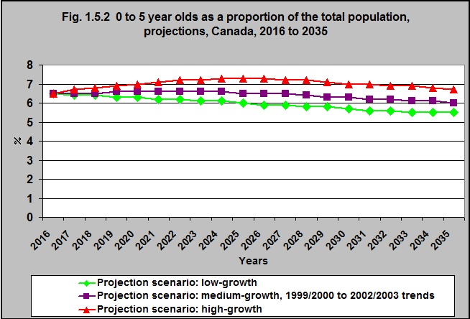
Notes:
Summary
According to a medium-growth scenario, it is projected that children under 6 will represent 6.0% of the population in 2035 - down from 6.5% in 2016.
According to a high-growth scenario, it is projected that children under 6 will represent 6.7% of the population in 2035 - up from 6.5% in 2016.
According to a low-growth scenario, it is projected that children under 6 will represent 5.5% of the total population in 2035, down from 6.5% in 2016.
Implications
In spite of the increasing life expectancy, and increasing numbers of older Canadians, children under 6 will continue to represent a significant proportion of the population in future years. Therefore, they will continue to require policies and programs that support their well-being and healthy development.
Notes: The low-growth scenario is defined by the following assumptions: a Canadian total fertility rate that reaches 1.53 births per woman in 2021/2022 and remains constant thereafter; a Canadian life expectancy that reaches 85.9 years for males and 87.1 years for females in 2062/2063; interprovincial migration based on the trends observed between 1991/1992 and 2010/2011; a national immigration rate that reaches 0.5% in 2022/2023 and remains constant thereafter; an annual number of non-permanent residents (Canada) that reaches 733,600 in 2014 and remains constant thereafter; a national net emigration rate of 0.16%.
The medium-growth and 1999/2000 to 2002/2003 interprovincial migrations trends scenario is defined by the following assumptions: a Canadian total fertility rate that reaches 1.67 births per woman in 2021/2022 and remains constant thereafter; a Canadian life expectancy that reaches 87.5 years for males and 89.1 years for females in 2062/2063; interprovincial migration based on the trends observed between 1999/2000 and 2002/2003; a national immigration rate that reaches 0.75% in 2022/2023 and remains constant thereafter; an annual number of non-permanent residents (Canada) that reaches 864,600 in 2021 and remains constant thereafter; a national net emigration rate of 0.19%.
The high-growth scenario is defined by the following assumptions: a Canadian total fertility rate that reaches 1.88 births per woman in 2021/2022 and remains constant thereafter; a Canadian life expectancy that reaches 89.9 years for males and 91.9 years for females in 2062/2063; interprovincial migration based on the trends observed between 1991/1992 and 2010/2011; a national immigration rate that reaches 0.9% in 2022/2023 and remains constant thereafter; an annual number of non-permanent residents (Canada) that reaches 1,144,300 in 2031 and remains constant thereafter; a national net emigration rate of 0.21%.
Source: CICH graphic created using data adapted from Statistics Canada CANSIM Table 052-0005. Projected population, by projection scenario, age and sex, as of July 1, Canada, provinces and territories, annual (persons x 1,000). http://www5.statcan.gc.ca/cansim/a26?lang=eng&retrLang=eng&id=0520005&&pattern=&stByVal=1&p1=1&p2=37&tabMode=dataTable&csid= -accessed March 19, 2017.

Slide 31
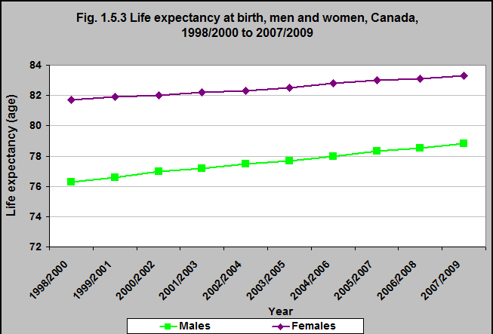
Notes:
Summary
In 1998/2000, the life expectancy at birth was 81.7 for women and 76.3 for men. In 2007/09, this rose to 83.3 (2%) for women and 78.8 (2%) for men.
This is up from a combined (men and women) life expectancy of 71 years in 1961. Wealthier people in Canada have a longer life expectancy than do poor people and the Indigenous population has a lower life expectancy than non-Indigenous people.¹
¹Conference Board of Canada. Life Expectancy. http://www.conferenceboard.ca/hcp/details/health/life-expectancy.aspx
Notes: Life expectancy is the number of years a person would be expected to live, starting at birth (for life expectancy at birth) or at age 65 (for life expectancy at age 65) if the age- and sex-specific mortality rates for a given observation period (such as a calendar year) were held constant over his/her life span.
Life expectancy is calculated with the Greville’s method for abridged life tables, using annual mortality rates with five-year age groupings of population and mortality rates. See “Life Tables, Canada, provinces and territories, 2000/2002” (catalogue number 84-537-XIE) for a complete explanation of the methodology used to produce abridged life tables.
Source: CICH graphic created using data adapted from Statistics Canada, Canadian Vital Statistics, Birth and Death Databases and population estimates. CANSIM table 102-0512. http://www5.statcan.gc.ca/cansim/a26?lang=eng&retrLang=eng&id=1020512&&pattern=&stByVal=1&p1=1&p2=37&tabMode=dataTable&csid= (accessed March 19, 2017) is an update of CANSIM table 102-0511.

Slide 32
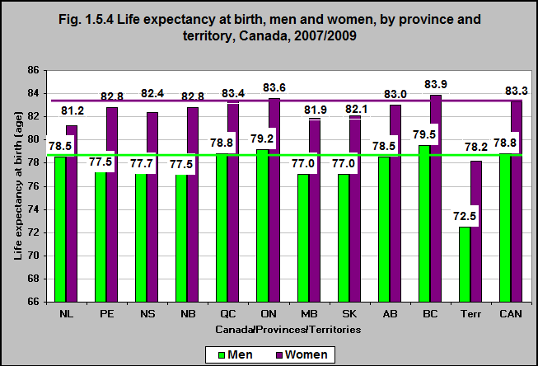
Notes:
Summary
In 2007/2009 the life expectancy at birth varied by province and territory.
In BC, women can be expected to live to 83.9 years while in Newfoundland and Labrador that age is 81.2 and in the territories it is 78.2.
In BC, men can be expected to live to 79.5 years while in Manitoba and Saskatchewan, they live to 77 years and in the Territories, to 72.5 years.
Source: CICH graphic created using data adapted from Statistics Canada, Canadian Vital Statistics, Birth and Death Databases and population estimates. CANSIM table 102-0512 http://www5.statcan.gc.ca/cansim/a26?lang=eng&retrLang=eng&id=1020512&&pattern=&stByVal=1&p1=1&p2=37&tabMode=dataTable&csid= (accessed March 19 2017) is an update of CANSIM table 102-0511.

Slide 33
Health and Development in the Early Years: Contextual/Demographic Information Consolidated Results
Notes:
Health and Development in the Early Years: Contextual/Demographic Information Consolidated Results
A substantial number of babies are born in Canada each year – close to 400,000. This number has been relatively stable over the past 30 years.
The total fertility rate in Canada is about 1.6 babies per woman – but that varies considerably between the provinces and territories from a low of just over 1.4 in Newfoundland & Labrador and British Columbia to a high of over 3.0 in Nunavut. This total fertility rate has been relatively stable since the mid-1970s but is less than half of what it was in 1960. The fertility rate among Indigenous women is also decreasing. However, their fertility rate (2.2) is higher than the Canadian average.
More and more women in Canada are delaying childbirth until they are in their thirties and forties. This is made possible by accessible and effective birth control methods. The decision to delay childbearing affects changing educational and employment strategies of women and men. Certainly the shift in maternal age distribution has far reaching repercussions for families and communities. For example, this shift increases the likelihood that many adults will be caring for their children and their own parents during the same years. In addition, there are concerns regarding delayed childbearing and infertility. The rate of infertility in Canada, depending on the definition, varies from about 12% to 16%. At the opposite end of the age spectrum, there are teenage mothers. Births to teenage women account for a very small percentage of all births; however, they represent a substantial challenge to health and social services. Women who have babies as teenagers face special challenges for many years to come in the absence of specialized programs.
There are over 2.3 million children under 6 living in Canada today. They account for almost 7% of the population. However, that proportion varies by province and territory – with the territories, Saskatchewan, Alberta and Manitoba having a larger proportion of their population made up of young children. …. Continued next slide

Slide 34
Health and Development in the Early Years: Contextual/Demographic Information Consolidated Results
Notes:
Continued….
Briefly characterizing young children in Canada is challenging. Some of Canada’s young children speak many languages at home in addition to Canada’s two official languages, English and French. While the majority (almost two-thirds) live in households where the primary language spoken is English and one-fifth live in homes where French is the primary language, over 12% live in homes where the language most often spoken is neither English nor French.
They come from diverse ethno-cultural backgrounds. Some are new to Canada. Some arrive as refugees. Due to changing patterns of immigration, young children who belong to a visible minority represent a growing demographic group.
Young children live in diverse families. Almost one-fifth of all Canadian families have young children. The majority of these families are couple families (either married or common-law), but 15% or almost 300,000 families with young children are lone-parent families, with the majority of these - 87% - being female led.
In addition, many children under five live in stepfamilies/blended families. They live in families where their parents are divorced/separated. They live with parents in same sex relationships. They live in foster families. They are adopted – either domestically or internationally.
Life expectancy is increasing in Canada. In 2007/09 the life expectancy at birth was 83.3 for women and 78.8 for men. This is up from a combined (men and women) life expectancy of 71 years in 1961. Wealthier people in Canada have a longer life expectancy than do poor people and the Indigenous population has a lower life expectancy than non-Indigenous people.
In spite of the increasing life expectancy, and increasing numbers of older Canadians, children under 6 will continue to represent a significant proportion of the population in future years. Depending on the growth projections they will represent between 5.5% to 6.7% of the total population in 2035 – and will continue to require policies and programs that support their well-being and healthy development.

