Slide 1
The following module describes Indigenous children and youth in Canada, where they live, socio-economic issues they face, family structures they are part of, community supports and challenges, health services they can access, the impact of the environment on their health, and developmental outcomes.
The Module is based on a Determinants of Health Model that examines the impacts of structural, systemic, community and family enablers on individual health and well-being.
Notes:
Creating the best possible environment for Indigenous children and youth to develop, grow and succeed is a responsibility we have as a society. Children and youth who have access to healthy food, physical activity, quality education, health care and positive parenting tend to be healthier and better equipped for the challenges they face growing up.

Slide 2
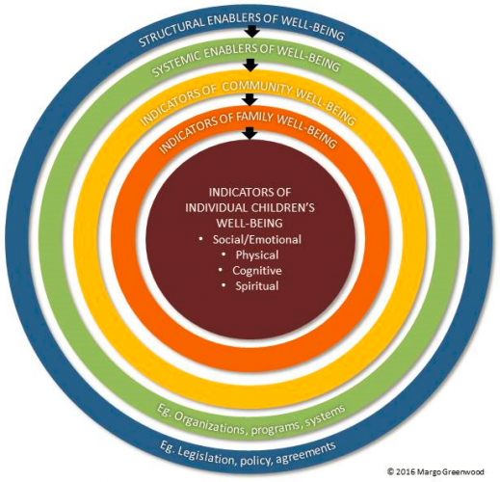
Developed by Dr. Margo Greenwood, the Determinants of Health Model presented provides a way to think about the complexity of individual and collective health and well-being. It is meant to provide a more holistic way to understand children and their health within their collective and broader society.
Notes:
This model assumes that the health and well-being of children and youth is impacted by their family, their community, as well as by the broader societal systems and structures in which they live. Alignment of these interdependent elements is key to supporting and building healthy communities and families that, in turn, impact individual well-being.
Structural enablers of well-being relate includes high level legislation, policies or agreements that either enable or hinder the development of healthy, positive environments for children, youth and families. Health service delivery agreements, governance and land treaties are examples of structural enablers that can either support or hinder well-being.
System enablers of well-being relate to systems (for example, the education, health, child welfare, justice systems) that provide needed services. Schools, hospitals, mental health programs, well-baby clinics and Head Start programs are examples of system components that support and enable well-being. Strong, community-focused, accessible systems that support families and individuals are instrumental to the development of healthy environments for Indigenous children and youth.
Community enablers of well-being include feeling safe, supported and engaged. Opportunities for land based learning, participation in cultural ceremonies and events, language learning activities and recreation/sport initiatives, for example, that are provided at the community level can greatly contribute to family and individual health and well-being.
Family enablers of well-being help build strong, healthy families. Parental age, employment, education levels and health as well as parental life style behaviours that impact children such as smoking, folic acid use and breastfeeding initiation are important contributors to overall family well-being. The home environment, especially for young children, has an enormous impact on children. Supporting parents and caregivers to make healthy choices for themselves and their children is essential.
The early years (ages 0-5) are a time of extreme growth and development for children. Prenatally, young children can be exposed to influences that impact their birth outcomes, making education and care of pregnant mothers critical. Equally important are the environments in which children grow up. Children with access to healthy food, physical activity, quality education, health care and positive parenting tend to be healthier and better equipped for the challenges they face growing up.
Individual well-being is at the heart of the model because in the end all the other layers of the circle impact the health and well-being of the individual. When looking at individual well-being it is important to examine social/emotional/ cognitive, physical and spiritual aspects to ensure a holistic approach is taken. Ensuring enablers are in place to support all aspects of health and well-being is essential and needs to be the goal of every other layer of the model.

Slide 3
This section provides some innovative examples of programs and interventions that groups and organizations have developed based on data and research. It is hoped that these examples, along with the supporting information found in this module, will provide inspiration for the further creation of initiatives to improve the lives of Indigenous children in Canada

Slide 4
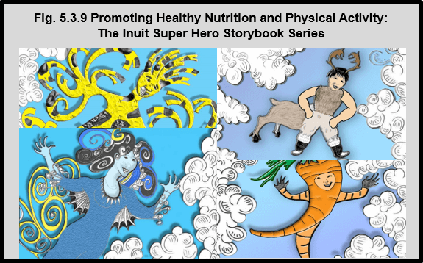
Notes:
Limited access to healthy foods and the high cost of food in northern and remote communities contribute to food insecurity in Inuit families. As a way to help promote healthy food choices, traditional/country foods and physical activity, the Arviat Wellness Centre, Nunavut Arctic College, Canadian Institute of Child Health (CICH) and numerous Inuit partners have partnered to create a series of fun storybooks for young children.
These engaging tri-lingual story books (English, French and Inuktitut) feature the following Inuit Super Heroes:
Meateater Man is strong and healthy. His strength comes from the meat in his diet because protein builds good muscles. A traditional Inuit diet consists mostly of meat and animal fats. With this diet, Inuit live long healthy lives.
Crunchy Carrot reminds us that to crunch is best and that snacking on crunchy things like carrots, celery, broccoli, cauliflower, peppers, pears, apples and berries is fun and healthy.
King Caribou teaches that protein is what builds muscle and helps us grow. Protein also makes our blood strong and helps us fight sickness. Without protein your body cannot work as well.
Stretchy Cheese is a flexible friend who teaches us how milk, yoghurt and cheese give you strong teeth and bones.
Water Woman is clear and fresh, fast and always flowing! What a beautiful super hero! She encourages us to drink water to help our body be like hers.
The storybooks are an educational and fun resource for early childhood educators, teachers and parents.

Slide 5
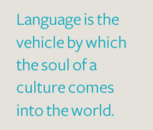
Notes:
In Canada, there are approximately 60 Indigenous languages spoken. Many of these languages have several dialects, particularly when the language is distributed over a large area.¹
According to the 2011 National Household Survey, 240,815 Indigenous people reported that they had knowledge of an Indigenous language.² This was a decrease of about 4.5% since 2006.³ Of those Indigenous people who reported knowledge of an Indigenous language in 2011, 39.4% reported Cree as the most common language spoken. The next most common language spoken was Inuktitut (15.1%).²
Language is a very important part of Indigenous history and culture. As a result, finding ways to increase the number of people speaking Indigenous languages is becoming a focus for Indigenous communities and Canada as a whole.
On December 6, 2016, at the Assembly of First Nations Special Chiefs Assembly, Prime Minister Justin Trudeau announced a plan to implement a new law to protect and preserve Indigenous languages in Canada, saying:
“Today, I commit to you that our government will enact an Indigenous Languages Act, co-developed with Indigenous Peoples, with the goal of ensuring the preservation, protection, and revitalization of First Nations, Métis, and Inuit languages in this country.”⁴
Below are a number of helpful websites, videos, apps and tools that have been developed to assist in learning Indigenous languages.
Michif – Métis langauge The Michif Language Project (http://www.michiflanguage.ca/index.html) developed by the Cowichan Valley Métis Association, is a fun web resource with animated videos that focus on learning numbers, colours, food, animals, body parts and names of relatives. There is also a video with syllabic exercises and a language guide.
Métis Nation BC Learn Michif website (http://www.learnmichif.com) is an on-line resource with 4 separate lessons where you can learn greetings, how to speak about your family, the weather and how to order food. There are also videos where you can watch people speaking.
Michif to Go (https://play.google.com/store/apps/details?id=com.emap.michif&hl=) from the Gabriel Dumont Institute, is an English-to-Michif Dictionary app available for Android phones. It has over 11,500 translations and audio pronunciations as well as a search tool to look up the English word to find the Michif-Cree translations.
Michif Lessons (https://itunes.apple.com/ca/app/michif-lessons/id965897763?mt=8) from the Gabriel Dumont Institute, is a downloadable app that contains over 60 exercises to learn over 1000 Michif words.
Cree – First Nations Language Online Cree Dictionary (http://www.creedictionary.com), developed in partnership by the Miyo Wahkohtowin Community Education Authority (MWCEA) and Dr. Earle Waugh Director Center for Culture & Health Family Medicine, University of Alberta (U of A), is a web based interactive First Nations language portal with dictionary and curriculum based resources to further the development for Cree language in Canada. The website and downloadable app provides translation functions, the creation of flash cards and storyboards using pictures and words (syllabics and English), educational games such as word matching and puzzles, and a database of Cree language lesson plans to help teachers integrate Indigenous languages into the curriculum.
Algonquin – First Nations language Learn Algonquin through Flash (http://kzadmin.com/Learningalgonquin.aspx#), developed by the Kitigan Zibi Anishinabeg, is an on-line learning centre that has a series of 20 different scenes with stick figures speaking the language. You can listen to the conversation in English or Algonquin.
Inuktitut- Inuit language Inuktitut Tusaalanga, (http://www.tusaalanga.ca) developed by the Pirurvik Centre, is a website dedicated to helping people learn Inuktitut in a variety of different dialects. Through a series of on-line lessons, learners can see spellings and add words or phrases to a playlist to hear how they should be pronounced. There is also information on grammar and exercises to practice what has been learned.
¹Canadian Encyclopedia. Aboriginal People and Languages http://www.thecanadianencyclopedia.ca/en/article/aboriginal-people-languages accessed August 22, 2017. ²Statistics Canada, 2011 National Household Survey, Statistics Canada and AANDC tabulations. https://www.aadnc-aandc.gc.ca/eng/1377004468898/1377004550980 -accessed August 2, 2017. ³Statistics Canada, 2006 Census of the Population. http://www12.statcan.gc.ca/census-recensement/2006/rt-td/lng-eng.cfm – accessed August 2, 2017. ⁴Justin Trudeau, Prime Minister of Canada, Government of Canada website. http://pm.gc.ca/eng/news/2016/12/06/prime-minister-justin-trudeaus-speech-assembly-first-nations-special-chiefs-assembly – accessed March 7, 2017.

Slide 6
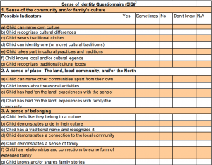
Notes:
Sense of Identity Questionnaire (SIQ)
The Early Development Instrument (EDI) is a teacher-completed questionnaire that measures children’s ability to meet age appropriate developmental expectations at school entry in 5 domains: physical health and well-being; social competence; language and cognitive development; communication skills and general knowledge; and, emotional maturity. Developed by the Offord Centre for Child Studies at McMaster University in 2000, as of 2013 all Canadian provinces and territories were using the EDI to measure how their children were doing.¹
The Northwest Territories (NWT) began territory-wide implementation of the EDI in 2012 and since then have been collecting information on a yearly basis.^{1, 2} The 2012, 2013 and 2014 EDI baseline results for children in the NWT reported that 38.1% were vulnerable in at least one or more of the 5 EDI domains, compared to 25% Canada-wide.³
When the Government of the Northwest Territories expressed interest in using the EDI, several organizations expressed concern that the unique experience of northern children would not be captured in the core EDI domains.² This was further discussed in March 2012, during a 3-day training entitled ‘Re-imaging Kindergarten’. The focus was to provide training for EDI implementation as well as professional development in other kindergarten areas.²
As part of the 3-day event, a 90 minute session was held to explore the meanings of identity in northern contexts and how it could be measured. During this session, 8 teams generated over 100 possible items that were grouped into 6 overarching themes: culture, language, communication, activities, pride and family.² This was further narrowed to 22 items that were focus tested on 41 teachers, resulting on 4 items being removed for a final total of 18 questions.²
The 18 questions, divided into 3 dimensions of identity (a sense of the community and/or family’s culture; a sense of place: the land, local community, and/or the North; and, a sense of belonging) became the Sense of Identity Questionnaire (SIQ).² The SIQ is a unique measure specifically for the kindergarten population of the NWT that is meant to be used in conjunction with the EDI. The SIQ adds a useful context to interpret EDI results.¹
Preliminary results of the SIQ suggest that:¹ – NWT children with higher EDI scores tend to demonstrate a greater sense of identity SIQ – Older NWT children demonstrate a greater sense of identity than younger children – NWT girls demonstrate a slightly greater sense of identity than boys
Although the SIQ is a new initiative that requires further analysis, preliminary findings suggest that much can be learned from linking children’s sense of identity with the developmental findings of the EDI.
¹Early Development Instrument NWT Baseline Results for the 2012, 2013 and 2014 school years: Technical Report. 2014. Northwest Territories Department of Education, Culture and Employment. https://www.ece.gov.nt.ca/sites/www.ece.gov.nt.ca/files/resources/early_development_instrument_-_technical_report_sept_2014.pdf -accessed August 21, 2017. ²Janus, M. and Hopkins, S. (2012) Constructing Measures of Northern Children’s Identity Through Dialogue. Pimatisiwin: A Journal of Aboriginal and Indigenous Community Health 10(2). http://www.pimatisiwin.com/uploads/vol11/12JanusHopkins.pdf -accessed August 21, 2017. ³Early Development Instrument, Measuring Children’s Readiness to Learn: Summary of NWT Baseline Results for the 2012, 2013 and 2014 School Years. (2014). Northwest Territories Department of Education, Culture and Employment and Department of Health and Social Services. https://www.ece.gov.nt.ca/sites/www.ece.gov.nt.ca/files/resources/early_development_instrument_-_summary_report_sept_2014.pdf -accessed August 21, 2017.

Slide 7
Notes:
Adopted by the House of Commons in 2007, Jordan’s Principle is a child-first principle that puts the needs of the child first and foremost so they do not experience denials, delays, or disruptions in needed services due to jurisdictional disputes.¹
Jordan’s Principle was named in memory of Jordan River Anderson, a First Nations child from Norway House Cree Nation in Manitoba. Jordan was born with complex medical needs and spent more than two years in hospital while the Province of Manitoba and the federal government debated over who should pay for his home care. Jordan died in the hospital at the age of five years old, never having spent a day in his family home.²
Responsibility for services to First Nations children is often shared by federal, provincial/ territorial and First Nations governments, resulting in a number of jurisdictional issues that can make access a challenge; in contrast, funding and delivery of these same services to most other children in Canada falls solely under provincial/territorial jurisdiction making access much less of an issue.¹
By putting the child’s needs as the priority, Jordan’s Principle calls on the government of first contact to pay for the services and seek reimbursement later so the child receives the services and does not get caught in government disputes.²
The infographic shown on this page, Jordan’s Principle: 8 Steps to Get There, is a helpful tool to better understand and implement Jordan’s Principle as outlined in the New Brunswick Jordan’s Principle Agreement. https://fncaringsociety.com/sites/default/files/JP%20Final%20with%20logo_AFN%20Graphic.pdf-accessed August 17, 2017.
Without denial, delay or disruption: Ensuring First Nations children’s access to equitable services through Jordan’s Principle, is a report developed by the Assembly of First Nations (AFN), together with UNICEF Canada, The Canadian Paediatric Society, McGill University and the University of Michigan. The report highlights inequities experienced by First Nations children who need government services and how jurisdictional confusion among provincial, territorial and federal governments results in First Nations children being denied necessary care.³
¹The Jordan’s Principle Working Group (2015) Without denial, delay, or disruption: Ensuring First Nations children’s access to equitable services through Jordan’s Principle. Ottawa, ON: Assembly of First Nations. http://health.afn.ca/uploads/files/jordans_principle_english.pdf-accessed August 17, 2017. ²First Nations Child and Family Caring Society of Canada website. https://fncaringsociety.com/jordans-principle-accessed August 17, 2017. ³Assembly of First Nations. Press release. Without denial, delay or disruption: Ensuring First Nations children’s access to equitable services through Jordan’s Principle. http://www.afn.ca/en/jordans-principle-feb10-accessed August 17, 2017.

Slide 8
Section 1:
Structural Enablers of Well-Being
Coming Soon !
Notes:
Structural enablers of well-being relate to the legislation, policies or agreements that currently exist that can enable the development of healthy, positive environments for children, youth and families. Health service delivery agreements, governance and land treaties are just some examples of structural enablers that can support health and overall community well-being.

Slide 9
Section 2:
Systemic Enablers of Well-Being
Coming Soon !

Slide 10
Section 3:
Community
Well-Being Enablers
Coming Soon !

Slide 11
Section 4:
Family Well-Being Enablers
Coming Soon!

Slide 12
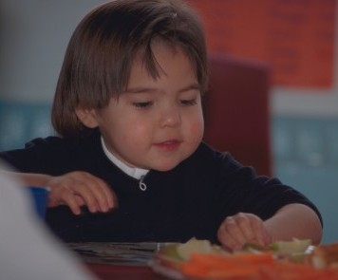
Section 5: Pregnancy and the early years (ages 0-5) are a time of extreme growth and development for children.
Notes:
Prenatally, young children can be exposed to influences that impact their birth outcomes – making education and care of pregnant mothers critical. Equally important are the environments in which children grow up. Children with access to healthy food, physical activity, quality education, health care and positive parenting tend to be healthier and better equipped for the challenges they face growing up.

Slide 13
Section 5.1: Demographic Information

Slide 14
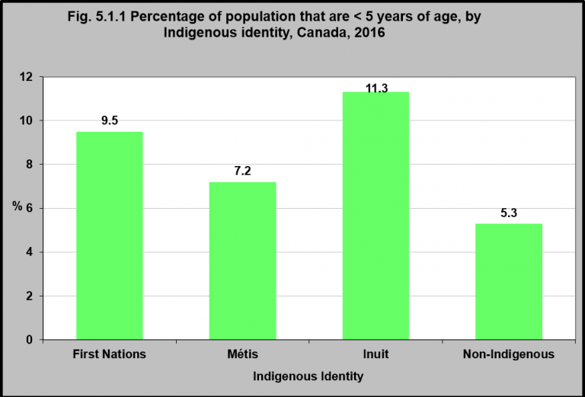
Notes:
Summary
Children under 5 make up a greater proportion of the Indigenous population than they do of the non-Indigenous population in Canada. 10% of all First Nations people in Canada are less than 5 years of age, as are 7% of Métis and 11% of Inuit peoples in Canada.
Among the non-Indigenous population, only 5% are under 5.
Implications
The Indigenous population in Canada is younger than the non-Indigenous population. The Indigenous population is also growing substantially faster than the rest of the Canadian population; however growth rates vary among Indigenous groups due in part to differences in fertility rates and changes in self-reporting of cultural affiliation.¹ With this growing youthful population, there is a need to prioritize interventions aimed at improving the health and well-being of Indigenous children 0-4 years as critical for strengthening Indigenous families and communities.
¹Aboriginal Affairs and Northern Development Canada. (2013). Aboriginal demographics from the 2011 National Household Survey. Ottawa, ON: Planning, Research and Statistics Branch. https://www.aadnc-aandc.gc.ca/eng/1370438978311/1370439050610
Note: Excludes census data for one or more incompletely enumerated Indian reserves or Indian settlements. Source: CICH graphic created using data adapted from Statistics Canada – 2016 Census. Catalogue Number 98-400-X2016155. http://www12.statcan.gc.ca/census-recensement/2016/dp-pd/dt-td/Rp-eng.cfm?LANG=E&APATH=3&DETAIL=0&DIM=0&FL=A&FREE=0&GC=0&GID=0&GK=0&GRP=1&PID=110588&PRID=10&PTYPE=109445&S=0&SHOWALL=0&SUB=0&Temporal=2017&THEME=122&VID=0&VNAMEE=&VNAMEF= – Accessed December 23, 2017.

Slide 15
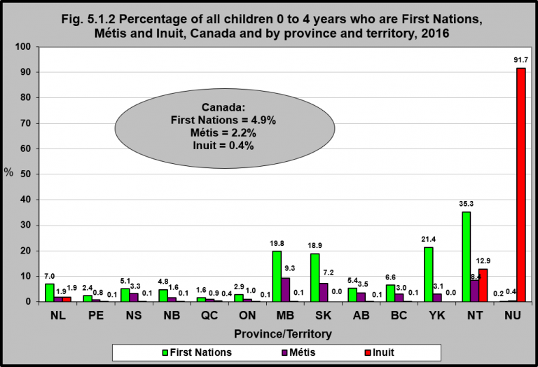
Notes:
Summary
In 2016, there were 145,645 Indigenous children under 5 years of age living in Canada. In fact, Indigenous children under age 5 accounted for 7.7% of all children under age 5 living in Canada. Of the total population of Indigenous children under age 5, 65%, were First Nations; 30% were Métis; and 5% were Inuit.
In Manitoba, almost 20% of children under 5 years of age were First Nations and 9.3% were Métis.
In Saskatchewan, 19% of children under 5 years of age were First Nations and 7.2% were Métis.
In Nunavut, 92% of children under age 5 were Inuit. In the Yukon, 21% of children under 5 years of age were First Nations and 35% of Northwest Territories children under 5 years of age were First Nations.
Implications
The population of Indigenous children is not spread evenly across Canada as some Canadian provinces/territories have significantly higher proportions of Indigenous peoples. Addressing the socio-economic inequities and health disparities of Indigenous children, especially in provinces/territories with high proportions of Indigenous children (the Western provinces and in the three territories), has considerable potential to not only strengthen Indigenous families and communities, but also the economic potential of the provinces/territories in which they reside.
Note: Excludes census data for one or more incompletely enumerated Indian reserves or Indian settlements. Source: CICH graphic created using data adapted from Statistics Canada – 2016 Census. Catalogue Number 98-400-X2016155. http://www12.statcan.gc.ca/census-recensement/2016/dp-pd/dt-td/Rp-eng.cfm?LANG=E&APATH=3&DETAIL=0&DIM=0&FL=A&FREE=0&GC=0&GID=0&GK=0&GRP=1&PID=110588&PRID=10&PTYPE=109445&S=0&SHOWALL=0&SUB=0&Temporal=2017&THEME=122&VID=0&VNAMEE=&VNAMEF= – Accessed December 23, 2017.

Slide 16
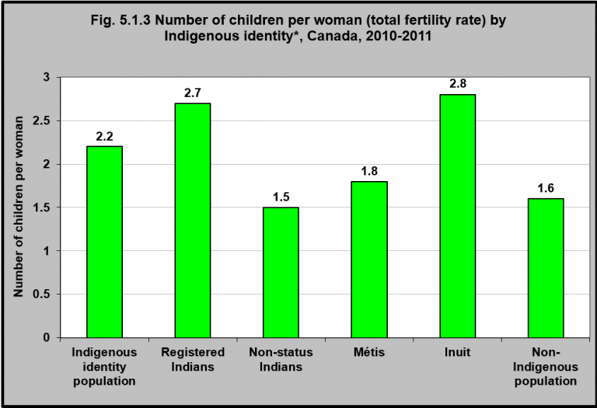
Notes:
Summary
In 2010/2011 the total fertility rate** for Indigenous women* was 2.2 children per woman. This was higher than that of Non-Indigenous women who had a total fertility rate of 1.6 children per woman.
The total fertility rate varied from a low of 1.5 children per woman for Non-Status Indian women to a high of 2.8 children per woman for Inuit women.
Implications
The higher fertility rate of Indigenous women is one of the contributing factors to the young and rapidly growing Indigenous population. As such, it is important that Indigenous women have access to culturally sensitive maternal and child health services in order to give infants the best start in life and to set them on a healthy pathway. Currently, due to a number of barriers, including geographic isolation, limited resources, lack of personnel, and culture and negative experiences with mainstream health services, many Indigenous women do not receive appropriate pre- and postnatal care or must travel to urban centres, away from the support of their families and communities, to give birth.² Existing data indicate that Indigenous women have poorer maternal health status and maternity experiences compared to non-Indigenous women, and experience disparities accessing culturally secure maternity care close to home and family.³ Health services, programs and policy responses tailored to Indigenous communities could improve maternity services for Indigenous women and improve health outcomes and enhance the well-being of both mother and child.
¹Fertility: Overview, 2009 to 2011. Component of Statistics Canada Catalogue no. 91-209-X Report on the Demographic Situation in Canada, 2013. http://www.statcan.gc.ca/pub/91-209-x/2013001/article/11784-eng.pdf
²Lalonde, A.B., Butt, C., & Bucio, A. (2009). Maternal health in Canadian Aboriginal communities: Challenges and opportunities. Journal of Obstetricians and Gynaecologists of Canada, 31(10), 956-962; ³Smylie, J. (2014). Strong women, strong nations: Aboriginal maternal health in British Columbia. Prince George, BC: National Collaborating Centre for Aboriginal Health.
*The data are classified according to the categories of Indigenous identity as defined by Indigenous and Northern Affairs Canada (INAC). Source: CICH graphic created using data adapted from Statistics Canada, Demography Division, own-children method applied to the adjusted data of the 2011 National Household Survey (NHS) http://www.statcan.gc.ca/pub/91-552-x/2015001/t/tbl04-eng.htm – accessed August 22, 2017.
**The total fertility rate refers to the number of children that a woman would have over the course of her reproductive life if she experienced the age-specific fertility rates observed in a particular calendar year. It is based on a compilation of the fertility experiences of many different cohorts of women in a given year.¹

Slide 17
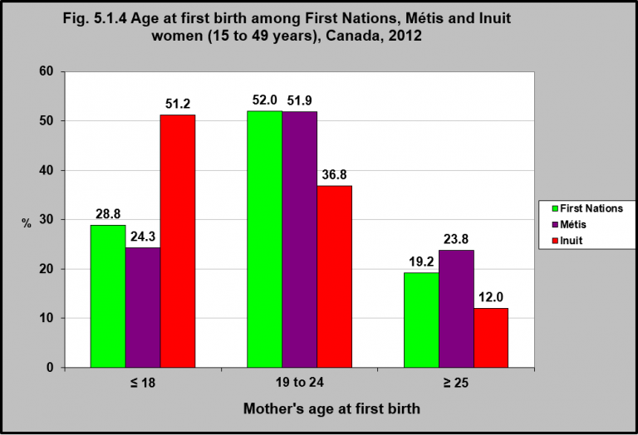
Notes:
Summary
In 2012, the majority (52%) of First Nations and Métis women had their first babies between the ages of 19 and 24.
The majority of Inuit women had their first babies when they were younger than 18.
A smaller percentage of women in all three groups had their first baby over the age of 24.
Implications
Indigenous girls aged 15-19 years are more likely to become parents than non-Indigenous teenage girls. The 2006 Census indicates that while only 1.3% of non-Indigenous teenage girls were parents, 8% of Indigenous teenage girls were parents (9% of all First Nations and Inuit girls, 12% of First Nations girls living on reserve, but only 4% of Métis teenage girls).¹ While being a teen parent can have consequences in terms of increasing vulnerability to socio-economic disadvantage (with concomitant poorer health outcomes), Indigenous cultures do not necessarily view teenage pregnancy from the same perspective as non-Indigenous peoples. This highlights the need for a wide range of culturally appropriate supports for young pregnant and parenting Indigenous women and culturally appropriate information about sexuality and contraceptive use for Indigenous teens in general.²
¹O’Donnell, V., & Wallace, S. (2011). First Nations, Métis and Inuit women. Ottawa, ON: Statistics Canada – Catalogue no. 89-503-X. ²Archibald, L. (2004). Teenage pregnancy in Inuit communities: Issues and perspectives. Ottawa, ON: Pauktuutit Inuit Women’s Association.

Slide 18
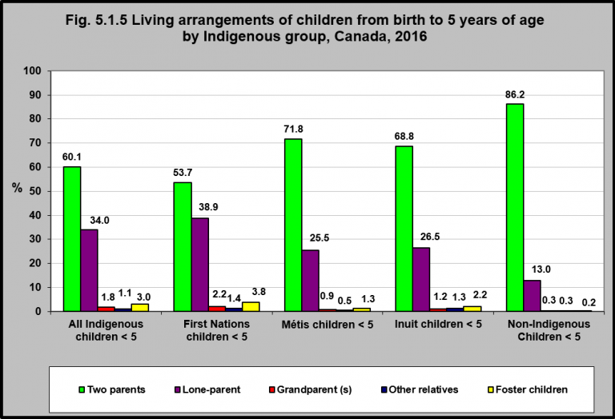
Notes:
Summary
In 2016, 60% of Indigenous children aged 0 to 4 lived in a family with two parents.
Fifty-four per cent of First Nations children under 5 lived with two parents, as did 72% of Métis and 69% of Inuit children in this age group.
More than one-third of Indigenous children aged 0 to 4 lived with a lone-parent. This was the case for 39% of First Nations, 26% of Métis and 27% of Inuit children in this age group.
Indigenous children accounted for 7.7% of all children aged 0 to 4, and about one-half of all foster children in this age group.
Implications
Indigenous children have diverse and varied living arrangements. While most live in families with a married couple, they are less likely than non-Indigenous children to be living with married parents and more likely to be living in other types of family arrangements. While living in a lone parent household likely results in socio-economic disadvantages to Indigenous children, it is important to remember that in Indigenous cultures, child-rearing is traditionally shared among extended families and communities.¹
¹Lafrance, J., & Collins, D. (2013). Residential schools and Aboriginal parenting: voices of parents. Native Social Work Journal, 4(1), 104-125.
Source: CICH graphic created using data adapted from Statistics Canada. Diverse family characteristics of Aboriginal children aged 0 to 4. Census in Brief. Census of Population, 2016. http://www12.statcan.gc.ca/census-recensement/2016/as-sa/98-200-x/2016020/98-200-x2016020-eng.cfm -accessed October 20, 2017.

Slide 19
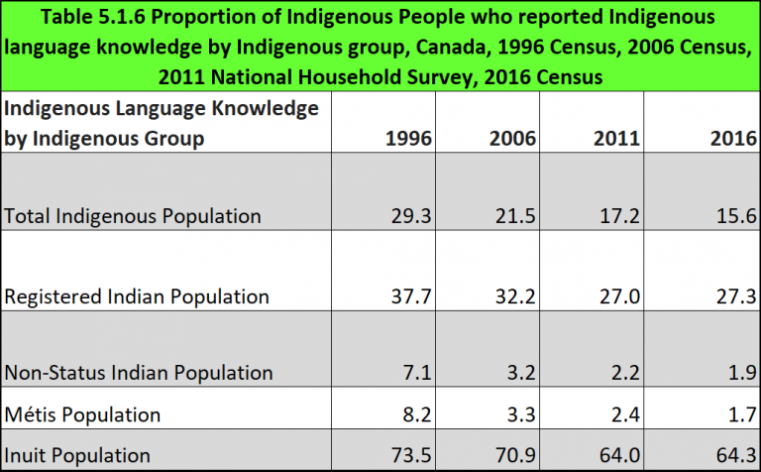
Notes:
Summary
While the number of Indigenous people with knowledge of an Indigenous language has increased since 1996, the proportion has been steadily decreasing since 1996. In 1996 that proportion was 29.3%. In 2006 it had declined to 21.5% and in 2011 it was 17.2%. In 2016 it was 15.6%.
This decline may have been influenced by the increasing number of people who are self-identifying as Indigenous.
In 2016, 27% of the Registered Indian population had knowledge of an Indigenous language – down from 32.2% in 2006 and 37.7% in 1996.
Among Non-Status Indians, 1.9% reported knowledge of an Indigenous language in 2016. That was down from about 3% in 2006 and 7.1% in 1996.
In 2016, 64.0% of Inuit reported knowledge of an Indigenous language – that was down from 70.9% in 2006 and 73.5% in 1996.
In 2016, 1.7% of Métis people could speak an Indigenous language. That was a decline from 3.3% in 2006 and 8.2% in 1996.
Implications
Language is intrinsically linked to the development of strong cultural identity, at both individual and collective levels. It is important to a child’s mental health and well-being,¹ to provide him/her with a sense of belonging and self-esteem as a foundation for individual resilience that contributes to the development of strong and resilient communities. In Canada, colonial legislation that aimed to assimilate Indigenous peoples into mainstream society has endangered many Indigenous languages. Of an estimated 450 Indigenous languages and dialects belonging to 11 language families, only 50-70 are still spoken in Canada, and only three (Cree, Inuktitut and Ojibway) are expected to remain and flourish in Indigenous communities.² Language preservation and revitalization must begin in early childhood; “if the children of a community are not learning the language, the language will die out.”²
¹Galley, V., Gessner, S., Herbert, T., Thompson, K.T., & Williams, L.W. (2016). Indigenous languages recognition, preservation and revitalization: A report on the national dialogue session on Indigenous languages. Victoria, BC: First Peoples’ Cultural Council. Retrieved September 12, 2017 from http://www.fpcc.ca/files/PDF/General/FPCC__National_Dialogue_Session_Report_Final.pdf ²McIvor, O. (2005). Building the nests: Indigenous language revitalization in Canada through early childhood immersion programs. Unpublished MA theses, School of Child and Youth Care, University of Victoria, Victoria, BC.
Notes: 1. Excludes census data for one or more incompletely enumerated Indian reserves or Indian settlements. 2. The total Indigenous population refers to the population that self-identified with one or more of the three Indigenous identity groups (First Nations, Inuit, Métis), and/or indicated Registered or Treaty Indian Status, and/or indicated band membership. 3. In 1996, 2006, 2011, excluded from these counts are respondents who reported more than one Indigenous identity, and those who reported being a member of a band with no Indigenous identity and no Registered Indian status. However, individuals included under these two groups reporting Indigenous language knowledge result in small numbers. In 2016 includes single and multiple languages. 4. The Registered Indian population refers to the population that indicated Registered or Treaty Indian Status. 5. The Non-Status Indian population refers to the population that identified as First Nations (single response) and indicated NO Registered or Treaty Indian Status. 6. The Métis population refers to the population that identified as Métis (single response) and indicated NO Registered or Treaty Indian Status. 7. The Inuit population refers to the population that identified as Inuk (single response) and indicated NO Registered or Treaty Indian Status. 8. The non-Indigenous population refers to the population that did not identify with any of the three Indigenous identity groups (First Nations, Inuit, Métis), did not indicate Registered or Treaty Indian Status, and did not indicate band membership.
Source: CICH graphic created using data adapted from Statistics Canada, 1996 to 2006 Censuses of Population and 2011 National Household Survey, Statistics Canada and AANDC tabulations. https://www.aadnc-aandc.gc.ca/eng/1377004468898/1377004550980 -accessed October 24, 2017 and Statistics Canada – 2016 Census. Catalogue Number 98-400-X2016160. http://www12.statcan.gc.ca/census-recensement/2016/dp-pd/dt-td/Rp-eng.cfm?TABID=2&LANG=E&A=R&APATH=3&DETAIL=0&DIM=0&FL=A&FREE=0&GC=01&GL=-1&GID=1341679&GK=1&GRP=1&O=D&PID=110449&PRID=10&PTYPE=109445&S=0&SHOWALL=0&SUB=0&Temporal=2017&THEME=122&VID=0&VNAMEE=&VNAMEF=&D1=5&D2=0&D3=0&D4=0&D5=0&D6=0 -accessed October 30, 2017.

Slide 20
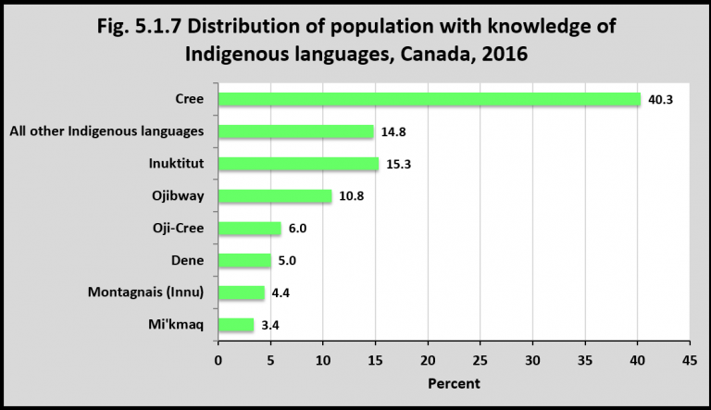
Notes:
Summary
In 2016, of the 260,550 Indigenous people who reported knowledge of an Indigenous language, 40.3% reported that it was Cree (105,020 people).
The next most common language was Inuktitut- 15.3% (39,770).
Implications
Of the 50-70 Indigenous languages spoken in Canada, only three languages are still flourishing (Cree, Inuktitut, and Ojibway).¹ Language preservation is seen as being important to the development of individual and collective identity, and the development of healthy and resilient individuals and communities.
¹McIvor, O. (2005). Building the nests: Indigenous language revitalization in Canada through early childhood immersion programs. Unpublished MA theses, School of Child and Youth Care, University of Victoria, Victoria, BC.
Notes: 1. Excludes census data for one or more incompletely enumerated Indian reserves or Indian settlements. 2. ‘Aboriginal identity’ includes persons who are First Nations (North American Indian), Métis or Inuk (Inuit) and/or those who are Registered or Treaty Indians (that is, registered under the Indian Act of Canada) and/or those who have membership in a First Nation or Indian band. Aboriginal peoples of Canada are defined in the Constitution Act, 1982, section 35 (2) as including the Indian, Inuit and Métis peoples of Canada. 3. Users should be aware that the estimates associated with this variable are more affected than most by the incomplete enumeration of certain Indian reserves and Indian settlements in the Census of Population. For more information on Aboriginal variables, including information on their classifications, the questions from which they are derived, data quality and their comparability with other sources of data, please refer to the Aboriginal Peoples Reference Guide, Census of Population, 2016 and the Aboriginal Peoples Technical Report, Census of Population, 2016. 4. The category ‘Total – Knowledge of languages: single and multiple language responses’ indicates the number of respondents who reported each language, either as their only response, or in combination with another language. Total responses represent the sum of single language responses and multiple language responses received in the census.
Source: CICH graphic created using data adapted from Statistics Canada – 2016 Census. Catalogue Number 98-400-X2016160. http://www12.statcan.gc.ca/census-recensement/2016/dp-pd/dt-td/Rp-eng.cfm?TABID=2&LANG=E&A=R&APATH=3&DETAIL=0&DIM=0&FL=A&FREE=0&GC=01&GL=-1&GID=1341679&GK=1&GRP=1&O=D&PID=110449&PRID=10&PTYPE=109445&S=0&SHOWALL=0&SUB=0&Temporal=2017&THEME=122&VID=0&VNAMEE=&VNAMEF=&D1=5&D2=0&D3=0&D4=0&D5=0&D6=0 -accessed October 19, 2017.

Slide 21
Section 5.2: Family Income, Education and Employment

Slide 22
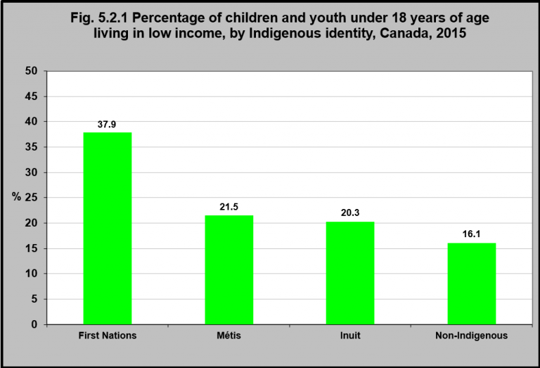
Notes:
Summary
In 2015, 37.9% of First Nations children and youth under 18 lived in low income. That was the case for 21.5% of Métis children and youth, 20.3% of Inuk (Inuit) children and youth, and 16.1% of non-Indigenous children and youth.
Implications
While the socio-economic conditions of Indigenous families vary greatly, a history of colonization, including social exclusion and political and economic marginalization, has contributed to many Indigenous families facing numerous and persistent disadvantages. Indigenous children are more likely to live in poverty than non-Indigenous children, especially First Nations children living on reserve.¹ Growing up in a household with persistent poverty is a major determinant of Indigenous children’s health and well-being with substantial cumulative impacts.² Poverty affects healthy child development and leads to poorer health outcomes, not only in young children but later in life as adults.³ Chronic poverty can result in food insecurity and nutritional deficiencies, with poorer physical health outcomes including obesity, diabetes, and cardiovascular diseases. It can impact children’s cognitive development, with impacts to academic success with consequences across the life course. It can also impact children’s emotional and mental development, as poverty can foster parental stresses and negative coping strategies, like substance abuse and family violence, which are experienced and internalized by children. However, the impact of poverty on children’s health can be mediated through an increased focus on family time, family assets, parenting styles, parenting relationships, and high quality schools.²
¹Macdonald, D., & Wilson, D. (2016). Shameful neglect: Indigenous child poverty in Canada. Ottawa, ON: Canadian Centre for Policy Alternatives. ²Phipps, S. (2003). The impact of poverty on health: A scan of research literature. Canadian Population Health Initiative, Canadian Institute for Health Information. Retrieved September 12, from https://secure.cihi.ca/free_products/CPHIImpactonPoverty_e.pdf ³Paul-Sen Gupta, R., de Wit, M.L., & McKeown, D. (2007). The impact of poverty on the current and future health status of children. Paediatric Child Health, 12(8), 667-672.
Notes: Excludes census data for one or more incompletely enumerated Indian reserves or Indian settlements. Low-income measure, after tax (LIM-AT) – The Low-income measure, after tax, refers to a fixed percentage (50%) of median adjusted after-tax income of private households. The household after-tax income is adjusted by an equivalence scale to take economies of scale into account. This adjustment for different household sizes reflects the fact that a household’s needs increase, but at a decreasing rate, as the number of members increases. Using data from the 2016 Census of Population, the line applicable to a household is defined as half the Canadian median of the adjusted household after-tax income, multiplied by the square root of household size. The median is determined based on all persons in private households where low-income concepts are applicable. Thresholds for specific household sizes are presented in Table 4.2 Low-income measures thresholds (LIM-AT and LIM-BT) for private households of Canada, 2015, Dictionary, Census of Population, 2016. When the unadjusted after-tax income of household pertaining to a person falls below the threshold applicable to the person based on household size, the person is considered to be in low income according to LIM-AT. Since the LIM-AT threshold and household income are unique within each household, low-income status based on LIM-AT can also be reported for households.
Users should be aware that the estimates associated with this variable are more affected than most by the incomplete enumeration of certain Indian reserves and Indian settlements in the Census of Population. For more information on Aboriginal variables, including information on their classifications, the questions from which they are derived, data quality and their comparability with other sources of data, please refer to the Aboriginal Peoples Reference Guide, Census of Population, 2016 and the Aboriginal Peoples Technical Report, Census of Population, 2016.
Aboriginal identity’ includes persons who are First Nations (North American Indian), Métis or Inuk (Inuit) and/or those who are Registered or Treaty Indians (that is, registered under the Indian Act of Canada) and/or those who have membership in a First Nation or Indian band. Aboriginal peoples of Canada are defined in the Constitution Act, 1982, section 35 (2) as including the Indian, Inuit and Métis peoples of Canada. Multiple Aboriginal responses’ includes persons who are any two or all three of the following: First Nations (North American Indian), Métis or Inuk (Inuit).
Source: CICH graphic created using data adapted from Statistics Canada – 2016 Census. Catalogue Number 98-400-X2016173. http://www12.statcan.gc.ca/census-recensement/2016/dp-pd/dt-td/Rp-eng.cfm?TABID=2&LANG=E&A=R&APATH=3&DETAIL=0&DIM=0&FL=A&FREE=0&GC=01&GL=-1&GID=1341679&GK=1&GRP=1&O=D&PID=111095&PRID=10&PTYPE=109445&S=0&SHOWALL=0&SUB=0&Temporal=2017&THEME=122&VID=0&VNAMEE=&VNAMEF=&D1=0&D2=0&D3=1&D4=0&D5=0&D6=0 -accessed October 21, 2017.

Slide 23
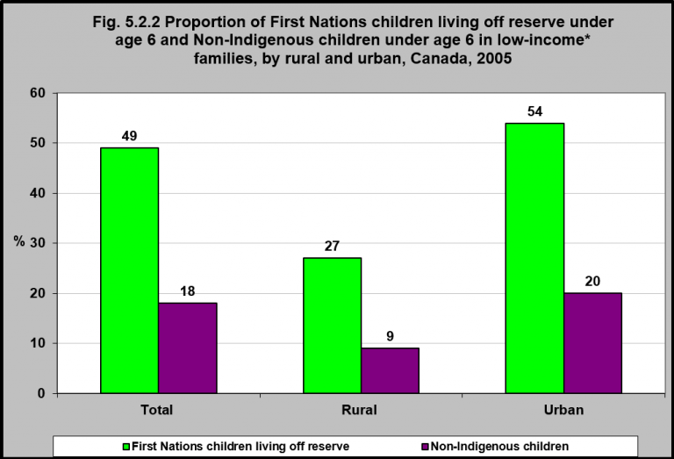
Notes:
Summary
In 2005, 49% of all First Nations children under 6 who were living off reserve lived in low-income families, compared to 18% of non-Indigenous children under 6.
First Nations children under 6 who lived in urban communities (off reserve) were about twice as likely as those living in rural communities to live in low-income families – 54% versus 27% respectively.
This was the same for non-Indigenous children.
Implications
The past 50 years has seen an increasing urbanization of the Indigenous population. Many Indigenous people move to urban centres because of the promise of better economic opportunities and housing but find that urbanization brings a high risk of poverty. While Indigenous people account for a relatively small proportion of the population in most cities, they make up a disproportionate number of those living in poverty, especially in cities like Winnipeg, Edmonton, Saskatoon and Regina.¹ In these cities, they face significant barriers to overcoming poverty, including lower levels of education (a key factor in competing in today’s urban economies), higher unemployment rates, and significant wage gaps. Also contributing to the high rates of poverty is the high degree of mobility among Indigenous people, not only between and within urban locations but also between urban and rural locations.² Children who live in situations where families are vulnerable are at increased risk of being removed from their homes.³
¹Canadian Council on Social Development. (2007). Populations vulnerable to poverty: Urban poverty in Canada, 2000. Ottawa, ON: Author. ²Aboriginal Affairs and Northern Development Canada. (2013). Aboriginal migration and urbanization in Canada, 1961-2006. Ottawa, ON: Author ³Aboriginal Children in Care Working Group. (2015). Aboriginal children in care: Report to Canada’s Premiers. https://www.canadaspremiers.ca/phocadownload/publications/aboriginal_children_in_care_report_july2015.pdf – accessed September 12, 2017.
Notes: Income here refers to total income from all sources including employment income, income from government sources, pension income, investment income and any other money income received during the calendar year 2005 by persons 15 years of age and over.
*Low income before tax cut-offs (LICOs) – Income levels at which families or persons not in economic families are expected to spend 20 percentage points more than average of their before tax income on food, shelter and clothing. Economic families in the Yukon Territory, Northwest Territories and Nunavut and on Indian reserves were excluded as the low income cut-offs are based on certain expenditure- income patterns which are not available from survey data for the entire population. Although the low-income before tax cut-off (LICO) is not applicable in the territories or on Indian reserves, other Census data reveal that in 2005, the median income for First Nations people living in the Yukon was $20,300 compared to a median income of $34,951 for the non-Indigenous population. In the Northwest Territories, the median income for First Nations people was $17,558 compared to $49,219 for the non-Indigenous population.
Source: CICH graphic created using data adapted from Statistics Canada – Catalogue no. 89-634-X 16. Aboriginal Children’s Survey, 2006: Family, Community and Child Care. http://www.statcan.gc.ca/pub/89-634-x/89-634-x2008001-eng.pdf -accessed July 17, 2017.

Slide 24
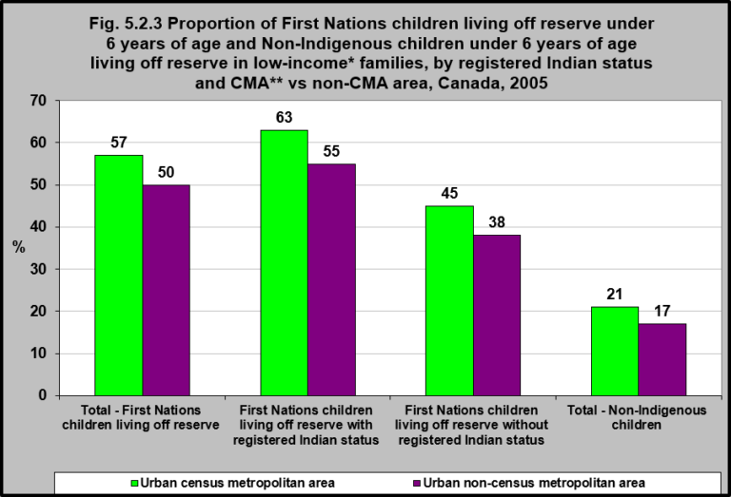
Notes:
Summary
In 2005, children under 6 living in Urban census metropolitan areas (CMAs) were more likely to live in low-income families than were those in urban non-census metropolitan areas.
This was the case for First Nations children with registered Indian status, without status or Non-Indigenous children.
However, non-Indigenous children living in CMAs were less likely to live in low-income families than were First Nations children either with or without registered Indian status.
Implications
The levels of poverty experienced by First Nations children under 6 living off reserve are much higher in the larger urban centres as compared to the smaller ones. This has left unemployed and low-income households less protected, having to work more for lower wages and take on more debt.¹
¹Walks, A. (2013). Income inequality and polarization in Canada’s cities: An examination and new form of measurement. Toronto, ON: University of Toronto, Cities Centre, Research paper 227, p. 3 and 91.
Notes: Income here refers to total income from all sources including employment income, income from government sources, pension income, investment income and any other money income received during the calendar year 2005 by persons 15 years of age and over.
*Low income before tax cut-offs (LICOs) – Income levels at which families or persons not in economic families are expected to spend 20 percentage points more than average of their before tax income on food, shelter and clothing. Economic families in the Yukon Territory, Northwest Territories and Nunavut and on Indian reserves were excluded as the low income cut-offs are based on certain expenditure- income patterns which are not available from survey data for the entire population. Although the low-income before tax cut-off (LICO) is not applicable in the territories or on Indian reserves, other Census data reveal that in 2005, the median income for First Nations people living in the Yukon was $20,300 compared to a median income of $34,951 for the non-Indigenous population. In the Northwest Territories, the median income for First Nations people was $17,558 compared to $49,219 for the non-Indigenous population.
**Census metropolitan areas (CMA) are formed by one or more adjacent municipalities centred on area (known as the urban core). A Census metropolitan area (CMA) must have a total population of at least 100,000 of which 50,000 or more must live in the urban core. Urban non- Census metropolitan areas (non-CMA) are smaller urban areas with a population 100,000.
Source: CICH graphic created using data adapted from Statistics Canada – Catalogue no. 89-634-X 16. Aboriginal Children’s Survey, 2006: Family, Community and Child Care. http://www.statcan.gc.ca/pub/89-634-x/89-634-x2008001-eng.pdf -accessed July 17, 2017.

Slide 25
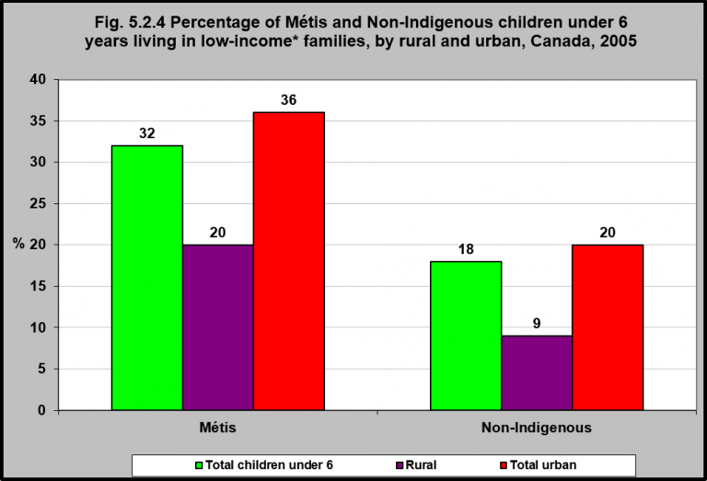
Notes:
Summary
In 2005, 32% of Métis children under 6 lived in low-income* families – compared to 18% of non-Indigenous children.
Rural Métis children were less likely to live in low-income families (20%) compared to urban Métis children (36%).
Rural non-Indigenous children were also less likely to live in poverty compared to urban non-Indigenous children.
Implications
Métis children are less likely to be living in low-income families as compared to First Nations children (on and off reserve); however, they are still much more likely to be living in low-income families as compared to non-Indigenous children. Like First Nations children, urban Métis children are considerably more likely to be living in low-income families compared to non-Indigenous children.
Notes: Income here refers to total income from all sources including employment income, income from government sources, pension income, investment income and any other money income received during the calendar year 2005 by persons 15 years of age and over.
*Low income before tax cut-offs (LICOs) – Income levels at which families or persons not in economic families are expected to spend 20 percentage points more than average of their before tax income on food, shelter and clothing. Economic families in the Yukon Territory, Northwest Territories and Nunavut and on Indian reserves were excluded as the low income cut-offs are based on certain expenditure- income patterns which are not available from survey data for the entire population.
Source: CICH graphic created using data adapted from Statistics Canada – Catalogue no. 89-634-X 16. Aboriginal Children’s Survey, 2006: Family, Community and Child Care. http://www.statcan.gc.ca/pub/89-634-x/89-634-x2008001-eng.pdf -accessed July 17, 2017.

Slide 26
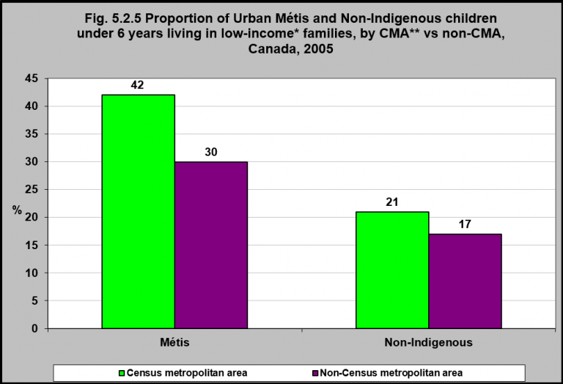
Notes:
Summary
In 2005, 42% of urban Métis children under 6 living in census metropolitan areas (CMAs) were living in low-income families compared to 30% of urban Métis children living in non-CMA areas.
The proportion of Métis children living in CMAs who were living in low-income families was twice that of non-Indigenous children living in CMAs (42% vs 21%).
Notes: Income here refers to total income from all sources including employment income, income from government sources, pension income, investment income and any other money income received during the calendar year 2005 by persons 15 years of age and over.
*Low income before tax cut-offs (LICOs) – Income levels at which families or persons not in economic families are expected to spend 20 percentage points more than average of their before tax income on food, shelter and clothing. Economic families in the Yukon Territory, Northwest Territories and Nunavut and on Indian reserves were excluded as the low income cut-offs are based on certain expenditure- income patterns which are not available from survey data for the entire population.
**Census metropolitan areas (CMA) are formed by one or more adjacent municipalities centred on area (known as the urban core). A Census metropolitan area (CMA) must have a total population of at least 100,000 of which 50,000 or more must live in the urban core. Urban non- Census metropolitan areas (non-CMA) are smaller urban areas with a population 100,000.
Source: CICH graphic created using data adapted from Statistics Canada – Catalogue no. 89-634-X 16. Aboriginal Children’s Survey, 2006: Family, Community and Child Care. http://www.statcan.gc.ca/pub/89-634-x/89-634-x2008001-eng.pdf

Slide 27
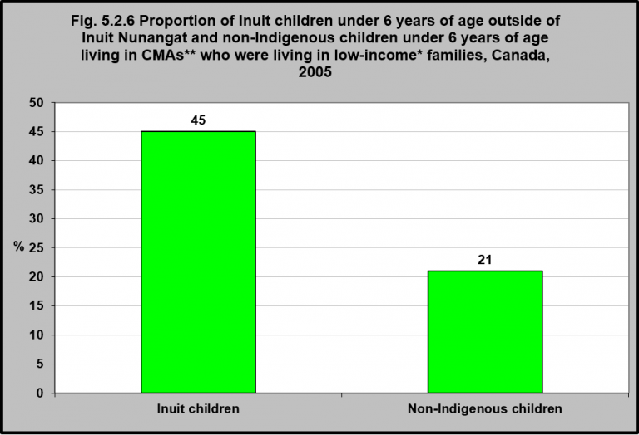
Notes:
Summary
In 2006, there were 7,000 Inuit children under the age of six living throughout Canada.¹ The majority (84%) lived in Inuit Nunangat² with the remaining 16% living outside Inuit Nunangat.¹
In 2005, almost half (45%) of Inuit children outside of Inuit Nunangat under 6 living in census metropolitan areas (CMAs) were living in low-income families.
This was a little more than double that for non-Indigenous children under six living in CMAs (21%).
Implications
Like off-reserve First Nations and Métis children, Inuit children under 6 years of age living in large urban centres/census metropolitan areas (CMAs) are also considerably more likely to be living in low-income families (more than twice as likely) compared to non-Indigenous children.
¹Statistics Canada. Inuit Children Under Six Years Old. http://www.statcan.gc.ca/pub/89-634-x/2008004/article/6500048-eng.htm -accessed November 15, 2017.
²Inuit Nunangat is the homeland of Inuit of Canada. It is comprised of four Inuit regions: Nunatsiavut (northern coastal Labrador), Nunavik (northern Quebec), the territory of Nunavut and the Inuvialuit region (northern Northwest Territories). These regions collectively encompass the area traditionally occupied by Inuit in Canada. Statistics Canada. 2016. Inuit: Fact Sheet for Inuit Nunangat. Catalogue no. 89-656 X2016014. http://publications.gc.ca/collections/collection_2016/statcan/89-656-x/89-656-x2016014-eng.pdf -accessed November 15, 2017.
Notes: Income here refers to total income from all sources including employment income, income from government sources, pension income, investment income and any other money income received during the calendar year 2005 by persons 15 years of age and over.
*Low income before tax cut-offs (LICOs) – Income levels at which families or persons not in economic families are expected to spend 20 percentage points more than average of their before tax income on food, shelter and clothing. Economic families in the Yukon Territory, Northwest Territories and Nunavut and on Indian reserves were excluded as the low income cut-offs are based on certain expenditure- income patterns which are not available from survey data for the entire population.
**Census metropolitan areas (CMA) are formed by one or more adjacent municipalities centred on area (known as the urban core). A Census metropolitan area (CMA) must have a total population of at least 100,000 of which 50,000 or more must live in the urban core. Urban non-census metropolitan areas (non-CMA) are smaller urban areas with a population 100,000.
Source: CICH graphic created using data adapted from Statistics Canada – Catalogue no. 89-634-X 16. Aboriginal Children’s Survey, 2006: Family, Community and Child Care. http://www.statcan.gc.ca/pub/89-634-x/89-634-x2008001-eng.pdf

Slide 28
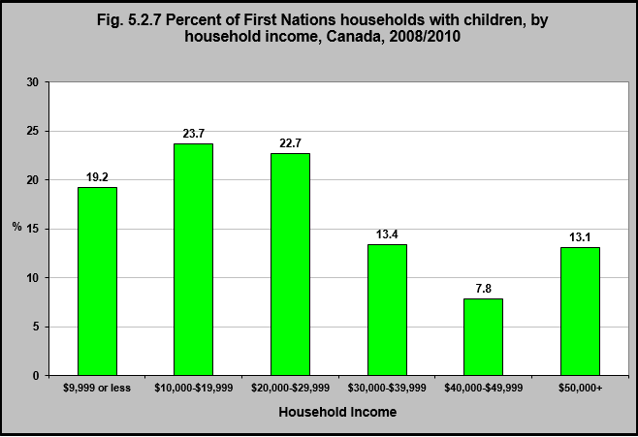
Notes:
Summary
In 2008/2010, 42.9% of First Nations children lived in households with incomes of less than $20,000.
In 2013/2015, according to the First Nations Regional Early Childhood, Education and Employment Survey, the number of First Nations children living in households with incomes less than $20,000 was slightly lower at 39.2%.¹
Implications
When children live in conditions of chronic poverty, they are more likely to have cognitive and social-emotional deficits (which impacts school success and academic trajectories); poorer health outcomes related to nutritional deficiencies or inadequacies; higher rates of unintentional injuries and related deaths; as well as higher rates of mental health and substance abuse issues as adults.
¹First Nations Information Governance Centre, Our Data, Our Stories, Our Future: The National Report of the First Nations Regional Early Childhood, Education and Employment Survey. 2016. http://fnigc.ca/sites/default/files/docs/fnigc_fnreees_national_report_2016_en_final_28072016_0.pdf-accessed August 25, 2017.
Source: CICH graphic created using data adapted from the First Nations Regional Longitudinal Health Survey (RHS) 2008/10, National report on adults, youth and children living in First Nations Communities. https://fnigc.ca/sites/default/files/docs/first_nations_regional_health_survey_rhs_2008-10_-_national_report.pdf -accessed August 15, 2017.

Slide 29
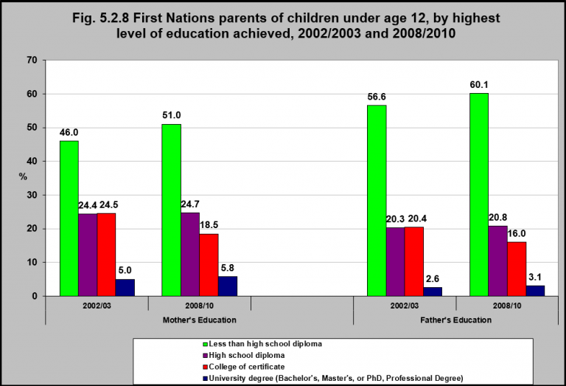
Notes:
Summary
In 2008/2010, 51% of First Nations mothers of children under 12 years of age had less than a high school diploma, compared with 46% in 2002/03.
That was the case for 57% and 60% of fathers respectively.
In 2008/2010, one quarter of mothers and about 20% of fathers had a high school diploma – unchanged since 2002/03.
In 2008/2010, one quarter of mothers and about 20% of fathers had a college or university education.
Implications
Children’s health outcomes are influenced by parental educational attainment, with low levels of education being associated with poorer health outcomes.¹ Education produces benefits such as increased earnings, greater social supports, and the development of skills and traits associated with resilience and success in later life.¹ It thus affects the ability to find gainful employment and acquire resources important to health such as food, stable housing, transportation, and health care.
¹Zimmerman, E.B., Woolf, S.H., & Haley, A. (2015). Understanding the relationship between education and health: Review of the evidence and an examination of community perspectives. Population health: Behavioral and social science insights. Rockville, MD: Agency for Healthcare Research and Quality. https://www.ahrq.gov/professionals/education/curriculum-tools/population-health/zimmerman.html -accessed September 12, 2017.
Source: CICH graphic created using data adapted from the First Nations Regional Longitudinal Health Survey (RHS) 2008/10, National report on adults, youth and children living in First Nations Communities. https://fnigc.ca/sites/default/files/docs/first_nations_regional_health_survey_rhs_2008-10_-_national_report.pdf -accessed August 15, 2017.

Slide 30
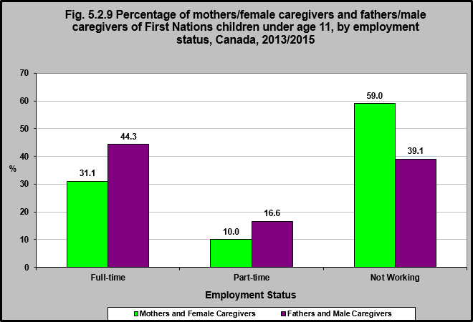
Notes:
Summary
In 2013/2015, 41.1% of mothers/female caregivers and 60.9% of fathers/male caregivers of First nations children under age 11 were employed full-time or part-time.
59% of mothers/female caregivers and 39.1% of fathers/male caregivers were not working.
Of those not working, 73.6% of mothers/female caregivers were stay at home parents, 9.7% were looking for work, 9.2% were students and 2% were on maternity leave.¹
For fathers/male caregivers, 39% were stay at home parents, 30.1% were looking for work and 12.2% indicated they work seasonally.¹
Implications
Mothers/female caregivers are most often the primary caregiver for children and are more likely to choose to be unemployed or employed in only a part-time capacity due to their child care responsibilities. In this context, the low rates of full-time employment and lack of employment opportunities for First Nations fathers/male caregivers is particularly concerning for the health and well-being of First Nations families, as lack of employment is associated with poverty, food insecurity, and mental health issues.
¹First Nations Information Governance Centre, Our Data, Our Stories, Our Future: The National Report of the First Nations Regional Early Childhood, Education and Employment Survey. 2016. http://fnigc.ca/sites/default/files/docs/fnigc_fnreees_national_report_2016_en_final_28072016_0.pdf-accessed August 25, 2017.
PREVIOUS
Source: CICH graphic created using data adapted from First Nations Information Governance Centre, Our Data, Our Stories, Our Future: The National Report of the First Nations Regional Early Childhood, Education and Employment Survey. 2016. http://fnigc.ca/sites/default/files/docs/fnigc_fnreees_national_report_2016_en_final_28072016_0.pdf -accessed August 25, 2017.

Slide 31
Section 5.3: Healthy Eating and Food Security

Slide 32
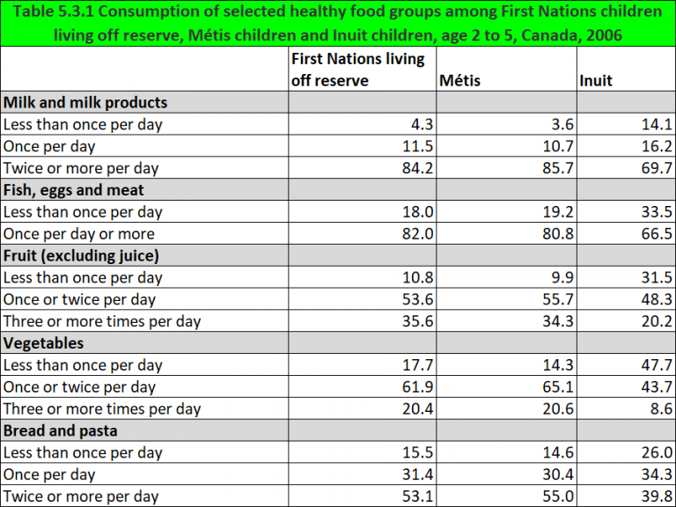
Notes:
Summary
Health Canada recommends Indigenous children aged 2 to 3 consume the following: fresh, canned or frozen fruit and vegetables 4 times a day; grain products three times a day; meat or meat alternatives once a day; and milk or milk alternatives twice a day.¹
In 2006, over 80% of First Nations children living off reserve and Métis children aged 2 to 5 consumed 2 or more milk products and at least one meat product per day which meets the guidelines. This was less (just under 70%) for Inuit children.
In 2006, over 60% of First Nations children living off reserve and Métis children aged 2 to 5 consumed at least one vegetable per day and over 50% consumed at least one fruit product per day.
This was slightly less for Inuit children with 48.3% consuming fruit and 43.7% consuming vegetables daily.
Just over 20% of First Nations children living off reserve and Métis children and 8.6% of Inuit children ate 3 or more vegetables per day.
Implications
Poverty is related to food insecurity. Low-income households often do not have enough money to pay for basic living expenses and it is often the purchase of healthy, nutritious foods that must be sacrificed in order to make ends meet.² As a result, low-income households are more likely to eat lower cost but less nutritious processed foods and less likely to eat the recommended servings of healthy nutritious foods. The prevalence of food insecurity is very high in Indigenous communities, especially in northern and remote communities where accessing healthy foods can be challenging and costly.³ As a result, they may experience a number of nutritional deficiencies, with impacts on their development.
¹Eating Well with Canada’s Food Guide – First Nations, Inuit and Métis. Health Canada 2007. https://www.canada.ca/en/health-canada/services/food-nutrition/reports-publications/eating-well-canada-food-guide-first-nations-inuit-metis.html-accessed August 10, 2017.
²Heart and Stroke Foundation. (2017). Position statement – Access to affordable, healthy and nutritious food (“food security”). http://www.heartandstroke.ca/-/media/pdf-files/canada/2017-position-statements/accessto-affordablehealthy-nutritiousfoods-ps-eng.ashx?la=en -accessed September 12, 2017. ³Egeland, G.M., Pacey, A., & Sobol, I. (2010). Food insecurity among Inuit preschoolers: Nunavut Inuit Child Health Survey, 2007-2008. Canadian Medical Association Journal, 182(3), 243-248. Tarasuk, V., Mitchell, A., & Dachner, N. (2016). Household food insecurity in Canada, 2014. Toronto, ON: Research to Identify Policy Options to Reduce Food Insecurity (PROOF).
Source: CICH graphic created using data adapted from Statistics Canada. 2006 Aboriginal Children’s Survey. http://www.statcan.gc.ca/pub/82-003-x/2013004/article/11776-eng.htm -accessed August 22, 2017.

Slide 33
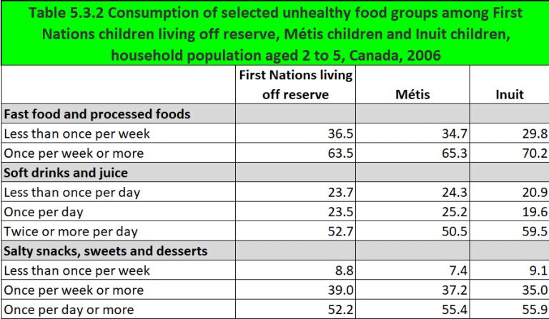
Notes:
Summary
In 2006, over 60% of First Nations children living off reserve, Métis children and Inuit children aged 2 to 5 ate fast or processed food once a week or more.
Soft drinks and/or juice were consumed by over 50% of First Nations children living off reserve, Métis children and Inuit children aged 2 to 5, twice or more per day. Twice or more is over double the once a day consumption rate.
Over 50% of Inuit, First Nations children living off reserve and Métis children aged 2 to 5 ate salty snacks, sweets and desserts daily.
Implications
Young Indigenous children consume a high proportion of unhealthy and processed foods, soft drinks and juices, and salty snacks and sweet desserts. These foods can often be obtained at a lower cost than healthy foods. Access to healthy foods is important for preventing childhood obesity, which can lead to numerous health consequences in childhood and later in life, including diabetes and cardiovascular diseases. While no comprehensive assessments of obesity in Indigenous preschoolers exist, evidence from several studies indicates that rates are high.¹
¹See for example, Willows, N.D., Johnson, M.S., & Ball, G.D.C. (2007). Prevalence estimates of overweight and obesity in Cree preschool children in northern Quebec according to international and US reference criteria. American Journal of Public Health, 92(2), 311-316; First Nations Information Governance Centre (FNIGC) (2012). First Nations Regional Health Survey (RHS) 2008/10: National report on adults, youth and children living in First Nations communities. Ottawa: FNIGC.
Source: CICH graphic created using data adapted from Statistics Canada. 2006 Aboriginal Children’s Survey. http://www.statcan.gc.ca/pub/82-003-x/2013004/article/11776-eng.htm -accessed August 22, 2017.

Slide 34
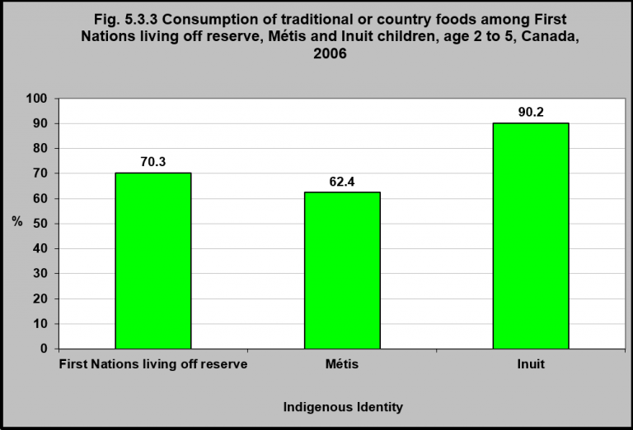
Notes:
Summary
In 2006, traditional or country foods were consumed by First Nations children living off reserve (70.3%), Métis children (62.4%) and Inuit children (90.2%) aged 2 to 5.
Fish and large game animals were consumed most frequently.¹
Implications
Traditional or country foods are an important source of nutrients for Indigenous peoples and obtaining them provides physical activity, an active lifestyle and has socio-cultural benefits. While no comprehensive assessments of nutrient intake have been undertaken with Indigenous children, several studies have found that children who consume high quantities of traditional or country foods have fewer nutritional deficiencies than those who do not.² Traditional or country food consumption, including plant-based foods such as berries, should be encouraged as part of a healthy diet for Indigenous children.
¹Statistics Canada. 2006 Aboriginal Children’s Survey. http://www.statcan.gc.ca/pub/82-003-x/2013004/article/11776-eng.htm-accessed August 22, 2017.
²See for example, Johnson-Down, L., & Egeland, G.M. (2010). Adequate nutrient intakes are associated with traditional food consumption in Nunavut Inuit children aged 3-5 years. Journal of Nutrition, 140(7), 1311-6; Gagné, D., Blanchet, R., Lauzière, J., Vaissière, E., Vézina, C., Ayotte, P., Déry, S., Turgeon O’Brien, H. (2012). Traditional food consumption is associated with higher nutrient intakes in Inuit children attending childcare centres in Nunavik. International Journal of Circumpolar Health, 71: 10.3402/ijch.v72i0.18401
Source: CICH graphic created using data adapted from Statistics Canada. 2006 Aboriginal Children’s Survey. http://www.statcan.gc.ca/pub/82-003-x/2013004/article/11776-eng.htm -accessed August 22, 2017.

Slide 35
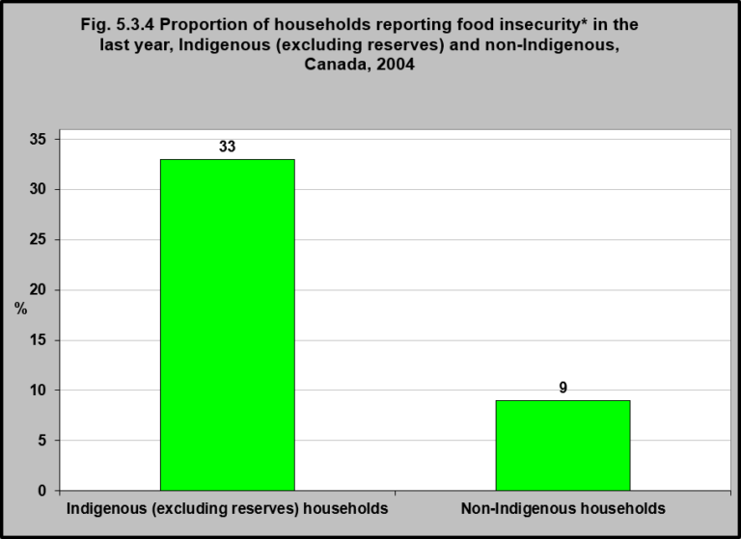
Notes:
Summary
In 2004, according to data from the Canadian Community Health Survey, 33% of Indigenous households (excluding those on reserves) were food insecure compared to 9% of non-Indigenous households.
Implications
The prevalence of food insecurity is high among Indigenous households (excluding those on reserves), with rates of more than 3 times that of non-Indigenous households.¹ Indigenous households'(excluding those on reserve) have a higher prevalence of socio-demographic risk factors for household food insecurity such as poverty. Household food insecurity is associated with poorer health outcomes including, high stress, anxiety and cigarette smoking, which can have impacts on children’s health and well-being.¹
¹Willows, N., Veugelers, P., Raine, K., & Kuhle, S. (2011). Associations between household food insecurity ad health outcomes in the Aboriginal population (excluding reserves). Health Reports, 22(2), 15-20.
Notes: *Food insecurity exists within a household when one or more members do not have access to the variety or quantity of food that they need due to lack of money.¹ ¹Statistics Canada Catalogue no. 82-624-X. Food insecurity in Canada. 2015. http://www.statcan.gc.ca/pub/82-624-x/2015001/article/14138-eng.pdf -July 28, 2017.
Source: CICH graphic created using data adapted from Willows ND, Veugelers P, Raine K, Kuhle S. Prevalence and socio demographic risk factors related to household food security in Aboriginal peoples in Canada. Public Health Nutrition. 12(8): 1150-1156 using data from Statistics Canada, Canadian Community Health Survey, Cycle 2.2, Nutrition (2004). https://www.cambridge.org/core/services/aop-cambridge-core/content/view/056403E64C5D4CA0FAFDAA6017EA752A/S1368980008004345a.pdf/div-class-title-prevalence-and-sociodemographic-risk-factors-related-to-household-food-security-in-aboriginal-peoples-in-canada-div.pdf -accessed July 28, 2017.

Slide 36
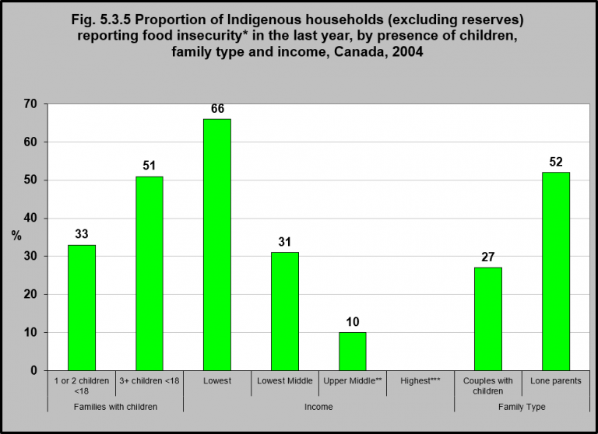
Notes:
Summary
In 2004, according to data from the Canadian Community Health Survey, 66% of Indigenous households in the lowest income group had food insecurity, as did 52% of lone parent households and 51% of households with 3 or more children under 18.
Implications
As food insecurity is associated with poverty and low income, any circumstances that increases the risk of poverty will contribute to food insecurity. In particular, lone parent households, especially those headed by women, are more likely to be low-income and depend on social assistance.³ Likewise, the number of children in the household can also impact food security, especially in lone-parent situations whereby caregiving responsibilities may take wage earners fully or partially out of the labour force or when there are the added costs of out-of-home care that must be paid to enable caregivers to earn a living wage. Indigenous families are more likely than non-Indigenous families to be lone parent families (which are primarily led by women), and due to higher fertility rates for Indigenous women⁴, children comprise a greater proportion of the Indigenous population as compared to the general Canadian population.⁵ These factors are contributing to increased risk of food insecurity in Indigenous families.
¹Statistics Canada Catalogue no. 82-624-X. Food insecurity in Canada. 2015. http://www.statcan.gc.ca/pub/82-624-x/2015001/article/14138-eng.pdf – accessed May 21, 2017. ²Statistics Canada. Canadian Community Health Survey, Cycle 2.2, Nutrition (2004): Income-Related Household Food Security in Canada. https://www.canada.ca/en/health-canada/services/food-nutrition/food-nutrition-surveillance/health-nutrition-surveys/canadian-community-health-survey-cchs/canadian-community-health-survey-cycle-2-2-nutrition-2004-income-related-household-food-security-canada-health-canada-2007.html?=undefined&wbdisable=true -accessed November 12, 2017.
³Che, J., & Chen, J. (2001). Food insecurity in Canadian households. Health Reports, 12(4), 11-22. ⁴Arriagada, P. (2016). First Nations, Inuit and Métis women. Ottawa, ON: Statistics Canada, Catalogue #89-503-X. ⁵Kelly-Scott, K., & Smith, K. (2015). Aboriginal peoples: Fact sheet for Canada. Ottawa, ON: Statistics Canada, Catalogue #89-656-X2015001.
Notes: *Food insecurity exists within a household when one or more members do not have access to the variety or quantity of food that they need due to lack of money.¹
**Use with caution.
***Number too small to report. Household Income Adequacy Categories: Lowest (<$10,000 if 1 to 4 people and <$15,000 if ≥ 5 people); Lower middle ($10,000 to $14,999 if 1 or 2 people, $10,000 to $19,999 if 3 or 4 people and $15,000 to $29,999 if ≥ 5 people); Middle ($15,000 to $29,999 if 1 or 2 people, $20,000 to $39,999 if 3 or 4 people, $30,000 to $59,999 if ≥ 5 people); Upper middle ($30,000 to $59,999 if 1 or 2 people, $40,000 to $79,999 if 3 or 4 people and $60,000 to $79,999 if ≥ 5 people); Highest (≥ $60,000 if 1 or 2 people and ≥ $80,000 if ≥ 3 people)
Source: CICH graphic created using data adapted from Willows ND, Veugelers P, Raine K, Kuhle S. Prevalence and socio demographic risk factors related to household food security in Aboriginal peoples in Canada. Public Health Nutrition. 12(8): 1150-1156 using data from Statistics Canada, Canadian Community Health Survey, Cycle 2.2, Nutrition (2004). https://www.cambridge.org/core/services/aop-cambridge-core/content/view/056403E64C5D4CA0FAFDAA6017EA752A/S1368980008004345a.pdf/div-class-title-prevalence-and-sociodemographic-risk-factors-related-to-household-food-security-in-aboriginal-peoples-in-canada-div.pdf -accessed July 28, 2017.

Slide 37
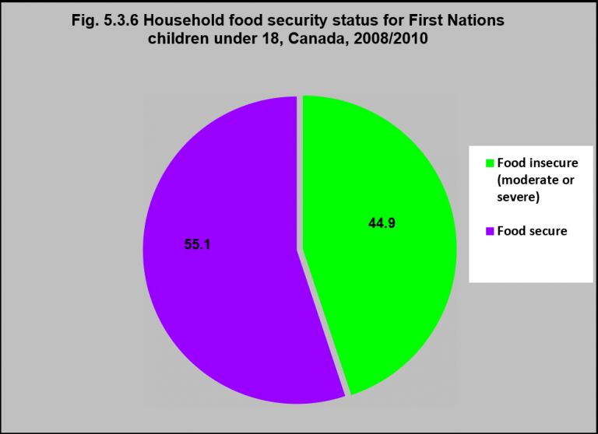
Notes:
Summary
In 2008/10, 45% of First Nations children under age 18 lived in households who were experiencing food insecurity – either moderate or severe.
Notes: *Food insecurity exists within a household when one or more members do not have access to the variety or quantity of food that they need due to lack of money.
Source: First Nations Information Governance Centre (FNIGC) (2012). First Nations Regional Health Survey (RHS) 2008/10: National report on adults, youth and children living in First Nations communities. Ottawa: FNIGC. https://fnigc.ca/sites/default/files/docs/first_nations_regional_health_survey_rhs_2008-10_-_national_report.pdf -accessed November 12, 2017.

Slide 38
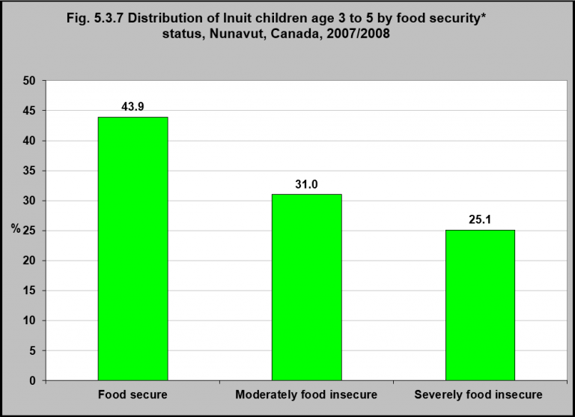
Notes:
Summary
In 2007/2008, 31.0% of Inuit children aged three to five years living in Nunavut communities were moderately food insecure and 25.1% were severely food insecure.
That means that in total, 56.1% – or more than half of the children – were food insecure.
Implications
Rates of food insecurity are highest among Inuit in Inuit Nunangat, at rates almost double that of the national average.¹ While, parents and caregivers will often sacrifice meals for themselves to provide for their children, rates of food insecurity are nevertheless very high for Inuit children. Food insecurity has physiological and nutritional consequences experienced from the early stages of life right through the life course, including anemia, obesity, slower growth rates, and learning and behavioral impacts that will extend into Inuit children’s lives and affect future education.² The consequences of this will be experienced not only by the individual, but by the entire community.
¹Rotem, T. (2016). Beyond hunger: Malnutrition and Inuit children. Feeding Nunavut. http://www.feedingnunavut.com/beyond-hunger-malnutrition-and-inuit-children/ -accessed August 23, 2017. ²See for example, Pirkle, C.M., Lucas, M., Dallaire, R., Ayotte, P., Jacobson, J.L., Jacobson, S.W., Dewailly, E., & Muckle, G. (2014). Food insecurity and nutritional biomarkers in relation to stature in Inuit children from Nunavik. Canadian Journal of Public Health, 105(4), e233-8; Rotem, 2016; and Expert Panel on the State of Knowledge of Food Security in Northern Canada. (2014). Aboriginal food security in northern Canada: An assessment of the state of knowledge. Ottawa, ON: The Council of Canadian Academies. http://www.scienceadvice.ca/uploads/eng/assessments%20and%20publications%20and%20news%20releases/food%20security/foodsecurity_fullreporten.pdf -accessed September 12, 2017.
Note: *Food security is a condition in which all people, at all times, have physical and economic access to sufficient, safe and nutritious food to meet their dietary needs and food preferences for an active and healthy life.
Source: CICH graphic created using data adapted from Egeland GM, Pacey A, Cao Z and Sobol I. Food insecurity among Inuit preschoolers: Nunavut Inuit Child Health Survey, 2007–2008. CMAJ February 23, 2010 vol. 182 no. 3. http://www.cmaj.ca/content/182/3/243.full -accessed July 17, 2017.

Slide 39
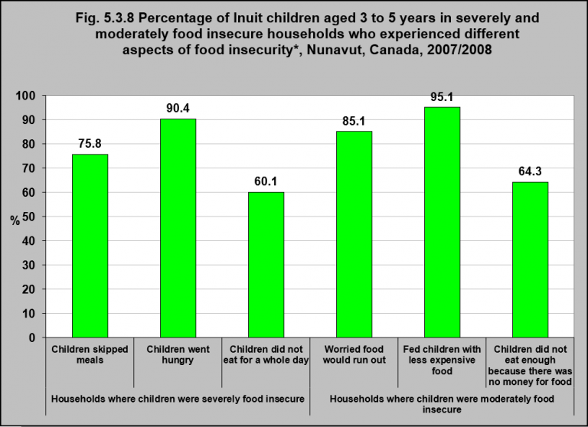
Notes:
Summary
In 2007/2008, 25.1% of Inuit children aged three to five years living in Nunavut were severely food insecure and 31% were moderately food insecure.¹
In households where children were severely food insecure, 90.4% of the children went hungry; 75.8% of the children skipped meals; and 60.1% of the children did not eat for a whole day in the previous year.
In households where children were moderately food insecure, 85.1% of the children’s primary caregiver worried that the food would run out; 95.1% fed their children with less expensive food; and 64.3% of the children did not eat enough because there was no money for food in the previous year.
Implications
Food insecurity can be experienced in a variety of ways, from skipping meals, to substituting healthy foods with lower cost and less nutritional foods, to going hungry. The majority of Inuit children aged 3 to 5 in food insecure households have experienced all of these aspects of food insecurity as shown in the figure.
¹Egeland GM, Pacey A, Cao Z and Sobol I. Food insecurity among Inuit preschoolers: Nunavut Inuit Child Health Survey, 2007–2008. CMAJ February 23, 2010 vol. 182 no. 3. http://www.cmaj.ca/content/182/3/243.full -accessed November 17, 2017.
Note: *Food security is a condition in which all people, at all times, have physical and economic access to sufficient, safe and nutritious food to meet their dietary needs and food preferences for an active and healthy life.
Source: CICH graphic created using data adapted from Egeland GM, Pacey A, Cao Z and Sobol I. Food insecurity among Inuit preschoolers: Nunavut Inuit Child Health Survey, 2007–2008. CMAJ February 23, 2010 vol. 182 no. 3. http://www.cmaj.ca/content/182/3/243.full -accessed July 17, 2017.

Slide 40
Notes:
Summary
Limited access to healthy foods and the high cost of food in northern and remote communities contribute to food insecurity in Inuit families. As a way to help promote healthy food choices, traditional/country foods and physical activity, the Arviat Wellness Centre, Nunavut Arctic College, Canadian Institute of Child Health (CICH) and numerous Inuit partners have partnered to create a series of fun storybooks for young children. All six storybooks are available on line.
Their titles are:
These engaging tri-lingual story books (English, French and Inuktitut) feature the following Inuit Super Heroes:
Meateater Man is strong and healthy. His strength comes from the meat in his diet because protein builds good muscles. A traditional Inuit diet consists mostly of meat and animal fats. With this diet, Inuit live long healthy lives.
Crunchy Carrot reminds us that to crunch is best and that snacking on crunchy things like carrots, celery, broccoli, cauliflower, peppers, pears, apples and berries is fun and healthy.
King Caribou teaches that protein is what builds muscle and helps us grow. Protein also makes our blood strong and helps us fight sickness. Without protein your body cannot work as well.
Stretchy Cheese is a flexible friend who teaches us how milk, yoghurt and cheese give you strong teeth and bones.
Water Woman is clear and fresh, fast and always flowing! What a beautiful super hero! She encourages us to drink water to help our body be like hers.
The storybooks are an educational and fun resource for early childhood educators, teachers and parents.

Slide 41
Section 5.4: Housing

Slide 42
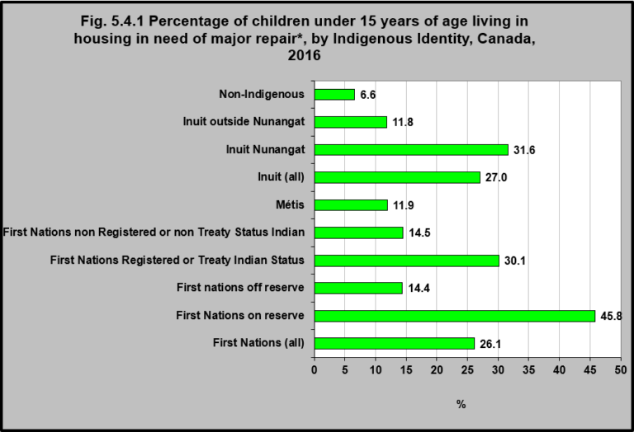
Notes:
Summary
In 2016, 26.1% of First Nations children under 15 lived in housing in need of major repair. That was the case for 11.9% of Métis children under 15 and 27.0% of Inuit children under 15.
First Nations children living on reserve were more likely to live in housing in need of major repair (45.8%) than were First Nations children living off reserve (14.4%)
First Nations children with Registered or Treaty Indian Status were more likely to live in housing in need of major repair (30.1%) than were those without status (14.5%).
Inuit children living in Inuit Nunangat were more likely to live in housing in need of major repair (31.6%) than were those living outside Nunangat (11.8%).
Non-Indigenous children under age 15 were the least likely to live in housing in need of major repair (6.6%).
Implications
The quality of housing, including access to clean running water, waste water disposal, ventilation, heating, electricity and the safety of the housing structure, is a major determinant of health.¹ Indigenous people, especially First Nations on reserve and Inuit, are more likely than the general Canadian population to be living in a home that needs major repair.² This has been linked to poorer health outcomes in Indigenous communities, especially among Indigenous children. Research has shown that poor quality housing has contributed to higher rates of respiratory infections, skin disease, parasites and nutritional disease in Indigenous children,³ as well as injuries.⁴
¹National Collaborating Centre for Aboriginal Health. (2016). Housing as a determinant of First Nations, Inuit and Métis health. Prince George, BC: Author. ²Statistics Canada. (2015). Aboriginal Statistics at a Glance, 2nd Edition. Ottawa, ON: Author. Retrieved September 22, 2017 from http://www.statcan.gc.ca/pub/89-645-x/89-645-x2015001-eng.pdf ³OHTN Rapid Response Service. (2011). Review: Impact of housing status and supportive housing on the health of Aboriginal people. Toronto, ON: Ontario HIV Treatment Network. ⁴George, M.A., Brussoni, M., Jin, A., Lalonde, C.E., & McCormick, R. (2016). Ecological analyses of the associations between injury risk and socioeconomic status, geography and Aboriginal ethnicity in British Columbia, Canada. Springer Open, 5, 567, DOI: 10.1186/s40064-016-2262-x; Kohen, D.E., Bougie, E., & Guèvremont, A. (2015). Housing and health among Inuit children. Health Reports, 26(11), 21-27.
Notes: *Major repairs needed includes dwellings needing major repairs such as dwellings with defective plumbing or electrical wiring and dwellings needing structural repairs to walls, floors or ceilings.
Excludes census data for one or more incompletely enumerated Indian reserves or Indian settlements. Users should be aware that the estimates associated with this variable are more affected than most by the incomplete enumeration of certain Indian reserves and Indian settlements in the Census of Population. For more information on Indigenous variables, including information on their classifications, the questions from which they are derived, data quality and their comparability with other sources of data, please refer to the Aboriginal Peoples Reference Guide, Census of Population, 2016 and the Aboriginal Peoples Technical Report, Census of Population, 2016. Residence on or off reserve refers to whether the person’s usual place of residence is in a census subdivision (CSD) that is defined as ‘on reserve’ or ‘off reserve.’ Indigenous identity’ includes persons who are First Nations (North American Indian), Métis or Inuk (Inuit) and/or those who are Registered or Treaty Indians (that is, registered under the Indian Act of Canada) and/or those who have membership in a First Nation or Indian band. Indigenous peoples of Canada are defined in the Constitution Act, 1982, section 35 (2) as including the Indian, Inuit and Métis peoples of Canada.
Source: Statistics Canada – 2016 Census. Catalogue Number 98-400-X2016164. http://www12.statcan.gc.ca/census-recensement/2016/dp-pd/dt-td/Rp-eng.cfm?TABID=2&LANG=E&A=R&APATH=3&DETAIL=0&DIM=0&FL=A&FREE=0&GC=01&GL=-1&GID=1341679&GK=1&GRP=1&O=D&PID=110519&PRID=10&PTYPE=109445&S=0&SHOWALL=0&SUB=0&Temporal=2017&THEME=122&VID=0&VNAMEE=&VNAMEF=&D1=0&D2=0&D3=1&D4=0&D5=0&D6=0 -accessed December 23, 2017.

Slide 43
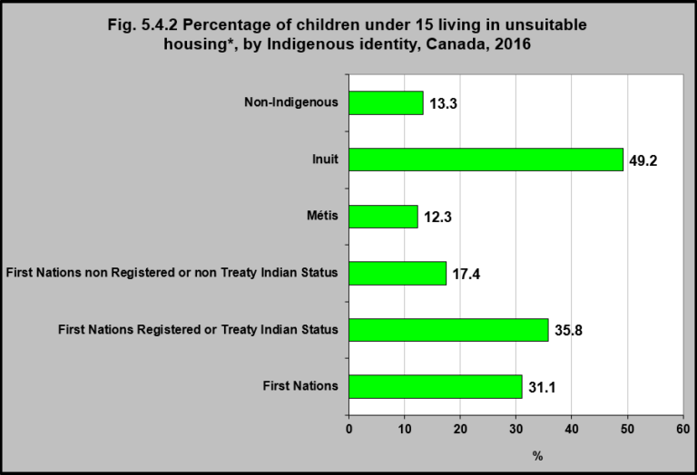
Notes:
Summary
In 2016, 31.1% of First Nations children under age 15 were living in housing that was considered to be unsuitable – that is, it did not have enough bedrooms for the size and composition of the household.
That was more likely to be the case among First Nations children under age 15 who had Registered or Treaty Indian Status (35.8%) than those who did not (17.4%).
Forty-nine percent of Inuit children under age 15 lived in unsuitable housing, as did 12.3% of Métis children under age 15 and 13.3% of non-Indigenous children under age 15.
Implications
Overcrowding is a major determinant of health for Indigenous peoples in Canada and is associated with poorer health outcomes, especially for Indigenous children.¹ It has been linked to the spread of infectious diseases like tuberculosis, food insecurity, as well as poorer mental health, well-being, educational, and other child development outcomes. Overcrowding is particularly prevalent among Inuit, who are more than three times more likely than the general population to live in overcrowded conditions.
¹See for example, Ruiz-Castell, M., Muckle, G., Dewailly, E., Jacobson, J.L., Jacobson, S.W.,Ayotte, P., & Riva, M. (2015). Household crowding and food insecurity among Inuit families with school-aged children in the Canadian Arctic. American Journal of Public Health, 105(3), e122-e132; Bourchard, F. (2017). Putting health into housing: Where we live matters. Nunavik Regional Board of Health and Social Services. https://www.ourcommons.ca/Content/Committee/421/HUMA/Brief/BR8828962/br-external/NunavikRegionalBoardOfHealthAndSocialServices-e.pdf -accessed September 23, 2017.
Notes: *Dwellings are considered as ‘unsuitable’ if the dwelling does not have enough bedrooms for the size and composition of the household. Excludes census data for one or more incompletely enumerated Indian reserves or Indian settlements. Users should be aware that the estimates associated with this variable are more affected than most by the incomplete enumeration of certain Indian reserves and Indian settlements in the Census of Population. For more information on Indigenous variables, including information on their classifications, the questions from which they are derived, data quality and their comparability with other sources of data, please refer to the Aboriginal Peoples Reference Guide, Census of Population, 2016 and the Aboriginal Peoples Technical Report, Census of Population, 2016. Residence on or off reserve refers to whether the person’s usual place of residence is in a census subdivision (CSD) that is defined as ‘on reserve’ or ‘off reserve.’ Indigenous identity’ includes persons who are First Nations (North American Indian), Métis or Inuit and/or those who are Registered or Treaty Indians (that is, registered under the Indian Act of Canada) and/or those who have membership in a First Nation or Indian band. Indigenous peoples of Canada are defined in the Constitution Act, 1982, section 35 (2) as including the Indian, Inuit and Métis peoples of Canada.
Source: Statistics Canada – 2016 Census. Catalogue Number 98-400-X2016165. http://www12.statcan.gc.ca/census-recensement/2016/dp-pd/dt-td/Rp-eng.cfm?TABID=2&LANG=E&A=R&APATH=3&DETAIL=0&DIM=0&FL=A&FREE=0&GC=01&GL=-1&GID=1341679&GK=1&GRP=1&O=D&PID=110520&PRID=10&PTYPE=109445&S=0&SHOWALL=0&SUB=0&Temporal=2017&THEME=122&VID=0&VNAMEE=&VNAMEF=&D1=1&D2=0&D3=1&D4=0&D5=0&D6=0 -accessed December 23, 2017.

Slide 44
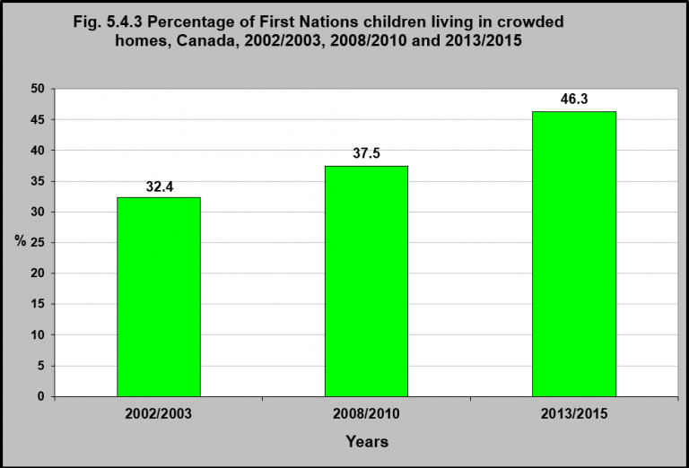
Notes:
Summary
In 2013/2015, according to the First Nations Regional Early Childhood, Education and Employment Survey, 46.3% of First Nations children were living in crowded homes¹ – that is homes having more than one person per habitable room.²
This was up from 37.5% in 2008/2010 and 32.4% in 2002/2003, according to the First Nations Regional Longitudinal Health Survey.
First Nations households had an average of 5.7 persons (2.4 adults and 3.4 children and youth).³
First Nations households with children had almost three times as many children as households in the general Canadian population – 3.2 vs. 1.1.⁴
Implications
It has been recognized for decades that the state of housing in First Nations reserves has been poor. Despite this recognition, and numerous initiatives to improve the quantity, quality and affordability of First Nations housing, the proportion of First Nations children living in overcrowded housing conditions has been steadily increasing. This is placing many First Nations children at risk of poorer health outcomes, including respiratory illnesses, injuries, poorer mental health and well-being, and developmental delays.
¹First Nations Information Governance Centre, Our Data, Our Stories, Our Future: The National Report of the First Nations Regional Early Childhood, Education and Employment Survey. 2016. http://fnigc.ca/sites/default/files/docs/fnigc_fnreees_national_report_2016_en_final_28072016_0.pdf-accessed August 25, 2017. ²Statistics Canada. 2006 Census: Aboriginal Peoples in Canada in 2006: Inuit, Metis and First Nations. http://www12.statcan.ca/census-recensement/2006/as-sa/97-558/note-eng.cfm-accessed August 22, 2017. ³Jackson, A., & Roberts, P. (2001). Physical housing conditions and the well being of children. Ottawa: Canadian Council on Social Development. http://www.peelearlyyears.com/pdf/Physical%20Housing%20Conditions%20and%20the%20Wellbeing%20of%20Children,%20Canada.pdf-accessed August 3, 2017. ⁴Statistics Canada. (2007). Census families by number of children at home, by province and territory (2006 Census). http://www5.statcan.gc.ca/olc-cel/olc.action?objId=97-553-X2006009&objType=46&lang=en&limit=0-accessed June 12, 2017.
Source: CICH graphic created using data adapted from First Nations Information Governance Centre, Our Data, Our Stories, Our Future: The National Report of the First Nations Regional Early Childhood, Education and Employment Survey. 2016. http://fnigc.ca/sites/default/files/docs/fnigc_fnreees_national_report_2016_en_final_28072016_0.pdf -accessed August 25, 2017 and the First Nations Regional Longitudinal Health Survey (RHS) 2008/10, National report on adults, youth and children living in First Nations Communities. https://fnigc.ca/sites/default/files/docs/first_nations_regional_health_survey_rhs_2008-10_-_national_report.pdf -accessed August 2, 2017.

Slide 45
Section 5.5: Community Well-Being

Slide 46
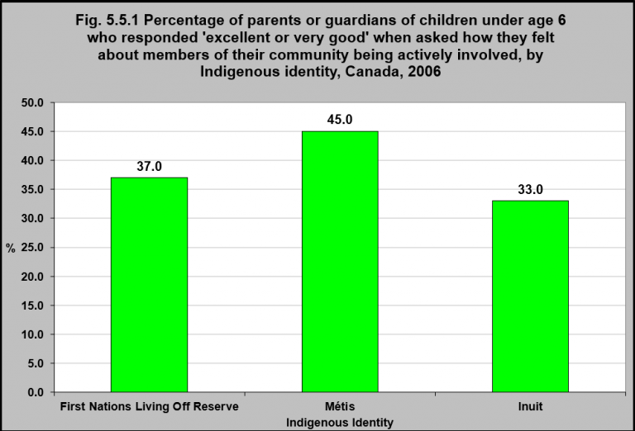
Notes:
Summary
In 2006, under half – 45% – of parents/guardians of Métis children under age 6 answered “Excellent or Very Good”. when asked how they felt about members of their community being actively involved, The proportion was smaller for First Nations living off reserve and Inuit parents/guardians of children under age 6.
Twenty-one percent of parents/guardians of First Nations children under age 6 living off reserve felt “fair or poor” about that question. That was the case for 16% of the Métis and 23% of the Inuit parents/guardians.¹
Implications
Community involvement and citizen engagement is considered key to building capacity to improve community health and well-being.² Building community capacity is especially important in Indigenous communities for re-establishing the self-reliance and self-determination that was lost through colonial policies and practices. Community involvement and citizen engagement can strengthen collective identity and enhance a sense of belonging which contributes to the health and well-being of communities. It also builds the skills and facilitates access to the resources that are necessary for communities to be able to move forward in improving local conditions. Active involvement in the community allows communities to build on local strengths, including culture, to manage their own services and develop programs that are better able to respond to community needs.
¹Statistics Canada, Aboriginal Children’s Survey, 2006. http://www.statcan.gc.ca/pub/89-634-x/89-634-x2008005-eng.htm-accessed August 2, 2017.
²Ontario Health Communities Coalition. (n.d.). The healthy communities approach: A framework for action on the determinants of health. http://www.ohcc-ccso.ca/en/webfm_send/550 -accessed September 23, 2017.
Source: CICH graphic created using data adapted from Statistics Canada, Aboriginal Children’s Survey, 2006. http://www.statcan.gc.ca/pub/89-634-x/89-634-x2008005-eng.htm -accessed August 2, 2017.

Slide 47
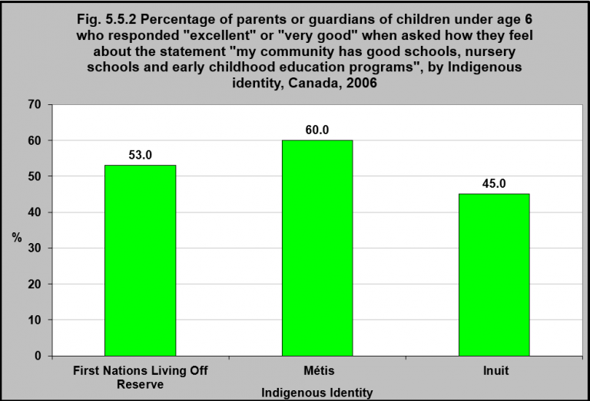
Notes:
Summary
In 2006, under half – 45% – of parents/guardians of Inuit children under age 6, responded ‘excellent’ or ‘very good’, when asked how they felt about the statement “My community has good schools, nursery schools and ECE programs”.
The percentage was greater for parents/guardians of First Nations children under age 6 living off reserve and parents/guardians of Métis children under age 6.
Implications
Early childhood education (ECE) is critically important for the emotional, social and physical development of young children which sets the foundations for well-being throughout the life course. Children’s early experiences, including the bonds they build with their parents and early learning, have life long impacts on learning, behavior, and physical and mental health.¹ Many Indigenous children experience multiple forms of adversity, and early interventions are more successful in preventing the consequences of this adversity than later life interventions.¹ However, many Indigenous children do not have access to quality early childhood development programs. For Indigenous peoples, quality ECE programs foster positive cultural identity, address differences in learning styles, and take into account Indigenous values and beliefs. Key components of such programs have been identified as ones which: 1) support Indigenous pedagogy; 2) promote Indigenous languages and culture; 3) are adequately staffed by qualified Indigenous educators; 4) empower Indigenous parents and communities; and 5) for kindergarten services, provide a full-day timetable.²
¹Shonkoff, J.P., & Richmond, J.B. (2009). Investment in early childhood development lays the foundation for a prosperous and sustainable society. ²Preston, J. (2014). Early childhood education and care for Aboriginal children in Canada. Moving Childcare Forward Project. Toronto,ON: A joint initiative of the Childcare Resource and Research Unit, Centre for Work, Families and Well-being at the University of Guelph, and the Department of Sociology at the University of Manitoba. Retrieved September 22, 2017 from https://movingchildcareforward.ca/images/policybriefs/MCCF_aboriginal_childcare_canada.pdf
Source: CICH graphic created using data adapted from Statistics Canada, Aboriginal Children’s Survey, 2006. http://www.statcan.gc.ca/pub/89-634-x/89-634-x2008005-eng.htm -accessed August 2, 2017.

Slide 48
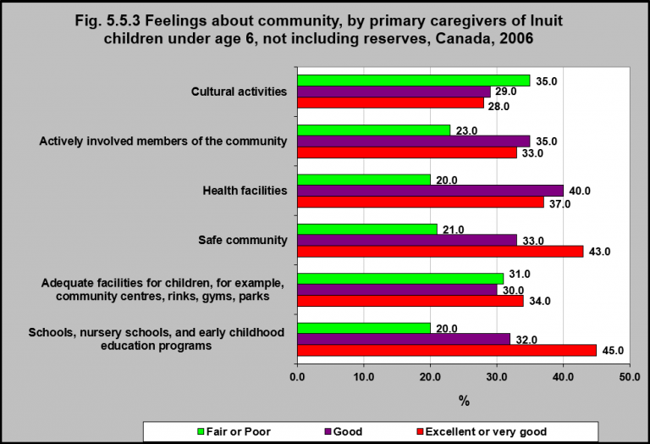
Notes:
Summary
In 2006, when asked their feelings about their community, 45% of primary caregivers of children under 6 years of age felt their schools, nursery schools and early child education (ECE) programs were ‘excellent’ or ‘very good’.
Forty-three percent felt their community safety was ‘excellent’ or ‘very good’ and 37% felt the same way about their health facilities.
Availability of facilities for children such as community centres received an ‘excellent’ or ‘very good’ rating with 34% of primary caregivers feeling this way, while 35% felt cultural activities offered for children under 6 were ‘fair’ or ‘poor’.
Implications
Indigenous communities, especially in rural and remote locations, often lack amenities which contribute to the health, wellness, cultural survival and quality of life of individuals and communities. Access to health, physical activity, recreation, cultural, and educational programs and services is essential for promoting health and addressing the social issues that are prevalent in many Indigenous communities. Participation in community programs and activities can contribute to the building of self-esteem and the necessary skills and traits which foster individual and collective resilience.
Notes: Percents may not add up to 100 because responses of ‘don’t know’, ‘refusal’ and ‘not stated’ were included in the calculation of all estimates and rounding. Not stated’ includes ‘not stated’, ‘don’t know’ and ‘refusal’. Questions answered by Person Most Knowledgeable (PMK).
Source: CICH graphic created using data adapted from Statistics Canada, Aboriginal Children’s Survey, 2006. http://www.statcan.gc.ca/pub/89-634-x/2008005/t/6000039-eng.htm -accessed August 22, 2017.

Slide 49
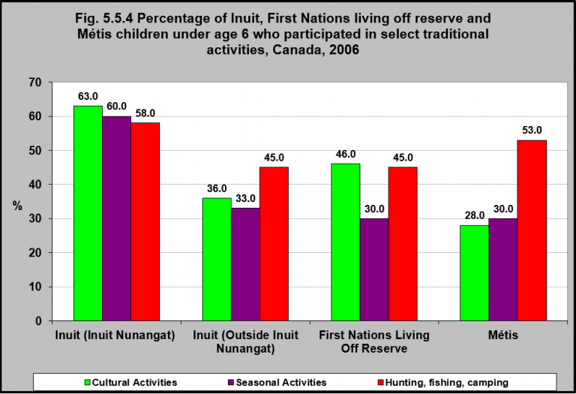
Notes:
Summary
In 2006, Inuit children under the age of 6 living in Inuit Nunangat participated in traditional activities more than First Nations living off reserve and Métis children of the same age. Inuit children under 6 living outside Nunangat, participated in cultural and seasonal activities about half as much as Inuit living in Nunangat.
Métis children under age six were more likely to hunt, fish, tramp or camp compared to First Nations children living off reserve.
First Nations children under 6 living off reserve were almost twice as likely to participate in cultural activities than Métis children of the same age group.
Implications
Research has indicated that strong cultural identity contributes to resilience and is a protective factor for at-risk Indigenous communities.¹ Building a positive cultural identity should begin early in order for children to grow to become healthy and leaders in their community, and to ensure the survival of their culture.² Participation in traditional activities is a cornerstone of building a positive cultural identity.
¹Chandler, M.J., & Lalonde, C. (1998). Cultural continuity as a hedge against suicide in Canada’s First Nations. Transcultural Psychiatry, 35, 191-219; McIvor, O., Napoleon, A., & Dickie, K.M. (2009). Language and culture as protective factors for at-risk communities. Journal of Aboriginal Health, November, 6-25. ²Government of Canada. (2013). Aboriginal children: The healing power of identity. Ottawa, ON: Author. https://www.canada.ca/en/public-health/services/health-promotion/childhood-adolescence/programs-initiatives/aboriginal-head-start-urban-northern-communities-ahsunc/aboriginal-children-healing-power-cultural-identity.html -accessed September 23, 2017.
Notes: Includes those reported taking part in this activity ‘more than once a day’, ‘once a day’, ‘more than once a week’, ‘at least once per month’, ‘at least once per year’, and ‘less than once per year’. Cultural activities: participated in or attend traditional First Nations, Métis or Inuit activities such as singing, drum dancing, fiddling, gatherings or ceremonies. Hunting, fishing, camping: taken part in hunting, fishing, trapping or camping. Seasonal activities: activities such as gathering goose eggs or wild plants for example, berries, sweet grass, roots or wild rice.
Source: CICH graphic created using data adapted from Statistics Canada, Aboriginal Children’s Survey, 2006. http://www.statcan.gc.ca/pub/89-634-x/89-634-x2008001-eng.pdf -accessed August 22, 2017.

Slide 50
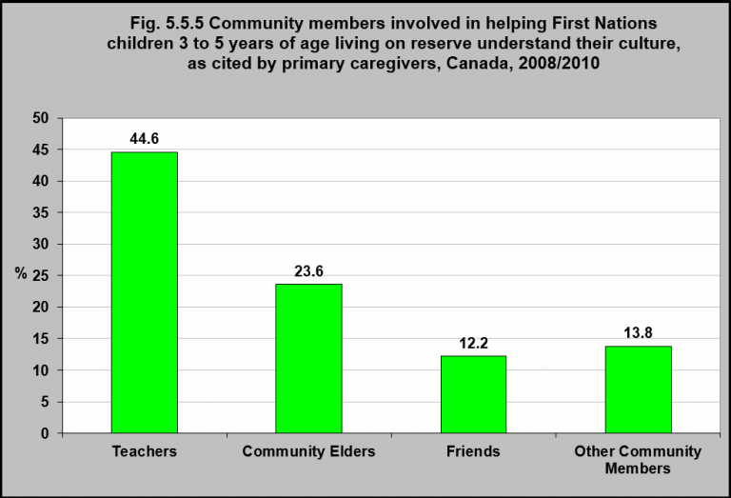
Notes:
Summary
In 2008/2010, over 40% of primary caregivers of First Nations children living on reserve between the ages of 3 to 5 identified teachers as being involved in helping children understand their culture. The involvement of teachers for children 6 to 8 and 9 to 11 was even higher.
Community Elders were also identified as being involved in helping children understand their culture – 23.6% for children 3 to 5 years of age, 29.6% for 6 to 8 years of age, and 26.3% for 9 to 11 years of age.¹
Implications
Building positive culture identity in Indigenous children will require the collective strengths of teachers, families, friends and communities. Each of these entities has the power to exert influence which can contribute to Indigenous children’s risk and resilience.
¹First Nations Regional Longitudinal Health Survey (RHS) 2008/10, National report on adults, youth and children living in First Nations Communities. https://fnigc.ca/sites/default/files/docs/first_nations_regional_health_survey_rhs_2008-10_-_national_report.pdf-accessed August 2, 2017.
Source: CICH graphic created using data adapted from First Nations Regional Longitudinal Health Survey (RHS) 2008/10, National report on adults, youth and children living in First Nations Communities. https://fnigc.ca/sites/default/files/docs/first_nations_regional_health_survey_rhs_2008-10_-_national_report.pdf -accessed August 2, 2017.

Slide 51
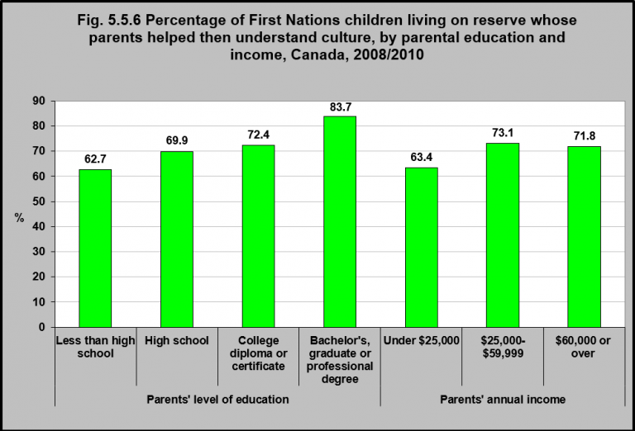
Notes:
Summary
In 2008/10, First Nations children on reserve living with parents who had higher levels of formal education were more likely to have parents who helped them understand their culture, than those living with parents with lower levels of formal education.
Sixty-three percent of children living with parents with less than a high school education had parents who helped them understand their culture, compared to 83.7% of those living with parents with a university degree.
Sixty-three percent of First Nations children on reserve living in households where the parents’ annual income was less than $25,000 had parents who helped them understand their culture.
This compared to 71.8% of children living in households where the parental income was $60,000 or more.
Implications
Culture is an important component of healthy child development. Culture contributes to the development of a sense of identity and belonging, which in turn is important for an individual’s psychological functioning, relationships with their peers, and academic achievement, as well as for the wellness of families and communities.¹ Language is the means by which culture is conveyed and preserved. As primary caregivers, parents play an important role in conveying and preserving culture, especially in the early years of a child’s development. The association between higher levels of parental education and income with a greater transmission of cultural knowledge among First Nations children, highlights the importance of developing strategies aimed at addressing education and employment gaps among First Nations people, as well as strategies to increase cultural education programs for children.
¹Lalonde, C.E. (2006). Identity formation and cultural resilience in Aboriginal communities. In R.J. Flynn, P.M. Dudding, & J.G. Barber (eds.). Promoting resilience in child welfare (Ch. 4).. Ottawa, ON: University of Ottawa Press.
Source: CICH graphic created using data adapted from the First Nations Regional Longitudinal Health Survey (RHS) 2008/10, National report on adults, youth and children living in First Nations Communities. https://fnigc.ca/sites/default/files/docs/first_nations_regional_health_survey_rhs_2008-10_-_national_report.pdf -accessed August 5, 2017.

Slide 52
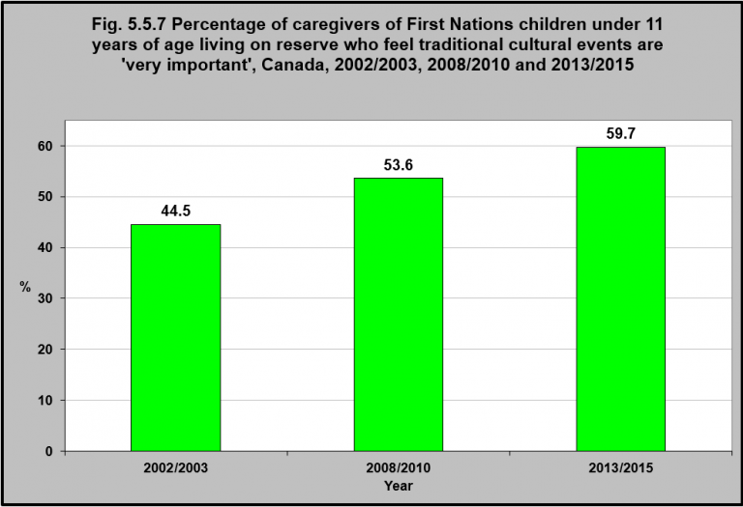
Notes:
Summary
The percentage of caregivers of First Nations children under 11 years of age living on reserve who feel traditional cultural events are ‘very important’ has been increasing.
In 2013/2015, 59.7% of caregivers felt traditional events were ‘very important’, compared to 53.6% in 2008/2010 and 44.5% in 2002/2003.
However, in 2013/2015, only 39.2% of caregivers said they participated at least once a month in cultural activities such as drumming, singing, storytelling and powpows. 60.8% said they participated in these activities less than once a month.¹
Primary caregivers reported that parents (54.6%) and other family members such as grandparents (52.4%) helped children learn about traditional teachings the majority of the time.¹
Implications
Culture is an important component of healthy child development. Culture contributes to the development of a sense of identity and belonging, which is important for an individual’s psychological functioning, relationships with their peers, and academic achievement, as well as for the wellness of families and communities.² One means of maintaining and preserving culture among Indigenous children is by encouraging them to participate in cultural events such as drumming, dancing, singing songs, hearing stories, tasting traditional foods, making crafts, touching nature, learning about plants and animals, and participating in traditional food gathering practices such as fishing, hunting, and berry picking.
¹First Nations Information Governance Centre, Our Data, Our Stories, Our Future: The National Report of the First Nations Regional Early Childhood, Education and Employment Survey. 2016. http://fnigc.ca/sites/default/files/docs/fnigc_fnreees_national_report_2016_en_final_28072016_0.pdf-accessed August 25, 2017.
²Lalonde, C.E. (2006). Identity formation and cultural resilience in Aboriginal communities. In R.J. Flynn, P.M. Dudding, & J.G. Barber (eds.). Promoting resilience in child welfare (Ch. 4).. Ottawa, ON: University of Ottawa Press.
Source: CICH graphic created using data adapted from First Nations Information Governance Centre, Our Data, Our Stories, Our Future: The National Report of the First Nations Regional Early Childhood, Education and Employment Survey. 2016. http://fnigc.ca/sites/default/files/docs/fnigc_fnreees_national_report_2016_en_final_28072016_0.pdf-accessed August 25, 2017.

Slide 53
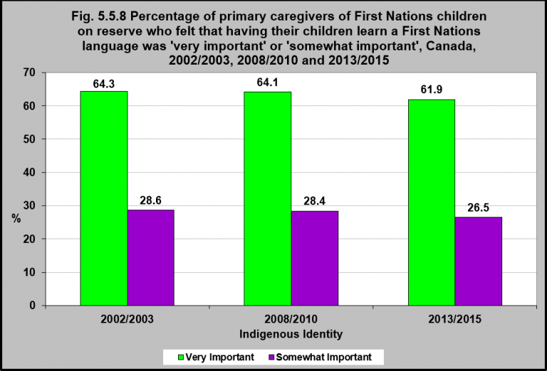
Notes:
Summary
In 2013/2015, 88.4% of primary caregivers of First Nations children living on reserve felt that learning a First Nations language was ‘very important’ or ‘somewhat important’.
This was down slightly from 92.5% in 2008/2010 and 92.9% in 2002/2003.
Implications
Language is one of the means by which culture is conveyed and preserved. Unfortunately, knowledge of Indigenous languages have been declining over the years, whereby only three of over 60 Indigenous languages originally spoken in Canada are expected to survive into the next century.¹ The impact of Residential Schools has had an impact on this decline. In order to preserve Indigenous languages, it is important to support Indigenous children to learn their language. This highlights the importance of the proper conditions for children to learn their language, such as increasing awareness among caregivers of Indigenous children of the importance of their children learning an Indigenous language, having access to an Indigenous language program within school, and having teachers in these programs fluent in the Indigenous language.
¹Assembly of First Nations. (2015). A closer look: Revitalizing Indigenous languages. 2015 Federal election priorities for First Nations and Canada. Ottawa, ON: Author. Retrieved October 7, 2015 from http://www.afn.ca/uploads/files/ctg/15-09-30_a_closer_look_-_indigenous_languages.pdf
Source: CICH graphic created using data adapted from First Nations Information Governance Centre, Our Data, Our Stories, Our Future: The National Report of the First Nations Regional Early Childhood, Education and Employment Survey. 2016. http://fnigc.ca/sites/default/files/docs/fnigc_fnreees_national_report_2016_en_final_28072016_0.pdf -accessed August 25, 2017 and the First Nations Regional Longitudinal Health Survey (RHS) 2008/10, National report on adults, youth and children living in First Nations Communities. https://fnigc.ca/sites/default/files/docs/first_nations_regional_health_survey_rhs_2008-10_-_national_report.pdf -accessed August 15, 2017

Slide 54
Notes:
Summary
Innovation in Language – Tools for Learning Indigenous Languages
In Canada, there are approximately 60 Indigenous languages spoken. Many of these languages have several dialects, particularly when the language is distributed over a large area.¹
According to the 2011 National Household Survey, 240,815 Indigenous people reported that they had knowledge of an Indigenous language.² This was a decrease of about 4.5% since 2006.³ Of those Indigenous people who reported knowledge of an Indigenous language in 2011, 39.4% reported Cree as the most common language spoken. The next most common language spoken was Inuktitut (15.1%).²
Language is a very important part of Indigenous history and culture. As a result, finding ways to increase the number of people speaking Indigenous languages is becoming a focus for Indigenous communities and Canada as a whole.
On December 6, 2016, at the Assembly of First Nations Special Chiefs Assembly, Prime Minister Justin Trudeau announced a plan to implement a new law to protect and preserve Indigenous languages in Canada, saying: “Today, I commit to you that our government will enact an Indigenous Languages Act, co-developed with Indigenous Peoples, with the goal of ensuring the preservation, protection, and revitalization of First Nations, Métis, and Inuit languages in this country.”⁴
Below are a number of helpful websites, videos, apps and tools that have been developed to assist in learning Indigenous languages.
Michif – Métis langauge The Michif Language Project (http://www.michiflanguage.ca/index.html) developed by the Cowichan Valley Métis Association, is a fun web resource with animated videos that focus on learning numbers, colours, food, animals, body parts and names of relatives. There is also a video with syllabic exercises and a language guide.
Métis Nation BC Learn Michif website (http://www.learnmichif.com) is an on-line resource with 4 separate lessons where you can learn greetings, how to speak about your family, the weather and how to order food. There are also videos where you can watch people speaking.
Michif to Go (https://play.google.com/store/apps/details?id=com.emap.michif&hl=) from the Gabriel Dumont Institute, is an English-to-Michif Dictionary app available for Android phones. It has over 11,500 translations and audio pronunciations as well as a search tool to look up the English word to find the Michif-Cree translations.
Michif Lessons (https://itunes.apple.com/ca/app/michif-lessons/id965897763?mt=8) from the Gabriel Dumont Institute, is a downloadable app that contains over 60 exercises to learn over 1000 Michif words.
Cree – First Nations Language Online Cree Dictionary (http://www.creedictionary.com), developed in partnership by the Miyo Wahkohtowin Community Education Authority (MWCEA) and Dr. Earle Waugh Director Center for Culture & Health Family Medicine, University of Alberta (U of A), is a web based interactive First Nations language portal with dictionary and curriculum based resources to further the development for Cree language in Canada. The website and downloadable app provides translation functions, the creation of flash cards and storyboards using pictures and words (syllabics and English), educational games such as word matching and puzzles, and a database of Cree language lesson plans to help teachers integrate Indigenous languages into the curriculum.
Algonquin – First Nations language Learn Algonquin through Flash (http://kzadmin.com/Learningalgonquin.aspx#), developed by the Kitigan Zibi Anishinabeg, is an on-line learning centre that has a series of 20 different scenes with stick figures speaking the language. You can listen to the conversation in English or Algonquin.
Inuktitut- Inuit language Inuktitut Tusaalanga, (http://www.tusaalanga.ca) developed by the Pirurvik Centre, is a website dedicated to helping people learn Inuktitut in a variety of different dialects. Through a series of on-line lessons, learners can see spellings and add words or phrases to a playlist to hear how they should be pronounced. There is also information on grammar and exercises to practice what has been learned.
¹Canadian Encyclopedia. Aboriginal People and Languages http://www.thecanadianencyclopedia.ca/en/article/aboriginal-people-languages accessed August 22, 2017. ²Statistics Canada, 2011 National Household Survey, Statistics Canada and AANDC tabulations. https://www.aadnc-aandc.gc.ca/eng/1377004468898/1377004550980 -accessed August 2, 2017. ³Statistics Canada, 2006 Census of the Population. http://www12.statcan.gc.ca/census-recensement/2006/rt-td/lng-eng.cfm – accessed August 2, 2017. ⁴Justin Trudeau, Prime Minister of Canada, Government of Canada website. http://pm.gc.ca/eng/news/2016/12/06/prime-minister-justin-trudeaus-speech-assembly-first-nations-special-chiefs-assembly – accessed March 7, 2017.

Slide 55
Section 5.6: Family Well-Being

Slide 56
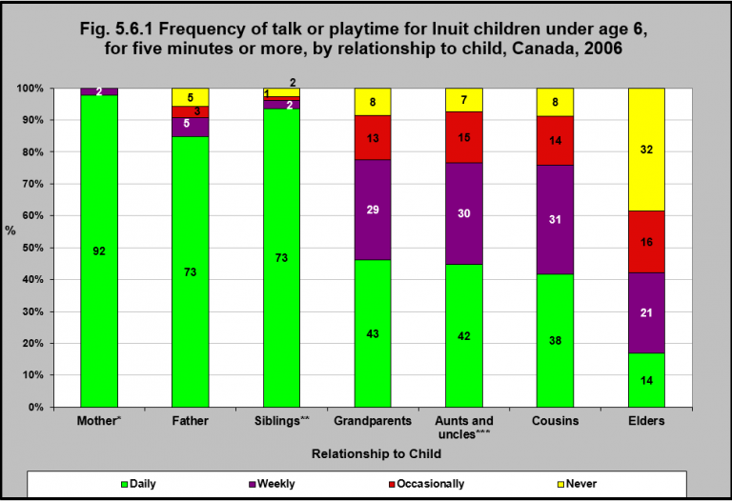
Notes:
Summary
In 2006, 92% of Inuit children under age 6 talked or played together with their mother, focusing attention on each other for five minutes or more on a daily basis. That was the case with their fathers for 73% of the children.
Seventy-two percent spent that time with their grandparents and their aunts and uncles on a daily or weekly basis.
Fourteen percent of Inuit children under age 6 spent at least 5 minutes daily with their Elders. A further 21% did that weekly and 16% occasionally. 32% never had that kind of activity with their Elders.
Implications
Indigenous cultures have traditionally valued kin, the interconnection of family, and non-family community members in the care and socialization of their children.¹ There is also an abiding respect for Elders for their wisdom, spiritual leadership, and role they play in the sharing and preserving social values and beliefs, history, Indigenous knowledge and traditions. While family life has undergone enormous changes over the past 50 years in both Indigenous and non-Indigenous families in Canada, the importance of extended family to Indigenous peoples often stand in contrast to the more nuclear family focused perspectives of mainstream Canadian society.² These differing perspectives must be taken into account in the design and adaptation of community services for Indigenous peoples.
¹Muir, N., & Bohr, Y. (2014). Contemporary practice of traditional Aboriginal child rearing: A review. First Peoples Child & Family Review, 9(1), 66-79. ²Brant Castellano, M. (2002). Aboriginal family trends: Extended families, nuclear families, families of the heart. Toronto, ON: The Vanier Institute of the Family. Retrieved October 7, 2017 from http://www.urbancentre.utoronto.ca/pdfs/elibrary/VIFAboriginal.pdf
Notes: *Weekly – use with caution. **Occasional and never – use with caution. ***Not applicable – use with caution. Occasionally, never, not applicable -numbers suppressed for mothers. Percents may not add up to 100 because responses of ‘don’t know’, ‘refusal’ and ‘not stated’ were included in the calculation of all estimates and rounding. Additionally, ‘not stated’ and ‘not applicable’ responses were removed. The category “Mother” includes birth mother, step mother (including common-law step parent), adoptive mother and foster mother. The category “Father” includes birth father, step father (including common-law step parent), adoptive father and foster father.
Source: CICH graphic created using data adapted from Statistics Canada, Aboriginal Children’s Survey, 2006. http://www.statcan.gc.ca/pub/89-634-x/2008005/t/6000027-eng.htm -accessed August 27, 2017.

Slide 57
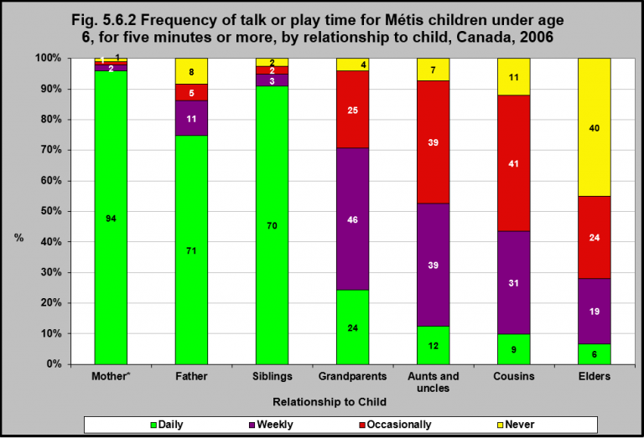
Notes:
Summary
In 2006, 94% of Métis children under age 6 spent at least 5 minutes talking or playing with their mothers daily, focusing their attention on each other. With fathers, 71% of children under age 6 spent at least 5 minutes talking or playing.
Forty-six percent of Métis children under age 6 spent at least 5 minutes talking or playing together with their grandparents on a weekly basis, and another 24% did that daily.
Nineteen percent of Métis children under age 6 spent at least 5 minutes talking or playing together with their Elders on a weekly basis, and another 6% did that daily. Twenty-four percent reported they talked or played together for at least 5 minutes occasionally.
Implications
Many Indigenous cultures have traditionally valued kin, the interconnection of family, and non-family community members in the care and socialization of their children.¹There is also an abiding respect for Elders for their wisdom, spiritual leadership, and role they play in the sharing and preserving of social values and beliefs, history, Indigenous knowledge and traditions. While family life has undergone enormous changes over the past 50 years in both Indigenous and non-Indigenous families in Canada, the importance of extended family to Indigenous peoples often stand in contrast to the more traditional nuclear family setting of mainstream Canadian society.²These differing perspectives must be taken into account in the design and adaptation of community services for Indigenous peoples.
¹Muir, N., & Bohr, Y. (2014). Contemporary practice of traditional Aboriginal child rearing: A review. First Peoples Child & Family Review, 9(1), 66-79. ²Brant Castellano, M. (2002). Aboriginal family trends: Extended families, nuclear families, families of the heart. Toronto, ON: The Vanier Institute of the Family. Retrieved October 7, 2017 from http://www.urbancentre.utoronto.ca/pdfs/elibrary/VIFAboriginal.pdf
Notes: *Occasional and never – use with caution. Percents may not add up to 100 because responses of ‘don’t know’, ‘refusal’ and ‘not stated’ were included in the calculation of all estimates and rounding. Additionally, ‘not stated’ and ‘not applicable’ responses were removed. The category “Mother” includes birth mother, step mother (including common-law step parent), adoptive mother and foster mother. The category “Father” includes birth father, step father (including common-law step parent), adoptive father and foster father.
Source: CICH graphic created using data adapted from Statistics Canada, Aboriginal Children’s Survey, 2006. http://www.statcan.gc.ca/pub/89-634-x/2008005/t/6000032-eng.htm -accessed August 22, 2017.

Slide 58
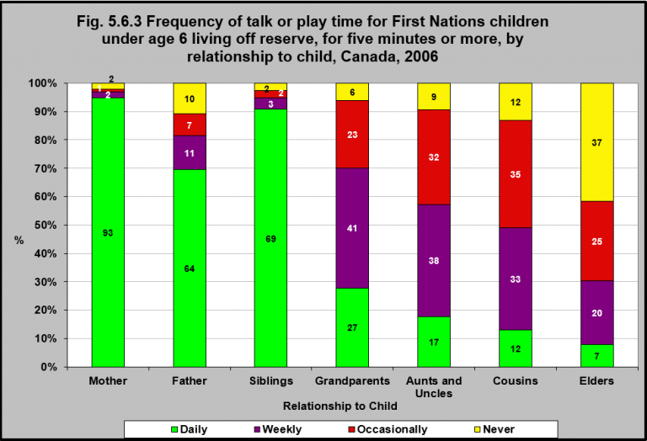
Notes:
Summary
In 2006, 93% of First Nations children under age 6, living off reserve, spent five minutes or more talking or playing with their mothers every day and 64% did that with their fathers.
Less spent five minutes or more talking or playing daily with grandparents (27%), Aunts/Uncles (17%), Cousins (12%) and Elders (7%).
However, 41% of First Nations children under age 6 living off reserve spent five minutes or more talking or playing with grandparents weekly and 20% had this weekly interaction with Elders.
Implications
Indigenous cultures have traditionally valued kin, the interconnection of family, and non-family community members in the care and socialization of their children.¹ There is also an abiding respect for Elders for their wisdom, spiritual leadership, and role they play in the sharing and preserving social values and beliefs, history, Indigenous knowledge and traditions. While family life has undergone enormous changes over the past 50 years in both Indigenous and non-Indigenous families in Canada, the importance of extended family to Indigenous peoples often stand in contrast to the more traditional nuclear family setting of mainstream Canadian society.² These differing perspectives must be taken into account in the design and adaptation of community services for Indigenous peoples.
¹Muir, N., & Bohr, Y. (2014). Contemporary practice of traditional Aboriginal child rearing: A review. First Peoples Child & Family Review, 9(1), 66-79. ²Brant Castellano, M. (2002). Aboriginal family trends: Extended families, nuclear families, families of the heart. Toronto, ON: The Vanier Institute of the Family. Retrieved October 7, 2017 from http://www.urbancentre.utoronto.ca/pdfs/elibrary/VIFAboriginal.pdf
Notes: Percents may not add up to 100 because responses of ‘don’t know’, ‘refusal’ and ‘not stated’ were included in the calculation of all estimates and rounding. Additionally, ‘not stated’ and ‘not applicable’ responses were removed. The category “Mother” includes birth mother, step mother (including common-law step parent), adoptive mother and foster mother. The category “Father” includes birth father, step father (including common-law step parent), adoptive father and foster father.
Source: CICH graphic created using data adapted from Statistics Canada, Aboriginal Children’s Survey, 2006. http://www.statcan.gc.ca/pub/89-634-x/2008005/t/6000023-eng.htm -accessed August 22, 2017.

Slide 59
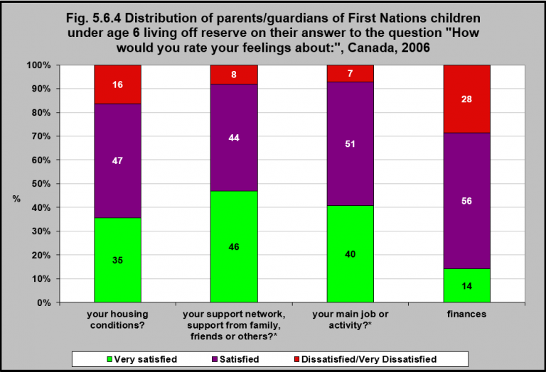
Notes:
Summary
In 2006, 35% of parents/guardians of First Nations children under age 6 living off reserve reported that they were ‘very satisfied’ with their housing conditions and an additional 47% reported they were ‘satisfied’.
Only 14% of parents/guardians of First Nations children under age 6 living off reserve reported being ‘very satisfied’ with their finances and 28% reported being ‘dissatisfied/very dissatisfied’.
Over 90% of parents/guardians of First Nations children under age 6 living off reserve reported being ‘very satisfied’ or ‘satisfied’ with their main job or activity and 90% reported being ‘very satisfied’ or ‘satisfied’ with their support network.
Notes: *Very dissatisfied use with caution. Percents may not add up to 100 because responses of ‘don’t know’, ‘refusal’ and ‘not stated’ were included in the calculation of all estimates and rounding. Additionally, ‘not stated’ and ‘not applicable’ responses were removed.
Source: CICH graphic created using data adapted from Statistics Canada, Aboriginal Children’s Survey, 2006. http://www.statcan.gc.ca/pub/89-634-x/2008005/t/6000030-eng.htm -accessed August 22, 2017.

Slide 60
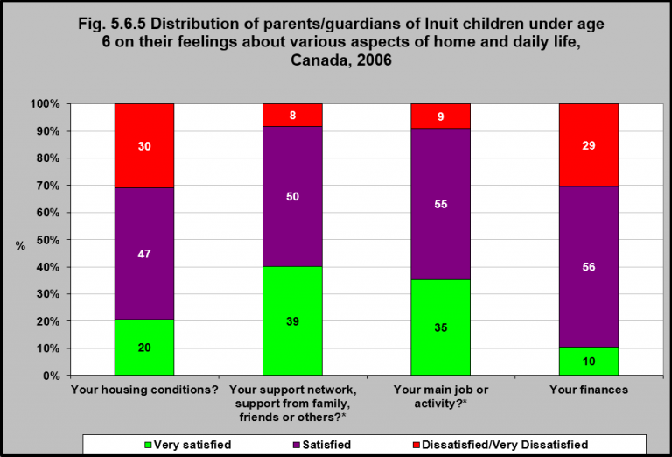
Notes:
Summary
In 2006, 20% of parents/guardians of Inuit children under age 6 reported that they were ‘very satisfied’ with their housing conditions, an additional 47% reported they were ‘satisfied’ and 30% reported being ‘dissatisfied/very dissatisfied’.
Only 10% of parents/guardians of Inuit children under age 6 reported that they were ‘very satisfied’ with their finances and 29% reported they were ‘dissatisfied/very dissatisfied’.
A large number (90%) of parents/guardians of Inuit children under age 6 reported that they were ‘very satisfied’ or ‘satisfied’ with their main job or activity and 89% reported being ‘very satisfied’ or ‘satisfied’ with their social support network.
Implications
Parents/guardians of Inuit children generally have lower levels of satisfaction than parents/guardians of First Nations children living off-reserve with regards to key determinants of health such as housing conditions, support networks, jobs, and income. Inuit are more likely than other Canadians, including Indigenous families living off reserve and Métis, to live in poor quality or overcrowded homes and in poverty, and they lack employment generating opportunities and face higher costs of living, placing Inuit children at increased risk of poorer health outcomes.¹ This highlights the need for a more holistic approach to addressing health inequities for Inuit families.
¹Inuit Tapiriit Kanatami. (2016). Social determinants of Inuit health in Canada. Ottawa, ON: Authors. Retrieved October 7, 2017 from https://www.itk.ca/wp-content/uploads/2016/07/ITK_Social_Determinants_Report.pdf
Notes: *Very dissatisfied use with caution Percents may not add up to 100 because responses of ‘don’t know’, ‘refusal’ and ‘not stated’ were included in the calculation of all estimates and rounding. Additionally, ‘not stated’ and ‘not applicable’ responses were removed. Four regions comprise Inuit Nunangat which means “Inuit homeland” in the Inuit language. These four regions are: Nunatsiavut in northern Labrador, Nunavik in northern Quebec, the territory of Nunavut, and the Inuvialuit region in the Northwest Territories.
Source: CICH graphic created using data adapted from Statistics Canada, Aboriginal Children’s Survey, 2006. http://www.statcan.gc.ca/pub/89-634-x/2008005/t/6000033-eng.htm -accessed August 22, 2017.

Slide 61
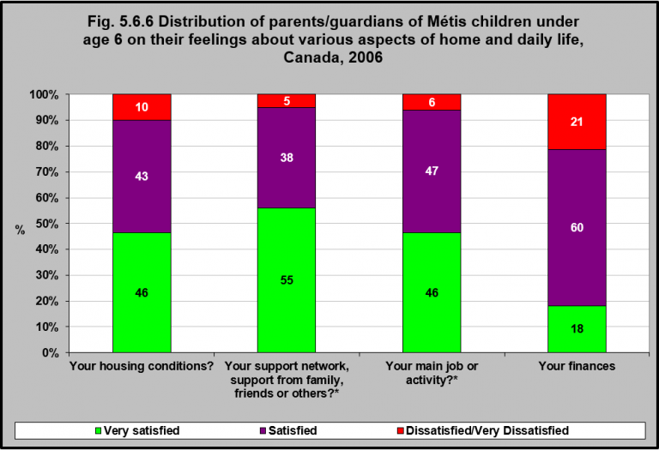
Notes:
Summary
In 2006, 46% of parents/guardians of Métis children under age 6 reported that they were ‘very satisfied’ with their housing conditions and an additional 43% reported they were satisfied.
Only 18% parents/guardians of Métis children under age 6 reported that they were ‘very satisfied’ with their finances and 21% reported being ‘dissatisfied/very dissatisfied’.
The large majority (93%) of parents/guardians of Métis children under age 6 reported that they were ‘very satisfied’ or ‘satisfied’ with their social support networks. The same majority (93%) reported being ‘very satisfied’ or ‘satisfied’ with their main job or activity.
Implications
While Métis people still experience many inequalities in the determinants affecting health and well-being compared to the general Canadian population, they generally live in better quality housing, are more likely to be employed in better quality jobs, and have higher incomes than their Inuit and First Nations on-reserve counterparts.¹ As a result, they generally have high levels of satisfaction with key determinants of health, including housing, social support, employment and income.
¹National Aboriginal Economic Development Board. (2015). The Aboriginal Economic Progress Report. Gatineau, QC: Author. Retrieved October 7, 2017 from http://www.naedb-cndea.com/reports/NAEDB-progress-report-june-2015.pdf; and Statistics Canada. (2016). Aboriginal Peoples in Canada: First Nations People, Métis and Inuit. Ottawa, ON: Author. Retrieved October 7, 2017 from http://www12.statcan.gc.ca/nhs-enm/2011/as-sa/99-011-x/99-011-x2011001-eng.pdf
Notes: *Dissatisfied/Very dissatisfied use with caution Percents may not add up to 100 because responses of ‘don’t know’, ‘refusal’ and ‘not stated’ were included in the calculation of all estimates and rounding. Additionally, ‘not stated’ and ‘not applicable’ responses were removed.
Source: CICH graphic created using data adapted from Statistics Canada, Aboriginal Children’s Survey, 2006. http://www.statcan.gc.ca/pub/89-634-x/2008005/t/6000032-eng.htm -accessed August 22, 2017.

Slide 62
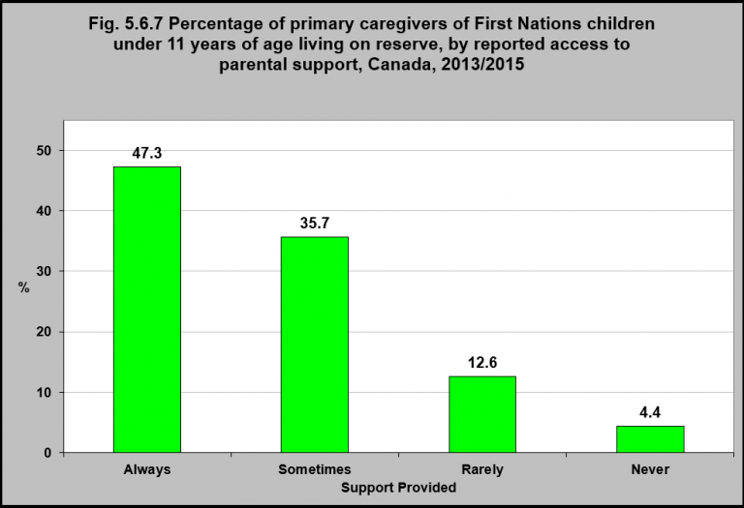
Notes:
Summary
In 2013/2015, 83% of primary caregivers of First Nations children under 11 years of age reported that they ‘always’ or ‘sometimes’ had someone they could rely on for support or help.
The majority of their support came from family and friends (93.7%), nurses and health care providers (32.8%), community members (26.8%) and Elders (26.2%).¹
¹First Nations Information Governance Centre, Our Data, Our Stories, Our Future: The National Report of the First Nations Regional Early Childhood, Education and Employment Survey. 2016. http://fnigc.ca/sites/default/files/docs/fnigc_fnreees_national_report_2016_en_final_28072016_0.pdf-accessed August 25, 2017.
Source: CICH graphic created using data adapted from First Nations Information Governance Centre, Our Data, Our Stories, Our Future: The National Report of the First Nations Regional Early Childhood, Education and Employment Survey. 2016. http://fnigc.ca/sites/default/files/docs/fnigc_fnreees_national_report_2016_en_final_28072016_0.pdf -accessed August 25, 2017.

Slide 63
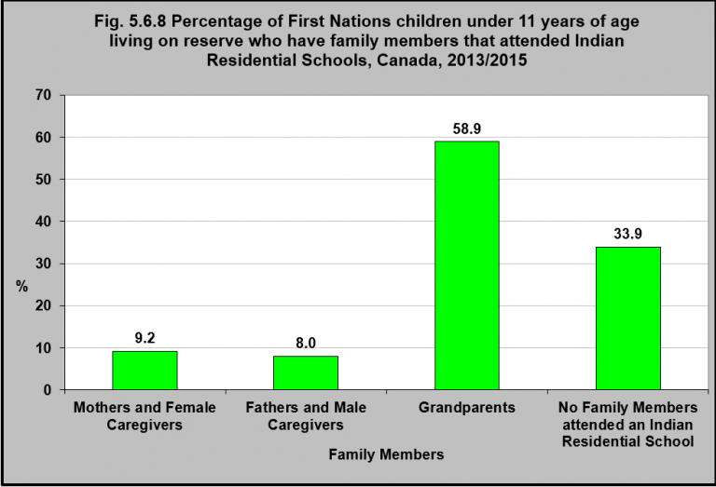
Notes:
Summary
In 2013/2015, 9.2% of First Nations children under 11 years of age living on reserve had a mother or female caregiver that had attended an Indian Residential School. 8% had a father or male caregiver that had attended.
Fifty-nine percent of First Nations children under 11 years of age living on reserve had at least one grandparent that had attended an Indian Residential School.
Implications
Over the years, the number of Indigenous people who have had direct experience with Indian Residential Schools continues to decline. Nevertheless, the physical, emotional, psychological and spiritual harms that Indigenous children experienced in these schools have left traumatic scars, manifested in mental health issues such as depression, post-traumatic stress disorder, and substance abuse, which in turn have had adverse intergenerational consequences.¹ This intergenerational trauma is evidenced by the rates of violence within Indigenous families and communities and in the rates of Indigenous children in the child welfare system, and must be considered in the development of programs and services for Indigenous people that focus on individual and collective healing and the rebuilding of relationships.
¹Bombay, A., Matheson, K., & Anisman, H. (2009). Intergenerational trauma: Convergence of multiple processes among First Nations people in Canada. Journal of Aboriginal Health, 5(3), 6-47.
Source: CICH graphic created using data adapted from First Nations Information Governance Centre, Our Data, Our Stories, Our Future: The National Report of the First Nations Regional Early Childhood, Education and Employment Survey. 2016. http://fnigc.ca/sites/default/files/docs/fnigc_fnreees_national_report_2016_en_final_28072016_0.pdf -accessed August 25, 2017.

Slide 64
Section 5.7: Maternal Behaviours

Slide 65
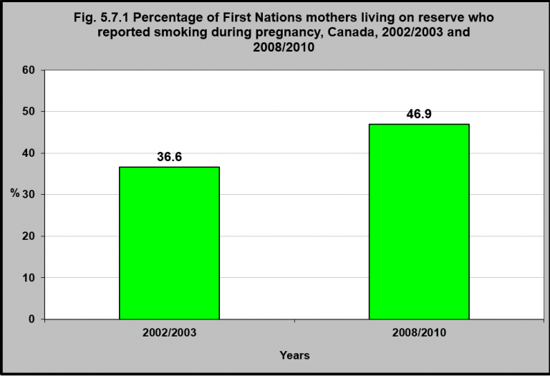
Notes:
Summary
In 2002/2003, 37% of First Nations mothers reported that they had ever smoked during their pregnancy. In 2008/2010, that proportion had increased to 47%.
While 47% of the mothers had ever smoked during pregnancy, 33% smoked throughout their pregnancy, 9% quit in the first trimester, 4% quit in the second trimester and 1% quit in the third trimester.¹
According to the 2007/2008 Nunavut Inuit Children’s Health Survey, 83% of Inuit mothers reported that they smoked during pregnancy.²
The rate of smoking among pregnant First Nations and Inuit women is much higher than that of non-Indigenous women.
Twelve percent of non-Indigenous women reported smoking during pregnancy in 2005-2008, down from 22% in 1993-1996.³
Implications
Smoking during and after pregnancy contributes to adverse outcomes for babies as well as mothers. Smoking during pregnancy can lead to premature birth, low birth weights, some birth defects and infant death.⁴ The toxins in cigarette smoke pass through the bloodstream, depriving fetuses of oxygen and nutrients, which can have devastating effects on a baby’s growth and development, including delayed lung development, heart defects, and impacts to brain function.⁵ Smoking during and after pregnancy also increases the risk of Sudden Infant Death Syndrome.⁴ While Canadian data indicate that the rates of smoking during pregnancy have been declining in the general population, the higher rates of smoking among pregnant Indigenous women, and the increasing rates of smoking noted among pregnant Inuit and First Nations women in particular, indicates that additional smoking cessation interventions are necessary among Indigenous populations. In addition, since the high prevalence of smoking is influenced by social determinants of health, including education, income, social support networks and culture, the socio-economic and cultural challenges to smoking cessation need to be addressed with culturally appropriate interventions.
¹First Nations Regional Longitudinal Health Survey (RHS) 2008/10, National report on adults, youth and children living in First Nations Communities. https://fnigc.ca/sites/default/files/docs/first_nations_regional_health_survey_rhs_2008-10_-_national_report.pdf-accessed August 2, 2017. ²The International Polar Year Nunavut Inuit Children’s Health Survey, 2007/2008. http://www.inuithealthsurvey.ca/pdf/Child_Inuit_Health_Survey_Aug_31.pdf-accessed August 22, 2017. ³Statistics Canada, National Longitudinal Survey of Children and Youth.2008-2009 (custom runs).
⁴Campbell, E. (2010). Addressing smoking cessation among pregnant Aboriginal women: Challenges and gaps in knowledge. Unpublished Masters of Public Health project, Simon Fraser University. ⁵Babycenter. (2017). How smoking during pregnancy affects you and your baby. https://www.babycenter.com/0_how-smoking-during-pregnancy-affects-you-and-your-baby_1405720.bc -accessed October 7, 2017.
Source: CICH graphic created using data adapted from the First Nations Regional Longitudinal Health Survey (RHS) 2008/10, National report on adults, youth and children living in First Nations Communities. https://fnigc.ca/sites/default/files/docs/first_nations_regional_health_survey_rhs_2008-10_-_national_report.pdf -accessed August 2, 2017.

Slide 66
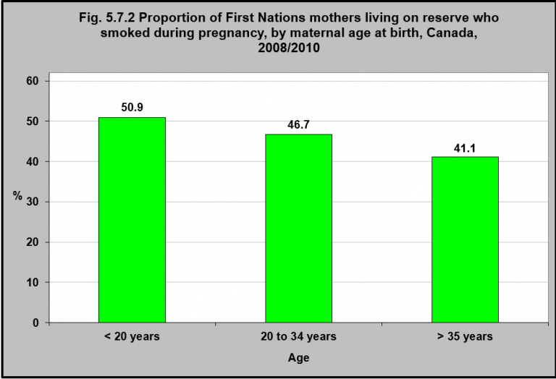
Notes:
Summary
In the combined years of 2008/2010, First Nations women living on reserve over age 35 smoked less during pregnancy than First Nations women living on reserve under 20 years of age.
41% of pregnant First Nations women over age 35 smoked compared to 51% of pregnant First Nations women under 20 years of age.
Source: CICH graphic created using data adapted from the First Nations Regional Longitudinal Health Survey (RHS) 2008/10, National report on adults, youth and children living in First Nations Communities. https://fnigc.ca/sites/default/files/docs/first_nations_regional_health_survey_rhs_2008-10_-_national_report.pdf -accessed August 2, 2017.

Slide 67
Notes:
Summary
In 2008/2010, First Nations women living on reserve with a high school education or less were more likely to smoke during pregnancy (51.4%) compared to First Nations women living on reserve who had a University or higher degree (15.9%).
Implications
Educational achievement has been found to be a predictor of smoking during pregnancy as well as quitting smoking during pregnancy.¹ Higher levels of maternal education are associated with decreased likelihood of smoking during pregnancy and increased likelihood of being successful in quitting smoking upon pregnancy. Addressing the issue of maternal smoking among Indigenous women will require a holistic approach focused on increasing educational attainment of Indigenous women, together with targeted public health interventions that consider both the social reality and cultural context of Indigenous women’s lives.
¹See for example Higgins, S.T., Heil, S.H., Badger, G.J., Skelly, J.M., Solomon, L.J., & Bernstein, I.M. (2009). Educational disadvantage and cigarette smoking during pregnancy. Drug & Alcohol Dependence, 104(Suppl 1), S100-S105; Severson, H.H., Andrews, J.A., Lichtenstein, E., Wall, M., & Zoref, L. (1995). Predictors of smoking during and after pregnancy: A survey of mothers of newborns. Preventive Medicine, 24(1), 23-28; and Walsh, R.A., Redman, S., Brinsmead, M.W., & Fryer, J.L. (2009). Predictors of smoking in pregnancy and attitudes and knowledge of risks of pregnant smokers. Drug and Alchohol Review, 16(1), 41-67.
Note: E = High sampling variability; interpret with caution.
Source: CICH graphic created using data adapted from the First Nations Regional Longitudinal Health Survey (RHS) 2008/10, National report on adults, youth and children living in First Nations Communities. https://fnigc.ca/sites/default/files/docs/first_nations_regional_health_survey_rhs_2008-10_-_national_report.pdf -accessed August 2, 2017.

Slide 68
Notes:
Summary
The proportion of First Nations women who smoke during pregnancy decreases as their household income increases.
Among First Nations women living on reserve who lived in households with less than $10,000 annual income, 55.7% of them smoked – compared with 17% of women who lived in households with more than $80,000 income.
Implications
Income is associated with educational attainment; the higher the level of education, the greater the level of income.¹ As an outcome of education, income can also be considered a predictor of smoking during pregnancy, with lower levels of income associated with higher levels of maternal smoking during pregnancy. Addressing the issue of maternal smoking among Indigenous women will require a holistic approach focused on factors that can improve income of Indigenous women (such as education), together with targeted public health interventions that consider both the social reality and cultural context of Indigenous women’s lives.
¹Mayer, S.E. (2010). The relationship between income inequality and inequality in schooling. Theory and Research in Education, 8(`), 5-10.
Note: E = High sampling variability; interpret with caution.
Source: CICH graphic created using data adapted from the First Nations Regional Longitudinal Health Survey (RHS) 2008/10, National report on adults, youth and children living in First Nations Communities. https://fnigc.ca/sites/default/files/docs/first_nations_regional_health_survey_rhs_2008-10_-_national_report.pdf -accessed August 2, 2017.

Slide 69
Notes:
Summary
In 2007-2010, 86% of First Nations women living off reserve, age 15 to 24 years, initiated breastfeeding.
That percentage was 81% for Métis women and 77% for Inuit women.
For non-Indigenous women the rate was 83%.
The rate of breastfeeding initiation for women 25 to 44 years was slightly less than the 15 to 24 age group for First Nations women living off reserve and Métis women.
However, the rate was higher for non-Indigenous women in the 25 to 44 year age group compared to the 15 to 24 age group.
Implications
Breastfeeding is a natural and nutritious way of feeding babies, and provides health benefits for both mother and baby. Research has shown that children who are breastfed have fewer respiratory tract and ear infections, diarrheal based illnesses, asthma, and early childhood caries,¹ and may also have a protective effect against obesity.² Breastfed off reserve First Nations children were found to have a lower prevalence of early childhood caries,¹ as well as lower rates of asthma/chronic bronchitis and chronic ear infections.³ Encouraging breastfeeding is a way of reducing health issues in Indigenous babies.⁴
¹Cidro, J., Zahayko, L., Lawrence, H.P., Folster, S., McGregor, M., & McKay, K. (2015). Breast feeding practices as cultural interventions for early childhood caries in Cree communities. BMC Oral Health, 15, 49. ²Gionet, L. (2013). Breastfeeding trends in Canada. Health at a Glance, November, 1-7. ³Badets, N., Hudon, T., & Wendt, M. (2017). Associations between breastfeeding and select chronic conditions among off-reserve First Nations, Métis and Inuit children in Canada. Ottawa, ON: Statistics Canada, Catalogue 75-006-X. ⁴McIsaac, K.E., Moineddin, R., & Matheson, F.I. (2015). Breastfeeding as a means to prevent infant morbidity and mortality in Aboriginal Canadians: A population prevented fraction analysis. Canadian Journal of Public Health, 106(4), e217-e222.
Source: CICH graphic created using data adapted from Statistics Canada. Table 105-0512 – Health indicator profile, by Aboriginal identity, age group and sex, four year estimates, Canada, provinces and territories, occasional (rate). http://www5.statcan.gc.ca/cansim/a05?lang=eng&id=1050512 -accessed August 2, 2017.

Slide 70
Notes:
Summary
In 2007-2010, 21% of 15 to 24 year old First Nations women living off reserve who had given birth in the previous 5 years breastfed exclusively for at least six months. That was the case for 14% of non-Indigenous women. (The numbers for Métis women and Inuit women are two small to report).
Among First Nations women 25 to 44 years of age living off reserve who had given birth in the previous 5 years, 17% exclusively breastfed for at least 6 months.
Among Métis women, 14% of those who gave birth in the previous 5 years breastfed exclusively for at least six months, as did 29% of Inuit women and 26% of non-Indigenous women.
Implications
A small proportion of women are exclusively breastfeeding for the first 6 months consistent with the recommendations of Health Canada and its partners. While Indigenous communities have had a “long history of support for breastfeeding mothers and their families,”¹ there may be a number of unique barriers and challenges to sustained breastfeeding among Indigenous women and culturally-relevant approaches to addressing these barriers and challenges are needed to facilitate supportive environments for breastfeeding in Indigenous communities.
¹Public Health Agency of Canada. (2014). Protecting, promoting and supporting breastfeeding: A practical workbook for community-based programs. Ottawa, ON: Author, p. 24.
Notes: E – Use with caution *Exclusive breastfeeding refers to an infant receiving only breast milk, without any additional liquid (even water) or solid food. **12 to 24 age group too unreliable to publish
Source: CICH graphic created using data adapted from Statistics Canada. Table 105-0512 – Health indicator profile, by Aboriginal identity, age group and sex, four year estimates, Canada, provinces and territories, occasional (rate). http://www5.statcan.gc.ca/cansim/a05?lang=eng&id=1050512 -accessed August 10, 2017.

Slide 71
Notes:
Summary
In 2008/2010, breastfeeding duration among First Nations women living on reserve increased with maternal age at birth.
Almost half of First Nations women living on reserve over 35 years of age breastfed for more than 6 months, whereas only one-third of women less than 20 years of age breastfed for more than 6 months.
Implications
Age has been associated with sustained breastfeeding, with older women more likely to sustain breastfeeding.¹ This may be related to the presence of a support system. The increasing trend for babies to be born to cohabiting and unmarried parents or to single women suggests that younger women may not have the support of a spouse or partner which may be contributing to early breastfeeding cessation.² Approaches to addressing these challenges are needed to facilitate supportive environments for prolonged breastfeeding in Indigenous communities.
¹Gionet, L. (2013). Breastfeeding trends in Canada. Health at a Glance, November, 1-7; Best Start. (2014). Populations with lower rates of breastfeeding. Background information. Health Nexus. https://www.beststart.org/pdf/BCP-P2_Background%20Information_final.pdf -accessed October 7, 2017. ²Brand, E., Kothari, C., & Stark, M.A. (2011). Factors related to breastfeeding discontinuation between hospital discharge and 2 weeks postpartum. Journal of Perinatal Education, 20(1), 36-44; Thulier, D., & Mercer, J. (2009). Variables associated with breastfeeding duration. Journal of Obstetric, Gynecologic, and Neonatal Nursing, 38, 259-267.
Source: CICH graphic created using data adapted from the First Nations Regional Longitudinal Health Survey (RHS) 2008/10, National report on adults, youth and children living in First Nations Communities. https://fnigc.ca/sites/default/files/docs/first_nations_regional_health_survey_rhs_2008-10_-_national_report.pdf -accessed August 22, 2017

Slide 72
Section 5.8: Physical Health

Slide 73
Notes:
Summary
In 2006, the majority (96-97%) of parents and guardians of First Nations children living off reserve, Inuit children and Métis children under 6 years of age reported their child’s general health was good, very good or excellent.
This was very similar to that of non-Indigenous children under age 6.
Implications
Self-rated health status is a subjective assessment of health status used in the public health field to rate one’s perceived health on a scale ranging from excellent to poor. It is considered to be consistent with objective health status and an adequate global measure of health status in the general population because of its relationship to prevalence of diagnosed diseases and health-related factors regarded as risks.¹ However, because self-rated health status is a subjective measure and different ethnic groups and cultures may assess self-rated health status differently,² some people may perceive their health in positive terms and over-estimate their health due to other personal and environmental factors. In Indigenous populations, health is not necessarily perceived of in terms of the absence of illness, but rather holistically as maintaining a balance between physical, emotional, mental and spiritual/cultural dimensions.³
¹Wu, S., Wang, R., Zhao, Y., Ma, X., Wu, M., &an, X,. & He, J. (2013). The relationship between self-rated health and objective health status: A population-based study. BMC Public Health, 13, 320. ²Bombak, A.E., & Bruce, S.G. (2012). Self-rated health and ethnicity: Focus on Indigenous populations. International Journal of Circumpolar Health, 71, 10.3402/ijch.v71i0.18538. ³Loiselle, M., & McKenzie, L. (2006). The wellness wheel: An Aboriginal contribution to social work. Waterloo, ON: Paper presented at Breaking barriers and creating common ground through a holistic approach: The Medicine Wheel, the First North-American Conference on Spirituality and Social Work, May 27. Retrieved October 10, 2017 from http://www.reseaudialog.qc.ca/Docspdf/LoiselleMcKenzie.pdf.
Source: CICH graphic created using data adapted from the Indigenous Children’s Health Report: Health Assessment in Action, 2009, Janet Smylie & Paul Adomako using data from the 2006 Aboriginal Children’s Survey and 2006 National Longitudinal Study on Children and Youth. http://caid.ca/IndChiHeaRep2009.pdf -accessed July 28, 2017.

Slide 74
Notes:
Summary
In 2006, First Nations living off reserve with and without registered Indian status (18% and 15% respectively), First Nations living on reserve (21%) and Métis (15%) mothers had babies of higher birth weight compared to the Canadian population (13%). The rate for Inuit mothers was slightly less at 11%.
For low birth weight, the rate for the Canadian population was 6%. All Indigenous groups had higher low birth weight rates except First Nations on reserve who had a slightly lower rate at 5.5%. First Nations on reserve mothers also had the highest high birth weight rate at 21%.
Implications
Babies who are born with high or low birth weight are at increased risk of adverse health outcomes in childhood and later in life. Babies born with low birth weight are more likely to have wheezing disorders in childhood, be overweight or obese in adulthood, have coronary heart disease, lower levels of intelligence in adolescence, all-cause mortality, and chronic kidney disease compared to normal weight babies.¹High birth weight babies are often called large for gestational age (LGA). They may be large because their parents are large and have passed this trait along to their children, because of the weight gained by a mother during pregnancy, or because the mother has high blood sugar which can be passed along to her baby.² Babies who are LGA are at greater risk of immediate health issues such as low blood sugar immediately after birth, birth defects, trouble breathing, and injuries sustained through birth, and jaundice. They are also at higher risk of long term health issues such as higher death rates from certain cancers, obesity and type II diabetes mellitus.¹
¹Belbasis, L., Savvidou, M.D., Kanu, C., Evangelou, E., & Tzoulaki, I. (2016). Birth weight in relation to health and disease in later life: An umbrella review of systematic reviews and meta-analyses. BMC Medicine, 14, 147. ²University of Rochester Medical Center. (2017). Large for gestational age. Adult and children’s health encyclopedia. https://www.urmc.rochester.edu/encyclopedia/content.aspx?ContentTypeID=90&ContentID=P02383 -accessed October 7, 2017.
Notes: Low birth weight: 0.4kg – 2.5kg Average birth weight: 2.51kg – 4.0kg High birth weight: >4.0kg
Source: CICH graphic created using data from Crengle,S., Freemantle, J., Gallaher, G., McAullay, D., McShane, K., & Taualii, M. (2009). Indigenous Children’s Health Report: Health Assessment in Action. Edited by Janet Smylie and Paul Adomako reference data from Aboriginal Children’s Survey, 2006; Regional Health Survey 2002/2003; National Longitudinal Survey of Children and Youth 2000/2001. http://caid.ca/IndChiHeaRep2009.pdf -accessed August 2, 2017.

Slide 75
Notes:
Summary
In 2008/10, the frequency and duration of maternal smoking and other smoking in the household did not have a significant impact on low birth weight.
The rate of high birth weight was much higher (23.9%) for First Nations women living on reserve who never smoked compared to First Nations women living on reserve who smoked throughout their pregnancy (14.3%).
Of those who smoked throughout their pregnancy, those who smoked daily had children with a high birth weight rate of 12.4% compared to 18.1% for those who reported they smoked occasionally.
Notes: E- Use with caution. Low birth weight: 0.4kg – 2.5kg Average birth weight: 2.51kg – 4.0kg High birth weight: >4.0kg
Source: CICH graphic created using data adapted from the First Nations Regional Longitudinal Health Survey (RHS) 2008/10, National report on adults, youth and children living in First Nations Communities. https://fnigc.ca/sites/default/files/docs/first_nations_regional_health_survey_rhs_2008-10_-_national_report.pdf -accessed August 22, 2017.

Slide 76
Notes:
Summary
In 2006, the rate of chronic conditions among First Nations children under 6 with status or treaty (on/off reserve) was 30%.
The rate of chronic conditions among First Nations children without status or treaty, Inuit children and Métis children of the same age group was 28%.
Notes: *Child has any chronic condition. The Aboriginal Children’s Survey asked about long-term health condition diagnosed by a health professional.
Source: CICH graphic created using data adapted from Crengle,S., Freemantle, J., Gallaher, G., McAullay, D., McShane, K., & Taualii, M. (2009). Indigenous Children’s Health Report: Health Assessment in Action. Edited by Janet Smylie and Paul Adomako using data from Statistics Canada. 2006 Aboriginal Children’s Survey. http://caid.ca/IndChiHeaRep2009.pdf -accessed July 26, 2017.

Slide 77
Notes:
Summary
In 2008/2010, one-third of First Nations children living on reserve age 0 to 11 years had been told by a health care professional that they had at least one health condition.¹
Allergies and asthma were the most diagnosed chronic health conditions with both seeing a slight decrease from 2002/2003 to 2008/2010.
In 2008/2010, the average age of diagnosis for asthma was 2.3 years of age and the majority (79.2%) of First Nations children living on reserve with asthma had, at some point, taken medication (e.g. Ventalin) for their asthma. Of these First Nations children, approximately half take asthma medication at least once per week (44.3%), with 23.4% taking asthma medication at least once per day.¹
In 2008/2010, dermatitis or atopic eczema was diagnosed in 7.5% of First Nations children living on reserve with the average age for diagnosis being 2.2 years of age.
In 2008/2010, 6% of First Nations children under age 12 living on reserve had been diagnosed with chronic ear infections. This number is significantly lower than data reported for Inuit children age 3 to 5 in the 2007/2008 Inuit Child Health Survey. The Inuit Child Survey reported that 37% of children had had an ear infection in the previous year with 84% receiving treatment.²
Implications
Due to the utilization of different methodologies across two rounds of the First Nations Regional Health Survey, it is not always possible to assess longitudinal trends in health status for First Nations children 0-11. While there have been improvements in a number of chronic health conditions since 2002/2003, at least 50% of First Nations children diagnosed with these conditions were undergoing some form of treatment, suggesting that some First Nations children are unable to receive treatment due to barriers to receiving health care.³ These barriers to access to health care needs to continue to be addressed.
¹First Nations Regional Longitudinal Health Survey (RHS) 2008/10, National report on adults, youth and children living in First Nations Communities. https://fnigc.ca/sites/default/files/docs/first_nations_regional_health_survey_rhs_2008-10_-_national_report.pdf-accessed July 12, 2017. ²The International Polar Year Nunavut Inuit Child Health Survey, 2007/2008. http://www.inuithealthsurvey.ca/pdf/Child_Inuit_Health_Survey_Aug_31.pdf-accessed August 27, 2017.
³First Nations Information Governance Centre, 2012, p. 376.
Notes: Prevalence of hepatitis, chronic anemia, speech or language difficulties, autism, anxiety or depression, dermatitis or atopic eczema, and cancer were not assessed in RHS 2002/03. E = high sampling variability – interpret estimate with caution.
Source: CICH graphic created using data adapted from the First Nations Regional Longitudinal Health Survey (RHS) 2008/10, National report on adults, youth and children living in First Nations Communities. https://fnigc.ca/sites/default/files/docs/first_nations_regional_health_survey_rhs_2008-10_-_national_report.pdf -accessed July 20, 2017.

Slide 78
Notes:
Summary
In 2008/2010, only 35% of First Nations children living on reserve under age 11 who had diabetes sought treatment for their condition.
That was down from 50.7% in 2002/03.
Implications
Diabetes is considered to be an epidemic in First Nations communities. Prevalence of diabetes among First Nations adults is 3-5 times that of non-First Nations adults¹, and First Nations individuals are more likely to experience diabetes related complications.²Additionally, the onset of diabetes is at a younger age in First Nations individuals compared to non-First Nations, and rates of diabetes among First Nations children have more than tripled over the period 1980 to 2005.³ Challenges such as accessing health care services (especially in remote rural locations), limited diabetes care providers and nutritionists, healthcare provider retention and shortage problems, limited knowledge about diabetes-related complications by generalist healthcare practitioners, and limited cultural safety in health care settings can compound care for those with diabetes or diabetes related complications.⁴ The prevalence of diabetes in First Nations communities must be understood as a reflection of economic and social conditions.⁵ As a result, strategies that focus solely on assisting an individual in making healthier choices and changing individual health behaviours will be ineffective. A holistic approach which addresses the multiple and complex risk factors is needed to prevent and alleviate Type 2 diabetes and its complications in First Nations communities.
¹Dyck, R., Osgood, N., Hsiang Lin, T., Gao, A., & Stang, M.R. (2010). Epidemiology of diabetes mellitus among First Nations and non-First Nations adults. Canadian Medical Association Journal, 182(3), 249-256; Harris, S.B., Bhattacharyya, O., Dyck, R., Naqshbandi Hayward, M., & Toth, E.L. (2013). Canadian Diabetes Association 2013 clinical practice guidelines for the prevention of diabetes in Canada. Canadian Journal of Diabetes, 37(suppl 1, S1-S212. ²Oster, R.T., Virani, S., Strong, D., Shade, S., & Toth, E.L. (2009). Diabetes care and health status of First Nations individuals with type 2 diabetes in Alberta. Canadian Family Physician, 55(4), 386-393. ³Harris et al., 2013. ⁴Oster et al. (2009); ⁵Ghosh, H. (2012). Urban reality of type 2 diabetes among First Nations of Eastern Ontario: Western science and Indigenous perceptions. Journal of Global Citizenship & Equity Education, 2(2), 158-181.
Source: CICH graphic created using data adapted from the First Nations Regional Longitudinal Health Survey (RHS) 2008/10, National report on adults, youth and children living in First Nations Communities. https://fnigc.ca/sites/default/files/docs/first_nations_regional_health_survey_rhs_2008-10_-_national_report.pdf -accessed July 23, 2017.

Slide 79
Notes:
Summary
In 2008/2010, 37.5% of First Nations children aged 2 to 11 living on reserve were normal weight or underweight, down slightly from 41.5% in 2002/2003.
The overweight rate between 2002/2003 and 2008/2010 did not see any major changes, remaining at 22.3% and 20.3% respectively.
The proportion of obese First Nations children between the ages of 2 and 11 years living on reserve increased from 36.2% in 2002/2003 to 42.2% in 2008/2010.
Implications
While there are few comparisons with non-Indigenous children, it is generally acknowledged that Indigenous children have consistently higher rates of being overweight and obese than their non-Indigenous counterparts. This places them at increased risk of obesity-related diseases like diabetes, hypertension and heart disease.¹ A number of factors are associated with obesity in Indigenous children, including characteristics of the mother, physical activity, diet, body fat.² Since children who are obese are more likely to be obese in adulthood, the health risks of obesity are great, suggesting the need for targeted health promotion programs to prevent childhood obesity in Indigenous communities.
¹National Aboriginal Health Organization. (2012). Aboriginal children and obesity. Ottawa, ON: Author. Retrieved October 11, 2017 from http://www.naho.ca/documents/naho/english/factSheets/2012_05_childhood_obesity.pdf ²Willows, N.D. (2005). Overweight in First Nations children: Prevalence, implications, and solutions. Journal of Aboriginal Health, 2(1), 76-87.
Source: CICH graphic created using data adapted from the First Nations Regional Longitudinal Health Survey (RHS) 2008/10, National report on adults, youth and children living in First Nations Communities. https://fnigc.ca/sites/default/files/docs/first_nations_regional_health_survey_rhs_2008-10_-_national_report.pdf -accessed July 28, 2017.

Slide 80
Notes:
Summary
In 2007/2008, 34% of Inuit boys and 32% of Inuit girls aged 3 to 5 years had a healthy bodyweight.
Inuit boys were slightly more at risk of being overweight.
More Inuit girls (30%) than Inuit boys (24%) were overweight.
Note: BMI percentile (BMIC) scores were categorized as “risk of overweight” (BMIC≥85 and <95) or “overweight” (BMIC≥95) according to CDC guidelines.¹
Source: CICH graphic created using data adapted from The International Polar Year Nunavut Inuit Child Health Survey, 2007/2008. http://www.inuithealthsurvey.ca/pdf/Child_Inuit_Health_Survey_Aug_31.pdf -accessed August 22, 2017.
¹Galloway, T., Kue Young, T., & Egeland, G.M. (2010). Emerging obesity among preschool-aged Canadian Inuit children: Results from the Nunavut Inuit Child Health Survey. International Journal of Circumpolar Health, 69(2), 151-157.

Slide 81
Notes:
Summary
In 2008/10, the proportion of asthma among First Nations boys aged 0-11 living on reserve was 13%.
The rate was almost half among girls at 7%.
Implications
Asthma is considered a serious health problem for Indigenous children, with prevalence rates between 6-14%.¹ Indigenous children may be at increased risk of respiratory diseases due to overcrowding, inadequately constructed housing, inadequate ventilation, poorly maintained housing, presence of mold, exposure to cigarette smoke and other indoor air contaminants such as wood stove combustion products.² However, due to limited access to asthma specialists in Indigenous communities, Indigenous children may be less likely to be diagnosed or receive treatment for asthma or other respiratory infections like bronchitis which are often difficult to distinguish from asthma.²
¹Douglas, M.L., McGhan, S.L., Tougas, D., Fenton, N., Sarin, C., Latycheva, O., & Befus, A.D. (2013). Asthma education programs for First Nations children: An exemplar of the knowledge-to-action framework. Canadian Respiratory Journal, 20(4), 295-300. ²Kovesi, T., Giles, B.L., & Pasterkamp. H. (2012). Long-term management of asthma in First Nations and Inuit children: A knowledge translation tool based on Canadian paediatric asthma guidelines, intended for use by front-line health care professionals working in isolated communities. Paediatrics Child Health, 17(7), e46-e64.
Source: CICH graphic created using data adapted from the First Nations Regional Longitudinal Health Survey (RHS) 2008/10, National report on adults, youth and children living in First Nations Communities. https://fnigc.ca/sites/default/files/docs/first_nations_regional_health_survey_rhs_2008-10_-_national_report.pdf -accessed July 27, 2017.

Slide 82
Notes:
Summary
Between 2002/03 and 2008/10, the proportion of First Nations children age 0 to 11 living on reserve who received treatment for asthma increased from 57% to 69%.
This was a 12% increase.
Source: CICH graphic created using data adapted from the First Nations Regional Longitudinal Health Survey (RHS) 2008/10, National report on adults, youth and children living in First Nations Communities. https://fnigc.ca/sites/default/files/docs/first_nations_regional_health_survey_rhs_2008-10_-_national_report.pdf – accessed July 27, 2017.

Slide 83
Notes:
Summary
Coughing, asthma, bronchiolitis, bronchitis and pneumonia are common respiratory illnesses among Inuit children.¹
The 2007/2008 International Polar Year Nunavut Inuit Child Health Survey reported that 42% of children aged 3 to 5 went to a health centre or hospital over the last 12 months for a respiratory illness.
Before the age of 2 years, 32% of Inuit children had a serious lung infection with 54% needing to be hospitalized outside of Nunavut.¹
For Inuit children age 3 to 5, respiratory infections were the most common reason for being hospitalized.¹
¹The International Polar Year Nunavut Inuit Child Health Survey, 2007/2008.
Implications
Respiratory infections are a leading cause of hospitalization among Indigenous children. First Nations and Inuit children in particular suffer disproportionately higher rates of respiratory infections due to poverty, overcrowding, inadequate housing, poor ventilation, and increased exposure to tobacco smoke and other indoor air contaminants.¹ Inuit children have high rates of respiratory syncytial virus (RSV) bronchiolitis requiring hospitalization, and they often experience repeated infections in the same season, which is considered to be unusual.¹ Additionally, Inuit have high rates of Tuberculosis (TB)² and young Inuit children have a higher risk of developing TB. The increased rates of respiratory infections early in life place Inuit children at greater risk of long-term lung diseases, suggesting the need to address respiratory infections among Indigenous children early in life.
¹Kovesi, T. (2012). Respiratory disease in Canadian First Nations and Inuit children. Paediatrics Child Health, 17(7), 376-380. ²Inuit Tapiriit Kanatami. (2013). Inuit-specific tuberculosis (TB) strategy. Ottawa, ON: Author, p. 2. Retrieved October 11, 2017 from http://www.itk.ca/wp-content/uploads/2013/03/20130503-EN-FINAL-Inuit-TB-Strategy.pdf
Source: CICH graphic created using data adapted from The International Polar Year Nunavut Inuit Child Health Survey, 2007/2008. http://www.inuithealthsurvey.ca/pdf/Child_Inuit_Health_Survey_Aug_31.pdf -accessed August 31, 2017.

Slide 84
Notes:
Summary
Early childhood caries (ECC) is defined as the presence of tooth decay involving any primary tooth in a child younger than six years of age.¹ ECC is also referred to as early childhood tooth decay in the vernacular (and formerly called baby bottle tooth decay).²
In 2008/2010, the prevalence of early childhood caries (ECC) among First Nations children living on reserve aged 0 to 2 was 18.7%. It was 30.9% for 3 to 5 year olds.
The prevalence of ECC for all age groups increased from 2002/2003 to 2008/2010 (except for the 6-11 age group, which was not reported in 2002/03).
According to the Inuit Oral Health Survey Report (2008-2009), over 85% of preschoolers reported dental caries with a mean of 8.22 deciduous (baby) teeth affected. By the time of adolescence, 97.7% had been affected. The prevalence greatly exceeded similar counts for southern Canadians.³
Multiple studies have shown that Indigenous children are disproportionately burdened by ECC.⁴
For more information, see the Early childhood tooth decay factsheet developed by the National Collaborating Centre on Aboriginal Health and the Canadian Paediatric Society’s Position Statement on Early Childhood Caries in Indigenous Communities.
Implications
Tooth decay, exemplified by the high prevalence of early childhood caries (ECC), is a major child health issue for Indigenous children. ECC can contribute to adverse health effects, including altered chewing, eating and sleeping patterns due to pain; potential growth restriction; speech difficulties; low self-esteem, and poor bite.⁵ It has also been associated with infectious diseases like respiratory tract infections and acute otitis media, as well as with obesity in children with families of low socioeconomic status, though possibly from common risk factors. Rates of ECC have been reported to be 86% among First Nations 3-5 year olds,⁶ with rates exceeding 90% in some Indigenous communities.⁵ Severe ECC frequently requires extensive treatment under general anesthesia, which can be costly for Indigenous families living in rural and remote communities who may not have access to dental surgery services. Dental surgery for severe ECC is common among Indigenous children, and recent studies suggest that a significant number of First Nations children with dental caries require repeat dental procedures under general anesthesia.⁵ Common risk factors for ECC include poverty, which is prevalent among First Nations children, as well as prolonged use of the bottle or training cups containing sugary drinks and high consumption of sugary snacks. Given the challenges and costs of surgical treatment of ECC in remote Indigenous communities and the fact that relapse and recurrent decay are common in such communities, dental disease will not be solved in Indigenous communities without disease prevention strategies that emphasize not only the preservation of healthy teeth, but also emphasize community development and address the determinants of health.
¹American Academy of Pediatric Dentistry. Definition of early childhood caries (ECC). Pediatr Dent 2005;27(7 Reference Manual):13. http://www.aapd.org/media/policies_guidelines/p_eccclassifications.pdf-accessed August 3, 2017. ²Position Statement – Early Childhood caries in Indigenous communities. 2016. Canadian Paediatric Society. JD Irvine, S Holve, D Krol, R Schroth; Canadian Paediatric Society , First Nations, Inuit and Métis Health Committee. http://www.cps.ca/en/documents/position/oral-health-indigenous-communities-accessed August 30. ³Inuit Oral Health Survey 2008 – 2009. Health Canada, 2011. http://www.hc-sc.gc.ca/fniah-spnia/alt_formats/pdf/pubs/promotion/_oral-bucco/oral-inuit-buccal-eng.pdf-accessed August 10, 2017. ⁴National Collaborating Centre for Aboriginal Health. 2013. Early Childhood Tooth Decay. http://www.nccah-ccnsa.ca/Publications/Lists/Publications/Attachments/95/Tooth_Decay_EN_web.pdf-accessed July 10, 2017.
⁵Irvine, J.D., Holve, S., Krol, D., Schroth, R., & the Canadian Paediatric Society, First Nations, Inuit and Métis Health Committee. (2011). Early childhood caries in Indigenous communities: Position statement. Paediatric Child Health, 16(6), 351-7. ⁶First Nations Information Governance Centre. (3023). Report on the findings of the First Nations Oral Health Survey (FNOHS) 2009-10. Ottawa, ON: Author.
Notes: *Early childhood caries prevalence estimates for children aged 6 to 11 years were not reported in the Regional Health Survey 2002/03. Early childhood caries was formerly called baby bottle tooth decay.
Source: CICH graphic created using data adapted from the First Nations Regional Longitudinal Health Survey (RHS) 2008/10, National report on adults, youth and children living in First Nations Communities. https://fnigc.ca/sites/default/files/docs/first_nations_regional_health_survey_rhs_2008-10_-_national_report.pdf -accessed July 17, 2017

Slide 85
Notes:
Summary
In 2008/2010, First Nations children aged 0 to 11 living on reserve who drank fruit juices, canned milk, iron-fortified formula, tea, soft drinks and powdered drinks were at greater risk of developing early childhood caries** (ECC) than those who did not consume these beverages.
The potential risk of these beverages is concerning with over 50% of First Nations, Métis and Inuit children aged 2 to 5 years consuming two or more servings of soft drinks and/or juice each day.¹
According to the 2007/2008 Nunavut Inuit Child Health Survey², on average 78% of children aged 3-5 consumed 3 glasses of sweet drinks daily which equals approximately 30 sugar cubes.²
The figure for Nunavut Inuit children was over 7 times the national average for children aged 1-3 years and over 3 times the national average for children aged 4-8 years.³
For more information please see the Early childhood tooth decay factsheet developed by the National Collaborating Centre on Aboriginal Health and the Canadian Paediatric Society’s Position Statement on Early Childhood Caries in Indigenous Communities.
Implications
Bottle feeding babies sugary liquids during sleep is one of the most prominent causes of tooth decay among children.⁶ Bacteria in the mouth uses sugars from liquids such as milk, juice and formula, to produce acids which decay the teeth. Indigenous children are more susceptible to early childhood caries (tooth decay in children less than 6 years) because many live in rural and remote or northern communities where drinking water often has not been supplemented with fluoride, as well as because of limited access to preventive care and dental services.⁶
**Early childhood caries (ECC) is defined as the presence of tooth decay involving any primary tooth in a child younger than six years of age.⁴ ECC is also referred to as early childhood tooth decay in the vernacular (and formerly called baby bottle tooth decay).⁵
¹2006 Aboriginal Children`s Survey. http://www.statcan.gc.ca/pub/82-003-x/2013004/article/11776-eng.htm-accessed August 24, 2017. ²The International Polar Year Nunavut Inuit Child Health Survey 2007-2008. http://www.inuithealthsurvey.ca/pdf/Child_Inuit_Health_Survey_Aug_31.pdf-accessed August 5, 2017. ³Garriguet, Didier. Beverage consumption of children and teens. 2008. Component of Statistics Canada Catalogue no. 82-003-x. Health Reports. http://publications.gc.ca/collections/collection_2008/statcan/82-003-X/82-003-x2008004-eng.pdf– accessed August 10, 2017. ⁴American Academy of Pediatric Dentistry. Definition of early childhood caries (ECC). Pediatr Dent 2005;27(7 Reference Manual):13. http://www.aapd.org/media/policies_guidelines/p_eccclassifications.pdf– accessed July 12, 2017. ⁵Position Statement – Early Childhood caries in Indigenous communities. 2016. Canadian Paediatric Society. JD Irvine, S Holve, D Krol, R Schroth; Canadian Paediatric Society , First Nations, Inuit and Métis Health Committee. http://www.cps.ca/en/documents/position/oral-health-indigenous-communities-accessed August 2, 2017.
⁶BC Aboriginal Childcare Society. (2007). Aboriginal children and early childhood caries (ECC). West Vancouver, BC: Author. Retrieved October 11, 2017 from http://www.acc-society.bc.ca/files_new/documents/CFOCFebApr07.pdf
Note: As reported by primary caregivers.
Source: CICH graphic created using data from the First Nations Regional Longitudinal Health Survey (RHS) 2008/10, National report on adults, youth and children living in First Nations Communities. https://fnigc.ca/sites/default/files/docs/first_nations_regional_health_survey_rhs_2008-10_-_national_report.pdf -accessed August 2, 2017.

Slide 86
Notes:
Summary
Twenty-five percent of First Nations children in First Nations communities who were breastfed had early childhood caries*, compared with 29% of those who were bottle fed.
Those children who were breastfed for 6 months or more were less likely to have early childhood caries than were those who were breastfeed for less than 6 months.
Twenty-nine percent of children who were bottle fed had early childhood caries compared with 11% of those who were not bottle fed.
One-third of children who were obese had early childhood caries compared with 24% of those who were overweight and 23% of those who were a normal weight or underweight.
For more information please see the Early childhood tooth decay factsheet developed by the National Collaborating Centre on Aboriginal Health and the Canadian Paediatric Society’s Position Statement on Early Childhood Caries in Indigenous Communities.
Implications
Tooth decay is more prevalent in bottle-fed babies compared to breastfed babies. This is because breastmilk does not pool in a baby’s mouth like bottled milk, as milk does not flow unless a baby is actively sucking, and if the baby is actively sucking, he/she is also swallowing.³ Further, children breastfed for longer durations have a reduced risk of caries compared to those breastfed for shorter durations. However, nocturnal breastfeeding aimed at comforting infants or children so they can fall asleep prolongs exposure of breast milk against the surfaces of the teeth and increases the risk of dental caries.⁴
*Early childhood caries (ECC) is defined as the presence of tooth decay involving any primary tooth in a child younger than six years of age.¹ ECC is also referred to as early childhood tooth decay in the vernacular (and formerly called baby bottle tooth decay).²
¹American Academy of Pediatric Dentistry. Definition of early childhood caries (ECC). Pediatr Dent 2005;27(7 Reference Manual):13. http://www.aapd.org/media/policies_guidelines/p_eccclassifications.pdf-accessed July 27, 2017. ²Position Statement – Early Childhood caries in Indigenous communities. 2016. Canadian Paediatric Society. JD Irvine, S Holve, D Krol, R Schroth; Canadian Paediatric Society, First Nations, Inuit and Métis Health Committee. http://www.cps.ca/en/documents/position/oral-health-indigenous-communities-accessed August 5, 2017.
³Bonyatta, K. (n.d.). Is breastfeeding linked to tooth decay. KellyMom.com. https://kellymom.com/ages/older-infant/tooth-decay/ -accessed October 11, 2017. ⁴Tham, R., Bowatte, G., Dharmage, S.C., Tan, D.M., Lau, M.X.Z., Dai, X., Allen, K.J., & Lodge, C.L. (2015). Breastfeeding and the risk of dental caries: A systematic review and meta-analysis. Acta Paediatrica, 104(S467), 62-84.
Notes: Breastfeeding was associated with a decrease in the prevalence of ECC, albeit the result was not statistically significant. Not crowded [≤ 1 person/room]; Crowded [> 1 person/room].
Source: CICH graphic created using data adapted from the First Nations Regional Longitudinal Health Survey (RHS) 2008/10, National report on adults, youth and children living in First Nations Communities. https://fnigc.ca/sites/default/files/docs/first_nations_regional_health_survey_rhs_2008-10_-_national_report.pdf -accessed July 27, 2017.

Slide 87
Notes:
Summary
In 2002/2003, the main reason First Nations children aged 0 to 11 years living on reserve visited a dentist was for a check-up or a cleaning.
Restorative treatments such as filling cavities tend to increase as children age.
The number of First Nations children age 0 to 2 living on reserve having dental extractions increased from 3.9% in 2002/2003 to 13.3% in 2008/2009. Restorative treatments for this age group also increased significantly from 9.5% to 21.4%.
Implications
Healthy baby teeth are required for chewing food, developing speech and communicating, and for ensuring there is adequate space in the jaw for adult teeth. However, early signs of tooth decay often go unnoticed or untreated because of the misconception that because baby teeth are not permanent, they do not require extensive oral health attention.¹ As such, as children age and their permanent teeth begin coming in, oral treatment needs increase.
¹BC Aboriginal Childcare Society. (2007).
Source: CICH graphic created using data adapted from the First Nations Regional Longitudinal Health Survey (RHS) 2008/10, National report on adults, youth and children living in First Nations Communities. https://fnigc.ca/sites/default/files/docs/first_nations_regional_health_survey_rhs_2008-10_-_national_report.pdf -accessed July 27, 2017.

Slide 88
Notes:
Summary
In 2008/2010, for First Nations children age 0 to 11 years living on reserve, the most common form of injury was minor scrapes, cuts and bruises, accounting for almost half of all injuries.
According to the Nunavut Inuit Child Health Survey (2007/08), for Inuit children aged 3 to 5, cuts and lacerations were the most common type of injury.¹
Implications
Factors contributing to injuries among First Nations children include: low rates of seatbelt usage; increased use of alternative modes of motorized transportation such as snowmobiles and all-terrain vehicles (ATVs); the remoteness of many Indigenous communities which means traveling greater distances on poor quality or icy roads, as well as limited access to emergency rescue or medical assistance; increased access to bodies of water for recreation, transportation and food, coupled with lower usage of flotation devices; high rates of smoking, reliance on wood heat, poor housing conditions and lack of smoke detectors; as well as poverty and poor quality/overcrowded housing conditions. Injury prevention in Indigenous communities must take into account the socio-economic realities in which Indigenous people live, in conjunction with an individual’s own personal resources.
¹The International Polar Year Nunavut Inuit Child Health Survey, 2007/2008. http://www.inuithealthsurvey.ca/pdf/Child_Inuit_Health_Survey_Aug_31.pdf-accessed August 10, 2017.
Source: CICH graphic created using data adapted from the First Nations Regional Longitudinal Health Survey (RHS) 2008/10, National report on adults, youth and children living in First Nations Communities. https://fnigc.ca/sites/default/files/docs/first_nations_regional_health_survey_rhs_2008-10_-_national_report.pdf -accessed July 27, 2017.

Slide 89
Notes:
Summary
According to data from the 2006 Aboriginal Children’s Survey, the proportion of Aboriginal children under 6, living off reserve, who were diagnosed with Fetal Alcohol Spectrum Disorder (FASD**) was 0.7%.
That proportion varied between provinces – it was 1.3% in Alberta and Manitoba and 0.9% in British Columbia.
Only 50% of those children who were diagnosed received treatment.¹
Implications
Fetal alcohol spectrum disorders (FASD)⁴ result from in utero alcohol exposure and are generally characterized by pre- and/or post-natal growth deficiencies, central nervous dysfunction, and cranio-facial malformations.⁵ The disabilities associated with FASD can have lifelong implications for the health and well-being of individuals. Although the true extent of FASD among Indigenous children is unknown, FASD is considered a significant public health issue in many Indigenous communities and needs be addressed with culturally appropriate methods “that foster cultural reintegration, personal and collective healing, and positive change.”⁶
**Fetal Alcohol Spectrum Disorder (FASD) describes a range of disabilities that result from exposure to alcohol during pregnancy.² Fetal Alcohol Syndrome (FAS) and Fetal Alcohol Effects (FAE) are birth defects caused by the consumption of alcohol during pregnancy.³ ¹Werk CM, Xinjie C and Tough S. Fetal alcohol spectrum disorder among Aboriginal children under six years of age and living off reserve.First Peoples Child & Family Review. Voume 8, Number 1, 2013 using data from Statistics Canada 2006 Aboriginal Children’s Survey. ²Public Health Agency of Canada. Fetal Alchol Spectrum Disorder. http://www.phac-aspc.gc.ca/hp-ps/dca-dea/prog-ini/fasd-etcaf/index-eng.php-accessed July 29, 2017. ³Health Canada. Fetal alcohol syndrome/Fetal alcohol effects – First Nations, Inuit and Aboriginal Health. Health Canada website https://www.canada.ca/en/health-canada/services/first-nations-inuit-health/family-health/healthy-pregnancy-babies/fetal-alcohol-syndrome-fetal-alcohol-effects-first-nations-inuit-health-main-page.html
⁴The full spectrum of effects associated with inutero exposure to alcohol are commonly referred to as fetal alcohol spectrum disorders (FASD). ⁵Tait, C.L. (2003). Fetal alcohol syndrome among Aboriginal people in Canada: Review and analysis of the intergenerational links to residential schools. Ottawa, ON: Aboriginal Healing Foundation. ⁶Indian Friendship Centres. (2013). Fetal alcohol spectrum disorder: A position paper. Toronto, ON: Author, p. 4.
Notes: *Use with caution. Other provinces and territories had estimates too small to report.
Source: CICH graphic created using data adapted from Werk CM, Xinjie C and Tough S. Fetal alcohol spectrum disorder among Aboriginal children under six years of age and living off reserve. First Peoples Child & Family Review. Voume 8, Number 1, 2013 using data from Statistics Canada 2006 Aboriginal Children’s Survey.

Slide 90
Notes:
Summary
Currently, no population-based estimates for FASD*** exist for First Nations, Inuit or Métis children in Canada.¹
In the 2002/2003 First Nations Regional Health Survey, parents/guardians reported that 1.8% of First Nations children (aged 11 and under) living on reserve suffer from Fetal Alcohol Effects (FAE).²
In a systematic review and meta-analysis of existing research-based evidence on the prevalence of FASD in a community settings, it was reported that the rate of FASD for Indigenous children was 0.17%. The pooled estimate of FAS prevalence for Indigenous peoples of 0.2% was not substantially higher than those identified in community samples of the general population.³
According to Health Canada, among the general Canadian population the incidence of FASD is 1 out of every 500 to 3,000 live births per year, and the incidence of FAE is five to 10 times higher than the incidence of FASD.⁴
Implications
Fetal alcohol spectrum disorders (FASD)⁶ result from in utero alcohol exposure and are generally characterized by pre- and/or post-natal growth deficiencies, central nervous dysfunction, and cranio-facial malformations.⁷ The disabilities associated with FASD can have lifelong implications for the health and well-being of individuals. Although the true extent of FASD among Indigenous children is unknown, FASD is considered a significant public health issue in many Indigenous communities and needs be addressed with culturally appropriate methods “that foster cultural reintegration, personal and collective healing, and positive change.”⁸
***Fetal Alcohol Spectrum Disorder (FASD) describes a range of disabilities that result from exposure to alcohol during pregnancy.⁵ Fetal Alcohol Syndrome (FAS) and Fetal Alcohol Effects (FAE) are birth defects caused by the consumption of alcohol during pregnancy.³
¹Smylie J and Adomako P. Indigenous Children’s Health Report: Health Assessment in Action. 2009. http://caid.ca/IndChiHeaRep2009.pdf – accessed August 2, 2017. ²First Nations information Governance committee. First Nations Regional Longitudinal Health Survey (RHS) 2002/03: Results for Adults, Youth and Children Living in First Nations Communities, Second Edition. Ottawa: Assembly of First Nations; 2007.available at: http://fnigc.ca/sites/default/files/ENpdf/RHS_2002/rhs2002-03-technical_report.pdf -accessed August 27, 2017. ³Systematic Review on the Prevalence of Fetal Alcohol Spectrum Disorders, Institute of Health Economic, Alberta, Canada http://fasd.alberta.ca/documents/Systematic_Prevalence_Report_FASD.pdf-accessed July 15, 2017. ⁴Health Canada. Fetal alcohol syndrome/Fetal alcohol effects – First Nations, Inuit and Aboriginal Health. Health Canada website https://www.canada.ca/en/health-canada/services/first-nations-inuit-health/family-health/healthy-pregnancy-babies/fetal-alcohol-syndrome-fetal-alcohol-effects-first-nations-inuit-health-main-page.html– accessed July 24, 2017. ⁵Public Health Agency of Canada. Fetal Alcohol Spectrum Disorder. http://www.phac-aspc.gc.ca/hp-ps/dca-dea/prog-ini/fasd-etcaf/index-eng.php-accessed August 2, 2017.
⁶The full spectrum of effects associated with inutero exposure to alcohol are commonly referred to as fetal alcohol spectrum disorders (FASD). ⁷Tait, C.L. (2003). Fetal alcohol syndrome among Aboriginal people in Canada: Review and analysis of the intergenerational links to residential schools. Ottawa, ON: Aboriginal Healing Foundation. ⁸Indian Friendship Centres. (2013). Fetal alcohol spectrum disorder: A position paper. Toronto, ON: Author, p. 4.
Notes: (1) According to parent/guardian self-report in the RHS 2002/3, 1.8% of participant First Nations children (aged 11 and under) suffer from Fetal Alcohol Effects (considered a broader diagnostic category). First Nations information Governance committee. First Nations Regional Longitudinal Health Survey (RHS) 2002/03: Results for Adults, Youth and Children Living in First Nations Communities, Second Edition. Ottawa: Assembly of First Nations; 2007. http://fnigc.ca/sites/default/files/ENpdf/RHS_2002/rhs2002-03-technical_report.pdf -accessed August 22, 2017. (2) One comprehensive community level study has been conducted to determine prevalence rates of FASD; between January 1998 and June 1999, the prevalence of FASD was 193 per 1,000 (or 19.25%) for children in grades one to eight in one Atlantic First Nations community.* (3) According to Health Canada, among the general Canadian population the incidence of FASD is 1 out of every 500 to 3,000 live births per year, and the incidence of FAE is five to 10 times the incidence of FASD.*
*Health Canada. Fetal alcohol syndrome/Fetal alcohol effects – First nations, Inuit and Aboriginal Health. Health Canada website. http://www.hc-sc.gc.ca/fniah-spnia/famil/preg-gros/intro-eng.php -accessed August 2, 2017.
Source: CICH graphic using data adapted from Smylie J and Adomako P. Indigenous Children’s Health Report: Health Assessment in Action. 2009. http://caid.ca/IndChiHeaRep2009.pdf -accessed July 28, 2017.

Slide 91
Section 5.9
Education and Child Care

Slide 92
Notes:
Summary
In 2006, primary caregivers reported that over 80% of Inuit children, Métis children and First Nations children living off reserve age 2 to 5 practiced their numeracy skills once a day through counting.
A majority also read or looked at books daily and heard stories.
Inuit children age 2 to 5 read or looked at books and heard stories less often than Métis children and First Nations children living off reserve the same age.
Implications
Early learning experiences play a key role in children’s brain development and affect a child’s future physical, cognitive, emotional and social development.¹ They are important for helping children learn about words, language and culture, and assist in the development of literacy skills and healthy attitudes towards learning. Oral communication and storytelling are integral parts of Indigenous culture, and are used by parents and grandparents to transmit history, traditional knowledge, values and beliefs to their children.²
¹Encyclopedia on Early Childhood Development. (2011). Importance of early childhood development. http://www.child-encyclopedia.com/importance-early-childhood-development -accessed October 11, 2017. ²Government of Canada. (2011). What do we know about the well-being of young Aboriginal children in Canada. In The well-being of Canada’s young children (pp. 71-76). Ottawa, ON: Human Resources and Skills Development Canada, the Public Health Agency of Canada, and Indian and Northern Affairs.
Source: CICH graphic created using data adapted from Statistics Canada. 2006 Aboriginal Children`s Survey. http://www.statcan.gc.ca/pub/89-634-x/89-634-x2008005-eng.htm -accessed July 17, 2017.

Slide 93
Notes:
Summary
In 2013/2015, 73.3% of primary caregivers of First Nations children under 6 years of age living on reserve who reported their child attended an early childhood program designed for First Nations children (such as the Aboriginal Head Start* On Reserve Program) reported that their child understood them all the time when they spoke.
This compared to 57.5% for children who did not attend an early childhood program designed for First Nations children.
Similarly, 63.5% of First Nations primary caregivers living on reserve whose children attended an early childhood program designed for First Nations, reported they could understand their children when they spoke compared to 41% for children who did not attend a First Nation specific program.
In 2008/2010, in addition to developing communication skills, children who had attended an Aboriginal Head Start program were able to speak or understand a First Nations language better than those who had not attended. (55.8% vs. 45.6%).¹
*Aboriginal Head Start is a culturally focused early childhood education program focused on the spiritual, emotional, intellectual, and physical growth of First Nations children.¹
¹First Nations Regional Longitudinal Health Survey (RHS) 2008/10, National report on adults, youth and children living in First Nations Communities. https://fnigc.ca/sites/default/files/docs/first_nations_regional_health_survey_rhs_2008-10_-_national_report.pdf -accessed August 15, 2017.
Implications
As early childhood is an important stage for the development of a positive sense of cultural identity, self-esteem and self-worth, learning about one’s culture and language in early childhood is important for providing a foundation on which this positive identity can be built.¹ Indigenous led early childhood programs build strong foundations centred on the child while involving parents as the child’s first and most influential teacher. The programs cultivate positive self-worth, a desire for learning and opportunities to succeed. It is therefore important that early childhood education programs promote Indigenous cultures and languages. When such programs are designed by Indigenous people for Indigenous people, they are culturally relevant and incorporate the cultural and linguistic components needed to foster Indigenous children’s cognitive and linguistic development.² These approaches improve the potential for equity for Indigenous young children and improve outcomes for Indigenous peoples over the long term.³ A number of such programs exist and have had a positive effect on school readiness; language, social, and motor development and academic skills; cultural literacy, and exposure to Indigenous languages.
¹National Aboriginal Health Organization. (Early childhood development and First Nations, Inuit and Métis children. Ottawa, ON: Author. Retrieved October 12, 2017 from http://www.naho.ca/documents/naho/english/factSheets/earlyChildhood.pdf ²See for example, Morcom, A., & Roy, S. (2017). Learning through language: Academic success in an Indigenous language immersion kindergarten. Journal of American Indian Education, 56(2), 57-80; Fontaine, S. (2012). First Nations languages and improving student outcomes. Ottawa, ON: Assembly of First Nations. ³Ball, J. (2014). Improving the reach of early childhood education for First Nations, Inuit and Mètis children. Child care: Moving Children Forward, December. Retrieved October 11, 2017 from http://www.ecdip.org/docs/pdf/Improving%20Reach%20of%20ECE%20to%20First%20Nations,%20Inuit,%20Metis%20Children.pdf
Source: CICH graphic created using data adapted from First Nations Information Governance Centre, Our Data, Our Stories, Our Future: The National Report of the First Nations Regional Early Childhood, Education and Employment Survey. 2016.http://fnigc.ca/sites/default/files/docs/fnigc_fnreees_national_report_2016_en_final_28072016_0.pdf -accessed August 25, 2017.

Slide 94
Notes:
Sense of Identity Questionnaire (SIQ)
The Early Development Instrument (EDI) is a teacher-completed questionnaire that measures children’s ability to meet age appropriate developmental expectations at school entry in 5 domains: physical health and well-being; social competence; language and cognitive development; communication skills and general knowledge; and, emotional maturity. Developed by the Offord Centre for Child Studies at McMaster University in 2000, as of 2013 all Canadian provinces and territories were using the EDI to measure how their children were doing.¹
The Northwest Territories (NWT) began territory-wide implementation of the EDI in 2012 and since then have been collecting information on a yearly basis.^{1, 2} The 2012, 2013 and 2014 EDI baseline results for children in the NWT reported that 38.1% were vulnerable in at least one or more of the 5 EDI domains, compared to 25% Canada-wide.³
When the Government of the Northwest Territories expressed interest in using the EDI, several organizations expressed concern that the unique experience of northern children would not be captured in the core EDI domains.² This was further discussed in March 2012, during a 3-day training entitled ‘Re-imaging Kindergarten’. The focus was to provide training for EDI implementation as well as professional development in other kindergarten areas.²
As part of the 3-day event, a 90 minute session was held to explore the meanings of identity in northern contexts and how it could be measured. During this session, 8 teams generated over 100 possible items that were grouped into 6 overarching themes: culture, language, communication, activities, pride and family.² This was further narrowed to 22 items that were focus tested on 41 teachers, resulting on 4 items being removed for a final total of 18 questions.²
The 18 questions, divided into 3 dimensions of identity (a sense of the community and/or family’s culture; a sense of place: the land, local community, and/or the North; and, a sense of belonging) became the Sense of Identity Questionnaire (SIQ).² The SIQ is a unique measure specifically for the kindergarten population of the NWT that is meant to be used in conjunction with the EDI. The SIQ adds a useful context to interpret EDI results.¹
Preliminary results of the SIQ suggest that:¹ – NWT children with higher EDI scores tend to demonstrate a greater sense of identity SIQ – Older NWT children demonstrate a greater sense of identity than younger children – NWT girls demonstrate a slightly greater sense of identity than boys
Although the SIQ is a new initiative that requires further analysis, preliminary findings suggest that much can be learned from linking children’s sense of identity with the developmental findings of the EDI.
¹Early Development Instrument NWT Baseline Results for the 2012, 2013 and 2014 school years: Technical Report. 2014. Northwest Territories Department of Education, Culture and Employment. https://www.ece.gov.nt.ca/sites/www.ece.gov.nt.ca/files/resources/early_development_instrument_-_technical_report_sept_2014.pdf -accessed August 21, 2017. ²Janus, M. and Hopkins, S. (2012) Constructing Measures of Northern Children’s Identity Through Dialogue. Pimatisiwin: A Journal of Aboriginal and Indigenous Community Health 10(2). http://www.pimatisiwin.com/uploads/vol11/12JanusHopkins.pdf -accessed August 21, 2017. ³Early Development Instrument, Measuring Children’s Readiness to Learn: Summary of NWT Baseline Results for the 2012, 2013 and 2014 School Years. (2014). Northwest Territories Department of Education, Culture and Employment and Department of Health and Social Services. https://www.ece.gov.nt.ca/sites/www.ece.gov.nt.ca/files/resources/early_development_instrument_-_summary_report_sept_2014.pdf -accessed August 21, 2017.

Slide 95
Notes:
Summary
In 2006, 47% of First Nations children under 6 years of age living off reserve were in some kind of child care arrangement.
Forty-eight percent of Métis children under 6 were in some kind of child care arrangement as were 40% of Inuit children under 6 years of age.
This compares to 51% of all Canadian children under 6 years of age being in some kind of child care arrangement (excluding those living on-reserve and those living in the territories).
Note: Child care arrangements refer to the care of a child by someone other than a parent, including daycare, nursery or preschool, Aboriginal Head Start, before or after school programs and care by a relative or other caregiver.
Source: CICH graphic created using data adapted from Statistics Canada. 2006 Aboriginal Children`s Survey. http://www.statcan.gc.ca/pub/89-634-x/89-634-x2008001-eng.pdf -accessed August 27, 2017.

Slide 96
Notes:
Summary
In 2006, the majority (40 – 54%) of First Nations children living off reserve, Inuit children and Métis children under 6 years of age, who needed child care, went to child care centres. All other types of child care were used less than 19% of the time by Indigenous children and their families.
Own home by non-relative was the least used form of child care.
Implications
By providing child care that focuses on children’s language, social, motor and academic skills in ways that incorporate culture and Indigenous languages, programs can have positive impacts on school readiness and on the health promoting behaviours of Indigenous children, as well as on enhancing parental skills that contribute to healthy child development.¹ There is a need to ensure all Indigenous children have access to culturally relevant early child development programs.
¹Ball, J. (2014). Improving the reach of early childhood education for First Nations, Inuit and Mètis children. Child care: Moving Children Forward, December. Retrieved October 11, 2017 from http://www.ecdip.org/docs/pdf/Improving%20Reach%20of%20ECE%20to%20First%20Nations,%20Inuit,%20Metis%20Children.pdf; Public Health Agency of Canada. (2012). The impact of the Aboriginal Head Start in Urban and Northern Communities (AHSUNC) program on school readiness. Ottawa, ON.
Note: E – Use with caution
Source: CICH graphic created using data adapted from Statistics Canada, Aboriginal Children’s Survey, 2006 Aboriginal Children`s Survey. http://www.statcan.gc.ca/pub/89-634-x/89-634-x2008001-eng.pdf -accessed July 17, 2017.

Slide 97
Notes:
Summary
In 2006, of those in regular child care, almost all (93%) of Indigenous (First Nations living off reserve, Métis and Inuit) children under age 6 participated in learning activities, such as songs, stories, or play.
Only 22% of these same young children were in child care that promoted First Nations, Métis or Inuit traditional and cultural values and customs.
Implications
Learning about Indigenous languages and culture is critical for the development of a positive cultural identity, self-esteem and self-worth, which are essential for academic success and improving outcomes for Indigenous children. First Nations, Inuit and Métis children may not be exposed to Indigenous languages and culture in their homes; as such early childhood development programs and schools play a critical role in the transmission of Indigenous culture.¹ Empirical evidence highlights the positive linkage between language, culture and health outcomes for Indigenous children which confer health benefits across the life course, including lower rates of suicide ideation and attempts, less substance use and depression, a greater sense of control over one’s life, and the transmission of values and practices linked to safe sexual practices and healthy relationships.¹
¹Ball, J., & Moselle, K. Contributions of culture and language in Aboriginal Head Start in Urban and Northern Communities to children’s health outcomes: A review of theory and research. Ottawa, ON: Division of Children, Seniors & Healthy Development, Health Promotion and Chronic Disease Branch, Public Health Agency of Canada.
Notes: 1. Percents may not add up to 100 because responses of ‘don’t know’, ‘refusal’ and ‘not stated’ were included in the calculation of all estimates and rounding. 2. Excludes children who are currently attending school. 3. Child care arrangements refer to the care of a child by someone other than a parent, including daycare, nursery or preschool, Head Start, before or after school programs and care by a relative or other caregiver. 4. These data refer to the main child care arrangement; that is the arrangement in which the child spends the most time. 5. All Indigenous children in the Yukon and Northwest Territories (on and off reserve) were included.
Source: CICH graphic created using data adapted from Statistics Canada. 2006 Aboriginal Children`s Survey. http://www.statcan.gc.ca/pub/89-634-x/2008005/t/6000040-eng.htm -accessed August 27, 2017

Slide 98
Notes:
Summary
In 2002/2003, 31.3% of First Nations children on reserve received child care in a formal setting. This increased to 39.2% in 2008/2010.
In 2013/2015, 40.9% of First Nations children on reserve received child care in a formal setting.¹
Of the First Nations children on reserve receiving care, a greater proportion of children received care in home settings, however this is decreasing. In 2002/2003 it was 64.7% and in 2008/2010 it was 58%.
Implications
Since 2002, there has been a decline in the proportion of First Nations children living on reserve who are participating in formal child care programs or receiving child care at home, and an increase in the proportion who are receiving child care in an informal setting. Informal settings are less likely to provide quality learning experiences that enhance cognitive development and language acquisition for First Nations children. There is a considerable difference in quality between formal and informal care; children in informal care settings watch more television per day, and spend less time on reading and math activities, with corresponding differences in learning.³ There are a variety of reasons why parents choose informal care settings for their young children, including limited information about quality, the need for flexible arrangements, cost, and limited access to formal care settings.²
¹First Nations Information Governance Centre, Our Data, Our Stories, Our Future: The National Report of the First Nations Regional Early Childhood, Education and Employment Survey. 2016. http://fnigc.ca/sites/default/files/docs/fnigc_fnreees_national_report_2016_en_final_28072016_0.pdf-accessed August 25, 2017.
²Loeb, S. (2016). Missing the target: We need to focus on informal care rather than preschool. Evidence Speaks Reports, 1(19). Retrieved October 12, 2017 from https://www.brookings.edu/wp-content/uploads/2016/07/childcare2.pdf
Source: CICH graphic created using data adapted from the First Nations Regional Longitudinal Health Survey (RHS) 2008/10, National report on adults, youth and children living in First Nations Communities. https://fnigc.ca/sites/default/files/docs/first_nations_regional_health_survey_rhs_2008-10_-_national_report.pdf -accessed July 19, 2017.

Slide 99
Section 5.10 Child Welfare

Slide 100
Notes:
Summary
Indigenous children make up a small proportion of the total population of many provinces but a significant number of children in care of the child welfare system (e.g., in Foster Care, Group Home, Institution or Kinship care).
In Manitoba and Saskatchewan almost 25% of their total populations are Indigenous. However, Indigenous children account for over 80% of children in care of the child welfare system.
For British Columbia and Alberta the percentages are even more staggering. In Alberta only 9% of children are Indigenous but account for 59% of all children in care of the child welfare system and in BC, Indigenous children make up 8% of all children but account for 52% of all children in care of the chlld welfare system.
Implications
Indigenous children are over-represented in the child welfare system in Canada. They are more likely to be investigated because of suspected maltreatment and more than twice as likely to be placed in foster care compared to non-Indigenous children.¹ In acknowledgement of the importance of children’s Indigenous heritage, child welfare policies have moved away from heavily relying on the adoption of Indigenous children into non-Indigenous families and towards greater control over the welfare of Indigenous children to their communities and placement of Indigenous children with extended family.¹
¹Trocmé, N., Knoke, D., & Blackstock, C. (2004). Pathways to the overrepresentation of Aboriginal children in Canada’s child welfare system. Social Service Review, Dec., 577-600.
Note: * Foster Care, Group Home, Institution or Kinship
Source: CICH graphic created using data adapted from Sinha et al., 2011, p. 5; Trocmé et al., 2005, p.10. Article: Sinha, V. & Kozlowski, A. 2013. The Structure of Aboriginal Child Welfare in Canada. The International Indigenous Policy Journal, 4(2). http://ir.lib.uwo.ca/cgi/viewcontent.cgi?article=1127&context=iipj&sei-redir=1&referer=http%3A%2F%2Fscholar.google.ca%2Fscholar%3Fstart%3D50%26q%3Daboriginal%2Badoption%2Bin%2Bcanada%26hl%3Den%26as_sdt%3D0%2C5%26as_ylo%3D2007#search=%22aboriginal%20adoption%20canada%22-accessed August 21, 2017.

Slide 101
Notes:
Summary
Between 1998 and 2016, the number of First Nations children living on reserve in care of the child welfare system (Foster Care, Group Home, Institution or Kinship), has increased from 7,220 in 1998/1999 to 8,483 in 2015/2016.
Although the number of children in care of the child welfare system has remained constant, the average maintenance cost per child has increased significantly.
In 1998/1998 to average cost per child was $19,806.09 per fiscal year. In 2015/2016 that cost had increased to $42,284.57 per child per fiscal year.
Notes: 1. This represents the number of children in some form of care outside the parental home as of March 31, 2014. 2. This represents the average annual maintenance cost per child in care only. It does not include expenditures on prevention, operations, or other types of funding that serve both children in care and other children and families on-reserve.
Source: CICH graphic created using data adapted from Comparison of Number of First Nations Children in Care and Maintenance Costs Per Child from 1998-1999 to 2013-2014. https://www.aadnc-aandc.gc.ca/eng/1100100035204/1100100035205 -accessed August 21, 2017.

Slide 102
Notes:
Summary
Over 75% of First Nations children in care on reserve are in foster care.
Between 2006 and 2016 the number of First Nations children on reserve in foster care dropped almost 15%.
During this same time period the number of First Nations children in kinship care doubled from 8.52% in 2008/2009 to 15.95% in 2015/2016.
Although only a small proportion of First Nations children on reserve are in institutional care, this percentage decreased from 5.89% in 2006/2007 to 2.43% in 20015/2016.
Implications
During the 1960s, Indigenous children were removed from their families and communities in masses and adopted out to non-Indigenous families in a period which has become known as the ‘60’s Scoop’. This has had devastating impacts to the health and well-being of Indigenous families and communities.¹ Since then, mainstream adoptions have become controversial and greater emphasis is being placed on kinship care and traditional forms of adoption to ensure that Indigenous children grow up in a familiar environment, connected to their culture, language and members of their family and clan. These approaches are more consistent with traditional Indigenous approaches to caregiving, where caregiving was seen as a communal responsibility. There is strong evidence that when Indigenous peoples have sovereignty over their children and adequate resources, outcomes for children are better.
¹Blackstock, C. (2010). Supporting First Nations adoption. Submission to: Standing Committee on Human Resources, Skills and Social Development and the Status of Persons with Disabilities. Ottawa, ON: First Nations Child and Family Caring Society of Canada.
Source: CICH graphic created using data adapted from Indigenous and Northern Affairs Canada. First Nations Child and Family Services. Program Expenditures and Statistics. https://www.aadnc-aandc.gc.ca/eng/1100100035204/1100100035205 -accessed August 21, 2017.

Slide 103
Notes:
Summary
Adopted by the House of Commons in 2007, Jordan’s Principle is a child-first principle that puts the needs of the child first and foremost so they do not experience denials, delays, or disruptions in needed services due to jurisdictional disputes.¹
Jordan’s Principle was named in memory of Jordan River Anderson, a First Nations child from Norway House Cree Nation in Manitoba. Jordan was born with complex medical needs and spent more than two years in hospital while the Province of Manitoba and the federal government debated over who should pay for his home care. Jordan died in the hospital at the age of five years old, never having spent a day in his family home.²
Responsibility for services to First Nations children is often shared by federal, provincial/ territorial and First Nations governments, resulting in a number of jurisdictional issues that can make access a challenge; in contrast, funding and delivery of these same services to most other children in Canada falls solely under provincial/territorial jurisdiction making access much less of an issue.¹
By putting the child’s needs as the priority, Jordan’s Principle calls on the government of first contact to pay for the services and seek reimbursement later so the child receives the services and does not get caught in government disputes.²
The infographic shown on this page, Jordan’s Principle: 8 Steps to Get There, is a helpful tool to better understand and implement Jordan’s Principle in the New Brunswick Jordan’s Principle Agreement. https://fncaringsociety.com/sites/default/files/JP%20Final%20with%20logo_AFN%20Graphic.pdf-accessed August 17, 2017.
Without denial, delay or disruption: Ensuring First Nations children’s access to equitable services through Jordan’s Principle, is a report developed by the Assembly of First Nations (AFN), together with UNICEF Canada, The Canadian Paediatric Society, McGill University and the University of Michigan. The report highlights inequities experienced by First Nations children who need government services and how jurisdictional confusion among provincial, territorial and federal governments results in First Nations children being denied necessary care.³
¹The Jordan’s Principle Working Group (2015) Without denial, delay, or disruption: Ensuring First Nations children’s access to equitable services through Jordan’s Principle. Ottawa, ON: Assembly of First Nations. http://health.afn.ca/uploads/files/jordans_principle_english.pdf-accessed August 17, 2017. ²First Nations Child and Family Caring Society of Canada website. https://fncaringsociety.com/jordans-principle-accessed August 17, 2017. ³Assembly of First Nations. Press release. Without denial, delay or disruption: Ensuring First Nations children’s access to equitable services through Jordan’s Principle. http://www.afn.ca/en/jordans-principle-feb10-accessed August 17, 2017.

Slide 104
Section 5.11:
Environmental Risks and Conditions

Slide 105
Notes:
Summary
On November 20, 1989, the United Nations General Assembly adopted the Convention on the Rights of the Child and opened it for signature. It came into force on September 2, 1990, after it was ratified by the required number of nations. 196 countries, including Canada, have signed the Convention on the Rights of the Child, making a promise to children to protect and promote their rights to survive and thrive, to learn and grow, to make their voices heard and to reach their full potential.¹
Article 24 and Article 29 of The United Nations Convention on the Rights of the Child provide child rights protections related to the environment.
Article 24 is related to a child’s right to the highest attainable standard of health, including the right to nutritious food and safe drinking water as well as protection from environmental pollution.
Article 29 is related to the child’s right to information on environmental health issues and defines environmental education as one of the goals of education.
Together these Articles, as well as many other Articles within the Convention on the Rights of the Child, help protect children’s rights, including their right to a safe and healthy environment.
Article 24 1. States Parties recognize the right of the child to the enjoyment of the highest attainable standard of health and to facilities for the treatment of illness and rehabilitation of health. States Parties shall strive to ensure that no child is deprived of his or her right of access to such health care services. 2. States Parties shall pursue full implementation of this right and, in particular, shall take appropriate measures: (a) To diminish infant and child mortality; (b) To ensure the provision of necessary medical assistance and health care to all children with emphasis on the development of primary health care; (c) To combat disease and malnutrition, including within the framework of primary health care, through, inter alia, the application of readily available technology and through the provision of adequate nutritious foods and clean drinking-water, taking into consideration the dangers and risks of environmental pollution.
Article 29 1. States Parties agree that the education of the child shall be directed to: (a) The development of the child’s personality, talents and mental and physical abilities to their fullest potential; (b) The development of respect for human rights and fundamental freedoms, and for the principles enshrined in the Charter of the United Nations; (c) The development of respect for the child’s parents, his or her own cultural identity, language and values, for the national values of the country in which the child is living, the country from which he or she may originate, and for civilizations different from his or her own; (d) The preparation of the child for responsible life in a free society, in the spirit of understanding, peace, tolerance, equality of sexes, and friendship among all peoples, ethnic, national and religious groups and persons of indigenous origin; (e) The development of respect for the natural environment.
¹ United Nations Human Rights Office of the High Commissioner. Convention on the Rights of the Child. http://www.ohchr.org/EN/ProfessionalInterest/Pages/CRC.aspx– accessed March 12th, 2017.

Slide 106
Notes:
Summary
The Precautionary Principle urges action in the best interests of children based on the information available at a given point in time. With regard to environmental issues, waiting for absolute and conclusive research can potentially put a generation of children at unnecessary risk.¹
The Precautionary Principle: When an activity raises threats of harm to the environment or human health, precautionary measures should be taken, even if some cause and effect relationships are not fully established scientifically.²
Key Elements:² • Taking anticipatory action in the face of scientific uncertainty • Exploring alternatives to possibly harmful actions • Placing the burden of proof on proponents of an activity rather than on the victims or potential victims of the activity; and • Using democratic processes to carry out and enforce the Principle, including the public right to informed consent.
¹Canadian Institute of Child Health. The Health of Canada’s Children and Youth: A CICH Profile. Guiding Principles. http://profile.cich.ca/en/index.php/guiding-principles – accessed March 12th, 2017. ²Raffensperger, C. 1999. Protecting Public Health and the Environment – Implementing the Precautionary Principle.

Slide 107
Notes:
Summary
Children have heightened vulnerability to a variety of exposures as a consequence of their developmental, behavioural and physiological characteristics.
They receive greater exposures per unit of body weight than adults because – for their size – they eat more food, drink more liquids and breathe more air than adults. Because of young children’s physical development, their bodies are less able to manage environmental toxins.
Exposures at this critical period of development can result in irreversible damage to the growing nervous system, affect emerging behaviour patterns, cause immune dysfunction and have serious reproductive effects.
Young children’s behaviour often places them at higher risk than adults to certain environmental hazards, including their exploratory behaviour, frequent hand-to-mouth activity and proximity to the ground – all of which result in greater contact with sources of contamination.¹
¹Canadian Institute of Child Health. 2000. The Health of Canada’s Children: A CICH Profile. p.252.
Implications
Implications
Indigenous children are at greater risk of exposure to environmental hazards, increasing their susceptibility to a number of physical illnesses and mental health issues.¹ They are more likely to live in homes needing major repairs or in crowded homes, increasing their susceptibility to respiratory illnesses, the spread of infectious diseases like flu and tuberculosis, injuries and stress. Indigenous infants are also more likely to be exposed to tobacco smoke in utero, which increases the risk of perinatal mortality, preterm birth, low birth weight, congenital abnormalities, sudden infant death syndrome (SIDS), behavioural problems and reduced academic achievement.² In addition, they are also more likely to be exposed to secondary smoke, increasing their susceptibility to otitis media, respiratory illnesses, SIDS, cancer, childhood invasive meningococcal disease, neurocognitive deficits and behavioural problems. A heavy reliance on traditional food diets, which can be contaminated with heavy metals, pesticides, and other chemicals, can increase the risk of damage to Indigenous children’s developing brains, leading to behavioural problems, intellectual deficits, learning disabilities, and vision or hearing problems.³ Indigenous people are also more likely to live in communities with contaminated water and drinking water advisories in place due to poor water and sanitation systems, and often live in areas of natural resource extraction or industrial projects, leaving them vulnerable to environmental contamination from industrial waste and pollution.⁴ A better understanding of the health implications of exposure to environmental hazards is therefore necessary for improving Indigenous children’s health.
¹Assembly of First Nations. (n.d.). Children and environmental health. Ottawa, ON: Author. Retrieved October 12, 2017 from http://www.afn.ca/uploads/files/env/ns_-_children_and_environmental_health.pdf ²Radha, J., Canadian Paediatric Society, First Nations, Inuit and Métis Health Committee. (2017). Tobacco use and misuse among Indigenous children and youth in Canada: Position Statement. Canadian Paediatric Society, July. ³Union of Ontario Indians. Anishinabek Health Secretariat. (2009). First Nation Children’s Environmental Health. Toronto, ON: Author. ⁴Phare, M.-A.S. (2009). Denying the source: The crisis of First Nations water rights. Surrey, BC: Rocky Mountain Books; Sandlos, J., & Keeling, A. (2016). Aboriginal communities, traditional knowledge, and the environmental legacies of extractive development in Canada. The Extractive Industries and Society, 3(2), 278-787.

Slide 108
Notes:
Summary
Climate change is unequivocal – the earth’s temperature is rising, causing changes in weather patterns and meteorological events of increased frequency and intensity.¹
Effects of climate change have already been seen and felt throughout Canada and worldwide.²
As some greenhouse gases remain in the atmosphere for hundreds or thousands of years, greenhouse gas emissions will drive climate change indefinitely.²
Because of their developing body systems, young children are less able than adults to adapt to heat and other climate-related conditions – both physiologically and metabolically. Because of their developing immune systems, they are at a greater risk of getting diseases and dying from them. They are also more likely to be killed or injured during climate change related events and disasters.³
¹ Intergovernmental Panel on Climate Change (IPCC). 2013: Summary for Policymakers. In: Climate Change 2013: The Physical Science Basis. Contribution of Working Group 1 to the Fifth Assessment Report of the Intergovernmental Panel on Climate Change [Stocker, T.F., D. Qin, G.-K. Plattner, M. Tignor, S.K. Allen, J. Boschung, A. Nauels, Y. Xia, V. Bex and P.M. Midgley (eds.)]. Cambridge University Press, Cambridge, United Kingdom and New York, NY, USA. http://www.ipcc.ch/pdf/assessment-report/ar5/wg1/WG1AR5_SPM_FINAL.pdf– accessed March 12th, 2017.
²Lemmen, D.S., Warren, F.J., Lacroix, J., and Bush, E., editors (2008): From Impacts to Adaptation: Canada in a Changing Climate 2007: Government of Canada, Ottawa, ON, 448 p. http://www.nrcan.gc.ca/sites/www.nrcan.gc.ca/files/earthsciences/pdf/assess/2007/pdf/full-complet_e.pdf– accessed March 12th, 2017.
³UNICEF. Children’s Vulnerability to Climate Change and Disaster Impacts in East Asia and the Pacific. 2011. https://www.unicef.org/environment/files/Climate_Change_Regional_Report_14_Nov_final.pdf-accessed July 24, 2017.
Implications
Indigenous people have a strong dependence upon and close relationship with the environment and its resources.¹ Because of this, they are directly impacted by climate change. Climate change is expected to result in changes in the availability of water, terrestrial and freshwater species, communities and ecosystems; changes in sea levels and declines in ice volume; and rising temperatures, increased fire activity, and greater unpredictability of weather. These changes are likely to cause adverse health impacts from heat-related mortality, injuries and fatalities, and the spread of vector-borne infectious diseases.² Climate change impacts have already been experienced by Indigenous peoples in Canada, especially in Arctic regions where changes affecting access to and availability of traditional food sources are posing challenges to Arctic peoples’ safety, health and food security. Because Indigenous peoples’ psychological well-being is intimately connected to the land, climate change impacts on traditional economies and resource use also erode Indigenous peoples’ social life, culture and traditional knowledge, and can lead to spiritual suffering. As a result, climate change is both an environmental and human rights issue for Indigenous peoples.³
¹United Nations Permanent Forum on Indigenous Issues. (n.d.). Climate change and Indigenous peoples – Backgrounder. Retrieved October 12, 2017
from http://www.un.org/en/events/indigenousday/pdf/Backgrounder_ClimateChange_FINAL.pdf ²Williams, J. (2012). The impact of climate change on Indigenous people – the implications for the cultural, spiritual, economic and legal rights of Indigenous people. The International Journal of Human Rights, 16(4), 648-688. ³Directorate B – Policy Department. (2009). Indigenous peoples and climate change. European Union, Directorate-General for External Policies of the Union. Retrieved October 12, 2017 from https://cmsdata.iucn.org/downloads/european_parliament_study_on_indigenous_peoples_and_climate_change.pdf

Slide 109
Notes:
Summary
The average surface air temperature over Canada has warmed by about 1.7°C between 1948 and 2012 – that is twice the global average. The rate of warming in Northern Canada has been about 2½ times the global average since the late 1940s.¹
There have already been significant environmental changes in the North as a result of increasing temperatures. These include decreased ice thickness, melting of permafrost, coastal erosion, rising sea levels, landslides, and altered distribution and migration of wildlife.^{2,3}
Climate change will likely lead to the spread of animal-transmitted diseases throughout the North, putting children at increased risk of disease.⁴ With remote health services in the North, illness, especially if widespread or epidemic, is of particular concern.
¹Government of Canada. (2013). Canada’s Sixth National Report on Climate Change: 2014. https://ec.gc.ca/cc/16153A64-BDA4-4DBB-A514-B159C5149B55/6458_EC_ID1180-MainBook_high_min%20FINAL-s.pdf-accessed March 5, 2017. ²Berry, P., Clarke, K., Fleury, M.D. and Parker, S. (2014): Human Health; In Canada in a Changing Climate: Sector Perspectives on Impacts and Adaptation, (ed.) F.J. Warren and D.S. Lemmen; Government of Canada, Ottawa, ON, p. 191-232. https://www.nrcan.gc.ca/sites/www.nrcan.gc.ca/files/earthsciences/pdf/assess/2014/pdf/Chapter7-Human-Health_Eng.pdf-accessed July 24, 2017. ³Furgal C. Health impacts of climate change in Canada’s north. Rep. No.: H128–1/08-528E. Ottawa, ON: Health Canada; 2008. ⁴Lemmen, D.S., Warren, F.J., Lacroix, J., & Bush, E. (2008). From Impacts to Adaptation: Canada in a Changing Climate 2007. Government of Canada, Ottawa, ON, 448. https://www.nrcan.gc.ca/sites/www.nrcan.gc.ca/files/earthsciences/pdf/assess/2007/pdf/synth_e.pdf-accessed July 24, 2017.

Slide 110
Notes:
Summary
Attention Deficit Hyperactivity Disorder (ADHD) and learning disabilities affect a large proportion of young children.¹
Studies have associated environmental exposures with lower IQs, problems in attention and a number of other neuropsychological effects. Nevertheless, for the most part, the causes of neurobehavioral disorders are unknown. Toxins of potential concern for the developing nervous system and brain include– food additives, pesticides, phthalates, bisphenol A (BPA), polycyclic aromatic hydrocarbons (PAHs) and arsenic, and perchlorate.²
Behavioural teratogens, such as alcohol, lead, polychlorinated biphenyls (PCBs) and methylmercury, are known to compromise brain development and function in children exposed in utero or in early life.
Implications
Studies have shown that Indigenous populations in the Arctic have higher concentrations of heavy metals and persistent organic pollutants than other populations. However, little research has been conducted on the impacts of these environmental contaminants on Indigenous peoples’ health.³ Of studies which have assessed health outcomes resulting from exposure to environmental contaminants in Indigenous children living in Arctic regions, results have been mixed. Some studies found associations between polychlorinated biphenyls (PCBs) and organochlorine pesticides with otitis media, respiratory tract infections, and gastrointestinal infections, while others have not. Some studies identified possible behavioural impacts of some contaminants, including attention deficit hyperactivity disorder, inattention, unhappiness and anxiety, impulsivity, irritability and activity, while others identified possible associations between some contaminants and brain development. No associations have yet been identified between environmental contaminants and cardiovascular outcomes, but one study found an inverse relationship between exposure to PCBs and polychlorinated pesticides (PCPs) on thyroid hormones. Several studies also identified associations between contaminants and birth outcomes, including an association between PCBs, organochlorine pesticides and mercury on shorter duration of pregnancy and fetal growth, and exposure to some contaminants with lower birth weight and shorter gestational age.³ Given that Indigenous peoples are especially vulnerable to environmental contaminant exposure, a better understanding of the health implications of this exposure is important for improving Indigenous children’s health.
¹Government of Canada. The Well-Being of Canada’s Young Children. Government of Canada Report 2011. http://www.dpe-agje-ecd-elcc.ca/eng/ecd/well-being/sp_1027_04_12_eng.pdf-accessed May 22, 2017. ²Environmental Protection Agency (EPA). Children’s Health and the Environment Third Edition. 2013. https://www.epa.gov/sites/production/files/2015-06/documents/ace3_2013.pdf-accessed July 24, 2017.
³Singh, K., Bjerregaard, P., & Chan, H.M. (2014). Association between environmental contaminants and health outcomes in Indigenous populations of the Circumpolar North. International Journal of Circumpolar Health, 73, 10.3402/9jch.v73.25808.

Slide 111
Section 6:
Individual Health and Well-Being – Middle Childhood
Coming Soon!
Notes:
During the middle years (ages 6-14) children learn important life skills such as problem solving and decision-making. These are the years that children enter school and establish new relationships with peers and adults. These new relationships, along with established family relationships help develop a sense of self and belonging, contributing greatly to overall health and well-being.

Slide 112
Section 7:
Individual Health and Well-Being – Youth
Coming Soon!
Notes:
In Indigenous communities, youth is loosely defined as 15-25 years of age. Indigenous youth contribute to their families and communities as students, employees and volunteers. This is a time of incredible change as individuals transition from children to adults. Youth need the guidance, support and respect of caring communities and families as they navigate this important developmental stage.

