Slide 1
The following section provides information on developmental indicators for Canadian children aged 0-5. Information on the EDI (Early Development Instrument) is provided including scores for: physical health and well-being; emotional maturity; language and cognitive development; communication and general knowledge; and social competence. Additional development measures are also presented including vocabulary, number knowledge, empathy, literacy and school readiness.

Slide 2
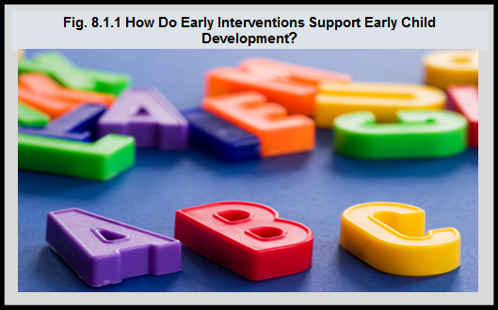
Notes:
Summary
Evidence suggests that policies that strengthen the foundations of health in early childhood may have long-lasting positive effects.¹ The following text provides examples of how data on early childhood development is being used to identify the early life determinants or predictors of school readiness to eventually inform decision-making:
– Reading to children and having a regular bedtime positively affect development.² A study in Canada found that reading to children daily was associated with better language development in children. Low-income families are less likely to engage in these activities. In all income groups, children who were read to daily had better receptive vocabulary scores than those who were not.³
– Developmental health at school entry of Canadian children is monitored in most provinces/territories with the Early Development Instrument.⁴ Low family income is associated with poorer Early Development Instrument (EDI) outcomes at both the individual and neighbourhood levels. An analysis from the Manitoba Centre for Health Policy (MCHP) showed that the odds of children being vulnerable in at least one EDI was 1.7 times greater for children in families on income assistance than for those in families not on income assistance.⁵
– Breastfeeding has a protective effect in reducing vulnerability. According to an analysis by the Manitoba Centre for Health Policy, children who were breastfed had reduced odds of being vulnerable in at least one EDI area of development (odds ratio = 0.86).⁵
¹Center on the Developing Child at Harvard University. The Foundations of Lifelong Health Are Built in Early Childhood. Cambridge, US: Center on the Developing Child at Harvard University; 2010. http://developingchild.harvard.edu/index.php/resources/ reports_and_working_papers/foundations-of-lifelong-health/ – accessed May 22, 2017. ²Marmot M, Allen J, Goldblatt P, et al. Fair Society, Healthy Lives: The Marmot Review. London, UK: The Marmot Review; 2010. http://www.instituteofhealthequity.org/resources-reports/fair-society-healthy-lives-the-marmot-review– accessed May 22, 2017. ³Thomas EM. Readiness to Learn at School Among Five-Year-Old Children in Canada. Ottawa, ON: Statistics Canada; 2006. ⁴Janus, M. & Offord, D. (2007). Development and psychometric properties of the Early Development Instrument (EDI): A measure of children’s school readiness. Canadian Journal of Behavioural Science, 39(1), 1-22. https://edi.offordcentre.com/wp/wp-content/uploads/2015/10/Janus-Offord-2007.pdf– accessed May 22, 2017. ⁵Santos R, Brownell M, Ekuma O, Mayer T, Soodeen R-A. The Early Development Instrument (EDI) in Manitoba: Linking Socioeconomic Adversity and Biological Vulnerability at Birth to Children’s Outcomes at Age 5. Winnipeg, MB: Manitoba Centre for Health Policy; 2012. http://mchp-appserv.cpe.umanitoba.ca/reference/MCHP_EDI_Report_WEB.pdf– accessed May 22, 2017.

Slide 3
Notes:
Summary
The Early Development Instrument (EDI): A innovative questionnaire measuring child development
The EDI and an early years video was created by the team at the Offord Centre for Child Studies, McMaster University with the help of ThinkLink Graphics.
To find out more about the Early Development Instrument (EDI) or to view the video (available in English and with French subtitles) please go to https://edi.offordcentre.com/about/what-is-the-edi/
Early Development Instrument (EDI) Domains
Communication Skills and General Knowledge The Communication Skills and General Knowledge domain includes skills to communicate needs and wants in socially appropriate ways, symbolic use of language, storytelling, and age-appropriate knowledge about the life and world around the child.
Emotional Maturity The Emotional Maturity domain includes the ability to think before acting, a balance between being too fearful and too impulsive, an ability to deal with feelings at the age-appropriate level, and empathetic responses to other people’s feelings.
Language and Cognitive Development The Language and Cognitive Development domain includes reading awareness, age-appropriate reading and writing skills, age-appropriate numeracy skills, ability to understand similarities and differences, and ability to recite back specific pieces of information from memory.
Physical Health and Well-being The Physical Health and Well-being domain includes gross and fine motor skills (e.g., holding a pencil, running on the playground, motor coordination), adequate energy levels for classroom activities, independence in looking after own needs, and daily living skills.
Social Competence The Social Competence domain includes curiosity about the world, eagerness to try new experiences, knowledge of standards of acceptable public behaviour, ability to control own behaviour, appropriate respect for adult authority, cooperation with others, following rules, and ability to play and work with other children.
“The Early Development Instrument (EDI) is a questionnaire developed by Dr. Dan Offord and Dr. Magdalena Janus at the Offord Centre for Child Studies at McMaster University. It is a 103-item questionnaire completed by kindergarten teachers in the second half of the school year that measures children’s ability to meet age-appropriate developmental expectations in five general domains (as described below): communication skills and general knowledge; emotional maturity; language and cognitive development; physical health and well-being; and social competence.”¹
Vulnerable children are those who, without additional support and care, are more likely to experience challenges in their school years and beyond. Vulnerability is assessed for each of the five EDI domains in comparison with a cut-off based on lowest 10th percentile boundary established on a normative sample.²
Children whose scores fall below the vulnerability cut-off on a particular EDI domain are said to be vulnerable in that area of development.³
Overall vulnerability, measured by combining the information from all five domains, indicates children who are vulnerable on one or more domains of the EDI. This group reflects children who are vulnerable for problems in later childhood by casting a wide net that includes all children who may benefit from universal programs. Children in this group may be vulnerable on only one domain or may be experiencing vulnerabilities on two, three, four or all five domains of the EDI.¹
¹What is the EDI? https://edi.offordcentre.com/researchers/how-to-interpret-edi-results/-accessed July 31, 2017. ² Janus, M. & Duku, E. (2007). The school entry gap: Socioeconomic, family, and health factors associated with children’s school readiness to learn. Early Education and Development, 18(3), 375-403. https://edi.offordcentre.com/wp/wp-content/uploads/2015/10/Janus-Offord-2007.pdf-accessed July 31, 2017. ³EDI BC 2016 Provincial Report. http://www.edibc2016.ca -accessed July 31, 2017.

Slide 4
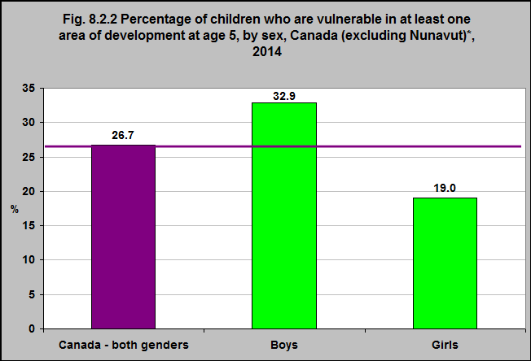
Notes:
Summary
The majority of children in Canada are doing well on each of the five Early Development Instrument (EDI)** areas of development (communication skills and general knowledge; emotional maturity; physical health and well-being; social competence; and, language and cognitive development).
Overall in Canada, one in four children (26.7%) is vulnerable in one or more areas of development prior to entering Grade 1.
Girls were less likely to be vulnerable at age 5 than boys.
32.9% of boys in Canada were vulnerable in one or more areas of development compared with 19% of girls.
**For more information on the Early Development Instrument (EDI) please go to https://edi.offordcentre.com/about/what-is-the-edi/

Slide 5
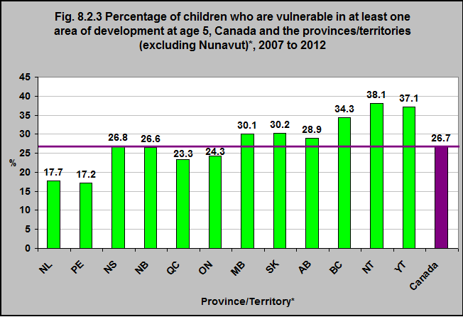
Notes:
Summary
The proportion of children age 5 who are vulnerable on one or more of the domains on the Early Development Instrument (EDI)** score varies between provinces and territories.
38.1% were vulnerable in the Northwest Territories and 17.2% were vulnerable in Prince Edward Island.
There are differences between how the EDI is administered between provinces and territories, as well as differences in how often it is administered. Therefore, the time period is not uniform – this needs to be considered when looking at differences across province/territories.
**For more information on the Early Development Instrument (EDI) go to https://edi.offordcentre.com/about/what-is-the-edi/
*The frequency of data collection varies across jurisdictions. Some jurisdictions have a 1-year data collection period, while others have a collection period of 2 or more years. The most recent data available is for the following periods: N.L.: 2012–2013; P.E.I.: 2007–2008; N.S.: 2012–2013; N.B.: 2008–2009; Que.: 2011–2012; Ont.: 2009–2010 to 2011–2012; Man.: 2012–2013; Sask.: 2008–2009 to 2010–2011; Alta.: 2008–2009 to 2012–2013; B.C.: 2011–2012 to 2012–2013; Y.T.: 2012–2013; N.W.T.: 2011–2012 to 2013–2014; Nunavut.: Not available. The Canadian average is calculated based on the most recent data for all available provinces and territories.
Source: CICH graphic created using data adapted from Canadian Institute for Health Information. Children Vulnerable in Areas of Early Development https://yourhealthsystem.cihi.ca/hsp/inbrief?lang=en#!/indicators/013/children-vulnerable-in-areas-of-early-development/;mapC1;mapLevel2;/ – accessed May 22, 2017.

Slide 6
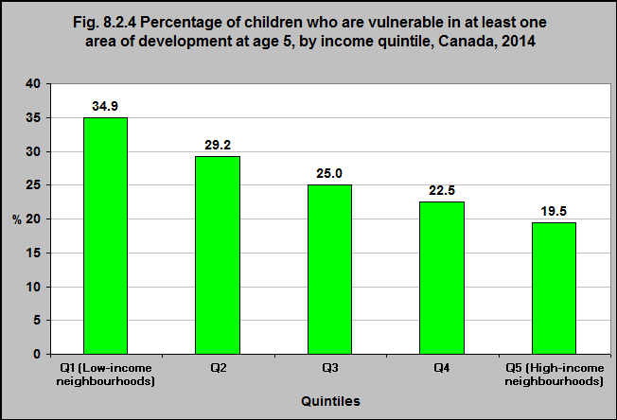
Notes:
Summary
Children living in the lowest income neighbourhoods were more likely to be vulnerable in at least one domain of the Early Development Instrument (EDI)* than were children in the highest income neighbourhoods, 34.9% and 19.5% respectively.
*For more information on the Early Development Instrument (EDI) go to https://edi.offordcentre.com/about/what-is-the-edi/
Source: CICH graphic created using data adapted from the Canadian Institute for Health Information. Children Vulnerable in Areas of Early Development: A Determinant of Child Health. Ottawa, ON: CIHI; 2014. https://secure.cihi.ca/free_products/Children_Vulnerable_in_Areas_of_Early_Development_EN.pdf -accessed July 24, 2017.

Slide 7
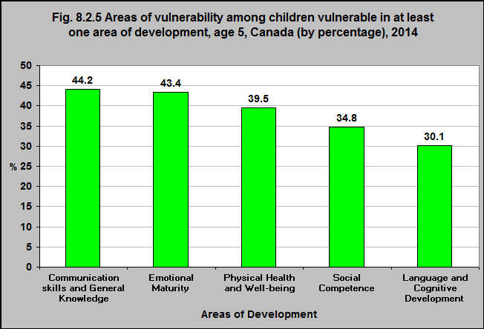
Notes:
Summary
The Communication Skills and General Knowledge domain of the Early Development Instrument (EDI)* includes skills to communicate needs and wants in socially appropriate ways, symbolic use of language, storytelling, and age-appropriate knowledge about the life and world around them.
The greatest vulnerability among children vulnerable in at least one area of development was in the domain of Communication Skills and General Knowledge.
The Language and Cognitive Development domain includes reading awareness, age-appropriate reading and writing skills, age-appropriate numeracy skills, ability to understand similarities and differences, and ability to recite back specific pieces of information from memory.
Language and Cognitive Development was the domain with the lowest rates of vulnerability.
*For more information on the Early Development Instrument (EDI) go to https://edi.offordcentre.com/about/what-is-the-edi/
Source: Canadian Institute for Health Information. Children Vulnerable in Areas of Early Development: A Determinant of Child Health. Ottawa, ON: CIHI; 2014.
https://secure.cihi.ca/free_products/Children_Vulnerable_in_Areas_of_Early_Development_EN.pdf – accessed May 22, 2017.

Slide 8
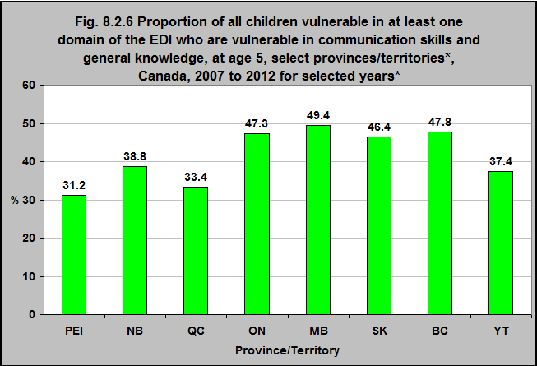
Notes:
Summary
The Communication Skills and General Knowledge domain of the Early Development Instrument (EDI)** includes skills to communicate needs and wants in socially appropriate ways, symbolic use of language, storytelling, and age-appropriate knowledge about the life and world around them.
Almost half of all children in Manitoba (49.4%) who are vulnerable in at least one area of the EDI are vulnerable in communications skills and general knowledge.
Less than one third (31.2%) of the children in PEI who are vulnerable in at least one area of the EDI are vulnerable in communications skills and general knowledge.
There are differences between how the EDI is administered between provinces and territories, as well as differences in how often it is administered. Therefore, the time period is not uniform – this needs to be considered when looking at differences across province/territories.
**For more information on the Early Development Instrument (EDI) go to https://edi.offordcentre.com/about/what-is-the-edi/
Notes: *Provincial/territorial analysis is available for only those jurisdictions that have complete province-/territory-wide coverage and have participated in this analysis. Data Years: P/T Data collection Period PE 2007-2008 NB 2008-2009 QC 2011-2012 ON 2009-2010 to 2011-2012 MB 2010-2011 SK 2008-2009 to 2010-2011 BC 2009-2010 to 2010-2011 YT 2011-2012 NT not available
Source: CICH graphic created using data adapted from Canadian Institute for Health Information. Children Vulnerable in Areas of Early Development: A Determinant of Child Health. Ottawa, ON: CIHI; 2014. https://secure.cihi.ca/free_products/Children_Vulnerable_in_Areas_of_Early_Development_EN.pdf -accessed July 24, 2017.

Slide 9
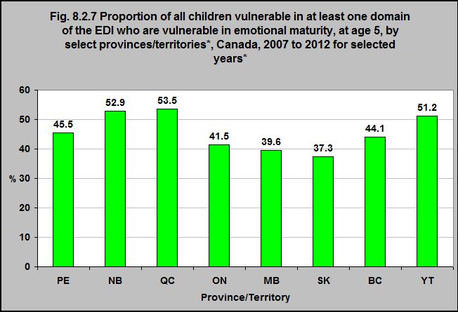
Notes:
Summary
The Emotional Maturity domain of the Early Development Instrument (EDI)** includes the ability to think before acting, a balance between being too fearful and too impulsive, an ability to deal with feelings at the age-appropriate level, and empathetic response to other people’s feelings.
More than half of all children in Québec and New Brunswick (53.5% and 52.9% respectively) who are vulnerable in at least one area of the EDI are vulnerable in emotional maturity.
37.3% of the children in Saskatchewan who are vulnerable in at least one area of the EDI are vulnerable in emotional maturity.
There are differences between how the EDI is administered between provinces and territories, as well as differences in how often it is administered. Therefore, the time period is not uniform – this needs to be considered when looking at differences across province/territories.
**For more information on the Early Development Instrument (EDI) go to https://edi.offordcentre.com/about/what-is-the-edi/
Notes: *Provincial/territorial analysis is available for only those jurisdictions that have complete province-/territory-wide coverage and have participated in this analysis. Data Years: P/T Data collection Period PE 2007-2008 NB 2008-2009 QC 2011-2012 ON 2009-2010 to 2011-2012 MB 2010-2011 SK 2008-2009 to 2010-2011 BC 2009-2010 to 2010-2011 YT 2011-2012 NT not available
Source: CICH graphic created using data adapted from Canadian Institute for Health Information. Children Vulnerable in Areas of Early Development: A Determinant of Child Health. Ottawa, ON: CIHI; 2014. https://secure.cihi.ca/free_products/Children_Vulnerable_in_Areas_of_Early_Development_EN.pdf -accessed July 24, 2017.

Slide 10
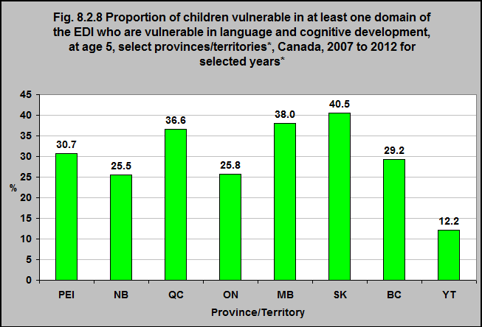
Notes:
Summary
The Language and Cognitive Development domain of the Early Development Instrument (EDI)** includes reading awareness, age-appropriate reading and writing skills, age-appropriate numeracy skills, ability to understand similarities and differences, and ability to recite back specific pieces of information from memory.
40.5% of all children in Saskatchewan who are vulnerable in at least one area of the EDI are vulnerable in language and cognitive development.
12.2% of the children in the Yukon who are vulnerable in at least one area of the EDI are vulnerable in language and cognitive development.
There are differences between how the EDI is administered between provinces and territories, as well as differences in how often it is administered. Therefore, the time period is not uniform – this needs to be considered when looking at differences across province/territories.
**For more information on the Early Development Instrument (EDI) go to https://edi.offordcentre.com/about/what-is-the-edi/
Notes: *Provincial/territorial analysis is available for only those jurisdictions that have complete province-/territory-wide coverage and have participated in this analysis. Data Years: P/T Data collection Period PE 2007-2008 NB 2008-2009 QC 2011-2012 ON 2009-2010 to 2011-2012 MB 2010-2011 SK 2008-2009 to 2010-2011 BC 2009-2010 to 2010-2011 YT 2011-2012 NT not available
Source: CICH graphic created using data adapted from Canadian Institute for Health Information. Children Vulnerable in Areas of Early Development: A Determinant of Child Health. Ottawa, ON: CIHI; 2014. https://secure.cihi.ca/free_products/Children_Vulnerable_in_Areas_of_Early_Development_EN.pdf -accessed July 24, 2017.

Slide 11
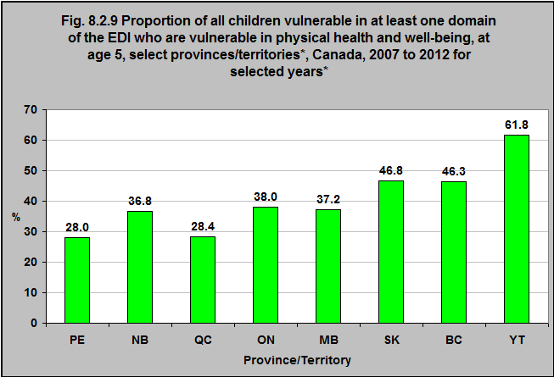
Notes:
Summary
The Physical Health and Well-being domain of the Early Childhood Instrument (EDI)** includes gross and fine motor skills (e.g., holding a pencil, running on the playground, motor coordination), adequate energy levels for classroom activities, independence in looking after own needs, and daily living skills.
61.8% of all children in the Yukon who are vulnerable in at least one area of the EDI are vulnerable in physical health and well-being.
28.0% of the children in Prince Edward Island and Québec who are vulnerable in at least one area of the EDI are vulnerable in physical health and well-being.
There are differences between how the EDI is administered between provinces and territories, as well as differences in how often it is administered. Therefore, the time period is not uniform – this needs to be considered when looking at differences across province/territories.
**For more information on the Early Development Instrument (EDI) go to https://edi.offordcentre.com/about/what-is-the-edi/
Notes: *Provincial/territorial analysis is available for only those jurisdictions that have complete province-/territory-wide coverage and have participated in this analysis. Data Years: P/T Data collection Period PE 2007-2008 NB 2008-2009 QC 2011-2012 ON 2009-2010 to 2011-2012 MB 2010-2011 SK 2008-2009 to 2010-2011 BC 2009-2010 to 2010-2011 YT 2011-2012 NT not available
Source: CICH graphic created using data adapted from Canadian Institute for Health Information. Children Vulnerable in Areas of Early Development: A Determinant of Child Health. Ottawa, ON: CIHI; 2014. https://secure.cihi.ca/free_products/Children_Vulnerable_in_Areas_of_Early_Development_EN.pdf -accessed July 24, 2017.

Slide 12
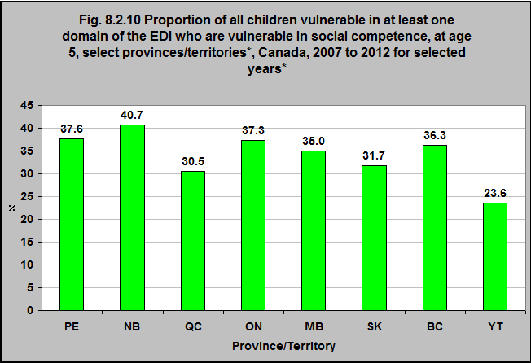
Notes:
Summary
The Social Competence domain of the Early Learning Instrument (EDI)** includes curiosity about the world, eagerness to try new experiences, knowledge of standards of acceptable public behaviour, ability to control own behaviour, appropriate respect for adult authority, cooperation with others, following rules, and ability to play and work with other children.
40.7% of all children in New Brunswick who are vulnerable in at least one area of the EDI are vulnerable in social competence.
23.6% of the children in the Yukon who are vulnerable in at least one area of the EDI are vulnerable in social competence.
There are differences between how the EDI is administered between provinces and territories, as well as differences in how often it is administered. Therefore, the time period is not uniform – this needs to be considered when looking at differences across province/territories.
**For more information on the Early Development Instrument (EDI) go to https://edi.offordcentre.com/about/what-is-the-edi/
Notes: *Provincial/territorial analysis is available for only those jurisdictions that have complete province-/territory-wide coverage and have participated in this analysis. Data Years: P/T Data collection Period PE 2007-2008 NB 2008-2009 QC 2011-2012 ON 2009-2010 to 2011-2012 MB 2010-2011 SK 2008-2009 to 2010-2011 BC 2009-2010 to 2010-2011 YT 2011-2012 NT not available
Source: CICH graphic created using data adapted from Canadian Institute for Health Information. Children Vulnerable in Areas of Early Development: A Determinant of Child Health. Ottawa, ON: CIHI; 2014. https://secure.cihi.ca/free_products/Children_Vulnerable_in_Areas_of_Early_Development_EN.pdf -accessed July 24, 2017.

Slide 13
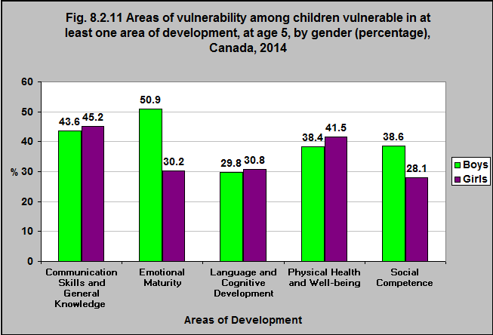
Notes:
Summary
Boys are more likely than girls to be vulnerable in the Early Development Instrument (EDI)* domain areas of emotional maturity and social competence.
The Emotional Maturity domain includes the ability to think before acting, a balance between being too fearful and too impulsive, an ability to deal with feelings at the age-appropriate level, and empathetic response to other people’s feelings.
The Social Competence domain includes curiosity about the world, eagerness to try new experiences, knowledge of standards of acceptable public behaviour, ability to control own behaviour, appropriate respect for adult authority, cooperation with others, following rules, and ability to play and work with other children.
*For more information on the Early Development Instrument (EDI) go to https://edi.offordcentre.com/about/what-is-the-edi/
Source: CICH graphic created using data adapted from Canadian Institute for Health Information. Children Vulnerable in Areas of Early Development: A Determinant of Child Health. Ottawa, ON: CIHI; 2014. https://secure.cihi.ca/free_products/Children_Vulnerable_in_Areas_of_Early_Development_EN.pdf -accessed July 24, 2017.

Slide 14
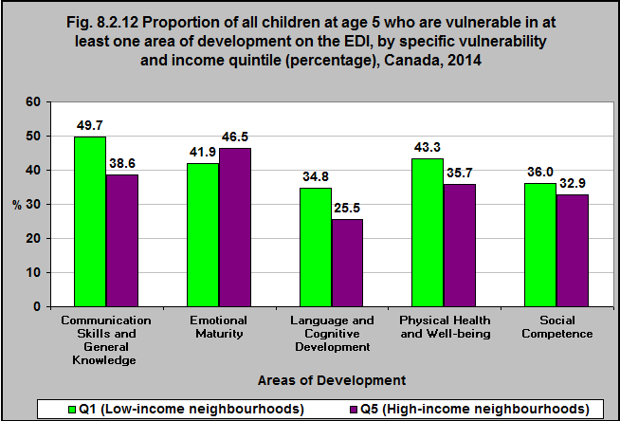
Notes:
Summary
Children living in low income neighbourhoods are more likely to be vulnerable in the Early Development Instrument (EDI) domains of communication skills and general knowledge, language and cognitive development, physical health and well-being and social competence than are children living in high income neighbourhoods.
Children in high income neighbourhoods are more likely to be vulnerable in the domain of emotional maturity than children living in low income neighbourhoods.
The Communication Skills and General Knowledge domain includes skills to communicate needs and wants in socially appropriate ways, symbolic use of language, storytelling, and age-appropriate knowledge about the life and world around.
The Language and Cognitive Development domain includes reading awareness, age-appropriate reading and writing skills, age-appropriate numeracy skills, ability to understand similarities and differences, and ability to recite back specific pieces of information from memory.
The Physical Health and Well-being domain includes gross and fine motor skills (e.g., holding a pencil, running on the playground, motor coordination), adequate energy levels for classroom activities, independence in looking after own needs, and daily living skills.
The Emotional Maturity domain includes the ability to think before acting, a balance between being too fearful and too impulsive, an ability to deal with feelings at the age-appropriate level, and empathetic response to other people’s feelings.
*For more information on the Early Development Instrument (EDI) go to https://edi.offordcentre.com/about/what-is-the-edi/
Note: The denominator of all of these proportions is the number of children who are vulnerable in at least one area of development on the EDI.
Source: CICH graphic created using data adapted from Canadian Institute for Health Information. Children Vulnerable in Areas of Early Development: A Determinant of Child Health. Ottawa, ON: CIHI; 2014. https://secure.cihi.ca/free_products/Children_Vulnerable_in_Areas_of_Early_Development_EN.pdf -accessed July 24, 2017.

Slide 15
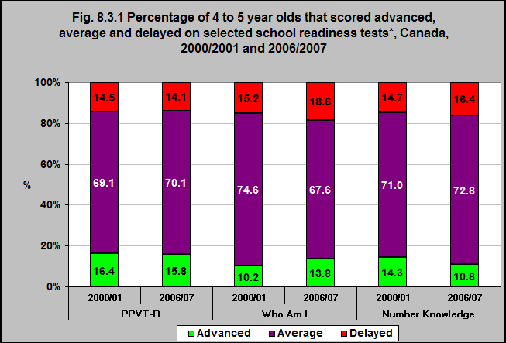
Notes:
Summary
In 2006/07, the majority of children from 4 to 5 years of age demonstrated an ability to hear and understand vocabulary.
In 2006/07, 70.1% of children from 4 to 5 years of age scored at the average level on the Peabody Picture Vocabulary Test (PPVT-R) and another 15.8% scored at the advanced level – for a total of 85.9%. This was marginally up from 85.5% in 2000/01.
The majority – 81.4% – also scored average or advanced on the Who Am I test in 2006/07 – down from 84.8% in 2000/01.
83.6% of children from 4 to 5 years of age scored average or advanced on the Number Knowledge test in 2006/07 – down from 85.3% in 2000/01.
Notes: *There are a number of measures of school readiness/academic ability among 4 and 5 year-olds. The Peabody Picture Vocabulary Test (PPVT-R) assesses a child’s verbal ability and scholastic aptitude by having them look at pictures and identify the picture that matches a word spoken by an interviewer. The Who Am I? test involves copying and writing tasks. The copying tasks in the assessment are designed to assess the child’s ability to conceptualize and reconstruct a geometrical shape. The writing tasks assess the ability of the child to understand and use symbolic representations such as numbers, letters and words. The child’s ability to complete the tasks depends on many factors including maturity, culture, experiences, and language skills. The Number Knowledge test assesses a child’s ability to understand and use numbers
Source: CICH graphic using data adapted from The Well-Being of Canada’s Children, Government of Canada Report, 2011. http://www.dpe-agje-ecd-elcc.ca/eng/ecd/well-being/sp_1027_04_12_eng.pdf -accessed July 28, 2017

Slide 16
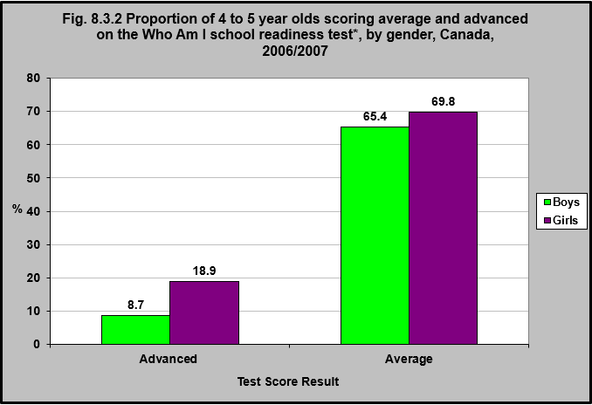
Notes:
Summary
Girls are more likely to score advanced on the Who Am I test than are boys – 18.9% compared with 8.7%.
Note: *The Who Am I? test involves copying and writing tasks. The copying tasks in the assessment are designed to assess the child’s ability to conceptualize and reconstruct a geometrical shape. The writing tasks assess the ability of the child to understand and use symbolic representations such as numbers, letters and words. The child’s ability to complete the tasks depends on many factors including maturity, culture, experiences, and language skills.
Source: CICH graphic using data adapted from The Well-Being of Canada’s Children, Government of Canada Report, 2011. http://www.dpe-agje-ecd-elcc.ca/eng/ecd/well-being/sp_1027_04_12_eng.pdf -accessed July 28, 2017.

Slide 17
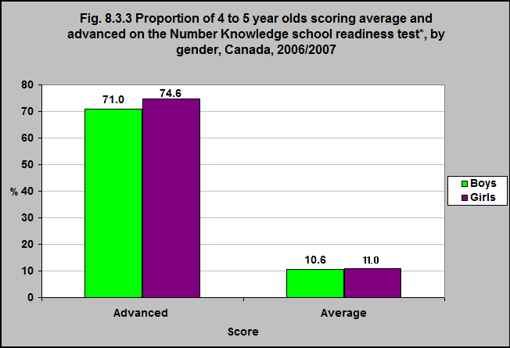
Notes:
Summary
Boys’ and girls’ scores are approximately equal on the Number Knowledge test.
Note: *The Number Knowledge test assesses a child’s ability to understand and use numbers.
Source: CICH graphic using data adapted from The Well-Being of Canada’s Children, Government of Canada Report, 2011. http://www.dpe-agje-ecd-elcc.ca/eng/ecd/well-being/sp_1027_04_12_eng.pdf -accessed July 28, 2017.

Slide 18
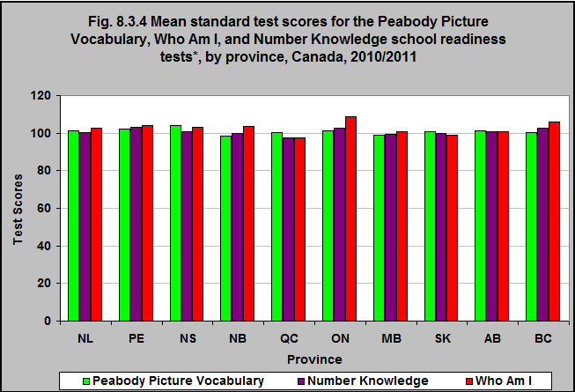
Notes:
Summary
The mean standardized test scores on the Peabody Picture Vocabulary, Number Knowledge and Who Am I tests vary between the provinces.
New Brunswick and Manitoba’s mean scores are 99 on the Peabody Picture Vocabulary test while Nova Scotia’s is 104.
Québec’s mean score on the Number Knowledge test is 97 while that score is 103 in PEI, Ontario and British Columbia.
The mean Who Am I score is 109 in Ontario and 98 in Québec.
Notes: *There are a number of measures of school readiness/academic ability among 4- and 5-year-olds. The Peabody Picture Vocabulary Test assesses a child’s verbal ability and scholastic aptitude by having them look at pictures and identify the picture that matches a word spoken by an interviewer. The Who Am I? test involves copying and writing tasks. The copying tasks in the assessment are designed to assess the child’s ability to conceptualize and reconstruct a geometrical shape. The writing tasks assess the ability of the child to understand and use symbolic representations such as numbers, letters and words. The child’s ability to complete the tasks depends on many factors including maturity, culture, experiences, and language skills. The Number Knowledge test assesses a child’s ability to understand and use numbers.
Source: CICH graphic using data adapted from the Survey of Young Canadians 2010/2011, Statistics Canada, custom run

Slide 19
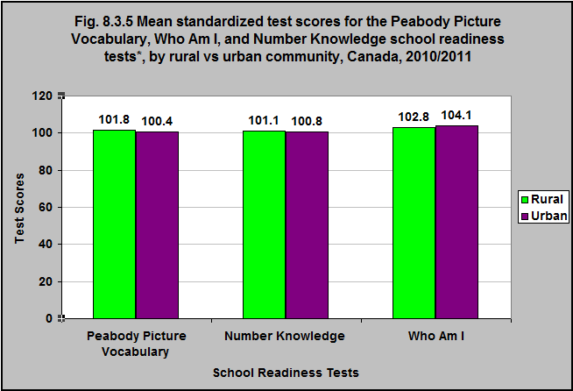
Notes:
Summary
Children living in urban and rural communities score relatively equally on the Peabody Picture Vocabulary, Number Knowledge and Who Am I school readiness tests.
Notes: *There are a number of measures of school readiness/academic ability among 4- and 5-year-olds. The Peabody Picture Vocabulary Test assesses a child’s verbal ability and scholastic aptitude by having them look at pictures and identify the picture that matches a word spoken by an interviewer. The Who Am I? test involves copying and writing tasks. The copying tasks in the assessment are designed to assess the child’s ability to conceptualize and reconstruct a geometrical shape. The writing tasks assess the ability of the child to understand and use symbolic representations such as numbers, letters and words. The child’s ability to complete the tasks depends on many factors including maturity, culture, experiences, and language skills. The Number Knowledge test assesses a child’s ability to understand and use numbers.
Source: CICH graphic using data adapted from the Survey of Young Canadians 2010/2011, Statistics Canada, custom run.

Slide 20
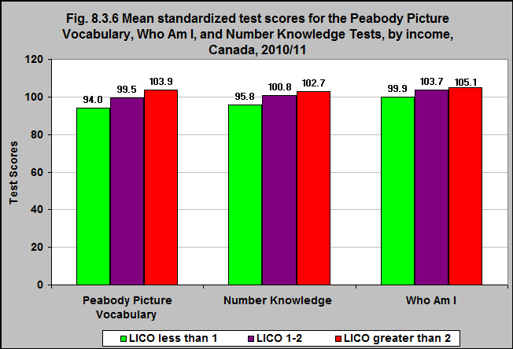
Notes:
Summary
The mean scores for the Peabody Picture Vocabulary, Number Knowledge and Who Am I school readiness tests were higher among children living in higher income communities than in lower (using the LICO**).
**The low income cut-offs (LICOs) are income thresholds below which a family will likely devote a larger share of its income on the necessities of food, shelter and clothing than the average family. The approach is essentially to estimate an income threshold at which families are expected to spend 20 percentage points more than the average family on food, shelter and clothing. For 2011, the 1992 based after-tax LICO for a family of four living in an community with a population between 30,000 and 99,999 is $30,487, expressed in current dollars. Accessed February 24, 2017 at http://www.statcan.gc.ca/pub/75f0002m/2012002/lico-sfr-eng.htm
Notes: *There are a number of measures of school readiness/academic ability among 4- and 5-year-olds. The Peabody Picture Vocabulary Test assesses a child’s verbal ability and scholastic aptitude by having them look at pictures and identify the picture that matches a word spoken by an interviewer. The Who Am I? test involves copying and writing tasks. The copying tasks in the assessment are designed to assess the child’s ability to conceptualize and reconstruct a geometrical shape. The writing tasks assess the ability of the child to understand and use symbolic representations such as numbers, letters and words. The child’s ability to complete the tasks depends on many factors including maturity, culture, experiences, and language skills. The Number Knowledge test assesses a child’s ability to understand and use numbers.
Source: CICH graphic using data adapted from the Survey of Young Canadians 2010/2011, Statistics Canada, custom run.

Slide 21
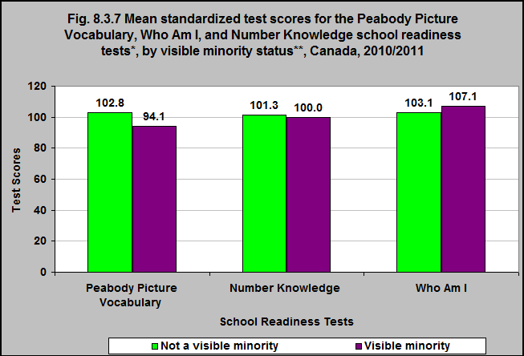
Notes:
Summary
The mean standardized scores on the Peabody Picture Vocabulary and Number Knowledge tests among 4 to 5 year olds are higher among those children who do not identify with a visible minority group** than among those who do identify with a visible minority group.
Children from visible minority groups have higher mean scores on the Who Am I test than do those who are not from visible minority groups.
**Self-identified as belonging to a racial or cultural group other than “White” (does not include Indigenous).
Notes: *There are a number of measures of school readiness/academic ability among 4- and 5-year-olds. The Peabody Picture Vocabulary Test assesses a child’s verbal ability and scholastic aptitude by having them look at pictures and identify the picture that matches a word spoken by an interviewer. The Who Am I? test involves copying and writing tasks. The copying tasks in the assessment are designed to assess the child’s ability to conceptualize and reconstruct a geometrical shape. The writing tasks assess the ability of the child to understand and use symbolic representations such as numbers, letters and words. The child’s ability to complete the tasks depends on many factors including maturity, culture, experiences, and language skills. The Number Knowledge test assesses a child’s ability to understand and use numbers.
Source: CICH graphic using data adapted from the Survey of Young Canadians 2010/2011, Statistics Canada, custom run.

Slide 22
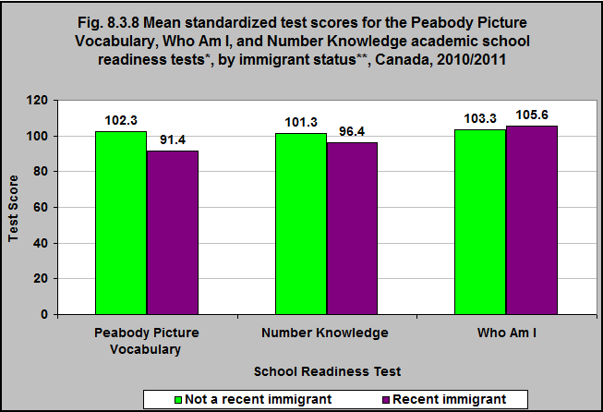
Notes:
Summary
Children whose families have come to Canada in the 10 years prior to the survey have lower mean scores on the Peabody Picture Vocabulary and Number Knowledge school readiness tests than do those who are non-recent immigrants.
Notes: *There are a number of measures of school readiness/academic ability among 4- and 5-year-olds: – The Peabody Picture Vocabulary Test assesses a child’s verbal ability and scholastic aptitude by having them look at pictures and identify the picture that matches a word spoken by an interviewer. – The Who Am I? test involves copying and writing tasks. The copying tasks in the assessment are designed to assess the child’s ability to conceptualize and reconstruct a geometrical shape. The writing tasks assess the ability of the child to understand and use symbolic representations such as numbers, letters and words. The child’s ability to complete the tasks depends on many factors including maturity, culture, experiences, and language skills. – The Number Knowledge test assesses a child’s ability to understand and use numbers. **At least one parent reported that they had become a landed immigrant in Canada in the 10 years prior to the survey.
Source: CICH graphic using data adapted from the Survey of Young Canadians 2010/2011, Statistics Canada, custom run.

Slide 23
Health and Development in the Early Years:
Developmental Outcomes Consolidated Results
Notes:
Summary
Young children are in an intense period of development – physically, emotionally and cognitively – as they move from complete dependence upon others to having the ability to act and express themselves independently and develop social relationships. What happens before children enter school has a strong influence on how well they will fare once they are in the classroom. Research shows that the most successful children in school are those who were nurtured and stimulated when they were infants, toddlers and preschoolers. Such children are exposed to books, ideas, and number concepts; they are introduced to problem-solving techniques and they have opportunities to develop their social and emotional skills in group settings. With the skills acquired through these activities and children’s innate abilities and temperament, they have a learning base upon which they can thrive, and they arrive at school ready to learn.
The Early Development Instrument, or the EDI for short, is a questionnaire developed by Dr. Dan Offord and Dr. Magdalena Janus at the Offord Centre for Child Studies at McMaster University. It is a 103-item questionnaire completed by kindergarten teachers in the second half of the school year that measures children’s ability to meet age-appropriate developmental expectations in five general domains: Physical Health and Well-Being; Social Competence; Emotional Maturity; Language and Cognitive Development; and Communications Skills and General Knowledge. Overall Vulnerability, measured by combining the information from all five domains, indicates children who are vulnerable on one or more domains of the EDI. This group reflects children who are vulnerable for problems in later childhood by casting a wide net that includes all children who may benefit from universal programs. Children in this group may be vulnerable on only one domain or may be experiencing vulnerabilities on two, three, four or all five domains of the EDI.
The majority of children in Canada are doing well on each of the five EDI areas of development. Overall in Canada, one in four children (26.7%) is vulnerable in one or more areas of development prior to entering Grade 1. In 2014, girls were less likely to be vulnerable at age 5 than boys. The proportion of children age 5 who are vulnerable on one or more of the domains on the EDI score varies between provinces and territories. (Note: There are differences in how the EDI is administered between provinces and territories, as well as differences in how often it is administered. Therefore, the time period is not uniform – we need to consider that when looking at differences across provinces/territories.) Children living in the lowest income neighbourhoods were more likely to be vulnerable on at least one domain of the EDI than were children in the highest income neighbourhoods.
In 2014, the greatest vulnerability among children vulnerable in at least one area of development was in the domain of Communication Skills and General Knowledge. (this includes skills to communicate needs and wants in socially appropriate ways, symbolic use of language, storytelling, and age-appropriate knowledge about the life and world around.) Language and Cognitive Development was the domain with the lowest vulnerability rates (this includes reading awareness, age-appropriate reading and writing skills, age-appropriate numeracy skills, ability to understand similarities and differences, and ability to recite back specific pieces of information from memory).
Boys are more likely than girls to be vulnerable in the EDI domain areas of emotional maturity and social competence. The Emotional Maturity domain includes the ability to think before acting, a balance between being too fearful and too impulsive, an ability to deal with feelings at the age-appropriate level, and empathetic response to other people’s feelings. The Social Competence domain includes curiosity about the world, eagerness to try new experiences, knowledge of standards of acceptable public behaviour, ability to control own behaviour, appropriate respect for adult authority, cooperation with others, following rules, and ability to play and work with other children.
Children living in low income neighbourhoods are more likely to be vulnerable in the EDI domains of communication skills and general knowledge, language and cognitive development, and physical health and well-being than are children living in high income neighbourhoods. Children in high-income neighbourhoods are more likely to be vulnerable in the domain of emotional maturity than children living in low-income neighbourhoods. (The Physical Health and Well-being domain includes gross and fine motor skills such as holding a pencil, running on the playground, motor coordination; adequate energy levels for classroom activities; independence in looking after own needs; and daily living skills.)
Three tests were administered as part of the National Longitudinal Survey of Children and Youth and the Survey of Young Canadians to measure academic ability and school readiness among 4- and 5-year-olds. One is the Peabody Picture Vocabulary Test, which assesses a child’s verbal ability and scholastic aptitude by having them look at pictures and identify the picture that matches a word spoken by an interviewer. In 2006/07, the majority of children from 4 to 5 years of age scored at the average or advanced level on the Peabody Picture Vocabulary Test (about 86%).
The second is the Who Am I? test, which involves copying and writing tasks – measuring the child’s ability to conceptualize and reconstruct a geometrical shape and to understand and use numbers, letters and words. The child’s ability to complete the tasks depends on many factors including maturity, culture, experiences, and language skills. The majority of children from 4 to 5 years of age (just over 81%) scored average or advanced on the Who Am I test in 2006/07.
Finally, the Number Knowledge test assesses a child’s ability to understand and use numbers. In 2006/07, the majority of 4 to 5 year-olds scored average or advanced on the Number Knowledge test (almost 84%).
Girls were more likely to score advanced on the Who Am I test than were boys. Boys’ and girls’ scores were approximately equal on the Number Knowledge test. The test scores on the Peabody Picture Vocabulary, Number Knowledge and Who Am I tests vary between the provinces. In 2010/11, children living in urban and rural communities scored relatively equally on the Peabody Picture Vocabulary, Number Knowledge and Who Am I school readiness tests. The mean scores for all three school readiness tests were higher among children living in higher income communities than for those in lower income communities.
The mean scores on the Peabody Picture Vocabulary were also higher among those children who do not identify with a visible minority group than among those who do identified with a visible minority group. Children from visible minority groups have higher mean scores on the Who Am I test than do those who are not from visible minority groups. Children whose families had come to Canada in the 10 years prior to the survey had lower mean scores on the Peabody Picture Vocabulary and Number Knowledge school readiness tests than non-recent immigrants.
¹What is the EDI? https://edi.offordcentre.com/researchers/how-to-interpret-edi-results/ -accessed July 31, 2017.

