Slide 1

The following section examines environmental risks and conditions impacting Canadian children aged 0-5 and their families. Information on exposures to environmental toxins such as lead, mercury, phthalates, tobacco smoke and UV radiation are provided. Air and water issues are presented including the presence of mould, indoor and outdoor air pollution, water quality and asthma incidence. The impact of climate change, related greenhouse gas emissions and their impacts on future generations is also presented.

Slide 2
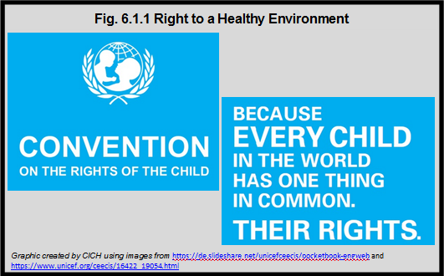
Notes:
Summary
On November 20, 1989, the United Nations General Assembly adopted the Convention on the Rights of the Child and opened it for signature. It came into force on September 2, 1990, after it was ratified by the required number of nations. 194 countries, including Canada, have ratified the Convention on the Rights of the Child, making a promise to children to protect and promote their rights to survive and thrive, to learn and grow, to make their voices heard and to reach their full potential.¹
Article 24 and Article 29 of The United Nations Convention on the Rights of the Child provide child rights protections related to the environment.
Article 24 is related to a child’s right to the highest attainable standard of health, including the right to nutritious food and safe drinking water as well as protection from environmental pollution.
Article 29 is related to the child’s right to information on environmental health issues and defines environmental education as one of the goals of education.
Together these Articles, as well as many other Articles within the Convention on the Rights of the Child, help protect children’s rights, including their right to a safe and healthy environment.
¹ United Nations Human Rights Office of the High Commissioner. Convention on the Rights of the Child. http://www.ohchr.org/EN/ProfessionalInterest/Pages/CRC.aspx– accessed March 12th, 2017.
Article 24
1. States Parties recognize the right of the child to the enjoyment of the highest attainable standard of health and to facilities for the treatment of illness and rehabilitation of health. States Parties shall strive to ensure that no child is deprived of his or her right of access to such health care services.
2. States Parties shall pursue full implementation of this right and, in particular, shall take appropriate measures:
(a) To diminish infant and child mortality;
(b) To ensure the provision of necessary medical assistance and health care to all children with emphasis on the development of primary health care;
(c) To combat disease and malnutrition, including within the framework of primary health care, through, inter alia, the application of readily available technology and through the provision of adequate nutritious foods and clean drinking-water, taking into consideration the dangers and risks of environmental pollution.
Article 29
1. States Parties agree that the education of the child shall be directed to:
(a) The development of the child’s personality, talents and mental and physical abilities to their fullest potential;
(b) The development of respect for human rights and fundamental freedoms, and for the principles enshrined in the Charter of the United Nations;
(c) The development of respect for the child’s parents, his or her own cultural identity, language and values, for the national values of the country in which the child is living, the country from which he or she may originate, and for civilizations different from his or her own;
(d) The preparation of the child for responsible life in a free society, in the spirit of understanding, peace, tolerance, equality of sexes, and friendship among all peoples, ethnic, national and religious groups and persons of indigenous origin;
(e) The development of respect for the natural environment.

Slide 3
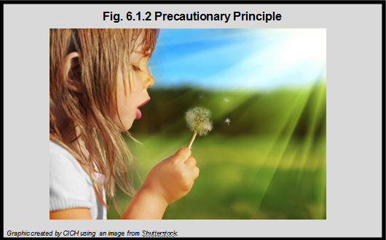
Notes:
Summary
The Precautionary Principle urges action in the best interests of children based on the information available at a given point in time. With regard to environmental issues, waiting for absolute and conclusive research can potentially put a generation of children at unnecessary risk.¹
The Precautionary Principle:
When an activity raises threats of harm to the environment or human health, precautionary measures should be taken, even if some cause and effect relationships are not fully established scientifically.²
Key Elements:²
• Taking anticipatory action in the face of scientific uncertainty
• Exploring alternatives to possibly harmful actions
• Placing the burden of proof on proponents of an activity rather than on the victims or potential victims of the activity; and
• Using democratic processes to carry out and enforce the Principle, including the public right to informed consent.
¹Canadian Institute of Child Health. The Health of Canada’s Children and Youth: A CICH Profile. Guiding Principles. http://profile.cich.ca/en/index.php/guiding-principles– accessed March 12th, 2017.
²Raffensperger, C. 1999. Protecting Public Health and the Environment – Implementing the Precautionary Principle.

Slide 4
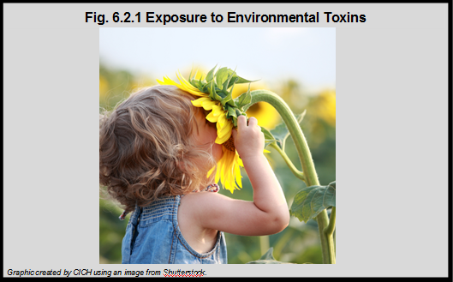
Notes:
Summary
Children have heightened vulnerability to a variety of exposures as a consequence of their developmental, behavioural and physiological characteristics.
They receive greater exposures per unit of body weight than adults because – for their size – they eat more food, drink more liquids and breathe more air than adults. Because of young children’s physical development, their bodies are less able to manage environmental toxins.
Exposures at this critical period of development can result in irreversible damage to the growing nervous system, affect emerging behaviour patterns, cause immune dysfunction and have serious reproductive effects.
Young children’s behaviour often places them at higher risk than adults to certain environmental hazards, including their exploratory behaviour, frequent hand-to-mouth activity and proximity to the ground – all of which result in greater contact with sources of contamination.¹
¹Canadian Institute of Child Health. 2000. The Health of Canada’s Children: A CICH Profile. p.252.

Slide 5
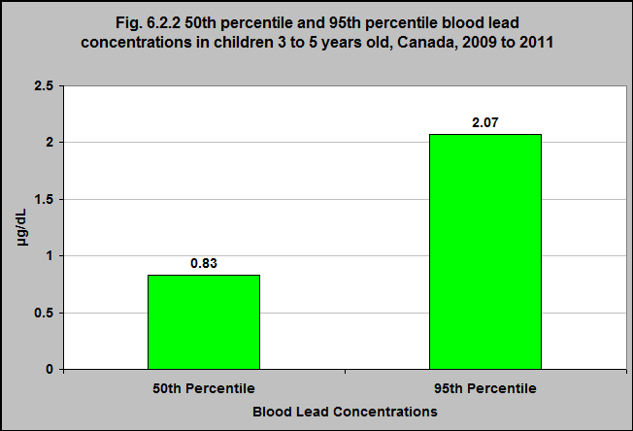
Notes:
Summary
All children and youth in Canada are exposed to lead. It occurs naturally in the environment in rock and soil, and is present in human-made products.¹
The most common route of exposure to lead is in and around the home.
According to the Canadian Health Measures Survey (2009-2011), the blood lead level of every child aged 3 to 5 years was above the limit of detection. We would expect this due to the many sources of lead exposure.
The median concentration was 0.83 µg/dL (meaning 50% of children have blood lead levels above 0.83 µg/dL) and the 95th percentile concentration was 2.07 µg/dL (meaning 5% of children have blood lead levels above 2.07 µg/dL).
The values are slightly lower in girls than boys²
Younger children have higher blood lead concentrations than do older children as they generally spend more time playing in soil and have a greater tendency to put objects that may contain lead in their mouths, such as toys. Childhood blood lead levels generally peak between the ages of 1 to 3 years old for these reasons.³
¹Health Canada. Environmental and Workplace Health: Lead. (2013) http://www.hc-sc.gc.ca/ewh-semt/contaminants/lead-plomb/index-eng.php– accessed March 12th 2017.
²Statistics Canada, Canadian Health Measures Survey, 2007-2009 and 2009-2011 – custom runs.
³Health Canada. 2013. Final Human Health State of the Science Report on Lead. http://www.hc-sc.gc.ca/ewh-semt/alt_formats/pdf/pubs/contaminants/dhhssrl-rpecscepsh/dhhssrl-rpecscepsh-eng.pdf– accessed March 12th, 2017.
Source: CICH graphic created using data adapted from Statistics Canada, Canadian Health Measures Survey, 2007-2009 and 2009-2011 – custom runs.

Slide 6
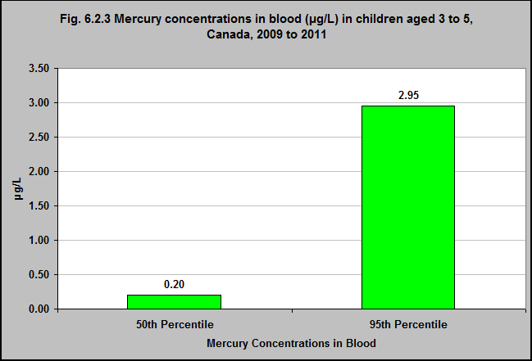
Notes:
Summary
According to the Canadian Health Measures Survey, for children and youth aged 3 to 5 in Canada, the median (50th percentile) and 95th percentile blood mercury concentrations in 2009-2011 were 0.20 µg/L and 3.0 µg/L, respectively. However this age group had the highest concentration of all children up to 18.
Recent Canadian research recommends a maximum guidance value of 8μg/L for children under 19, pregnant women and women of childbearing age.²
Implications
Mercury exposure can have significant negative health consequences for young children including neurological, renal, cardiovascular, and immunological effects.¹
¹Environment and Climate Change Canada. Health Concerns. (last modified 2013). Mercury. https://www.ec.gc.ca/mercure-mercury/default.asp?lang=En&n=0EB35C98-1 – accessed March 12th, 2017.
²Legrand, M., Feeley, M., Tikhonov, C., Schoen, D., & Li-Muller, A. (2010). Methylmercury blood guidance values for Canada. Canadian Journal of Public Health, 101(1), 28-31.
Note: This data reflects the children and youth whose concentration of the chemical met or surpassed the limit of detection. The 50th percentile concentration is the middle concentration, above and below which there is an equal number of values. The 95th percentile concentration is among the highest exposures.
Source: CICH graphic created using data adapted from Statistics Canada, Canadian Health Measures Survey, 2007-2009 and 2009-2011 – custom runs.

Slide 7
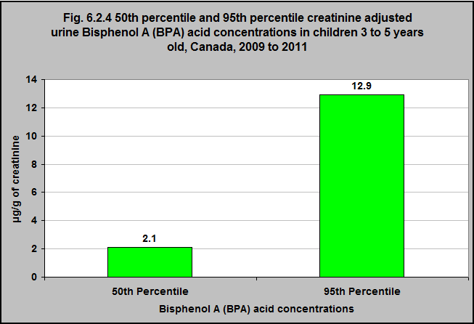
Notes:
Summary
Bisphenol A (BPA) is a man-made chemical known for its widespread use in consumer products.
According to the Canadian Health Measures Survey, for children and youth aged 3 to 5 in Canada, the median (50th percentile) and 95th percentile blood mercury concentrations in 2009-2011 were 2.1 µg/g of creatinine and 12.9 µg/g of creatinine, respectively.
Implications
In humans, BPA acts as an endocrine disruptor, interfering with the production and action of hormones. Hormones play important roles in physiological processes in the human body. Altering the effectiveness of hormones can have serious repercussions on behaviour, adolescent development, and reproduction. ¹
There are other negative health outcomes that have been linked to BPA exposure. For many of them, the evidence is not conclusive. They include behavioural issues, altered neurodevelopment, mental health problems and increased risk of asthma, as well as prenatal effects on the fetus, including increased risk of spontaneous abortion, low birth weight and childhood obesity.²,³
Children and youth are exposed to Bisphenol A (BPA) primarily through the consumption of foods and beverages that have absorbed BPA from their packaging.² They are also exposed to this chemical via contact with air, drinking water, soil, dust, and the use of a variety of products.
There are now regulations that limit the use of BPA in some consumer products, such as infant bottles. However, BPA is still present in some products available in Canada, potentially exposing children and youth to this chemical on a regular basis.
¹United States Environmental Protection Agency. (2013). America’s Children and the Environment, Third Edition. https://www.epa.gov/sites/production/files/2015-06/documents/ace3_2013.pdf – accessed March 12th, 2017.
²Health Canada. (2013). Second Report on Human Biomonitoring of Environmental Chemicals in Canada: Results of the Canadian Health Measures Survey Cycle 2 (2009-2011). http://www.hc-sc.gc.ca/ewh-semt/alt_formats/pdf/pubs/contaminants/chms-ecms-cycle2/chms-ecms-cycle2-eng.pdf – accessed March 12th, 2017.
³Braun, J.M., Kalkbrenner, A.E., Calafat, A.M., Yolton, K., Ye, X., Dietrich, K.N., & Lanphear, B.P. (2011). Impact of early-life Bisphenol A exposure on behavior and executive function in children. Pediatrics, 128, 873-882. doi:10.1542/peds.2011-1335.
Note: This data reflects the children and youth whose concentration of the chemical met or surpassed the limit of detection. The 50th percentile concentration is the middle concentration, above and below which there is an equal number of values. The 95th percentile concentration is among the highest exposures.
Source: CICH graphic created using data adapted from Statistics Canada, Canadian Health Measures Survey, 2007-2009 custom runs.

Slide 8
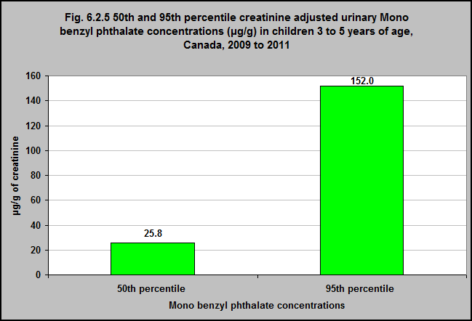
Notes:
Summary
Mono benzyl phthalate (MBzP) is the primary metabolite of benzyl butyl phthalate (BBP). Measures have been taken to reduce human exposure to BBP including Health Canada’s restrictions on the use of this phthalate in children’s toys and child-care products.¹
One hundred percent of Canadians have urinary creatinine-adjusted mono-benzyl phthalate metabolite (MBzP) concentrations that meet or exceed the limit of detection. The median (50th percentile) creatinine-adjusted urinary mono-benzyl phthalate concentration among 3 to 5 year-olds in Canada is 25.8 μg/g of creatinine. The 95th percentile concentration for 3 to 5 year-old Canadians is 152 μg/g of creatinine.
3 to 5 year-olds have the highest concentration of all age groups.
Implications
There is some evidence that phthalates may be endocrine disruptors. Endocrine disruptors affect the functioning of hormones, which play important roles in many physiological processes. It is thought that endocrine disruptors might negatively affect a child’s development, behaviour, and reproductive health.²
Exposure to phthalates has been associated with other negative child health and well-being outcomes, including behaviour problems, attention deficit hyperactivity disorders and lower than average intelligence quotient (IQ) in children.²
¹Phthalates Regulations. (Current to February 28, 2017). SOR/2010-298. Government of Canada. http://laws-lois.justice.gc.ca/PDF/SOR-2016-188.pdf– accessed March 20th, 2017.
²United States Environmental Protection Agency. (2013). America’s Children and the Environment, Third Edition. https://www.epa.gov/sites/production/files/2015-06/documents/ace3_2013.pdf – accessed March 12th, 2017.
Source: CICH graphic created using data adapted from Statistics Canada. Canadian Health Measures Survey, 2009-2011, Custom runs.

Slide 9
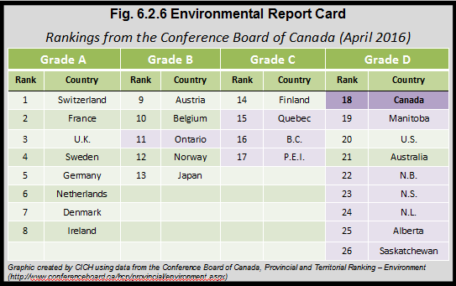
Notes:
Summary
The Conference Board of Canada measures the environmental performance of Canada, its provinces, and 15 peer countries.
It uses 9 indicators for the international comparisons and one additional indicator to evaluate the provinces for which there is not an international comparison.
The indicators are: Nitrogen oxides emissions; sulphur oxides emissions; volatile organic compounds emissions; particulate matter emissions; waste generation; wastewater treatment; water withdrawals; GHG emissions; low-emitting electricity production; and energy intensity.
The Environmental Report Card assigns Grades according to a composite of these indicators.
Compared to the 15 peer countries, Canada gets a “D” overall and ranks third-last.
The Conference Board reports that compared to our international peers, all of the provinces rank poorly.
The top-ranked province is Ontario – who scores a “B” – but still places behind 10 of the 15 peer countries. Quebec, British Columbia, and P.E.I. score “C” and Manitoba scores “D.” Saskatchewan, Alberta, Newfoundland and Labrador, Nova Scotia, and New Brunswick are scored lowest – worse than the lowest-ranking peer country.
Source: CICH graphic created using data adapted from the Conference Board of Canada, Provincial and Territorial Ranking – Environment. (2016). http://www.conferenceboard.ca/hcp/provincial/environment.aspx – accessed March 12th, 2017.

Slide 10
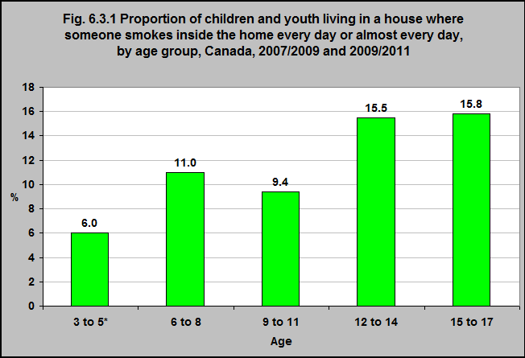
Notes:
Summary
According to the Canadian Health Measures Survey (2007/2009 and 2009/2011), 6% of children 3 to 5 years of age are exposed to environmental tobacco smoke in their homes every day or almost every day.
That proportion was higher for older Canadian children and youth.
Note:
*Age 3 to 5, Cycle 2, 2009/11 only.
Source: CICH graphic created using data adapted from Statistics Canada. Canadian Health Measures Survey. Data underlying the Figure combines Cycles 1 (2007/09) and 2 (2009/11) – custom runs.

Slide 11
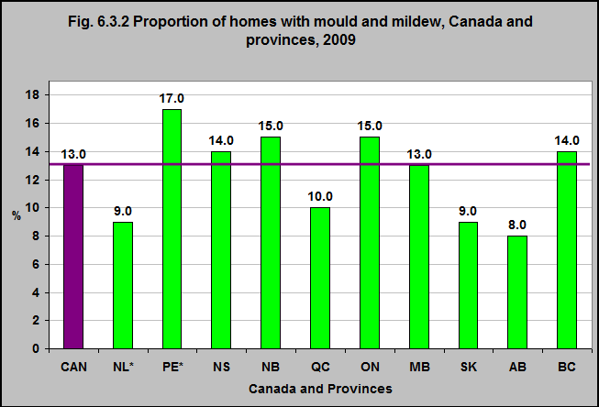
Notes:
Summary
In 2009, 13% of Canadians reported the presence of mould or mildew in their home.
That proportion varied from 8% in Alberta to 17% in Prince Edward Island.
Note:
*Use with caution due to small numbers.
Source: CICH graphic created using data adapted from Statistics Canada, Environment Accounts and Statistics Division, Households and the Environment Survey, 2009. http://www.statcan.gc.ca/pub/11-526-x/11-526-x2011001-eng.htm – accessed March 12th, 2017.

Slide 12
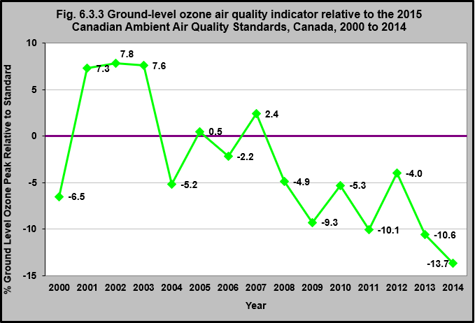
Notes:
Summary
There are a number of pollutants that can cause poor air quality – ground-level ozone (O3), sulphur oxides (SOX), nitrogen oxides (NOX), volatile organic compounds (VOCs) and solid and liquid particles called fine particulate matter (PM2.5).¹
Smog is primarily made up of ground-level ozone (O3) ad fine particulate matter (PM2.5). These pollutants can cause adverse health and environmental effects.¹
Canada has set standards for air quality. One air quality indicator that is monitored in Canada is the ground-level ozone, peak (4th-highest) 8-hour level. This indicator is based on the annual 4th-highest daily maximum 8-hour average concentrations and is used to capture immediate or acute short-term exposure.¹
This indicator was below the standard from 2008 to 2014. In 2014, the O3 peak indicator was 14% below the 2015 standard.
Implications
Exposure to ozone has been associated with a number of health effects such as premature death, asthma and hospital admissions due to respiratory illness.¹
¹Environment and Climate Change Canada. 2016. Canadian Environmental Sustainability Indicators: Air Quality. https://www.ec.gc.ca/indicateurs-indicators/7DCC2250-A982-4286-B466-70681EBC994B/AirQuality_EN.pdf – accessed March 12th, 2017.
Note:
New fine particulate matter monitoring equipment was progressively introduced across Canada to replace older monitoring equipment from the mid-2000’s to 2014. These new instruments measure a portion (semi-volatile) of the fine particulate matter mass not captured by the older instruments. Due to the differences between the new and the old monitoring equipment, concentrations measured with the new monitors may not be directly comparable with measurements from years in which older instruments were used.
Source: CICH graphic created using data adapted from Environment and Climate Change Canada. 2016. Canadian Environmental Sustainability Indicators: Air Quality. https://www.ec.gc.ca/indicateurs-indicators/7DCC2250-A982-4286-B466-70681EBC994B/AirQuality_EN.pdf – accessed March 12th, 2017.

Slide 13
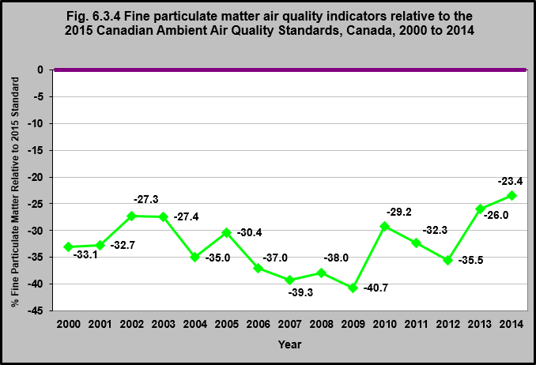
Notes:
Summary
A number of pollutants can cause poor air quality – ground-level ozone (O3), sulphur oxides (SOX), nitrogen oxides (NOX), volatile organic compounds (VOCs) and solid and liquid particles called fine particulate matter (PM2.5).¹
Smog is primarily made up of ground-level ozone (O3) and fine particulate matter (PM2.5). These pollutants can cause adverse health and environmental effects.¹
The annual average PM2.5 is an indicator of air quality. It is based on the annual average of the daily 24-hour average concentrations for PM2.5 and is used to capture prolonged or repeated exposures over longer periods or chronic exposure.¹
Between the years 2000 and 2014 the annual average PM2.5 was below the 2015 national air quality standards. In 2014, it was 23% below the 2015 standard.
Implications
Exposure to fine particulate matter has been associated with asthma, bronchitis and emphysema as well as heart disease.¹
¹Environment and Climate Change Canada. 2016. Canadian Environmental Sustainability Indicators: Air Quality. https://www.ec.gc.ca/indicateurs-indicators/7DCC2250-A982-4286-B466-70681EBC994B/AirQuality_EN.pdf – accessed March 12th, 2017.
Note:
New fine particulate matter monitoring equipment was progressively introduced across Canada to replace older monitoring equipment from the mid-2000’s to 2014. These new instruments measure a portion (semi-volatile) of the fine particulate matter mass not captured by the older instruments. Due to the differences between the new and the old monitoring equipment, concentrations measured with the new monitors may not be directly comparable with measurements from years in which older instruments were used.
Source: CICH graphic created using data adapted from Environment and Climate Change Canada. 2016. Canadian Environmental Sustainability Indicators: Air Quality. https://www.ec.gc.ca/indicateurs-indicators/7DCC2250-A982-4286-B466-70681EBC994B/AirQuality_EN.pdf – accessed March 12th, 2017

Slide 14
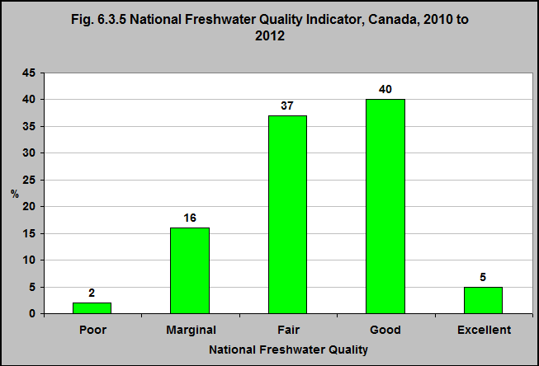
Notes:
Summary
The quality of fresh water varies naturally in Canada. This is due to Canada’s diversity of geology and climate.
The development of land around rivers and lakes also affects the quality of fresh water.
The Government of Canada monitors the quality of fresh water at 172 stations across the country.
For the period 2010 to 2012, 45% of the monitoring stations reported that the water was of excellent or good quality. 18% reported that it was of poor or marginal quality.
Note:
Freshwater quality was assessed at 172 sites on select rivers throughout 16 of Canada’s drainage regions where human activity is most intensive using the Canadian Council of Ministers of the Environment’s Water Quality Index.
Source: CICH graphic created using data adapted from data assembled by Environment Canada from federal, provincial, territorial and joint water quality monitoring programs. 2010 to 2012.
https://www.ec.gc.ca/indicateurs-indicators/default.asp?lang=En&n=68DE8F72-1 – accessed March 12th, 2017.

Slide 15
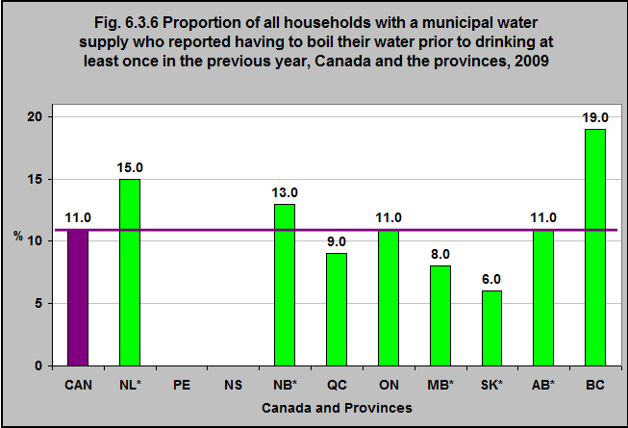
Notes:
Summary
According to the Households and the Environment Survey, in 2009, 11% of all Canadian households reported that they had to boil their water prior to drinking at least once in the previous year.
That proportion varied from 19% in British Columbia to 6% in Saskatchewan.
Notes:
*Use with caution due to small numbers.
Prince Edward Island and Nova Scotia – numbers too small to report.
Source: CICH graphic created using data adapted from Statistics Canada, Environment Accounts and Statistics Division, Households and the Environment Survey, 2009. http://www.statcan.gc.ca/pub/11-526-x/2011001/t012-eng.htm – accessed March 12th, 2017.

Slide 16
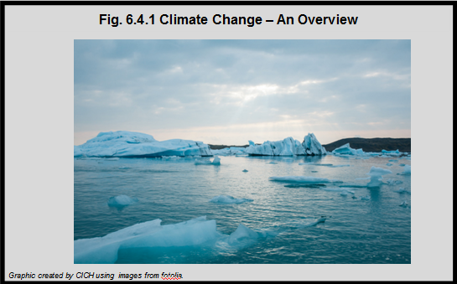
Notes:
Summary
Climate change is unequivocal – the earth’s temperature is rising, causing changes in weather patterns and meteorological events of increased frequency and intensity.¹
Effects of climate change have already been seen and felt throughout Canada and worldwide.²
As some greenhouse gases remain in the atmosphere for hundreds or thousands of years, greenhouse gas emissions will drive climate change indefinitely.²
Implications
Because the climate in which we live impacts many aspects of human life, climate change will undoubtedly affect the health and well-being of Canada’s young children.
As a result, today’s children and future generations will experience the effects of climate change to a greater degree than will today’s adults.
¹ Intergovernmental Panel on Climate Change (IPCC). 2013: Summary for Policymakers. In: Climate Change 2013: The Physical Science Basis. Contribution of Working Group 1 to the Fifth Assessment Report of the Intergovernmental Panel on Climate Change [Stocker, T.F., D. Qin, G.-K. Plattner, M. Tignor, S.K. Allen, J. Boschung, A. Nauels, Y. Xia, V. Bex and P.M. Midgley (eds.)]. Cambridge University Press, Cambridge, United Kingdom and New York, NY, USA. http://www.ipcc.ch/pdf/assessment-report/ar5/wg1/WG1AR5_SPM_FINAL.pdf– accessed March 12th, 2017.
²Lemmen, D.S., Warren, F.J., Lacroix, J., and Bush, E., editors (2008): From Impacts to Adaptation: Canada in a Changing Climate 2007: Government of Canada, Ottawa, ON, 448 p. http://www.nrcan.gc.ca/sites/www.nrcan.gc.ca/files/earthsciences/pdf/assess/2007/pdf/full-complet_e.pdf– accessed March 12th, 2017.

Slide 17
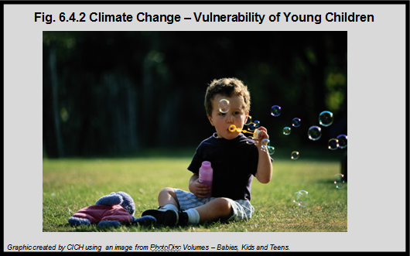
Notes:
Summary
Because of their developing body systems, young children are less able than adults to adapt to heat and other climate-related conditions – both physiologically and metabolically. Because of their developing immune systems, they are at a greater risk of getting diseases and dying from them. They are also more likely to be killed or injured during climate change related events and disasters.
¹UNICEF. Children’s Vulnerability to Climate Change and Disaster Impacts in East Asia and the Pacific. 2011. https://www.unicef.org/environment/files/Climate_Change_Regional_Report_14_Nov_final.pdf-accessed July 24, 2017.

Slide 18
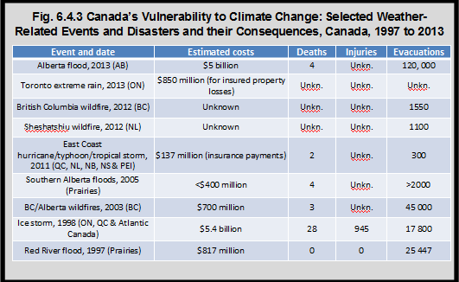
Notes:
Summary
Canada has seen the impact of climate change more than other countries. From 1948 to 2012, the annual average surface air temperature in Canada increased by approximately 1.7°C, roughly twice the global increase.¹
This is largely due to the significant increase in temperature in Canada’s North, which has been roughly 2.5 times greater than the global average temperature increase since the late 1940s.^{1,2}
Climate change has contributed to the increased frequency, duration and intensity of climate and weather-related events and disasters in Canada.¹
Recent wildfires, ice storms, floods, hurricanes, and other disasters have cost Canadians billions of dollars and too many lives.³ The table shows a portion of these extreme weather related events and disasters that happened between 1997 and 2013 in Canada and some of their consequences.
Implications
As children are more vulnerable to the effects of climate change than adults, they are likely to make up a large portion of those evacuated, injured, and deceased people as a result of climate change related events and disasters.
¹Government of Canada. Canada’s Sixth National Report on Climate Change (2014). http://www.ec.gc.ca/cc/0BA54AAB-6E8E-4D48-B42C-DCBB09B27D10/6458_EC_ID1180-MainBook_high_min%20FINAL-s.pdf-accessed July 24, 2017.
²IPCC (2007). Climate Change 2007: Synthesis Report. Contribution of Working Groups I, II and III to the Fourth Assessment Report of the Intergovernmental Panel on Climate Change [Pachauri, R.K. and A. Reisinger (eds.)]. Geneva, Switzerland. https://www.ipcc.ch/pdf/assessment-report/ar4/syr/ar4_syr_full_report.pdf-accessed July 24, 2017.
³Lemmen, D.S., Warren, F.J., Lacroix, J., and Bush, E., editors (2008): From Impacts to Adaptation: Canada in a Changing Climate 2007: Government of Canada, Ottawa, ON, 448 p. https://www.nrcan.gc.ca/sites/www.nrcan.gc.ca/files/earthsciences/pdf/assess/2007/pdf/full-complet_e.pdf-accessed July 24, 2017.
Source: CICH graphic created using data adapted from: Lemmen, D.S., Warren, F.J., Lacroix, J., and Bush, E., editors (2008): From Impacts to Adaptation: Canada in a Changing Climate 2007: Government of Canada, Ottawa, ON, 448 p. https://www.nrcan.gc.ca/sites/www.nrcan.gc.ca/files/earthsciences/pdf/assess/2007/pdf/full-complet_e.pdf – accessed March 8h, 2017.

Slide 19
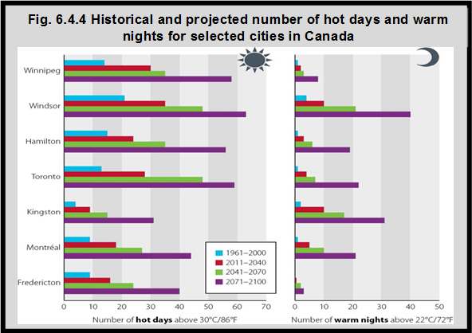
Notes:
Summary
As a result of climate change, it is expected that heat waves will become longer, more frequent, and more intense in Canada.¹
It is projected that the number of days with temperatures above 30°C in Toronto, Winnipeg and Windsor will double between 2011 and 2040.
Implications
Young children are especially vulnerable to heat waves because of the amount of time they spend being active outside and their dependence on caregivers for their safety and well-being.^{2,3}
¹IPCC [Intergovernmental Panel on Climate Change] (2012): Summary for policymakers; in Managing the Risks of Extreme Events and Disasters to Advance Climate Change Adaptation; Cambridge University Press, Cambridge, United Kingdom. https://www.ipcc.ch/pdf/special-reports/srex/SREX_FD_SPM_final.pdf-accessed July 24, 2017.
²Xu, Z., Etzel, R.A., Su. H., Huang, C., Guo, Y., & Tong, S. (2012). Impact of ambient temperature on children’s health : A systematic review. Environmental Research, 117, 120-131
³Ebi, K.L., & Paulson, J.A. (2007). Climate Change and Children. Pediatric Clinics of North America, 54, 213-226
Source: CICH graphic created using data adapted from Casati, B., 2010. Analysis of the daily minimum and maximum temperatures. Ouranos – Consortium on Regional Climatology and Adaptation to Climate Change, Montreal.

Slide 20
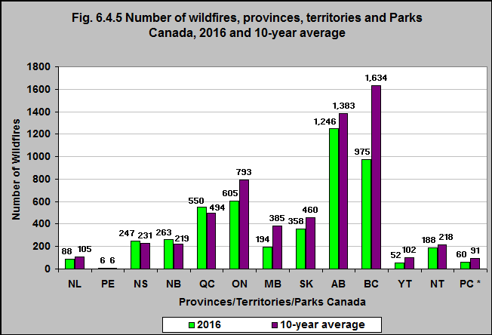
Notes:
Summary
In 2016 there were 975 wildfires in British Columbia – the 10-year average for that provinces was 1,634. In 2016 there were 1,246 wildfires in Alberta and the 10-year average was 1,383.
It is expected that in Canada’s forests, the incidence of wildfire will increase as the temperature rises and the amount of precipitation lessens.¹
Implications
Wildfires can cause health problems, including smoke inhalation, respiratory tract burns, dehydration, and heat exhaustion due to the release of a large quantity of particulate matter. Children are especially vulnerable to respiratory illness and eye irritation.²
Infant mortality rates are associated with wildfires due to the increased risk of cardiovascular and respiratory disease.³
¹Berry, P., Clarke, K., Fleury, M.D. and Parker, S. (2014): Human Health; In Canada in a Changing Climate: Sector Perspectives on Impacts and Adaptation, (ed.) F.J. Warren and D.S. Lemmen; Government of Canada, Ottawa, ON, p. 191-232.
²Kunzli, N., Avol, E., Wu., J., Gauderman, W.J., Rappaport, E., Millstein, J., et al. (2006). Health Effects of the 2003 Southern California Wildfires on Children. Am J Respir Crit Care Med, 174: 1221-1228., as cited in Sheffield, P.E., & Landrigan, P.J. (2011). Global Climate Change and Children’s Health: Threats and Strategies for Prevention. Environ Health Perspect, 119: 291-298. doi: 10.1289/ehp.1002233
³Robinson, B., & Alatas, M.F., Robertson, A., & Steer, H. (2011). Natural Disasters and the lung. Respirology, 16 (3). 386-395, as cited in Berry et al., (2011), above.
Note:
*PC = Parks Canada
Source: CICH graphic created using data adapted from the Canadian Wildfire Information System of Natural Resources Canada. http://cwfis.cfs.nrcan.gc.ca/report/graphs#gr1 – accessed March 8th, 2017.

Slide 21
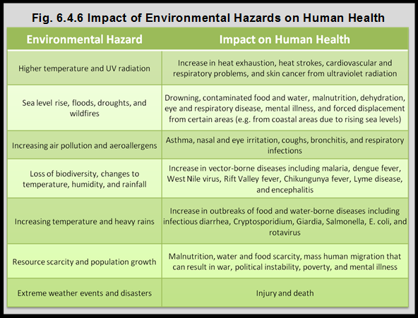
Notes:
Summary
The increased frequency and intensity of climate-related events and disasters can result in injury or death, and disruption and damage to communities, ecosystems, food sources and production, water supply, and infrastructure.¹
This can affect thousands of people, including young children, and result in loss of safe housing, food, and water – all impacting health.
¹IPCC, 2013: Summary for Policymakers. In: Climate Change 2013: The Physical Science Basis. Contribution of Working Group 1 to the Fifth Assessment Report of the Intergovernmental Panel on Climate Change [Stocker, T.F., D. Qin, G.-K. Plattner, M. Tignor, S.K. Allen, J. Boschung, A. Nauels, Y. Xia, V. Bex and P.M. Midgley (eds.)]. Cambridge University Press, Cambridge, United Kingdom and New York, NY, USA. http://www.ipcc.ch/pdf/assessment-report/ar5/wg1/WG1AR5_SPM_FINAL.pdf-accessed July 24, 2017.
Source: CICH Table created using data adapted from the National Environmental Education Foundation, Climate Change and Human Health. (n.d) https://www.neefusa.org/resource/human-health-changing-climate -accessed July 24, 2017; with information from Committee on Environmental Health (Shannon, M.W., Best, D., Binns, H.J., Forman, J.A., Johnson, C.L., Karr, C.J., Kim, J.J., Mazur, L.J., & Roberts, J.R.). 2007.;and, Policy Statement: Global Climate Change and Children’s Health. Pediatrics, 120. DOI: 10.1542/peds.2007-2645.

Slide 22
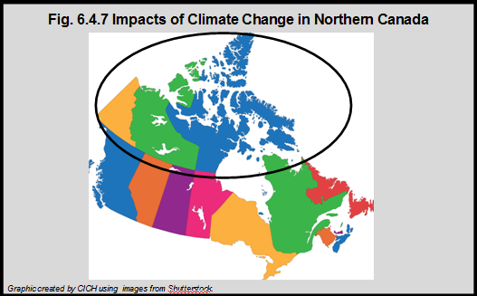
Notes:
Summary
The average surface air temperature over Canada has warmed by about 1.7°C between 1948 and 2012 – that is twice the global average. The rate of warming in Northern Canada has been about 2½ times the global average since the late 1940s.¹
There have already been significant environmental changes in the North as a result of increasing temperatures. These include decreased ice thickness, melting of permafrost, coastal erosion, rising sea levels, landslides, and altered distribution and migration of wildlife.^{2,3}
Climate change will likely lead to the spread of animal-transmitted diseases throughout the North, putting children at increased risk of disease.⁴ With remote health services in the North, illness, especially if widespread or epidemic, is of particular concern.
Implications
All people in Northern Canada will experience consequences of climate change, but the most vulnerable are the Indigenous peoples, who make up over half of the North’s population.¹ Indigenous populations traditionally live off the land by hunting, gathering and fishing.² The land is also a source of traditional medicines, and other cultural practices are tied to the land.²
Not only do changing environmental conditions affect the timing and the ways in which Indigenous peoples engage in subsistence and traditional activities, unpredictable weather limits participation in travel, hunting, gathering, and fishing – increasing the risk of being stranded and of boating accidents.³
¹Government of Canada. (2013). Canada’s Sixth National Report on Climate Change: 2014. https://ec.gc.ca/cc/16153A64-BDA4-4DBB-A514-B159C5149B55/6458_EC_ID1180-MainBook_high_min%20FINAL-s.pdf-accessed March 5, 2017.
²Berry, P., Clarke, K., Fleury, M.D. and Parker, S. (2014): Human Health; In Canada in a Changing Climate: Sector Perspectives on Impacts and Adaptation, (ed.) F.J. Warren and D.S. Lemmen; Government of Canada, Ottawa, ON, p. 191-232. https://www.nrcan.gc.ca/sites/www.nrcan.gc.ca/files/earthsciences/pdf/assess/2014/pdf/Chapter7-Human-Health_Eng.pdf-accessed July 24, 2017.
³Furgal C. Health impacts of climate change in Canada’s north. Rep. No.: H128–1/08-528E. Ottawa, ON: Health Canada; 2008.
⁴Lemmen, D.S., Warren, F.J., Lacroix, J., & Bush, E. (2008). From Impacts to Adaptation: Canada in a Changing Climate 2007. Government of Canada, Ottawa, ON, 448. https://www.nrcan.gc.ca/sites/www.nrcan.gc.ca/files/earthsciences/pdf/assess/2007/pdf/synth_e.pdf-accessed July 24, 2017

Slide 23
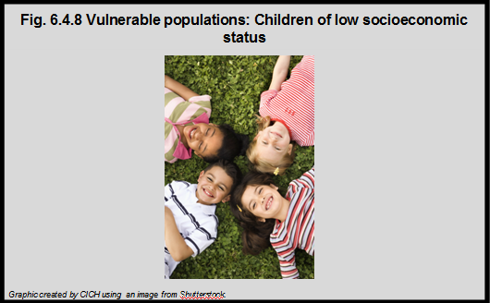
Notes:
Summary
Children who live in low income households are more vulnerable to the effects of climate change.
For example, they are less likely to have access to air conditioning, swimming pools, or climate controlled recreational facilities, during periods of extreme heat.¹
They are also more likely to share smaller living quarters with more people, which contributes to a warmer living environment.
In addition, lower quality housing is more likely to be damaged by climate-related events such as heavy rain which could lead to flooding or the development of mold.
Families living in these homes may struggle to cope with the hardships and to find the finances to repair the damages.
¹Nugent, O., for Pollution Probe. (2004). A Primer on Climate Change and Human Health. http://www.pollutionprobe.org/publications/primer-on-climate-change-and-human-health-accessed July 24, 2017.

Slide 24
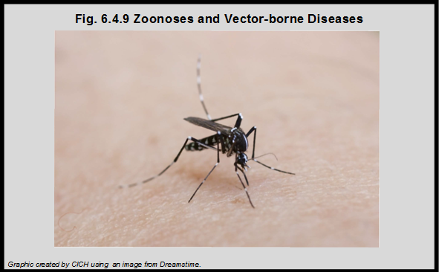
Notes:
Summary
The threat of contracting disease through zoonoses (disease directly transmitted from animals to humans) and vector-borne disease (those transmitted between humans or from animals to humans by an arthropod such as an insect) may be increased with climate change.
Children are more vulnerable to vector-borne illness because they generally spend more time outside than do adults.¹
In Canada, Lyme disease, spread through ticks, is considered an important threat. The annual number of cases of Lyme disease in Canada has increased from roughly 30 cases in 2007 to 315 in 2012.² The southernmost areas in Canada are the most vulnerable to Lyme disease as ticks live in warm areas.
The Eastern Equine Encephalitis virus and the West Nile Virus have also begun to spread throughout parts of Canada. Furthermore, as the temperature continues to rise, southern Canada could become a more hospitable location for malaria to thrive and spread.³
¹Ebi, K.L., & Paulson, J.A. (2007). Climate Change and Children. Pediatric Clinics of North America, 54, 213-226.
²Berry, P., Clarke, K., Fleury, M.D. and Parker, S. (2014): Human Health; In Canada in a Changing Climate: Sector Perspectives on Impacts and Adaptation, (ed.) F.J. Warren and D.S. Lemmen; Government of
Canada, Ottawa, ON, p. 191-232. https://www.nrcan.gc.ca/sites/www.nrcan.gc.ca/files/earthsciences/pdf/assess/2014/pdf/Chapter7-Human-Health_Eng.pdf-accessed July 25, 2017.
³Berrang-Ford, L., MacLean, D., Gyorkos, T., Ford, J., and Ogden, N. H. (2009): Climate change and malaria in Canada: a systems approach; Interdisciplinary Journal of Infectious Diseases, 2009, 13 p. as cited in Berry et al., 2014 (above).

Slide 25
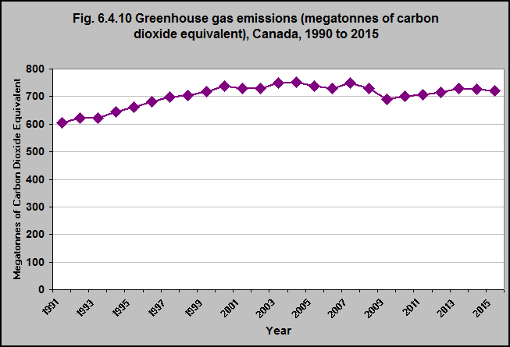
Notes:
Summary
Greenhouse gases trap heat in the Earth’s atmosphere. The activities of people increase the amount of greenhouse gases in the atmosphere.
Over the past 200 years in particular, humans have released greenhouse gases into the atmosphere primarily from burning fossil fuels.¹
In 2015, Canada’s total greenhouse gas (GHG) emissions were 722 megatonnes (Mt) of carbon dioxide equivalent (CO2 eq), or 20% (120 Mt CO2 eq) above the 1990 emissions. The first 10 years of this time period showed steady increases in annual emissions. There were fluctuating emission levels between 2000 and 2008 with a steep decline in 2009, and then levels gradually increased from 2010 to 2015.
The growth between 1990 and 2015 was mostly due to increased emissions from mining and upstream oil and gas production as well as transport.¹
Reductions between 2005 and 2015 were due primarily to reduced emissions from the public electricity and heat production category.¹
¹Environment and Climate Change Canada (2017) National Inventory Report 1990–2015: Greenhouse Gas Sources and Sinks in Canada. https://www.ec.gc.ca/ges-ghg/default.asp?lang=En&n=662F9C56-1#figure-s-4– accessed May 21, 2017
Note: The national indicator tracks seven greenhouse gases (GHGs) released by human activity: carbon dioxide (CO2), methane (CH4), nitrous oxide (N2O), sulphur hexafluoride (SF6), perfluorocarbons (PFCs), hydrofluorocarbons (HFCs) and nitrogen trifluoride (NF3), reported in megatonnes of carbon dioxide equivalent (Mt CO2 eq). Emission levels for some previous years have been revised in light of improvements to estimation methods and availability of new data.
Source: CICH graphic created using data adapted from Environment and Climate Change Canada (2017) National Inventory Report 1990–2015: Greenhouse Gas Sources and Sinks in Canada. https://www.ec.gc.ca/indicateurs-indicators/?lang=en&n=FBF8455E-1- accessed May 21, 2017.

Slide 26
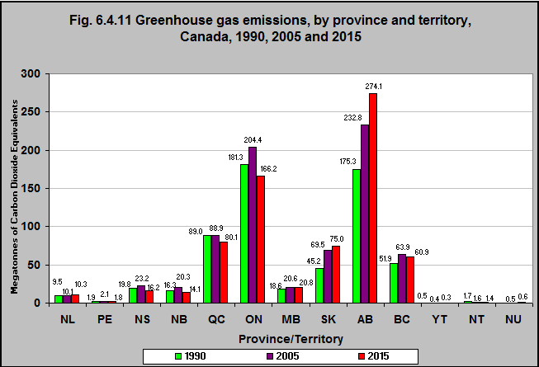
Notes:
Summary
Greenhouse gas emissions (GHG) vary significantly by province and territory. This is due to differences in population, energy sources and economic base.
If everything else were equal, those provinces/territories whose economies are based on resource extraction would tend to have higher emission levels than those who rely on service-based economies.
Provinces/territories that rely on fossil fuels for their electricity generation will have higher emissions than provinces relying more on renewable sources.
Between 1990 and 2015, greenhouse gas emissions (measured as megatonnes of carbon dioxide equivalents) decreased in six provinces/territories (PEI, Nova Scotia, New Brunswick, Quebec, Ontario, the Northwest Territories and the Yukon*).
In contrast, greenhouse gas emissions increased in Newfoundland & Labrador, Manitoba, Saskatchewan, Alberta and British Columbia. The biggest increases were in Saskatchewan (67% increase) and Alberta (56% increase).
The five provinces with the highest emissions – Alberta, Ontario, Quebec, Saskatchewan and British Columbia – released a total of 656 megatonnes of carbon dioxide equivalent, or 91% of Canada’s national total green house gas (GHG) emissions of 722 of megatonnes of carbon dioxide equivalent (Mt CO2 eq) in 2015.
Alberta has the highest emissions due to the oil and gas industry for export markets. Quebec and British Columbia rely on abundant hydroelectric resources for their electricity production and have shown more stable emission patterns since 1990, and a decreasing trend since 2005.
*1990 emissions data for the Northwest Territories include emissions for Nunavut, which was part of the Northwest Territories until 1999.
Notes:
Emission levels for some years have been revised in light of improvements to estimation methods and availability of new data.
1990 emissions data for the Northwest Territories include emissions for Nunavut, which was part of the Northwest Territories until 1999.
Source: CICH graphic created using data adapted from Environment and Climate Change Canada (2017) National Inventory Report 1990–2016: Greenhouse Gas Sources and Sinks in Canada. https://www.ec.gc.ca/indicateurs-indicators/default.asp?lang=en&n=18F3BB9C-1 – accessed May 21, 2017.

Slide 27
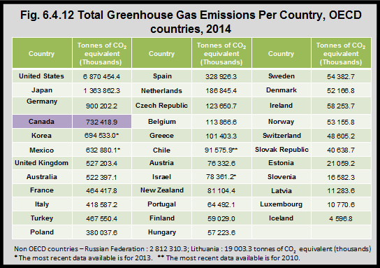
Notes:
Summary
According to the Organisation for Economic Co-operation and Development (OECD), in 2014, Canada had the fourth highest level of greenhouse gas emissions of 35 OECD countries.¹ The United States had the highest greenhouse gas emissions and Iceland had the lowest emissions.
Canada’s high emissions are due to a number of factors. The climate is variable – so Canadians use space heating and cooling to stay comfortable.²
Canada is a large country with its population dispersed throughout, meaning Canadians spend more time traveling and have a greater demand for freight transportation of goods.²
Canada’s economy is based on natural resources, including agricultural products, electricity, oil, gas, and metals. Accessing these resources leads to considerable greenhouse gas emissions.²
¹OECD. Greenhouse gas emissions by source. http://www.oecd-ilibrary.org/environment/data/oecd-environment-statistics/greenhouse-gas-emissions_data-00594-en?isPartOf=/content/datacollection/env-data-en– accessed February 15, 2017.
²Government of Canada. Canada’s Sixth National Report on Climate Change. 2014. http://publications.gc.ca/site/eng/456520/publication.html-accessed July 2017.
Source: CICH tabled created using data adapted from OECD. Greenhouse gas emissions by source. http://www.oecd-ilibrary.org/environment/data/oecd-environment-statistics/greenhouse-gas-emissions_data-00594-en?isPartOf=/content/datacollection/env-data-en – accessed February 15, 201

Slide 28
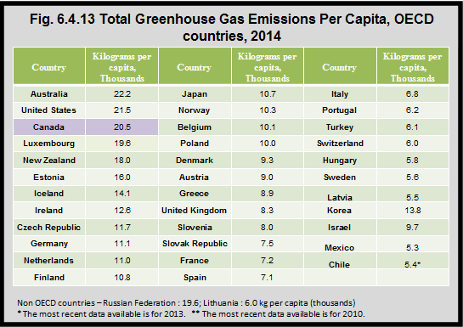
Notes:
Summary
According to the Organisation for Economic Co-Operation and Development (OECD), in 2014, Canada had the third highest level of greenhouse gas emissions per capita of 35 OECD countries.¹
The country with the highest per capita emissions was Australia, with 22,200 kg of greenhouse gas emissions per capita. The lowest was Mexico.
¹OECD. Greenhouse gas emissions by source. http://www.oecd-ilibrary.org/environment/data/oecd-environment-statistics/greenhouse-gas-emissions_data-00594-en?isPartOf=/content/datacollection/env-data-en– accessed February 15, 2017.
CICH graphic created using data adapted from OECD. Greenhouse gas emissions by source. http://www.oecd-ilibrary.org/environment/data/oecd-environment-statistics/greenhouse-gas-emissions_data-00594-en?isPartOf=/content/datacollection/env-data-en – accessed February 15, 201

Slide 29
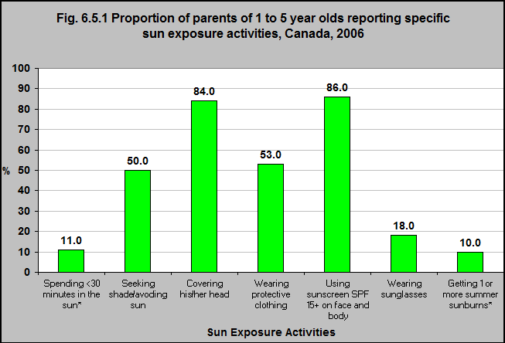
Notes:
Summary
In 2006, only 11% of parents of 1 to 5 year-olds reported that their children spent <30 minutes in the sun.
Of the children who spent more than 30 minutes in the sun, the majority of parents covered their children’s heads (84%) and used sunscreen on their faces (86%). Only 10% had one or more summer sunburns.
Notes:
*Figures should be interpreted with caution: N≥10 but coefficient of variation 16.6%-33.3%
Denominator for “spending greater than 30 minutes in sun” includes all children; denominator for all other sun protection behaviours includes only children spending at least 30 minutes in the sun.
Source: CICH graphic created using data adapted from Sun Behaviour in Canadian Children: Results of the 2006 National Sun Survey. Pichora, E.C., & Marrett, L.D.

Slide 30
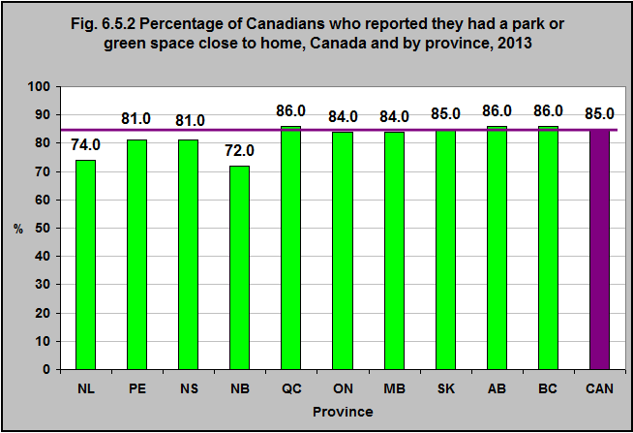
Notes:
Summary
In 2013, the majority of Canadians – 85% – report that they had a park or green space close to home.
This varied by province – from 72% in New Brunswick to 86% in Québec, Alberta and British Columbia.
Source: CICH graphic created using data adapted from Statistics Canada. Table 153-0148 – Households and the environment survey, parks and green spaces, Canada, provinces and census metropolitan areas (CMA). http://www5.statcan.gc.ca/cansim/a26;jsessionid=107BA08D2BAA4D46B2F73BA33D821ABE?lang=eng&retrLang=eng&id=1530148&tabMode=dataTable&srchLan=-1&p1=-1&p2=9 – accessed May 21. 2017.

Slide 31
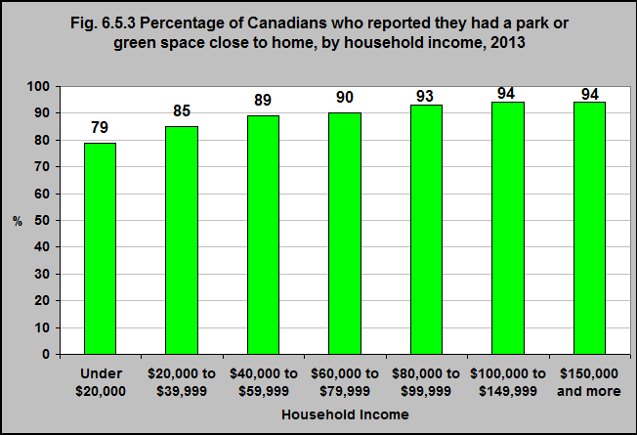
Notes:
Summary
In 2013, Canadians living in lower income households were less likely to live near a park or a green space. 79% of households whose income was less than $20,000 reported they lived close to a park or green space in comparison to 94% of households with incomes of $100,000 or more.
94% of households with incomes of $100,000 or more reported they had a park or green space close to home.
Source: CICH graphic created using data adapted from Statistics Canada. Table 153-0148 – Households and the environment survey, parks and green spaces, Canada, provinces and census metropolitan areas (CMA). http://www5.statcan.gc.ca/cansim/a26;jsessionid=107BA08D2BAA4D46B2F73BA33D821ABE?lang=eng&retrLang=eng&id=1530148&tabMode=dataTable&srchLan=-1&p1=-1&p2=9 – accessed May 21, 2017.

Slide 32
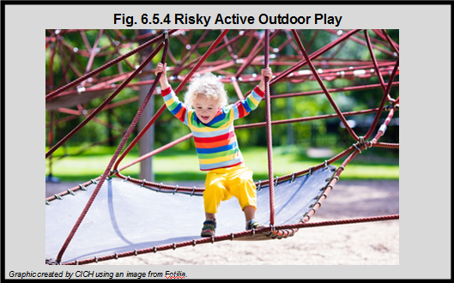
Notes:
Summary
Over the last few decades, there has been an increased focus on childhood injury prevention – in Canada and internationally. The result has been that many childhood injury prevention programs have limited risky play to prevent physical injury. There has been an increasing focus on parents’ supervision – often resulting in less independence for children to play freely and actively. There has also been increasing focus on child abduction.^{1,2,3,4}
A recent systematic review found that the positive health benefits of risky outdoor play outweighed those benefits from limiting outdoor risky play to protect children 3 to 12 years.¹
Many studies concluded that promoting risky outdoor play was an opportunity to promote children’s health, development and active lifestyles – and that policies and programs should support such play.¹
What is risky outdoor active play?
It is not play that puts children at extreme risk “like skating on a half-frozen lake or sending a preschooler to the park alone”. It is play that is “thrilling and exciting”; where children are given freedom to “decide how high to climb, to explore the woods, get dirty, play hide’n seek, wander in their neighbourhoods, balance, tumble and rough-house, especially outdoors, so they can be active, build confidence, autonomy and resilience, develop skills, solve problems and learn their own limits.”⁵ There is risk of physical injury, but children can recognize and evaluate challenges according to their own ability.⁵
¹Brussoni M, Gibbons R, Gray C, Ishikawa T, Beate E, Sandseter H, Bienenstock A, Chabot G, Fuselli P, Herrington S, Janssen I, Pickett W, Power M, Stanger N, Sampson M and Tremblay MS. What is the Relationship between Risky Outdoor Play and Health in Children? A Systematic Review. Int. J. Environ. Res. Public Health 2015, 12, 6423-6454. https://www.ncbi.nlm.nih.gov/pubmed/26062038-accessed July 24, 2017.
²Jago, R.; Thompson, J.L.; Page, A.S.; Brockman, R.; Cartwright, K.; Fox, K.R. Licence to be active: Parental concerns and 10-11-year-old children’s ability to be independently physically active. J. Public Health. 2009, 31, 472–477. In Brussoni M, Gibbons R, Gray C, Ishikawa T, Beate E, Sandseter H, Bienenstock A, Chabot G, Fuselli P, Herrington S, Janssen I, Pickett W, Power M, Stanger N, Sampson M and Tremblay MS. What is the Relationship between Risky Outdoor Play and Health in Children? A Systematic Review. Int. J. Environ. Res. Public Health 2015, 12, 6423-6454. https://www.ncbi.nlm.nih.gov/pubmed/26062038– accessed July 24, 2017.
³Kalish, M.; Banco, L.; Burke, G.; Lapidus, G. Outdoor play: A survey of parent’s perceptions of their child’s safety. J. Trauma 2010, 69, S218–S222. In Brussoni M, Gibbons R, Gray C, Ishikawa T, Beate E, Sandseter H, Bienenstock A, Chabot G, Fuselli P, Herrington S, Janssen I, Pickett W, Power M, Stanger N, Sampson M and Tremblay MS. What is the Relationship between Risky Outdoor Play and Health in Children? A Systematic Review. Int. J. Environ. Res. Public Health 2015, 12, 6423-6454. https://www.ncbi.nlm.nih.gov/pubmed/26062038-accessed July 24, 2017..
⁴Alparone, F.R.; Pacilli, M.G. On children’s independent mobility: the interplay of demographic, environmental, and psychosocial factors. Child. Geogr. 2012, 10, 109–122. In Brussoni M, Gibbons R, Gray C, Ishikawa T, Beate E, Sandseter H, Bienenstock A, Chabot G, Fuselli P, Herrington S, Janssen I, Pickett W, Power M, Stanger N, Sampson M and Tremblay MS. What is the Relationship between Risky Outdoor Play and Health in Children? A Systematic Review. Int. J. Environ. Res. Public Health 2015, 12, 6423-6454. https://www.ncbi.nlm.nih.gov/pubmed/26062038-accessed July 24, 2017.
⁵Position Statement on Active Outdoor Play. Herrington S and Pickett W and: the BC Injury Research and Prevention Unit, CHEO Research Institute, Physical Activity Epidemiology Lab, Best Start, KidActive, Play by Nature, Child and Nature Alliance, Centre de Recherche Institut Universitaire de Cardiologe et de Pneumologe de Québec, Queen Maud University College of Early Childhood Education, Canadian Parks Council, ParticipAction, Evergreen and PHE Canada. http://www.haloresearch.ca/outdoorplay/-accessed July 24, 2017.

Slide 33

Notes:
Summary
There is also evidence that active outdoor play is safer than many people think:
• Major injuries are uncommon – most injuries are minor.
• Children are much more likely to die as a passenger in a car then they are when playing outside.
• Many people are worried about abduction – but the chances are about 1 in 14 million in Canada.
Keeping children indoors may be less safe:
• When indoors – and in front of screens – children are subjected to other dangers – such as cyber-predators and violence. They may eat unhealthy foods.
• Indoor air quality may be poor – with toxins such as mould or environmental tobacco smoke – which can result in respiratory problems.
• If children are sedentary/inactive they have increased risk of developing chronic diseases (heart disease and type-2 diabetes); cancer and mental health problems.
What are the benefits of active outdoor play?¹
Systematic reviews have found many benefits to active outdoor play:
• When playing outdoors children move more – this is associated with many physical health benefits related to cardiovascular and respiratory health, musculoskeletal fitness and weight.
• Children who engage in active outdoor play in natural environments demonstrate a number of mental health benefits – such as resiliency and the development of skills to deal with stress.
• Children develop many social skills when they play freely with a minimum of structure – such as getting along with their peers, developing a relationship with their community and the environment. It also reduces feelings of isolation.
• Children who played in risky outdoor environments spent more time playing, have more social interactions and demonstrated increased creativity.²
• And children are naturally more interested in natural spaces than play structures.
¹Adapted From: Position Statement on Active Outdoor Play. Herrington S and Pickett W and: the BC Injury Research and Prevention Unit, CHEO Research Institute, Physical Activity Epidemiology Lab, Best Start, KidActive, Play by Nature, Child and Nature Alliance, Centre de Recherche Institut Universitaire de Cardiologe et de Pneumologe de Québec, Queen Maud University College of Early Childhood Education, Canadian Parks Council, ParticipAction, Evergreen and PHE Canada. http://www.haloresearch.ca/outdoorplay/-accessed July 24, 2017.
²Brussoni M, Gibbons R, Gray C, Ishikawa T, Beate E, Sandseter H, Bienenstock A, Chabot G, Fuselli P, Herrington S, Janssen I, Pickett W, Power M, Stanger N, Sampson M and Tremblay MS. What is the Relationship between Risky Outdoor Play and Health in Children? A Systematic Review. Int. J. Environ. Res. Public Health 2015, 12, 6423-6454.

Slide 34
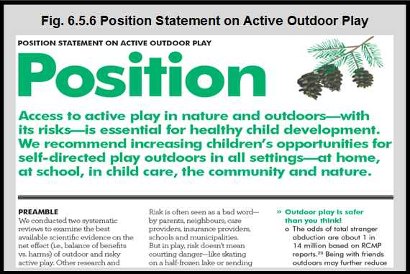
Notes:
Summary
The Position Statement on Active Outdoor Play was developed¹ by a host of partners (see below figure) using the results of two systematic reviews^{2,3} that measured the net effect (balance of benefits vs harms) of outdoor and risky active play.
The Statement provides information on the differences between danger and risk as well as the importance of valuing health and fun as much as safety.
Throughout the Statement (targeted at girls and boys age 3 to 12) are recommendations and helpful ideas for parents, caregivers, government officials, teachers, media and a host of other stakeholders that are focused on getting children more actively engaged in outdoor play in a way that is fun and safe.
¹Position Statement on Active Outdoor Play (2015). Mark S. Tremblay, Casey Gray, Shawna Babcock, Joel Barnes, Christa Costas Bradstreet, Dawn Carr, Guylaine Chabot, Louise Choquette, David Chorney, Cam Collyer, Susan Herrington, Katherine Janson, Ian Janssen, Richard Larouche, William Pickett, Marlene Power, Ellen Beate Hansen Sandseter, Brenda Simon and Mariana Brussoni. Int. J. Environ. Res. Public Health 2015, 12(6), 6475-6505.- accessed May 22, 2017
²What Is the Relationship between Outdoor Time and Physical Activity, Sedentary Behaviour, and Physical Fitness in Children? A Systematic Review. 2015. Casey Gray, Rebecca Gibbons, Richard Larouche, Ellen Beate Hansen Sandseter, Adam Bienenstock, Mariana Brussoni, Guylaine Chabot, Susan Herrington, Ian Janssen, William Pickett, Marlene Power, Nick Stanger, Margaret Sampson and Mark S. Tremblay. Int. J. Environ. Res. Public Health 2015, 12(6), 6455-6474.
³What is the Relationship between Risky Outdoor Play and Health in Children? A Systematic Review. 2015. Mariana Brussoni, Rebecca Gibbons, Casey Gray, Takuro Ishikawa, Ellen Beate Hansen Sandseter, Adam Bienenstock, Guylaine Chabot, Pamela Fuselli, Susan Herrington, Ian Janssen, William Pickett, Marlene Power, Nick Stanger, Margaret Sampson and Mark S. Tremblay. Int. J. Environ. Res. Public Health 2015, 12(6), 6423-6454.
Source: CICH graphic created using a screen shot of the Position Statement on Active Outdoor Play (2015). Mark S. Tremblay, Casey Gray, Shawna Babcock, Joel Barnes, Christa Costas Bradstreet, Dawn Carr, Guylaine Chabot, Louise Choquette, David Chorney, Cam Collyer, Susan Herrington, Katherine Janson, Ian Janssen, Richard Larouche, William Pickett, Marlene Power, Ellen Beate Hansen Sandseter, Brenda Simon and Mariana Brussoni. Int. J. Environ. Res. Public Health 2015, 12(6), 6475-6505. http://stage.participaction.com/sites/default/files/downloads/Participaction-PositionStatement-ActiveOutdoorPlay.pdf – accessed May 22, 2017.

Slide 35
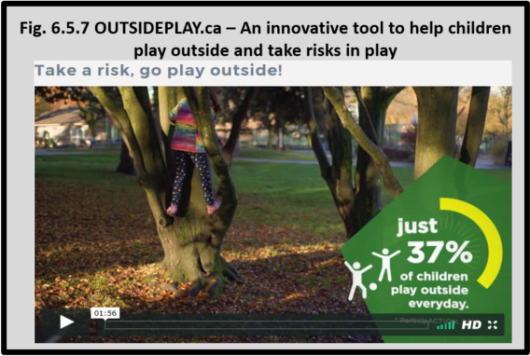
Notes:
Summary
The University of British Columbia, BC Children’s Hospital, and the BC Injury Research and Prevention Unit have created the Outsideplay.ca app to help parents, caregivers and community stakeholders encourage children to play outside and take risks in play.
The goal of the app is to help parents, caregivers and stakeholders manage their fears, find a more balanced approach to risky play and give them the confidence they need to allow children to explore and experience their environment safely.
Risky play is a natural part of children’s play and involves things such as climbing, sliding, balancing, jumping from heights and hanging upside down that involve some kind of physical risk.¹ Involvement in risky play gives children the opportunity to access risks and manage situations which in turn leads to new learning experiences and provides children with the motivation to try again and develop different ways of doing things. It is important that both parents and caregivers are aware of the importance of risky play and encourage children to explore their environments in a safe, fun way.²
On Outsideplay.ca there is a journey map with a series of questions/scenarios where parents and caregivers reflect on their past experience playing outside and taking risks, examine concerns they might have and create an action plan for parents and caregivers.
There are also FAQs that describe the importance of risky play, common concerns such as safety and fear of abduction, dealing with criticism from other parents and ideas to get started.
¹Outsideplay.ca Frequently Asked Questions. https://outsideplay.ca/#/faq -accessed July 31, 2017.
²Outdoor learning in the early years. The benefits of outdoor learning and outdoor activities for children. Outdoor risky play for all. https://earlyyearsoutdooreducation.wordpress.com/outdoor-risky-play-for-all/ -accessed July 31, 2017.
On Outsideplay.ca there is a journey map with a series of questions/scenarios where parents and caregivers reflect on their past experience playing outside and taking risks, examine concerns they might have and create an action plan for parents and caregivers.
There are also FAQs that describe the importance of risky play, common concerns such as safety and fear of abduction, dealing with criticism from other parents and ideas to get started.

Slide 36
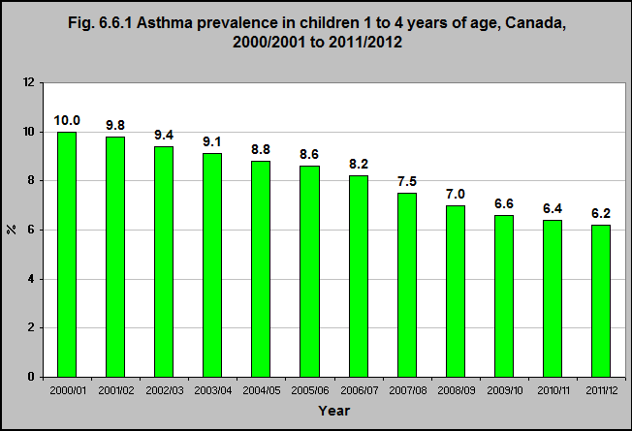
Notes:
Summary
Since the 1970s, there have been substantial increases in asthma prevalence in children of industrialized and non-industrialized countries.¹
Statistics Canada confirmed a four-fold increase in childhood asthma over a 20-year period between 1978/79 and 1994/95.¹
While some of this increase might be due to over-diagnosis, a number of international studies indicate a definite increase, with changes in the environment potentially contributing to this increase.¹
According to the Canadian Chronic Disease Surveillance System, asthma prevalence in young children has been steadily declining since 2000 with 6.2% of children aged 1 to 4 having asthma in 2011/2012 compared to 10% in 2000/2001.
¹Millar WJ, Hill GB. Childhood asthma. Health Reports (Statistics Canada, catalogue 82-003) 1998; 10(3): 9-21. http://www.statcan.gc.ca/pub/82-003-x/1998003/article/4137-eng.pdf– accessed March 15, 2017.
Source: CICH graphic created using data adapted from Public Health Agency of Canada, Canadian Chronic Disease Surveillance System 2000-2001 to 2010-2011, customized analyses.

Slide 37
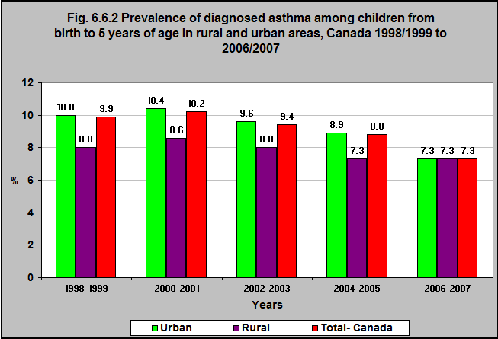
Notes:
Summary
In 1998/99, children under 6 who lived in rural areas were somewhat less likely to have been diagnosed with asthma (8%) than those living in urban areas (10%).
In 2006/07 these proportions were the same – at 7.3%.
Implications
Children are exposed to a number environmental toxins in indoor and outdoor air – environmental tobacco smoke, mould, smog (made up of ground-level ozone and fine particulate matter). These have been associated with asthma.
Source: CICH graphic created using data adapted from the National Longitudinal Survey of Children and Youth, Cycles 3 (1998-1999) through 7 (2006-2007). http://www.dpe-agje-ecd-elcc.ca/eng/ecd/well-being/longdesc/figure6-eng.shtml – accessed May 22, 2017.
Additional information on the prevalence of diagnosed asthma for children under 6 years of age in urban and rural areas can be found in the Health Outcome section of the Early Child Development Module.

Slide 38
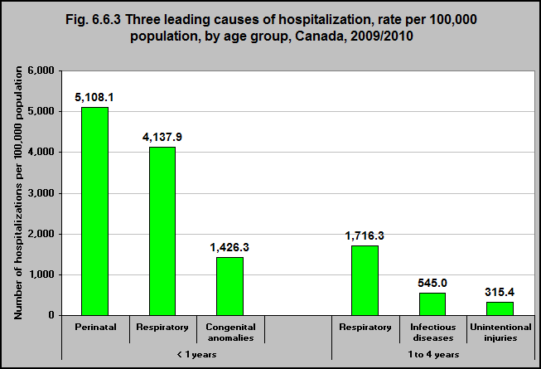
Notes:
Summary
In 2009/10, respiratory illness was the leading cause of hospitalization for children aged 1 to 4.
In 2009/10, there were 25,301 hospitalizations due to respiratory illness among children aged 1 to 4. The hospitalization rate was 1,716 per 100,000 children aged 1 to 4 years.
In 2009/10 respiratory illness was the second leading cause of hospitalization among infants under 1 year.
In 2009/10, there were 15,991 hospitalizations due to respiratory illness among infants under 1 year. The rate of hospitalization was 4,138 per 100,000 infants.
Source: CICH graphic created using data adapted from Injury Section analysis of hospitalization data from the Canadian Institute for Health Information. http://www.phac-aspc.gc.ca/publicat/lcd-pcd97/table2-eng.php – accessed March 5th, 2017.

Slide 39
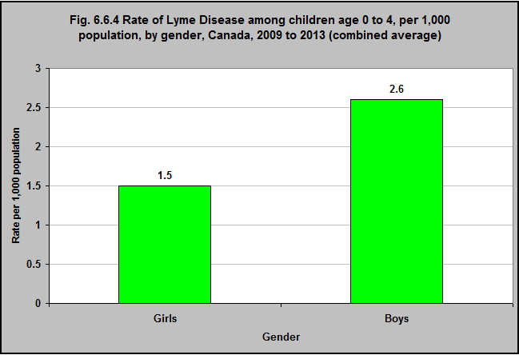
Notes:
Summary
In Canada, between 2009 and 2013 the incidence of Lyme Disease was 2.6 per 1,000 among boys aged 0 to 4 years. Among girls of the same age group it was 1.5 per 1,000 population.
The total number of reported cases of Lyme Disease (total population) has increased 4 times in Canada between 2009 and 2013 – from 144 to 682.¹
The number of reported cases increased more than two-fold between 2012 and 2013 (338 to 682). The greatest increase in incidence occurred in Nova Scotia. The increase was mostly due to an increase of Lyme Disease cases acquired in Canada, in comparison to cases acquired in other countries.¹
¹National Lyme Disease Surveillance in Canada 2013: Web Report. http://www.healthycanadians.gc.ca/publications/diseases-conditions-maladies-affections/lyme-surveillance-2013/index-eng.php#a4– accessed March 12th, 2017
Source: CICH graphic created using data adapted from National Lyme Disease Surveillance in Canada 2013: Web Report. http://www.healthycanadians.gc.ca/publications/diseases-conditions-maladies-affections/lyme-surveillance-2013/index-eng.php#a4– accessed March 12th, 2017.

Slide 40
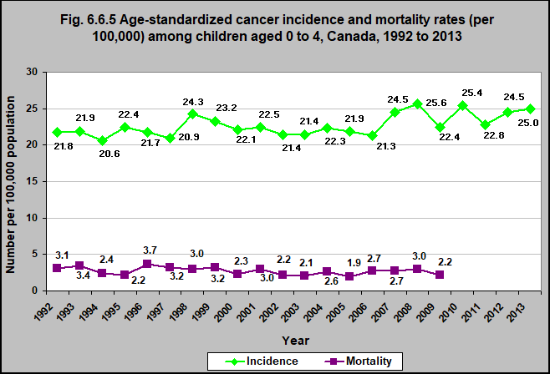
Notes:
Summary
Cancer in childhood is rare compared with cancer in adults, but cancer is the sixth leading cause of death among children aged 0 to 4 years.
For all children aged 0 to 4 years, the cancer mortality rate decreased by 29% between 1992 and 2009.
The cancer incidence rate increased by 14.7% between 1992 and 2013. Part of the increase in incidence may be explained by better diagnostic imaging or changing classification of tumors, specifically brain tumors.
Implications
It is generally agreed that different forms of cancer have different causes – and these causes are not well understood.
A number of studies indicate that environmental toxins may contribute to the development of childhood cancers. Most of these studies have been on pesticides and solvents, such as benzene.¹
¹Environmental Protection Agency. Children’s Health and the Environment Third Edition. 2013. https://www.epa.gov/sites/production/files/2015-06/documents/ace3_2013.pdf -accessed July 24, 2017.
Source: CICH graphic created using data adapted from the Government of Canada Public Health Infobase. Cancer Incidence: http://infobase.phac-aspc.gc.ca:9600/PHAC/readPPReports.jsp?l=en&folder=iAE672900438C404C87AF6E1AE46F0EC3 and Cancer Mortality by Type, Age Group and Sex: http://infobase.phac-aspc.gc.ca:9600/PHAC/readPPReports.jsp?l=en-US,en;q=0.8&folder=i438F952B80014F0F85B974BF9F5A6E2B -accessed September 7, 2017.

Slide 41
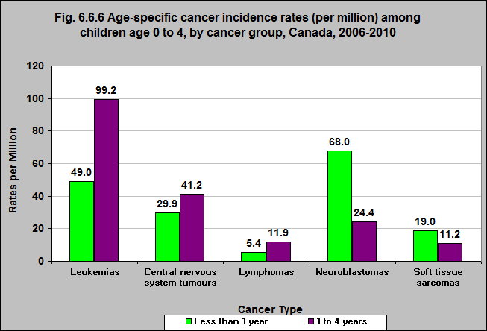
Notes:
Summary
During the time period 2006-2010, neuroblastomas were the most common kinds of cancer in infants less than 1 year old.
During the time period 2006-2010, leukemias were the most common kinds of cancer among children aged 1 to 4 years.
Leukemias, central nervous system tumours, lymphomas, neuroblastomas and soft tissue sarcomas accounted for 68% of all cancers among infants under a year and 80% of all cancers among 1 to 4 year-olds.
Related Studies
In meta-analyses of studies linking parents, prenatal and childhood exposure to leukemia have shown associations between pesticide exposure and childhood leukemia in both residential and occupational settings.¹
In addition, recent studies have shown a link between children’s exposure to air pollutants and leukemia.¹
Studies also indicated that childhood, parental and prenatal exposure to pesticides may lead to brain tumors in children.¹
Evidence also suggests that exposure to environmental tobacco smoke – prenatal and postnatal – is linked to childhood brain tumors.¹
Many studies have looked at the association between cellular phone use and brain cancer – the findings are not yet conclusive.¹
A number of review studies have found associations between parental, prenatal and childhood exposures to pesticides and childhood lymphomas.¹
There is also evidence linking prenatal and postnatal exposure to environmental tobacco smoke and childhood lymphomas.¹
¹Environmental Protection Agency. Children’s Health and the Environment Third Edition. 2013. https://www.epa.gov/sites/production/files/2015-06/documents/ace3_2013.pdf – accessed May 22, 2017
Source: CICH graphic created using data adapted from Ellison, L., and Janz, T. Statistics Canada, Canadian Cancer Registry (last modified in 2015). http://www.statcan.gc.ca/pub/82-624-x/2015001/article/14213-eng.htm – accessed March 8th, 2017.

Slide 42
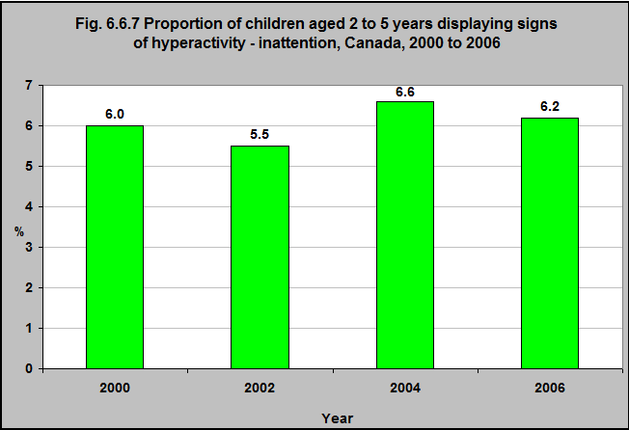
Notes:
Summary
In 2006, 6.2% of children from 2 to 5 years of age displayed signs of hyperactivity – inattention. This was 6.0% in 2000, 5.5% in 2002 and 6.6% in 2004.
Implications
Neurodevelopmental disorders among young children have been associated with exposure to environmental toxins.^{1,2}
These are disorders that affect the neurological system and brain – for example attention-deficit/hyperactivity disorder (ADHD), autism, learning disabilities, intellectual disability, conduct disorders, cerebral palsy, and impairments in vision and hearing.
Lead, methylmercury, and polychlorinated biphenyls (PCBs) have been associated with negative effects on the developing brain and nervous system of the fetus and young children. This association has been shown in multiple studies. Exposure is widespread in Canada.^{1,2}
Other environmental toxins have been identified as having potential concerns for the developing nervous system and brain – these have not been as widely studied, but young children are exposed to them in Canada. They include the organophosphate pesticides, polybrominated diphenyl ether flame retardants (PBDEs),¹ phthalates, bisphenol A (BPA), polycyclic aromatic hydrocarbons (PAHs), arsenic, and perchlorate.²
¹Abelsohn AR and Sanborn M. Lead and children: Clinical management for family physicians. Canadian Family Physician June 2010 vol. 56 no. 6 531-535.
²Environmental Protection Agency. Children’s Health and the Environment Third Edition. 2013. https://www.epa.gov/sites/production/files/2015-06/documents/ace3_2013.pdf -accessed July 24, 2017.
Source: CICH graphic created using Government of Canada. The Well-Being of Canada’s Young Children. Government of Canada Report 2011. http://www.dpe-agje-ecd-elcc.ca/eng/ecd/well-being/sp_1027_04_12_eng.pdf – accessed May 22, 2017.

Slide 43
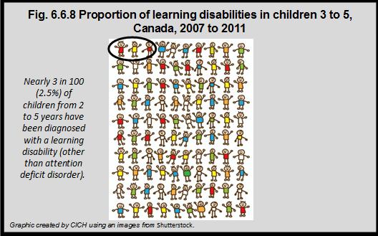
Notes:
Summary
During the years 2007 to 2011, nearly 3 in 100 (2.5%) of children from ages 2 to 5 years were diagnosed with a learning disability (other than attention deficit disorder).
Boys are more likely than girls to have been diagnosed with learning disabilities.³
Implications
Neurodevelopmental disorders among young children have been associated with exposure to environmental toxins.^{1,2}
These are disorders that affect the neurological system and brain – for example attention-deficit/hyperactivity disorder (ADHD), autism, learning disabilities, intellectual disability, conduct disorders, cerebral palsy, and impairments in vision and hearing.
Lead, methylmercury, and polychlorinated biphenyls (PCBs) have been associated with negative effects on the developing brain and nervous system of the fetus and young children. This association has been shown in multiple studies. Exposure is widespread in Canada.^{1,2}
There are other environmental toxins that have been identified as having potential concerns for the developing nervous system and brain – these have not been as widely studied, but young children are exposed to them in Canada.
They include the organophosphate pesticides, polybrominated diphenyl ether flame retardants (PBDEs)¹, phthalates, bisphenol A (BPA), polycyclic aromatic hydrocarbons (PAHs), arsenic, and perchlorate.²
¹Abelsohn AR and Sanborn M. Lead and children: Clinical management for family physicians. Canadian Family Physician June 2010 vol. 56 no. 6 531-535.
²Environmental Protection Agency. Children’s Health and the Environment Third Edition. 2013. https://www.epa.gov/sites/production/files/2015-06/documents/ace3_2013.pdf -accessed July 24, 2017.
³Statistics Canada, Canadian Health Measures Survey, 2010/11 – custom runs.

Slide 44
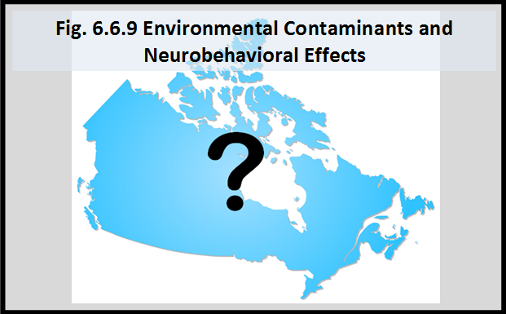
Notes:
Summary
Attention Deficit Hyperactivity Disorder (ADHD) and learning disabilities affect a large proportion of young children.¹
Studies have associated these exposures with lower IQs, problems in attention and a number of other neuropsychological effects. Nevertheless, for the most part, the causes of neurobehavioral disorders are unknown. There are other toxins of potential concern for the developing nervous system and brain – such as food additives, pesticides, phthalates, bisphenol A (BPA), polycyclic aromatic hydrocarbons (PAHs) and arsenic, and perchlorate.²
Behavioural teratogens, such as alcohol, lead, polychlorinated biphenyls (PCBs) and methylmercury, are known to compromise brain development and function in children exposed in utero or in early life. Studies have associated these exposure with lower IQs, problems in attention and a number of other neuropsychological effects.
Implications
More research into the possible association between exposure to environmental contaminants and neurobehavioral effects such as learning disabilities is needed.
¹Government of Canada. The Well-Being of Canada’s Young Children. Government of Canada Report 2011. http://www.dpe-agje-ecd-elcc.ca/eng/ecd/well-being/sp_1027_04_12_eng.pdf accessed May 22, 2017.
²Environmental Protection Agency (EPA). Children’s Health and the Environment Third Edition. 2013. https://www.epa.gov/sites/production/files/2015-06/documents/ace3_2013.pdf-accessed July 24, 2017.

Slide 45
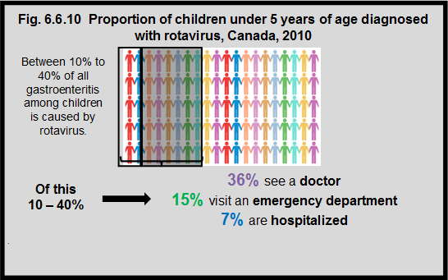
Notes:
Summary
Rotavirus is a virus that causes gastroenteritis. The virus is spread by the fecal-oral route. It can be spread by contaminated hands, objects (such as toys), food and water. Children are most likely to get rotavirus in the winter and spring.¹
In 2010, it was estimated that rotavirus was responsible for 10% to 40% of all gastroenteritis among children.
Canadian data indicate that rotavirus gastroenteritis results in significant use of the health care system. 36% of children with rotavirus see a doctor, 15% visit an emergency department, and 7% are hospitalized. Rotavirus is responsible for the majority of hospitalizations due to gastroenteritis – estimated between one in 62 and one in 312 children under 5 years of age.³
Household transmission of rotovirus is common, and there is some evidence that crowded living conditions contribute.⁴ Improved sanitation alone is not sufficient to prevent the infection as rotovirus is spread by oral-fecal contact, a common behaviour among young children.
¹Centers for Disease Control and Prevention. Rotavirus. https://www.cdc.gov/rotavirus/index.html-accessed May 22, 2017.
²National Advisory Committee on Immunization. An Advisory Committee Statement (ACS). Statement on the Recommended Use of Pentavalent Human-Bovine Reassortant Rotavirus Vaccine. Canadian Disease Weekly Report. January 2008 • Volume 34 • ACS-1.
³National Advisory Committee on Immunization (NACI). An Advisory Committee Statement (ACS): Updated Statement on the use of Rotavirus Vaccines. Canadian Communicable Disease Report. July 2010 • Volume 36 • ACS-4
⁴Henry F and Bartholomew RK. Epidemiology and transmission of rotavirus infections and diarrhoea in St. Lucia, West Indies. West Indian Med J. 1990 Dec;39(4):205-12.
Source: CICH graphic created using using an image from Shutterstock and data adapted from the National Advisory Committee on Immunization. An Advisory Committee Statement (ACS). Statement on the Recommended Use of Pentavalent Human-Bovine Reassortant Rotavirus Vaccine. Canadian Disease Weekly Report. January 2008 • Volume 34 • ACS-1 and National Advisory Committee on Immunization (NACI). An Advisory Committee Statement (ACS): Updated Statement on the use of Rotavirus Vaccines

Slide 46
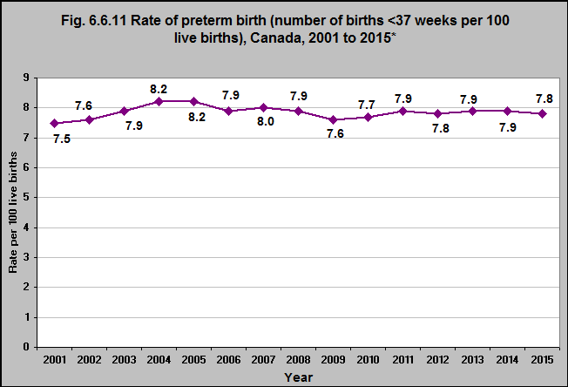
Notes:
Summary
The length of pregnancy – or gestation – has a large impact on the infant’s health – at birth and throughout life. Babies who are born too soon – preterm – and babies who are born at low birth weight are at increased risk of death, developmental problems and health challenges.¹
Complications related to short gestation and low birth weight are the second leading cause of infant death in Canada – accounting for 20% of all infant deaths.²
In 2001, the preterm birth rate (number of births before 37 weeks per 100 live births) was 7.5 and in 2015 it was 7.8.
The rate varied from a low of 7.5 in 2001 to a high of 8.2 in 2004 and 2005.
Between 2000/02 and 2010/12, the low birth weight rate (less than 2,500 grams) increased in Canada from 5.6% to 6.1%.³
There is a growing body of research examining the association between exposure to environmental toxins and preterm birth and low birth weight. The evidence is strong for environmental tobacco smoke (ETS) and lead.⁴
Recently, studies have identified potential associations between exposure to common components of air pollution (particulate matter, sulfur dioxide, nitrogen dioxide and carbon monoxide) and preterm birth and low birth weight.⁴
Bisophenal A (BPA) exposure has been linked to a number of adverse outcomes such as preterm birth and low birth weight – but the data are not conclusive.⁵
Other research has shown an association between phthalate exposure during gestation and preterm birth and low birth weight.⁴
¹UK HealthcareFact Sheet. Short And Long-Term Effects Of Preterm Birth Fact Sheet. 2016. https://ukhealthcare.uky.edu/health-and-wellness/publications/fact-sheets/mother-baby/Short-and-Long-Term-Effects-of-Preterm-Birth-Fact-Sheet/ – accessed April 28, 2017.
²Statistics Canada. Table 102-0562. Leading causes of death, infants, by sex, Canada. http://www5.statcan.gc.ca/cansim/a26?lang=eng&id=1020562 – accessed April 28, 2017.
Statistics Canada, Canadian Vital Statistics, Birth Database. The CANSIM table 102-4318 is an update of CANSIM table 102-4304. http://www5.statcan.gc.ca/cansim/a05?lang=eng&id=01024318 – accessed on July 24, 2017.
⁴Environmental Protection Agency. Children’s Health and the Environment Third Edition. 2013. https://www.epa.gov/sites/production/files/2015-06/documents/ace3_2013.pdf – accessed May 22, 2017.
⁵Rochester, J.R. (2013). Bisphenol A and human health: A review of the literature. Reproductive Toxicology, 42, 132-155.
Note:
*Data from Ontario were excluded between 2001 and 2010 because of data quality concerns.
Source: CICH graphic created using data adapted from 2001 to 2010: Public Health Agency of Canada (PHAC). Perintatal Health indicators for Canada, 2013. A Report from the Canadian Perinatal Surveillance System. Statistics Canada Vital Statistics; and 2011 to 2015: Discharge Abstract Database (DAD) Hospital Morbidity Database (HMDB), Canadian Institute for Health Information; Fichier des hospitalisations MED-ECHO, Ministère de la Santé et des Services sociaux du Québec. https://apps.cihi.ca/mstrapp/asp/Main.aspx?Server=apmstrextprd_i&project=Quick%20Stats&uid=pce_pub_en&pwd=&evt=2048001&visualizationMode=0&documentID=029DB170438205AEBCC75B8673CCE822-accessed March 8th, 2017. (Please note the link defaults to an epidural rate table. Please hit the arrow button to access the preterm birth data for different years by province/territory)

Slide 47
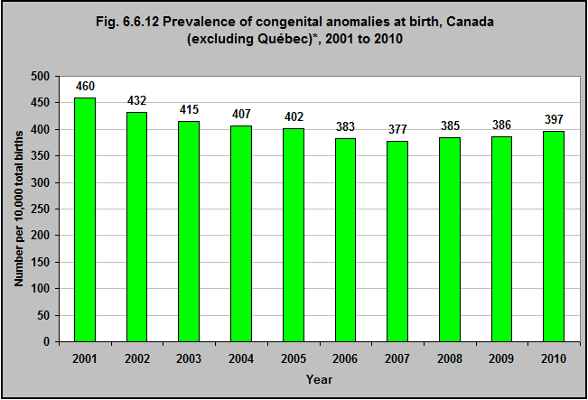
Notes:
Summary
Congenital anomalies (birth defects) are the leading cause of death for babies under a year. They account for about a third of all infant deaths in Canada.¹
In 2010, there were 11,441 babies born with congenital anomalies in Canada and the birth prevalence (number per 10,000 total births) of congenital anomalies was 397. The rate was 460 in 2001, and declined to 377 in 2007.²
Related Studies
There is a growing body of research examining the association between environmental exposures and congenital anomalies (birth defects). Several studies have found an increased risk for congenital anomalies in mothers who were exposed to organic solvents during pregnancy.³
For instance, an association was found between mothers’ and fathers’ exposure to pesticides – before and after conception – and their infants having – or dying from – congenital anomalies.⁴
However another study did not confirm this association.⁵
There have been a smaller number of studies of congenital anomalies and mothers’ exposure to air pollution prenatally. A recent pooled analysis of this research found associations between nitrogen dioxide, sulfur dioxide, particulate matter and certain cardiac anomalies.⁶
Over the last 25 years, research has found possible associations between mothers’ living near contaminated sites, hazardous waste sites or active facilities and congenital anomalies.⁴
¹Canadian Institute of Health Information (CIHI), Discharge Abstract Database; and, Perinatal Health Indicators for Canada, 2013 http://publications.gc.ca/collections/collection_2014/aspc-phac/HP7-1-2013-eng.pdf– accessed May 22, 2017.
²Statistics Canada. Table 102-0562. Leading causes of death, infants, by sex, Canada. http://www5.statcan.gc.ca/cansim/a26?lang=eng&id=1020562– accessed May 22, 2017.
³McMartin, K.I., M. Chu, E. Kopecky, T.R. Einarson, and G. Koren. 1998. Pregnancy outcome following maternal organic solvent exposure: a meta-analysis of epidemiologic studies. American Journal of Industrial Medicine 34 (3):288-92. In Environmental Protection Agency. Children’s Health and the Environment Third Edition. 2013. https://www.epa.gov/sites/production/files/2015-06/documents/ace3_2013.pdf – accessed May 22, 2017.
⁴Environmental Protection Agency. Children’s Health and the Environment Third Edition. 2013. https://www.epa.gov/sites/production/files/2015-06/documents/ace3_2013.pdf – accessed May 22, 2017.
⁵Wigle, D.T., T.E. Arbuckle, M.C. Turner, A. Berube, Q. Yang, S. Liu, and D. Krewski. 2008. Epidemiologic evidence of relationships between reproductive and child health outcomes and environmental chemical contaminants. Journal of Toxicology and Environmental Health Part B: Critical Reviews 11 (5-6):373-517. In Environmental Protection Agency. Children’s Health and the Environment Third Edition. 2013. https://www.epa.gov/sites/production/files/2015-06/documents/ace3_2013.pdf – accessed May 22, 2017.
⁶Vrijheid, M., D. Martinez, S. Manzanares, P. Dadvand, A. Schembari, J. Rankin, and M. Nieuwenhuijsen. 2011. Ambient air pollution and risk of congenital anomalies: a systematic review and meta-analysis. Environmental Health Perspectives 119 (5):598-606. In Environmental Protection Agency. Children’s Health and the Environment Third Edition. 2013. https://www.epa.gov/sites/production/files/2015-06/documents/ace3_2013.pdf – accessed May 22, 2017.
Notes:
*Quebec does not contribute to the Discharge Abstract Database.
Source: CICH graphic created using data adapted from the Canadian Institute of Health Information (CIHI), Discharge Abstract Database; and, Perinatal Health Indicators for Canada, 2013 http://publications.gc.ca/collections/collection_2014/aspc-phac/HP7-1-2013-eng.pdf – accessed May 22, 2017.

Slide 48
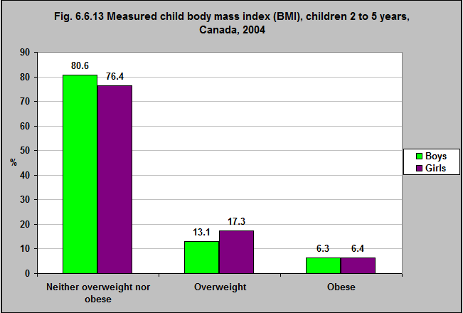
Notes:
Summary
In 2004, 62.8% of boys 2 to 5 years and 68.3% of girls were neither overweight or obese.
25.4% of boys were overweight, 11.8% were obese.
22.3% of girls were overweight, 9.4% were obese.
Implications
Childhood obesity is a serious public health concern in Canada, and is associated with several adverse health effects in childhood and later in life. The association between chemical exposures and obesity is not clear. Animal and cellular studies have given some evidence that chemical exposures in the environment may contribute to obesity and in children. The studies of chemical exposures and obesity in children are limited.²
In addition, in both animals and children, researchers have found that obesity may be associated with a greater susceptibility to the negative affects particulate matter and ozone.^{3,4} Air pollution and childhood obesity may be associated if the number of days that children can play outside is limited by the quality of the air. This would be the case particularly for children with existing respiratory illnesses.⁵
Children’s built environments may also contribute to the increasing rates of obesity. (The term “built environment” is used to describe the physical elements of the environment for a population.) For example, a number of studies have concluded that the built environment – urban sprawl, housing density, access to food sources, and access to places where children can play – may be associated with obesity.^{6,7} Children who are socioeconomically disadvantaged are more likely to live in built environments that contribute to obesity.^{8,9,10}
¹Shields and Tremblay. 2010. Canadian childhood obesity estimates based on WHO, IOTF and CDC cut-points. International Journal of Pediatric Obesity, 5: 265–273. http://www.obesitynetwork.ca/files/WHO_vs_CDC_Shields1704.pdf– accessed June 25, 2017.
²Environmental Protection Agency. Children’s Health and the Environment Third Edition. 2013. https://www.epa.gov/sites/production/files/2015-06/documents/ace3_2013.pdf – accessed May 22, 2017.
³Chen, J.C., J.M. Cavallari, P.H. Stone, and D.C. Christiani. 2007. Obesity is a modifier of autonomic cardiac responses to fine metal particulates. Environmental Health Perspectives 115 (7):1002-6. In Environmental Protection Agency. Children’s Health and the Environment Third Edition. 2013. https://www.epa.gov/sites/production/files/2015-06/documents/ace3_2013.pdf – accessed May 22, 2017.
⁴Shore, S.A., Y.M. Rivera-Sanchez, I.N. Schwartzman, and R.A. Johnston. 2003. Responses to ozone are increased in obese mice. Journal of Applied Physiology 95 (3):938-45. In Environmental Protection Agency. Children’s Health and the Environment Third Edition. 2013. https://www.epa.gov/sites/production/files/2015-06/documents/ace3_2013.pdf – accessed May 22, 2017.
⁵Corbo, G.M., F. Forastiere, M. De Sario, L. Brunetti, E. Bonci, M. Bugiani, E. Chellini, S. La Grutta, E. Migliore, R. Pistelli, et al. 2008. Wheeze and asthma in children: associations with body mass index, sports, television viewing, and diet. Epidemiology 19 (5):747-55. In Environmental Protection Agency. Children’s Health and the Environment Third Edition. 2013. https://www.epa.gov/sites/production/files/2015-06/documents/ace3_2013.pdf – accessed May 22, 2017.
⁶Papas, M.A., A.J. Alberg, R. Ewing, K.J. Helzlsouer, T.L. Gary, and A.C. Klassen. 2007. The built environment and obesity. Epidemiologic Reviews 29:129-43. In Environmental Protection Agency. Children’s Health and the Environment Third Edition. 2013. https://www.epa.gov/sites/production/files/2015-06/documents/ace3_2013.pdf – accessed May 22, 2017.
⁷Sallis, J.F., and K. Glanz. 2006. The role of built environments in physical activity, eating, and obesity in childhood. The Future of Children 16 (1):89-108. In Environmental Protection Agency. Children’s Health and the Environment Third Edition. 2013. https://www.epa.gov/sites/production/files/2015-06/documents/ace3_2013.pdf – accessed May 22, 2017.
⁸Cutts, B.B., K.J. Darby, C.G. Boone, and A. Brewis. 2009. City structure, obesity, and environmental justice: an integrated analysis of physical and social barriers to walkable streets and park access. Social Science & Medicine 69 (9):1314-22. In Environmental Protection Agency. Children’s Health and the Environment Third Edition. 2013. https://www.epa.gov/sites/production/files/2015-06/documents/ace3_2013.pdf – accessed May 22, 2017.
⁹Redwood, Y., A.J. Schulz, B.A. Israel, M. Yoshihama, C.C. Wang, and M. Kreuter. 2010. Social, economic, and political processes that create built environment inequities: perspectives from urban African Americans in Atlanta. Family & Community Health 33 (1):53-67. In Environmental Protection Agency. Children’s Health and the Environment Third Edition. 2013. https://www.epa.gov/sites/production/files/2015-06/documents/ace3_2013.pdf – accessed May 22, 2017.
¹⁰Taylor, W.C., J.T. Hepworth, E. Lees, K. Feliz, S. Ahsan, A. Cassells, D.C. Volding, and J.N. Tobin. 2008. Obesity, physical activity, and the environment: is there a legal basis for environmental injustices? Environmental Justice 1 (1):45-48. In Environmental Protection Agency. Children’s Health and the Environment Third Edition. 2013. https://www.epa.gov/sites/production/files/2015-06/documents/ace3_2013.pdf- accessed May 22, 2017.
Note:
*Body mass index (BMI) is calculated by dividing the respondent’s body weight (in kilograms) by their height (in metres) squared. The index is: neither overweight nor obese; overweight; obese. Body mass index (BMI) for children is different from that of adults as they are still maturing. This variable classifies the measured BMI of children aged 2 to 17 as “obese” or “overweight” according to the age-and-sex-specific BMI cut-off points as defined by the WHO. Based on the the WHO growth curves, the WHO recommends that children whose BMI is more than two standard deviations (SDs) above the mean should be considered obese, and those whose BMI is between one and two SDs above the mean, overweight.¹
Source: CICH graphic created using data adapted from Shields and Tremblay. 2010. Canadian childhood obesity estimates based on WHO, IOTF and CDC cut-points. International Journal of Pediatric Obesity, 5: 265–273. http://www.obesitynetwork.ca/files/WHO_vs_CDC_Shields1704.pdf – accessed June 25, 2017.
Additional information on measured child body mass index (BMI) for children aged 2 to 5 years of age can be found in the Health Outcomes section of the Early Child Development Module.

Slide 49

Health and Development in the Early Years: Environmental Risks/Conditions Consolidated Results
Notes:
Health and Development in the Early Years: Environmental Risks/Conditions Consolidated Results
Just as young children need consistent and loving relationships with their families, they also need safe environments in which to grow and play. This includes clean air, water and land. They need quality natural and built environments which support, not threaten, their health and development.
In 1990, the world, including Canada, signed the United Nations Convention on the Rights of the Child, making a promise to children to protect and promote their rights to survive and thrive, to learn and grow, to make their voices heard and to reach their full potential. The Convention provides protections related to the environment.
Children have increased vulnerability to many environmental threats as a consequence of their developmental, behavioural and physiological characteristics. They receive greater exposures per unit of body weight than adults. They have less ability to metabolize, detoxify and excrete many toxins. Young children are at critical periods of development, and exposure can result in irreversible damage to the growing nervous system, affect emerging behaviour patterns, cause immune dysfunction and have serious reproductive effects. Young children’s behaviour, such as frequent hand-to-mouth activity, exploration and proximity to the ground, often places them at higher risk than adults to environmental hazards.
Environmental Toxins
There are certain metals found in the environment that pose a particular risk to children. These include lead and mercury – among others. All children and youth in Canada are exposed to lead, as it occurs naturally in the environment and is present in human-made products. Lead is one of the most extensively researched toxins, and has been linked to many adverse health and behavioural outcomes. Mercury exposure can have negative neurological, renal, cardiovascular, and immunological effects.
Evidence suggests that a number of synthetic and naturally occurring organic chemicals, such as Bisphenol A (BPA), phthalates and others, may disrupt the endocrine systems of humans and wildlife. The fetus and young child may be at a particularly high risk from even very low levels of endocrine disrupting chemicals because of the important role that the endocrine system plays in development. Regulations now limit the use of BPA in some consumer products, such as infant bottles. However, BPA is still present in other products, potentially exposing Canadian children to this chemical daily. Health Canada has placed restrictions on the use of Mono benzyl phthalate in children’s toys/products.
Canada does not compare well on international environmental indicators. In 2016, the Conference Board of Canada ranked Canada third last among 15 peer countries. Compared to our international peers, all of the provinces also ranked poorly.
Air and Water Quality
Children inhale or come into skin contact with contaminants from outdoor and indoor air. Young children are at high risk from exposure to toxins in air, because they require more air per kilogram of body weight than adults – therefore, they inhale greater amounts of air pollutants relative to their body weight. They also spend more time engaged in vigorous outdoor activities compared to adults.
Environmental tobacco smoke and mould are recognized toxins with many adverse health effects. Six percent of children 3 to 5 years of age are exposed to environmental tobacco smoke in their homes every day or almost every day, and 13% of Canadians reported the presence of mould or mildew in their homes. Smog is made up of ground-level ozone (O3) and fine particulate matter (PM2.5). Exposure to smog has been associated with a number of health effects such as premature death, asthma and other respiratory illnesses. Between 2000 and 2014 the annual average of fine particulate matter was below the 2015 national air quality standards.
Water quality is an important determinant of health. Children are at increased risk to the effects of contaminants in drinking water because they drink relatively more water per unit of body weight than adults.
Based on a national monitoring system, between 2010 to 2012, 45% of 172 monitoring stations reported that the water was of excellent or good quality. 18% reported that it was poor or marginal. In 2009, 11% of all Canadian households reported that they had to boil their water prior to drinking at least once in the previous year.
Climate Change
Climate change is leading to more severe weather around the world such as heat waves, droughts and extreme storms, rising sea levels, changes in the range of insects that carry infectious diseases and changes to agriculture and the production of food products, as well as the availability of fresh, clean water.
Greenhouse gases trap heat in the Earth’s atmosphere. Between 1990 and 2015, Canada’s total greenhouse gas emissions increased by 20%. According to the Organisation for Economic Co-operation and Development in 2014, Canada had the fourth highest level of greenhouse gas emissions of 35 OECD countries and the third highest level of greenhouse gas emissions per capita.
Canada is more vulnerable to climate change than other countries. From 1948 to 2012, the annual average surface air temperature in Canada increased by approximately 1.7°C, roughly twice the global increase. This has contributed to the increased frequency, duration and intensity of climate and weather-related events and disasters. In Northern Canada, the average temperature increase has been greater than that for Canada overall. Most vulnerable are the Indigenous peoples, who make up over half of the North’s population.
Children who live in low income households are more vulnerable to the effects of climate change. They are less likely to have access to air conditioning and are more likely to share smaller living quarters with more people, which contributes to a warmer living environment. Lower quality housing is more likely to be damaged by climate-related events.
Increasing and changing patterns of vector borne illnesses are a particular threat to children because they generally spend more time outside than adults. The increase in Lyme Disease in Canada is an example.
Depletion of atmospheric ozone is linked directly to ultravioket (UV) radiation, which in turn is linked to heightened risk of skin cancer. Researchers believe that high exposure to UV rays as a child is one of the most significant risk factors for this form of cancer. Fortunately, the majority of parents in Canada covered their children’s heads (84%) and used sunscreen on their faces (86%) according to 2006 reports.
Contact with Nature
There is accumulating evidence regarding the health benefits for young children on the time spent in nature/greenspace. The majority of Canadians – 85% – report that they live with a park or green space close to home. This varied by province. In 2013, Canadians living in lower income households were less likely to live near a green space. Engaging in active outdoor play benefits children’s physical and mental health. A recent systematic review has identified the positive benefits of ‘risky outdoor play’ on healthy child development. Allowing children the freedom to explore natural settings, play and be active helps develop resilience, problem solving skills and evaluating challenges based on their individual abilities, along with all of the benefits of physical activity.
Health Impacts
The length of pregnancy/gestation has a large impact on an infant’s health at birth and throughout life. Babies who are born too soon – preterm – and babies who are born at low birth weight are at increased risk of death, developmental problems and health challenges. Complications related to short gestation and low birth weight are the second leading cause of infant death in Canada – accounting for 20% of all infant deaths.
There is a growing body of research examining the association between exposure to environmental toxins and preterm birth and low birth weight – but the data are not conclusive. Other research has shown an association between phthalate exposure during gestation and preterm birth and low birth weight. Continued research is needed.
In 2010, 11,441 babies were born with congenital anomalies (birth defects) in Canada. Congenital anomalies are the leading cause of death for babies under a year, accounting for about a third of all infant deaths in Canada. There is a growing body of research examining the association between environmental exposures and birth defects. Several studies have found an increased risk for congenital anomalies in mothers who were exposed to organic solvents during pregnancy.
Contaminants in both indoor and outdoor air are associated with respiratory problems in children. In 2009/10, respiratory illness was the leading cause of hospitalization for children aged 1 to 4. In the same period, there were 25,301 hospitalizations due to respiratory illness among children aged 1 to 4, which was the second leading cause of hospitalization among infants under 1 year.
Between 1978/79 and 1994/95, Statistics Canada reported a four-fold increase in childhood asthma over a 20-year period, with hospital admissions data reflecting this increase. While there is debate over the role of over-diagnosis in this increase, a number of international studies suggest changes in the environment may be contributing to the increase.
There is evidence of increased incidence of childhood cancers; this may be due, in part, to earlier and improved diagnosis. While the causes of childhood cancer are not well understood, there is some evidence of a causal link between exposure to environmental contaminants and the development of cancers. Cancer is the third leading cause of death among children aged 1 to 14 years, accounting for 12.8% of all deaths in this age group. Between 1992 and 2010, the childhood cancer incidence rate increased by 0.4% annually on average. Between 2006 and 2010, neuroblastomas were the most common kinds of cancer in infants less than 1 year old, while leukemias were the most common kinds of cancer among children aged 1 to 4 years.
Neurodevelopmental disorders among young children have been associated with exposure to environmental toxins. Developmental and behavioural neurotoxic effects are of particular concern as more is learned about the potential for subtle degrees of impairment at even low level exposures. Lead, methylmercury, and polychlorinated biphenyls (PCBs) have been associated with negative effects on the developing brain and nervous system of the fetus and young children – and there are other toxins of concern. Nearly 3 in 100 (2.5%) of children from 2 to 5 years were diagnosed with a learning disability (other than attention deficit disorder) between 2007 and 2011. Boys are more likely than girls to have been diagnosed with learning disabilities.
The rate of obesity has increased in Canada in recent years and is a serious health concern with severe adverse health effects in childhood and later in life. The association between chemical exposures and obesity is not clear. Animal, cellular and some human studies suggest that chemical exposure and air pollutants may be associated with obesity. Children’s built environments may also contribute to the increasing rates of obesity and children who are socioeconomically disadvantaged are more likely to live in built environments that contribute to obesity.

