Slide 1
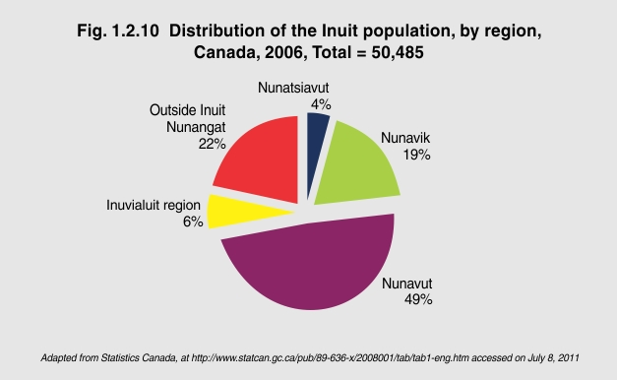
Notes:
“Inuit Nunangat” is the Inuktitut expression for “Inuit homeland.” The Inuit Nunangat consists of four regions that extend across northern Canada. Inuit have inhabited this region for 5,000 years.¹
In 2006, the majority of Inuit (78%) lived in Inuit Nunangat. Of the total Inuit population in Canada, 49% lived in Nunavut, 19% in Nunavik in northern Quebec, 6% in the Inuvialuit region of the Northwest Territories and 4% in Nunatsiavut in northern Labrador.
¹ Statistics Canada. Aboriginal Peoples in Canada in 2006: Inuit, Metis and First Nations, 2006 Census. Ottawa, Statistics Canada, 2008 (Cat. No. 97-558-XIE).

